Slide 1
EUROCHOCOLATE

Slide 2
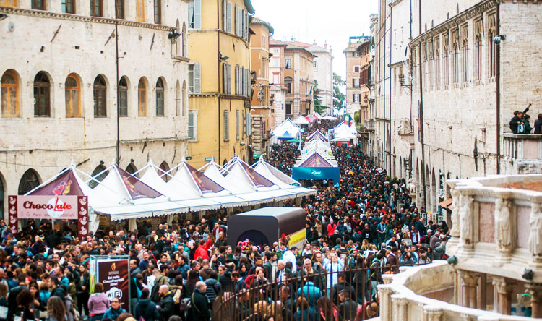
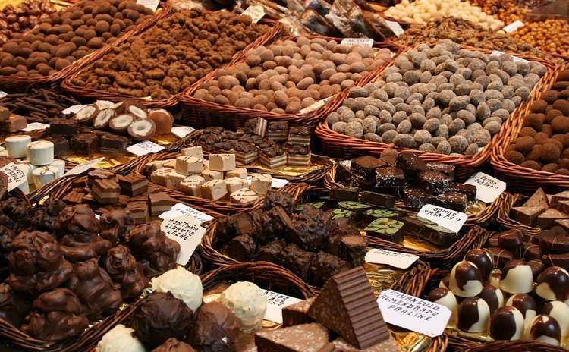
WHAT IS IT?
Eurochocolate is the event dedicated to chocolate par excellence, the most important in Umbria, if not Italy. The annual event takes place in Perugia every October, when after summer the consumption of chocolate resumes at full speed.
The protagonists are the traditions of the Italian and international chocolatier, with workshops and food stands of chocolate producers that are set up within the event; in addition, for each edition many themed events, tasting paths, shows, cultural initiatives, enliven and involve the streets and squares of the historic center of the capital city of Umbria.

Slide 3
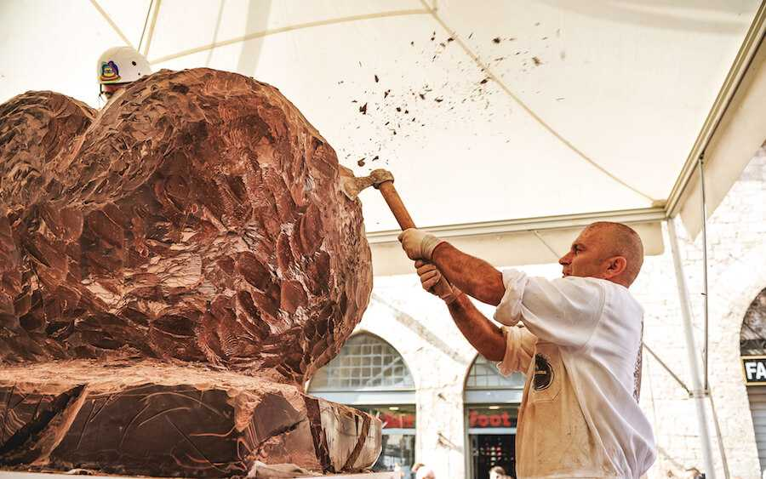
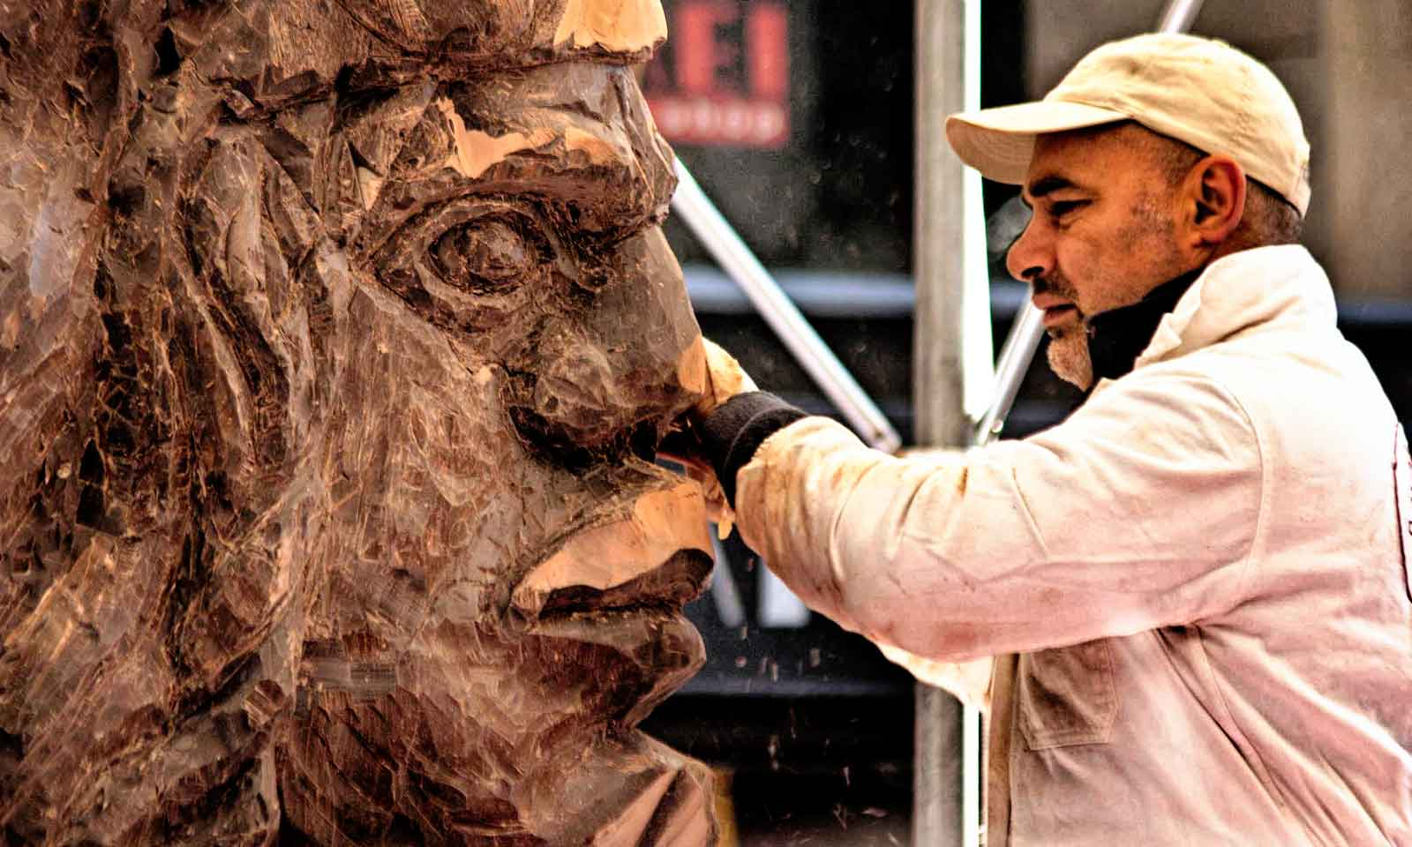
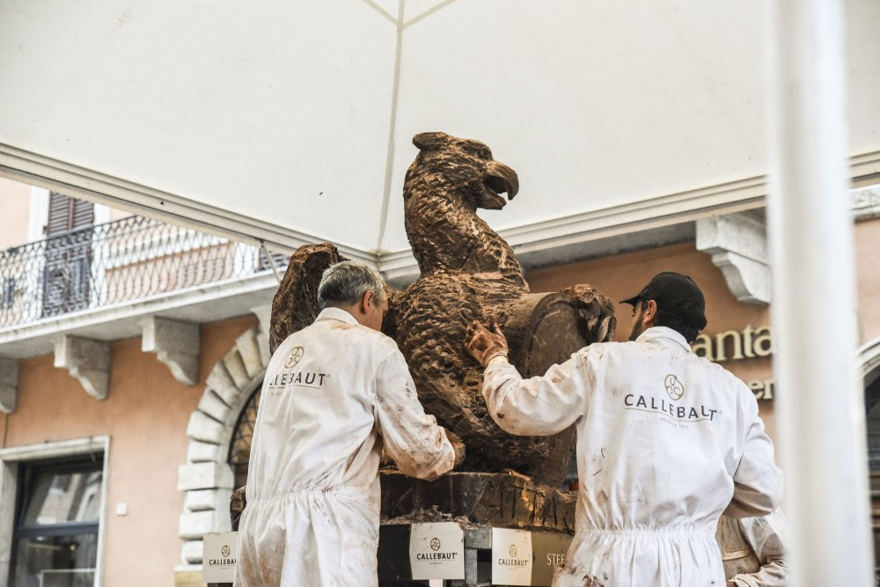
ALSO...
Unmissable are the Chocolate Sculptures, made by skilled sculptors who delight in sculpting blocks of chocolate of 1 m³ volume and to get real works of art that are exposed for the duration of the event.

