Slide 1
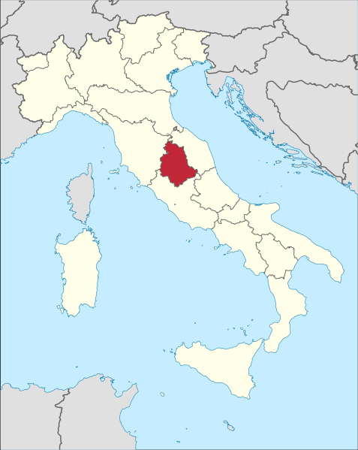
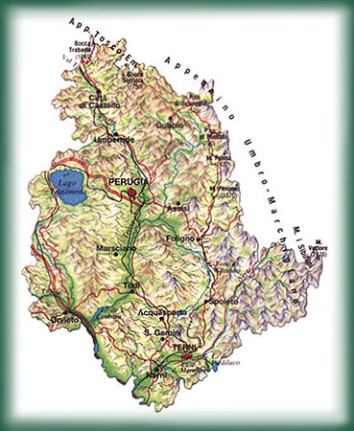
UMBRIA
also called "Umbria Verde" for the wealth of water and thick vegetation

Slide 2
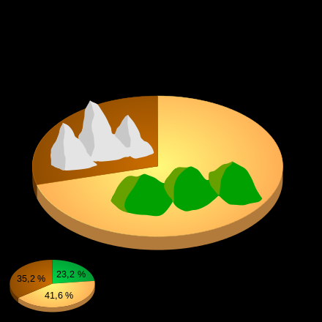
Geography
Mainly hilly territory we find lots of mountains such as the Umbrian-Marche Apennines, numerous valleys, and the stunning lake of Trasimeno. The hills cover two thirds of the territory, the most important rivers are the Tiber, the Nera and the Velino and there are also numerous deciduous forests

Slide 3
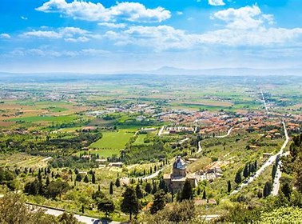
History
The Umbrians were an ancient Indo-European Italian people of the Osco-Umbrian group, living in an area that in classical times extended from the upper middle Tiber valley to the Adriatic Sea.

Slide 4
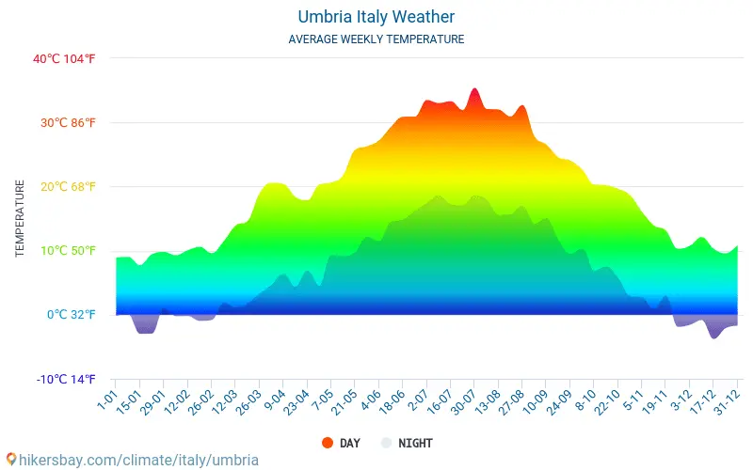
Climate
Not too harsh in winter and hot, often humid summers

Slide 5
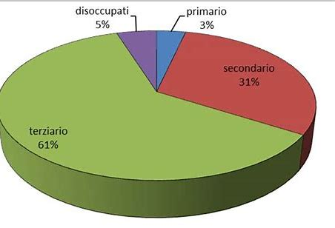
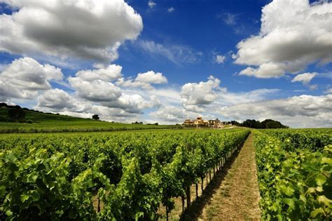
Economy
In the secondary sector Umbria specialises in crafts such as ceramics and industries like food & wine, steel, and chemical
The primary sector focuses on pig breeding and agriculture, growing cereals, olives, vines, truffles, lentils, onions
The most important area of interest in the tertiary sector is Tourism, thanks to the beauties of the landscape, the artistic & religious heritage and to the gastronomic tradition. Religious tourism owes a lot to ‘San Francesco d'Assisi’, Italy’s Patron Saint.

Slide 6
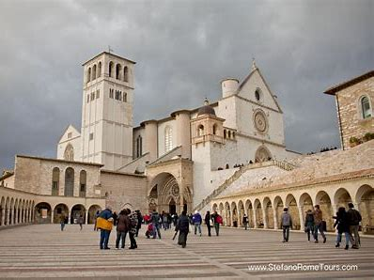
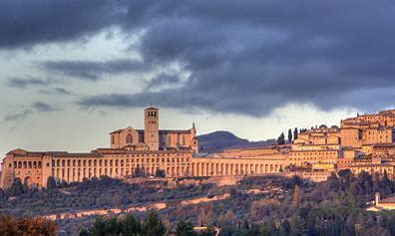
Assisi
It is known for being the city where St. Francis, patron saint of Italy, and Saint Clare lived and died.
Basilica di San Francesco
The construction of the basilica began in Assisi in 1228, two years after the death of St. Francis, dedicated to him, and ended in 1280. It is one of the first examples of the originality of Italian Gothic. It consists of two overlapping rooms: a lower church and an upper church.The façade is very sober, and in its solidity and compactness resembles romanesque buildings. Next to it stands the bell tower with a rectangular plan, without openings.

Slide 7
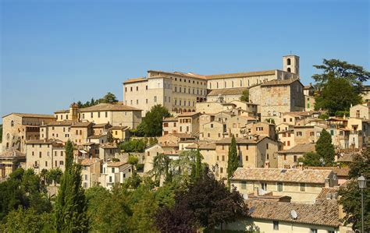
Todi
According to legend, initially the city was to be built at the foot of the hill, on the left bank of the Tiber, but the tablecloth with which the founders were having breakfast was taken by an eagle that, flying, dropped it on the top of the hill. This was interpreted as a sign of the gods, so the founders decided to move and build the city at the top of the hill.

Slide 8
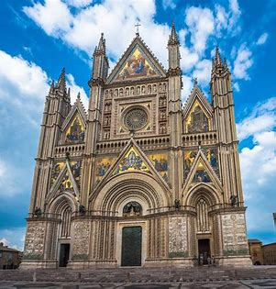
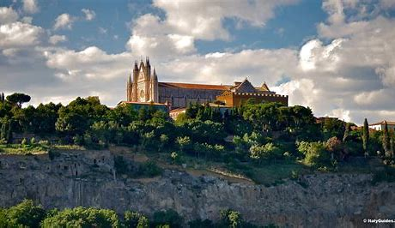
Orvieto
The Cathedral of Santa Maria Assunta is the main Catholic place of worship in Orvieto, in the province of Terni, masterpiece of Gothic architecture in Central Italy.

Slide 9
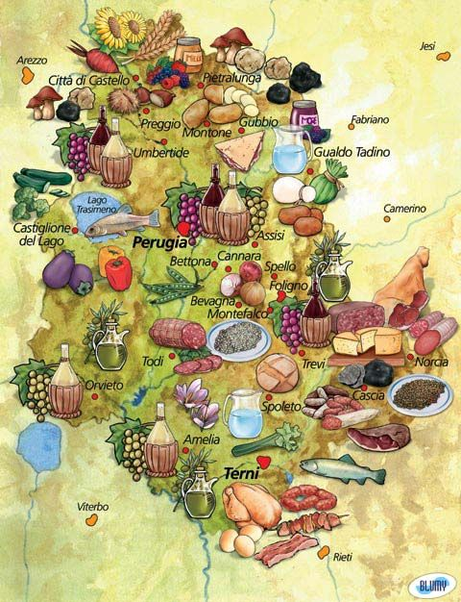
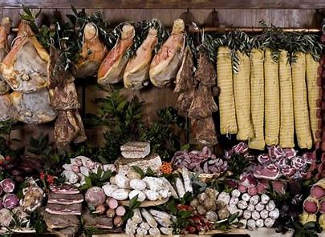
Gastronomic Tourism
The Umbria region offers a wide tradition of wines and flavors.
the typical dishes are:
Torta al testo.
Pasta alla Norcina
Typical products are truffles and Umbrian Norcineria with cured meats and sausages

Slide 10
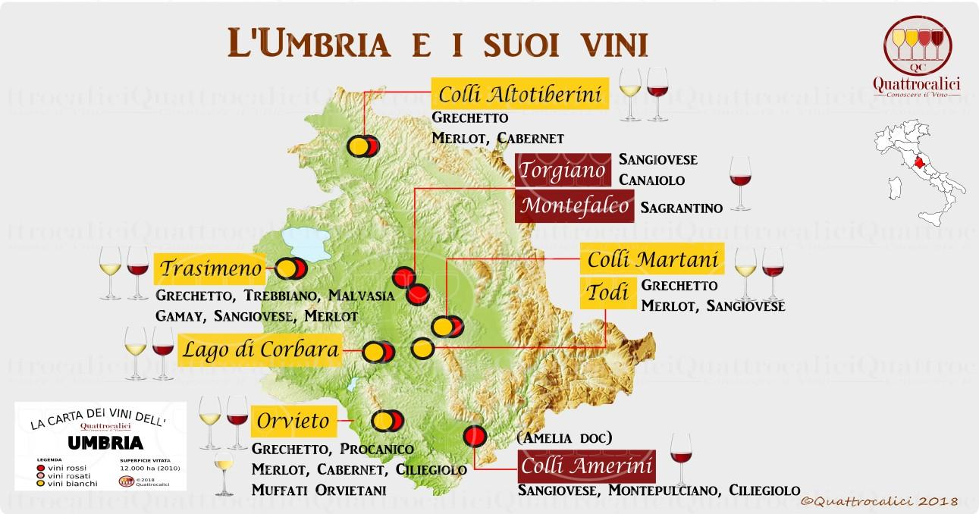
wine tourism
Typical wines such as Grechetto,Merlot,Sagrantino and Sangiovese are very important products in Umbria

