Slide 1
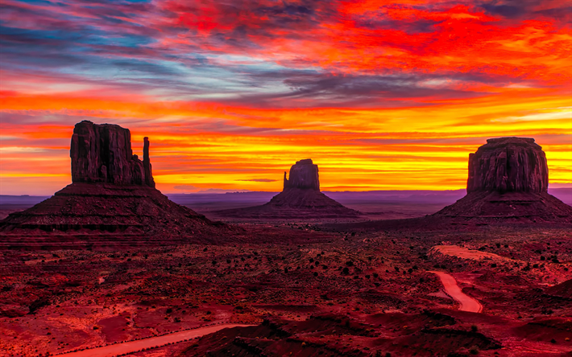
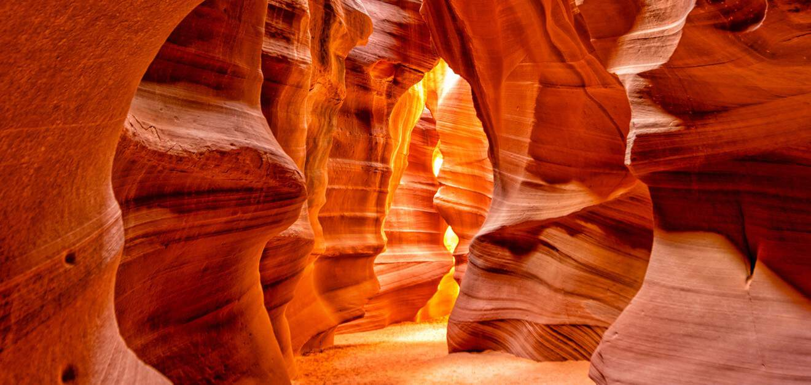
WELCOME TO ARIZONA

Slide 2
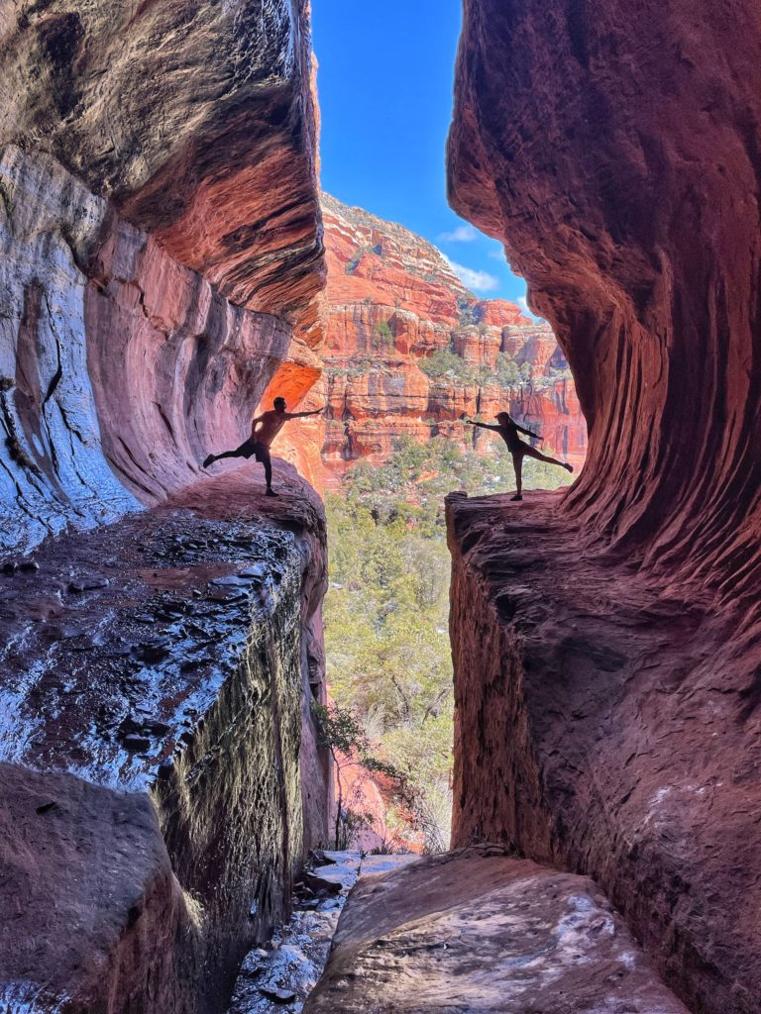
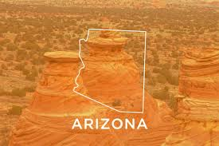
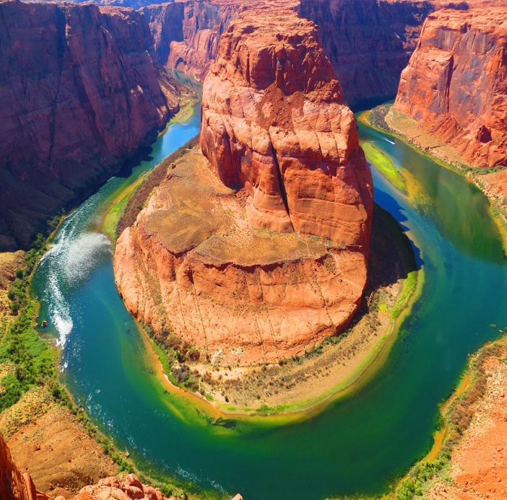
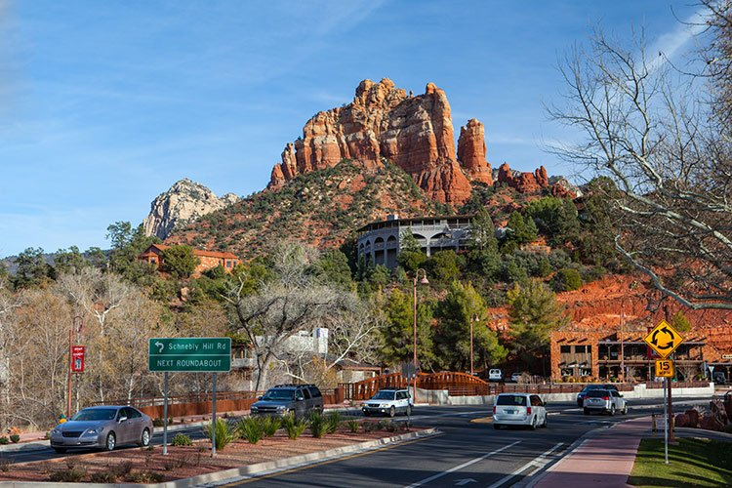
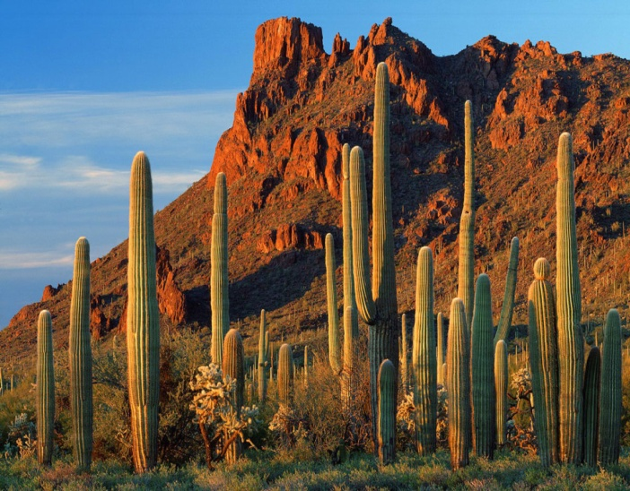
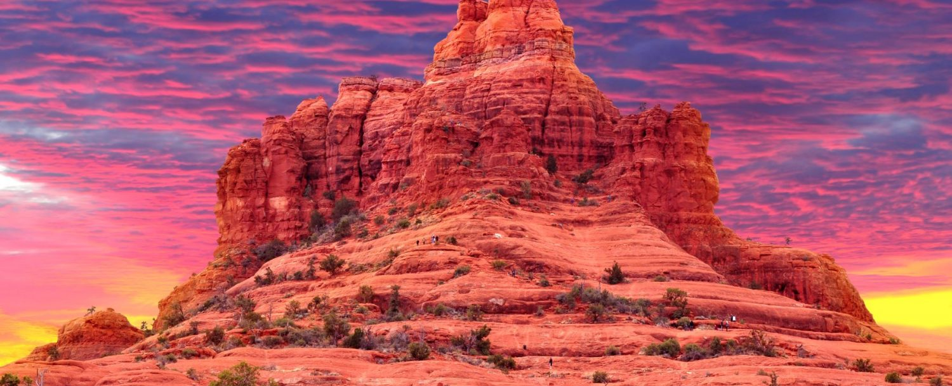
FIRST DAY
9:00 am check-in and departure from Rome Fiumicino Airport
7:00 pm arrival at Sedona Airport
8:00 pm accommodation in the CourtYard by Marriot hotel (Sedona)
8:30 pm dinner and overnight stay

Slide 3
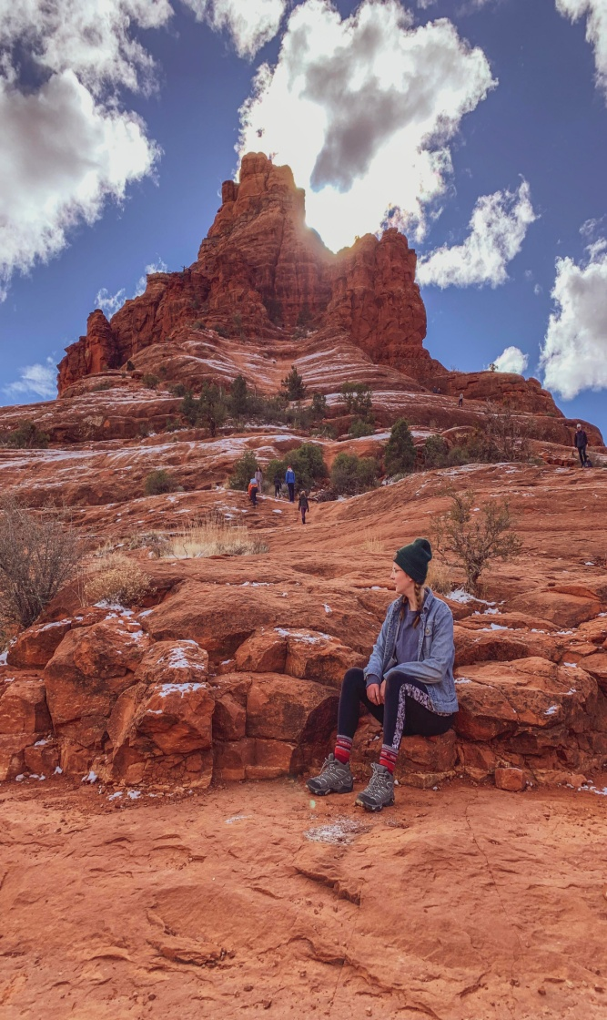
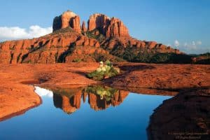
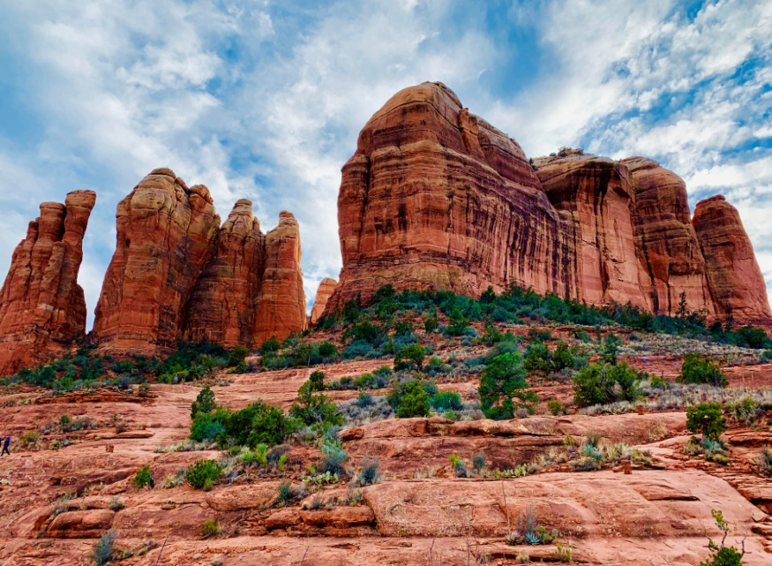
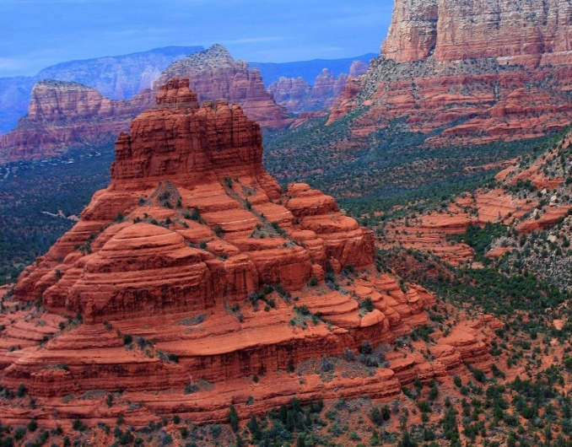
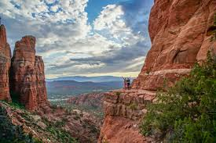
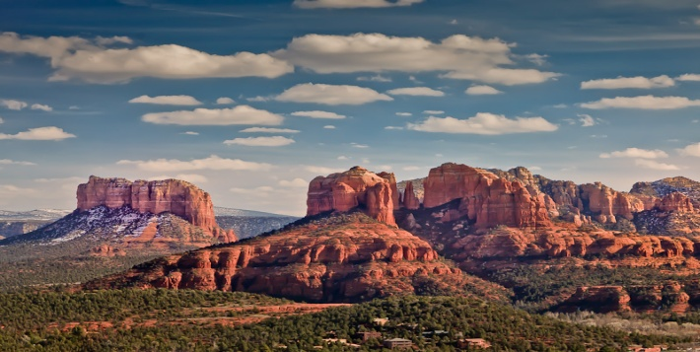
SECOND DAY
8:30 am breakfast at the hotel
10:00 am departure from the hotel
11:00 am visit of the Chatedral Rock
2:00 pm free lunch
4:00 pm visit to the
Bell Rock
7:00 pm departure and return to the hotel
8:00 pm dinner and overnight stay

Slide 4
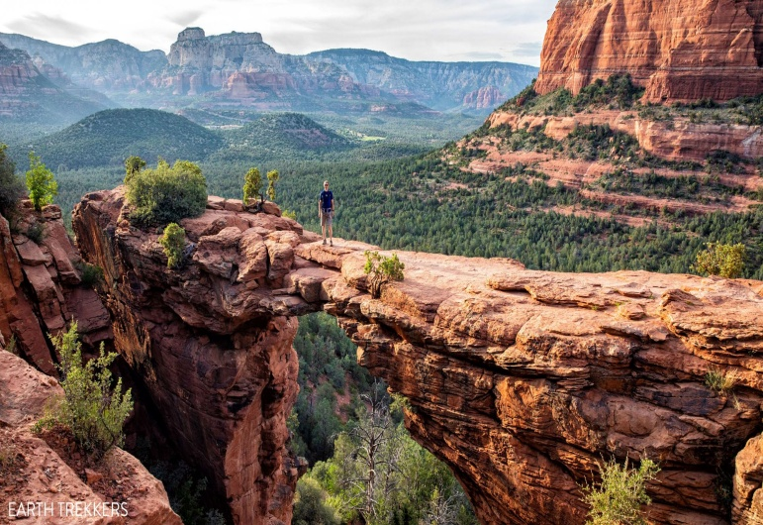
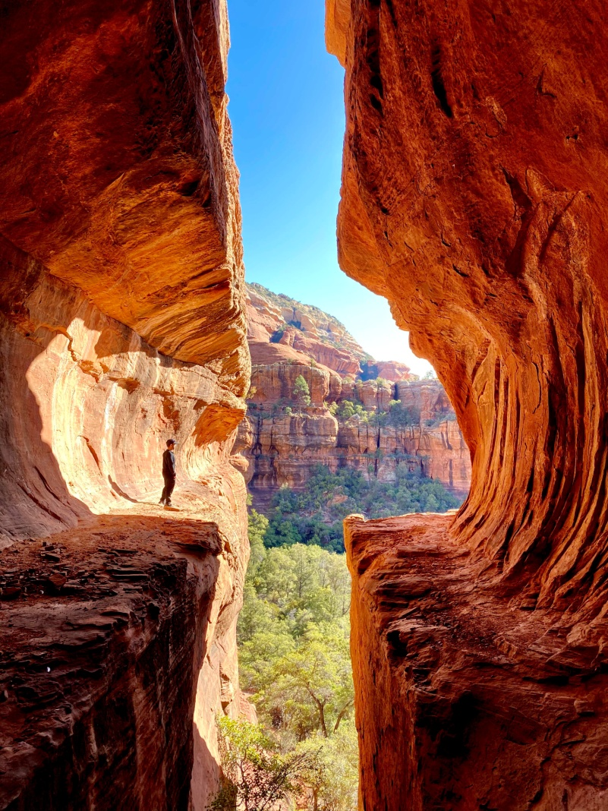
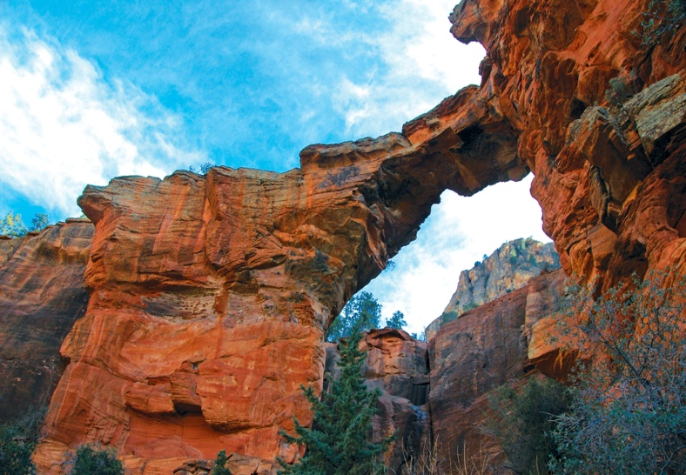
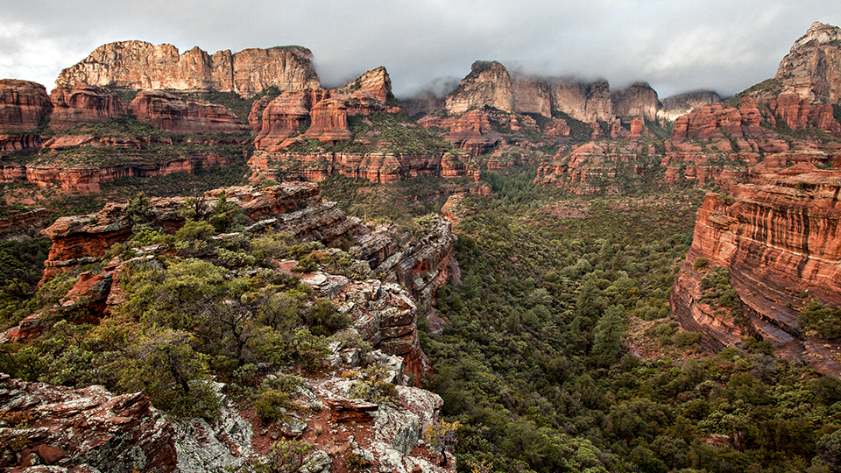
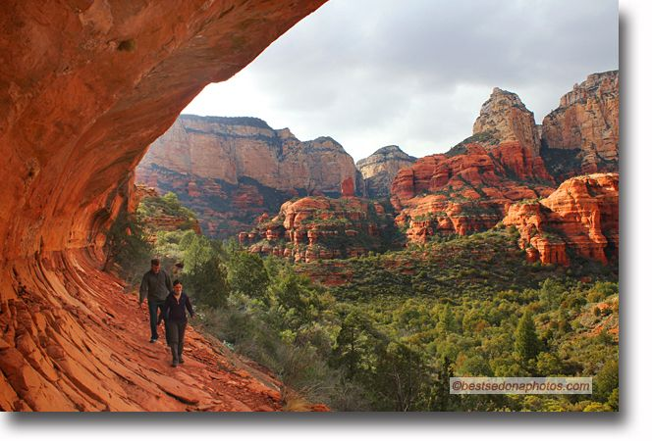
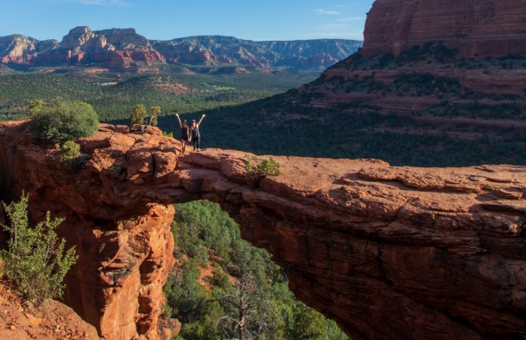
THIRD DAY
8:00 am breakfast at the hotel
9:30 am departure from the hotel
11:00 am arrival and visit of the Boynton Canyon Trail
2:00 pm free lunch
3:00 pm drive in the wilderness and pass over the Devil's Bridge
6:00 pm departure and return to the hotel
7:30 pm dinner and overnight stay

Slide 5
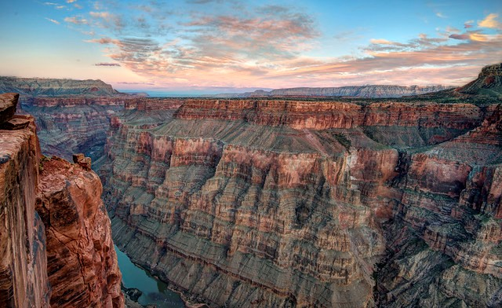
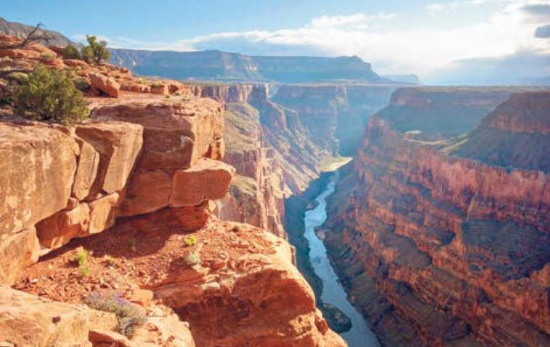
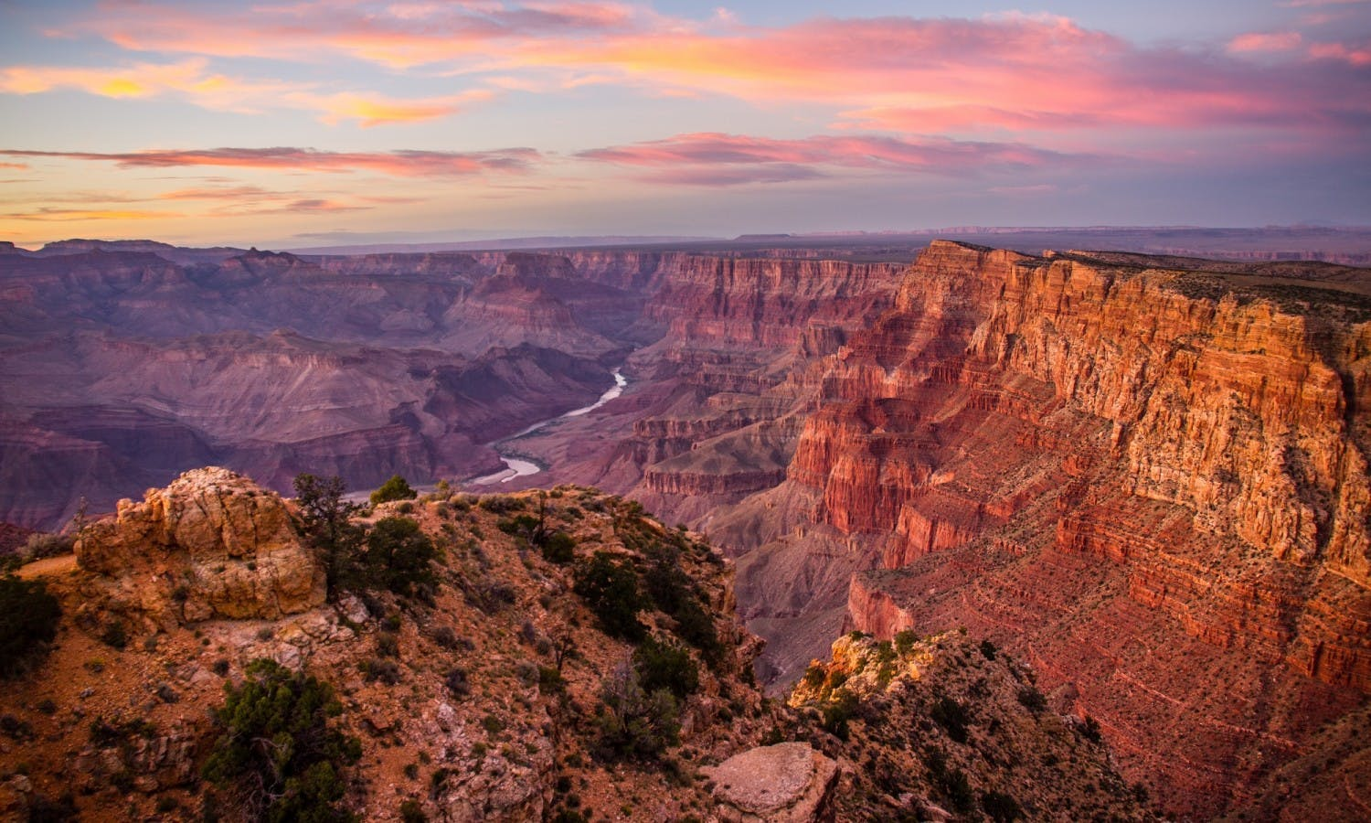
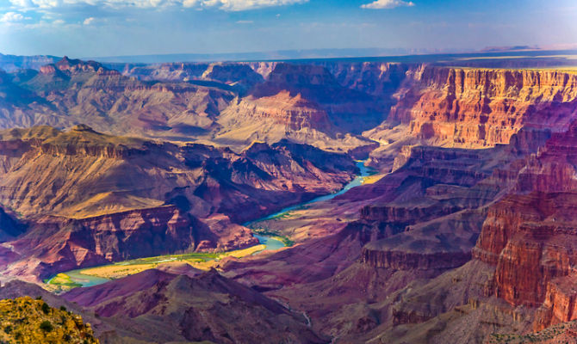
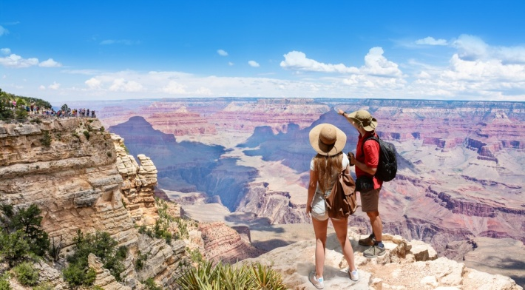
FOURTH DAY
7:30 am breakfast at the hotel
9:00 am departure from the hotel
11:00 am arrival and visit to the Grand Canyon National Park
3:00 pm free lunch
4:00 pm Colorado rafting activity
6:00 pm departure and return to the hotel
8:30 pm dinner and overnight stay

Slide 6
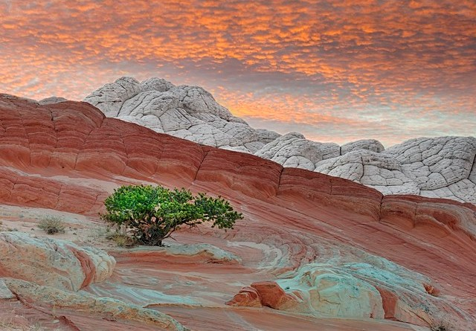
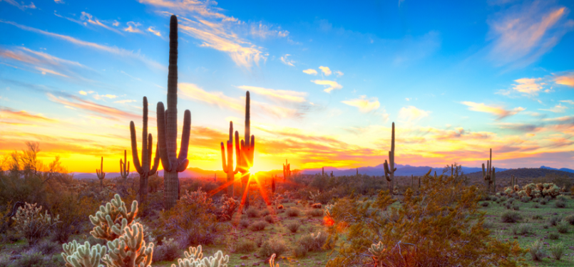
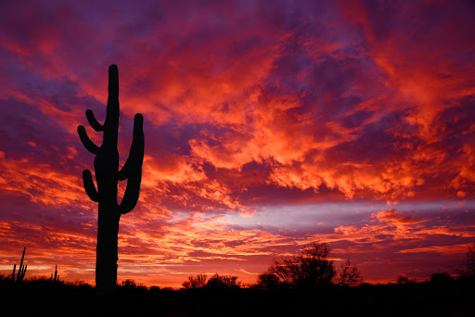
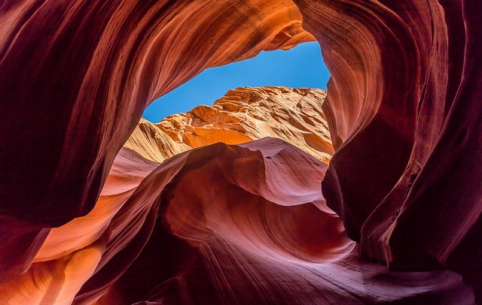
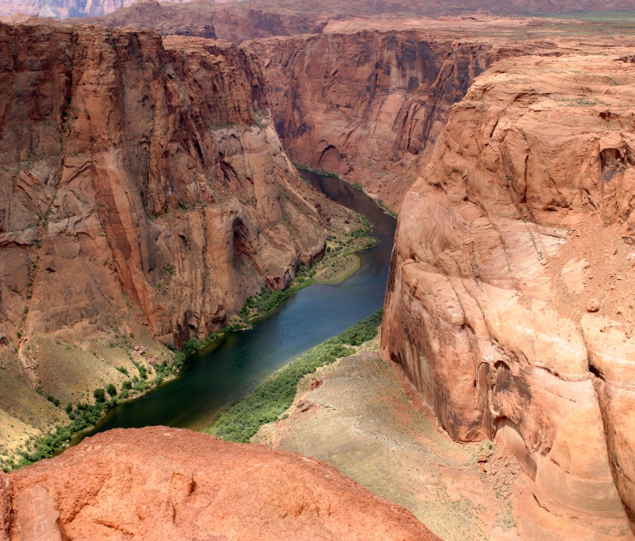
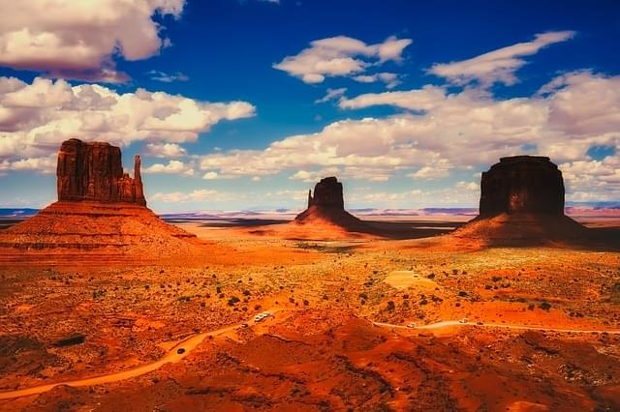
FIFTH DAY
8:00 am breakfast at the hotel
10:00 am check-in and departure from Sedona airport
8:00 pm arrival at Rome Fiumicino airport
9:00 pm return to their homes

