Slide 1
Music and Peace
By Valeria Battiato Paternò Castello and Beatrice Bonaccorsi
From Cutelli highschool

Slide 2
«Music has always been conditioned by political events of different eras.»

Slide 3
John Lennon and Yoko Ono
«There’s nothing you can make that can’t be made. No one you can save that can’t be saved.» - All you need is love.
«Have the courage and strength to be yourself. Because there is no other choice. Do you have a choice of being somebody else?» - Yoko Ono

Slide 4
Bed-in Protest
It was a form of non violent protest aganist the Vietnam war put in place in 1969 by John Lennon and Yoko Ono.

Slide 5
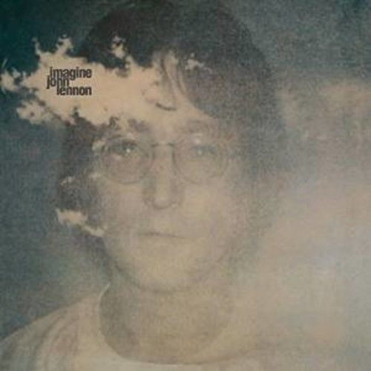
Imagine by john LENNON
Imagine there’s no countries
It isn’t hard to do
Nothing to kill or die for
And no religion too
Imagine all the people living life in peace.

Slide 6
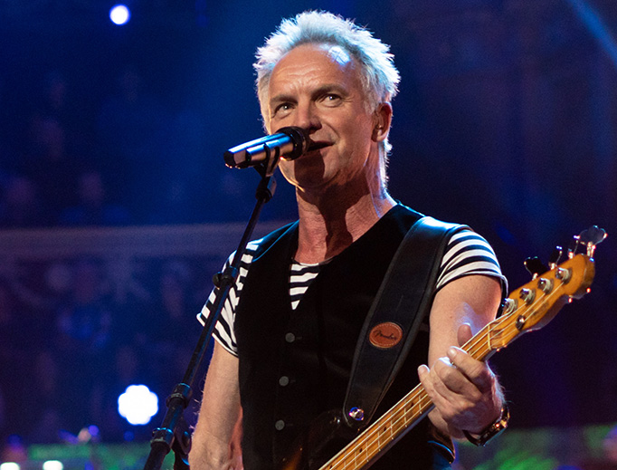
Sting
Sting, pseudonym of Gordon Matthew Thomas Sumner (Wallsend, 2 ottobre 1951), is a multi-instrumental, singer-songwriter and British actor, who made is debut as a member of the «Police» and then embark on a successful solo career. Like solo singer and member of «Police», during his career Sting recived 16 Grammy Awards, 3 BRIT Awards and one Golden Globe. Also he was candidated 4 times for Oscar to the best song in 2001, 2002, 2004 and 2017.

Slide 7
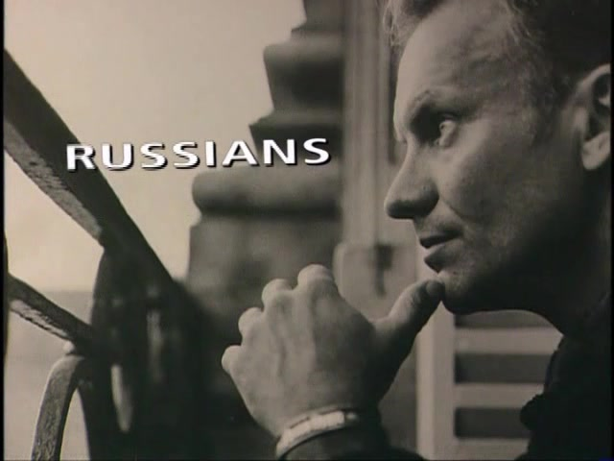
Russians
In Europe and America there's a growing feeling of hysteria. Conditioned to respond to all the threats In the rhetorical speeches of the Soviets. MIster Krushchev said, "We will bury you." I don't subscribe to this point of view. It'd be such an ignorant thing to do If the Russians love their children too. How can I save my little boy from Oppenheimer's deadly toy? There is no monopoly on common sense On either side of the political fence. We share the same biology, regardless of ideology. Believe me when I say to you, I hope the Russians love their children too.

Slide 8
FABRIZIO DE ANDRè
Fabrizio De André (Genova, 18 febbraio 1940 – Milano, 11 gennaio 1999), he was an Italian singer-songwriter. Many texst of his songs tell stories of marginalized people, rebels and prostitute, and they are considered by some critcs as real poetry. He has also been an anarchist and pacifist of ideas, he was also one of the artist who most valued le Ligurian language.

Slide 9
LA GUERRA DI PIERO
E mentre marciavi con l'anima in spalle
vedesti un uomo in fondo alla valle
che aveva il tuo stesso identico umore
ma la divisa di un altro colore.
Sparagli Piero, sparagli ora
e dopo un colpo sparagli ancora
fino a che tu non lo vedrai esangue,
cadere in terra, a coprire il suo sangue.

Slide 10
"E se gli sparo in fronte o nel cuore
soltanto il tempo avra' per morire,
ma il tempo a me restera' per vedere,
vedere gli occhi di un uomo che muore".

Slide 11
FRANCESCO DE GREGORI
Francesco De Gregori (Roma, 4th April 1951) is an Italian musician. He is one of the most important artists of the Italian music scene; he is often defined singer-songwriter and poet, even if he prefers to be identified simply as an "artist".

Slide 12
generale
Generale
la guerra è finita
il nemico è scappato, è vinto, è battuto
dietro la collina non c'è più nessuno
solo aghi di pino e silenzio e funghi
buoni da mangiare, buoni da seccare
da farci il sugo quando viene Natale
quando i bambini piangono
e a dormire non ci vogliono andare.
Generale
queste cinque stelle
queste cinque lacrime sulla mia pelle
che senso hanno
dentro al rumore di questo treno
che è mezzo vuoto e mezzo pieno
e va veloce verso il ritorno
tra due minuti è quasi giorno
è quasi casa
è quasi amore.

Slide 14
thank you for listening
Beatrice and Valeria from Cutelli CT

