Slide 1
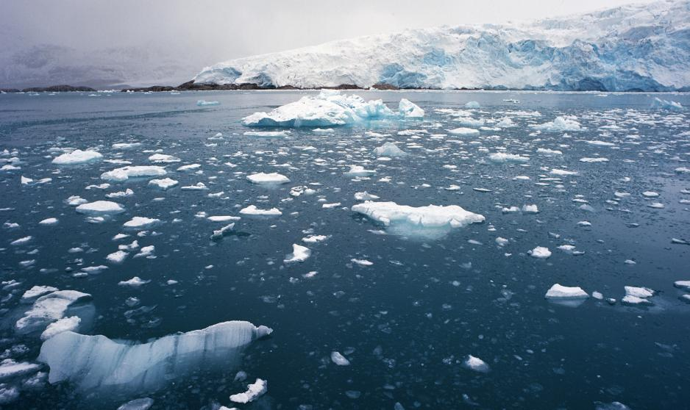
The Effects of climate change in the Arctic.

Slide 2
Causes Of climate change
Climate change is caused due to Global warming which is caused by :-
Increased emission of Co2
Co2(carbon dioxide) is being released into the air by cars, industrial buildings and humans breathing . This carbon dioxide is trapping the heat from the sun and is slowly making the earth warmer. This is called the Greenhouse effect.

Slide 3
What is the Greenhouse Effect?
The Greenhouse effect is basically the Earth’s atmosphere acting like a greenhouse and capturing the sun’s rays so that life can survive on Earth, Hence the name “Greenhouse Effect”.
Without the Earth’s atmosphere acting as a greenhouse, the Earth would be very cold. One of the worst examples of the Earth cooling down happened about 1500 years ago. Two massive volcanic eruptions, one year after the other, released so much black dust into the upper atmosphere that very little sunlight came through. Crops withered and people died of starvation. The Black Death started its course.

Slide 5
Positions on Global Warming
There are three main positions on Global Warming:-
1.That Global Warming is not occurring and so is climate change.
2.That Global Warming is occurring, but this is a natural event and has nothing to with humans.
3.That Global Warming is occurring as a primary result of human intervention in the from of more cars, more factories, less trees and generally more carbon dioxide emission.

Slide 6
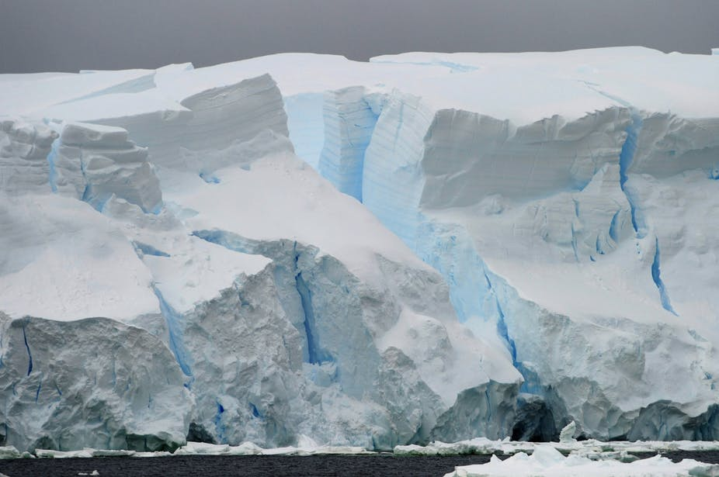
More details on the Positions
1st:- This is a hard claim because of all the evidence against it in the form of the polar icecaps melting, satellite images, videos and other forms of evidence which clearly show the rising sea levels, the increased temperatures and the melting icecaps.

Slide 7
Increasing temperature

Slide 8
Rising sea levels

Slide 9
Position on Global Warming
2nd:- The claim that the observed global warming is natural or at the very least, not the result of man-made carbon emissions focuses on data that shows that the world temperatures and atmospheric Co2 levels have equally high in the past. They also point to the well understood effects of solar activity on the amount of radiation striking the earth and the fact that the sun has been particularly active.
3rd:- The position which says that global warming is real and is being is caused by humans, scientists attribute the current atmospheric imbalance due to the fact that humans have increased the amount of carbon containing gases and to increased amounts of tiny particles in the air by cutting trees and making more factories to name a few of the factors.

Slide 10
Factories producing Co2

Slide 11
Deforestation

Slide 12
How does all this affect the arctic?
The arctic is affected in many ways, for example:-
The polar ice caps melting.
The Greenland Ice sheet melting.
It also affects the arctic animals, for example the polar bear, which is unable to hunt its prey, the seal due to the ice sheets melting.
It is predicted that in the next century the polar bear population will be reduced to almost half, if things continue on its course.

Slide 13
A polar bear trying to cross the ice.

Slide 14
The End

