Slide 1
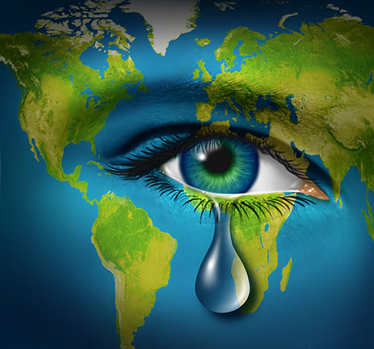
The Causes And Effects Of Climate Change
Presented By: Amy Psaila and Kyra Grech

Slide 2
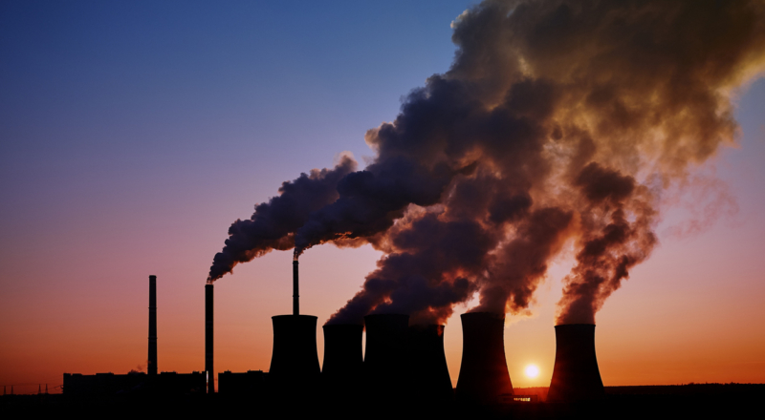
What Is Climate Change?
Climate change is any significant long-term change in the expected patterns of average weather of a region (or the whole Earth) over a significant period of time. Climate change is about abnormal variations to the climate, and the effects of these variations on other parts of the Earth.
Humans are increasingly influencing the climate and the earth's temperature by air pollution, cutting down rainforests(deforestation)and farming livestock.
This adds enormous amounts of greenhouse gases to those naturally occurring in the atmosphere, increasing the greenhouse effect and global warming.

Slide 3
Antarctica (before and after)

Slide 4
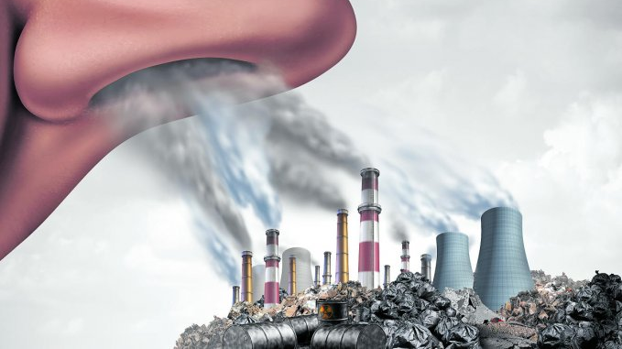
Air Pollution {green house gases}
Greenhouse gases are gases in Earth’s atmosphere that trap heat. They let sunlight pass through the atmosphere, but they prevent the heat that the sunlight brings from leaving the atmosphere. The main greenhouse gases are:
Water vapor
Carbon dioxide
Methane
Ozone
Nitrous oxide
Chlorofluorocarbons

Slide 5
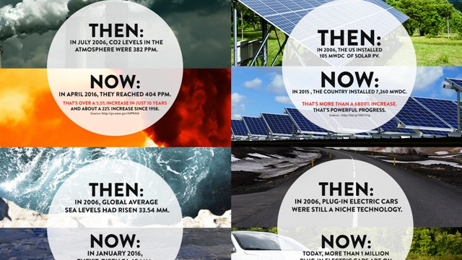

Slide 6
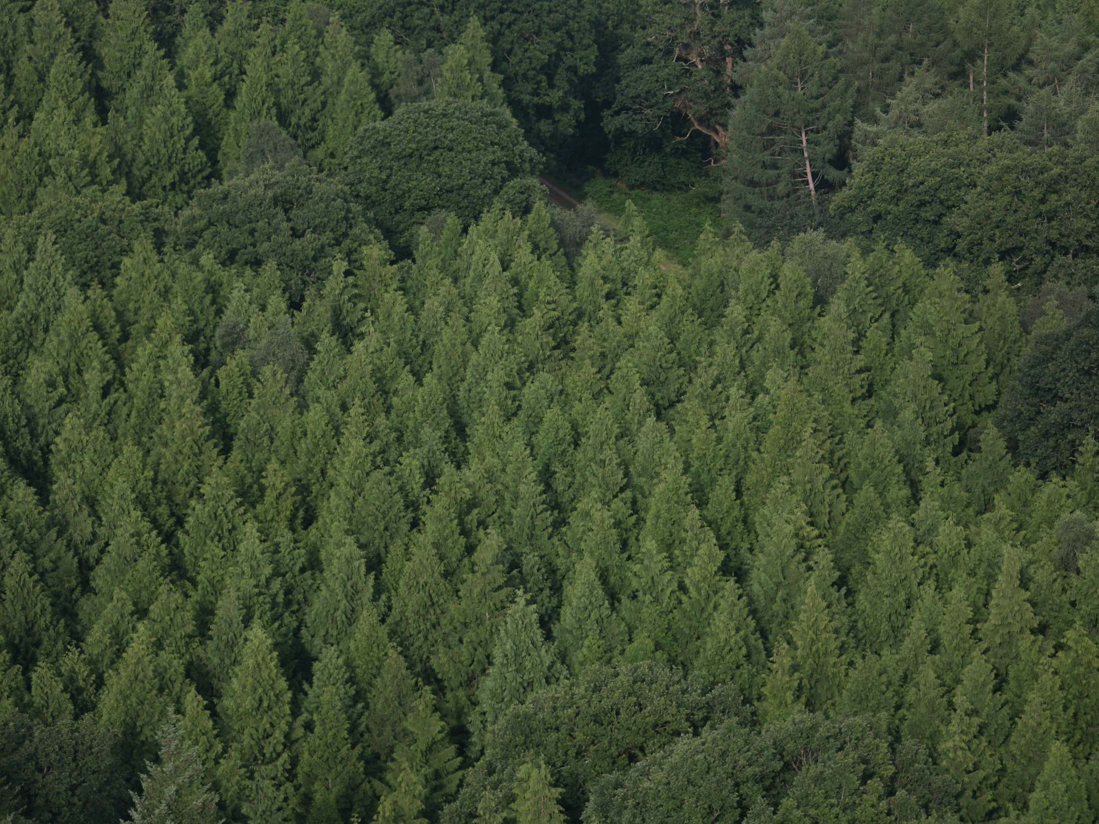
Deforestation (cutting down rainforests)
Deforestation is the permanent removal of trees to make room for something besides forest. This can include clearing the land for agriculture or grazing, or using the timber for fuel, construction or manufacturing.
The loss of trees and other vegetation can cause climate change, desertification, soil erosion, fewer crops, flooding, increased greenhouse gases in the atmosphere, and a host of problems for indigenous people.
The 5 Major Rainforests
a. The Amazon in South America
b. The Congo in Central Africa
c. Southeast Asia
d. New Guinea
e. Madagascar

Slide 7
The Amazon Rainforest (before and after)

Slide 8
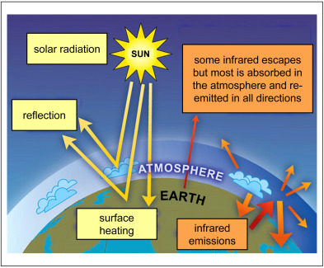
Causes of climate change
climate change can also result from external forcing, when events outside of the climate system’s components nonetheless produce changes within the system . Examples include changes in solar output and volcanism. Human activities can also change climate, and are presently driving climate change through global warming.

Slide 10
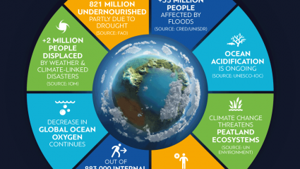

Slide 11
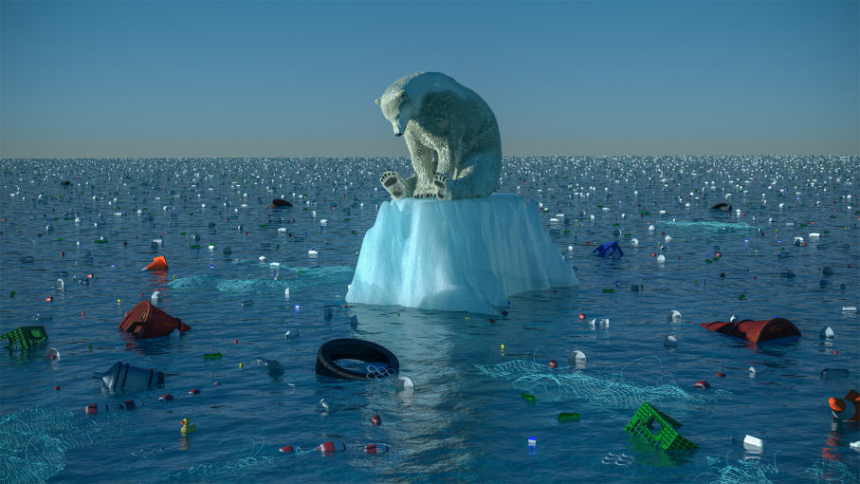
Once the planet warms an additional 2 degrees Celsius (3.6 degrees Fahrenheit), predicted to happen by 2035, scientists foresee a range of catastrophic effects, from widespread flooding in coastal areas to searing heat waves and extreme storms.

