Slide 1
To reduce the impact of Climate Change
Initiatives carried out by the Social Studies Team - St Clare College Secondary Pembroke

Slide 2
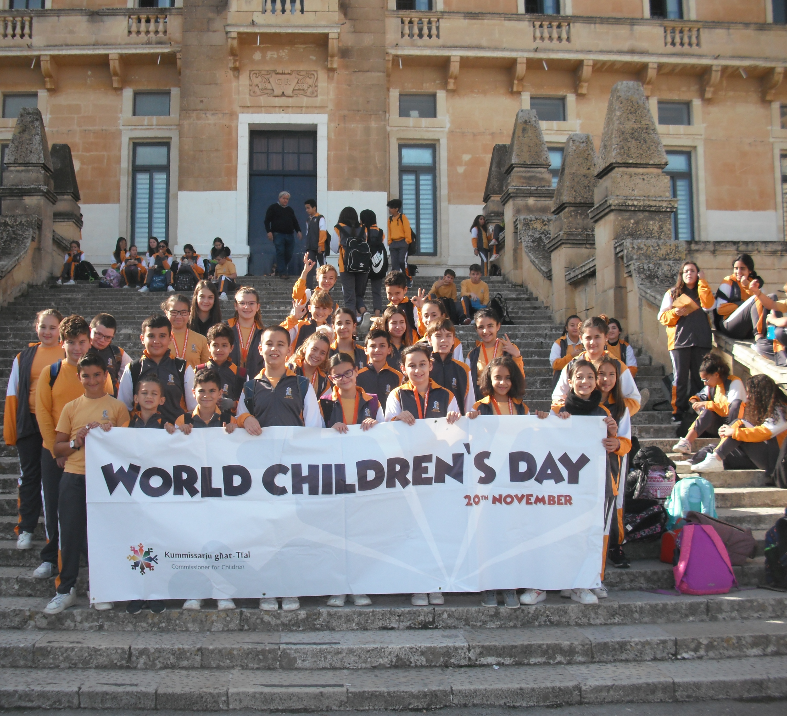
Raising Awareness about Children’s Rights and Climate Change

Slide 3
Climate Change and Children’s Rights
Climate change is a direct threat to a child’s ability to survive, grow, and thrive.
As extreme weather events such as cyclones and heatwaves increase in frequency and ferocity, they threaten children’s lives and destroy infrastructure critical to their well-being. Floods compromise water and sanitation facilities, leading to diseases such as cholera, to which children are particularly vulnerable.

Slide 4
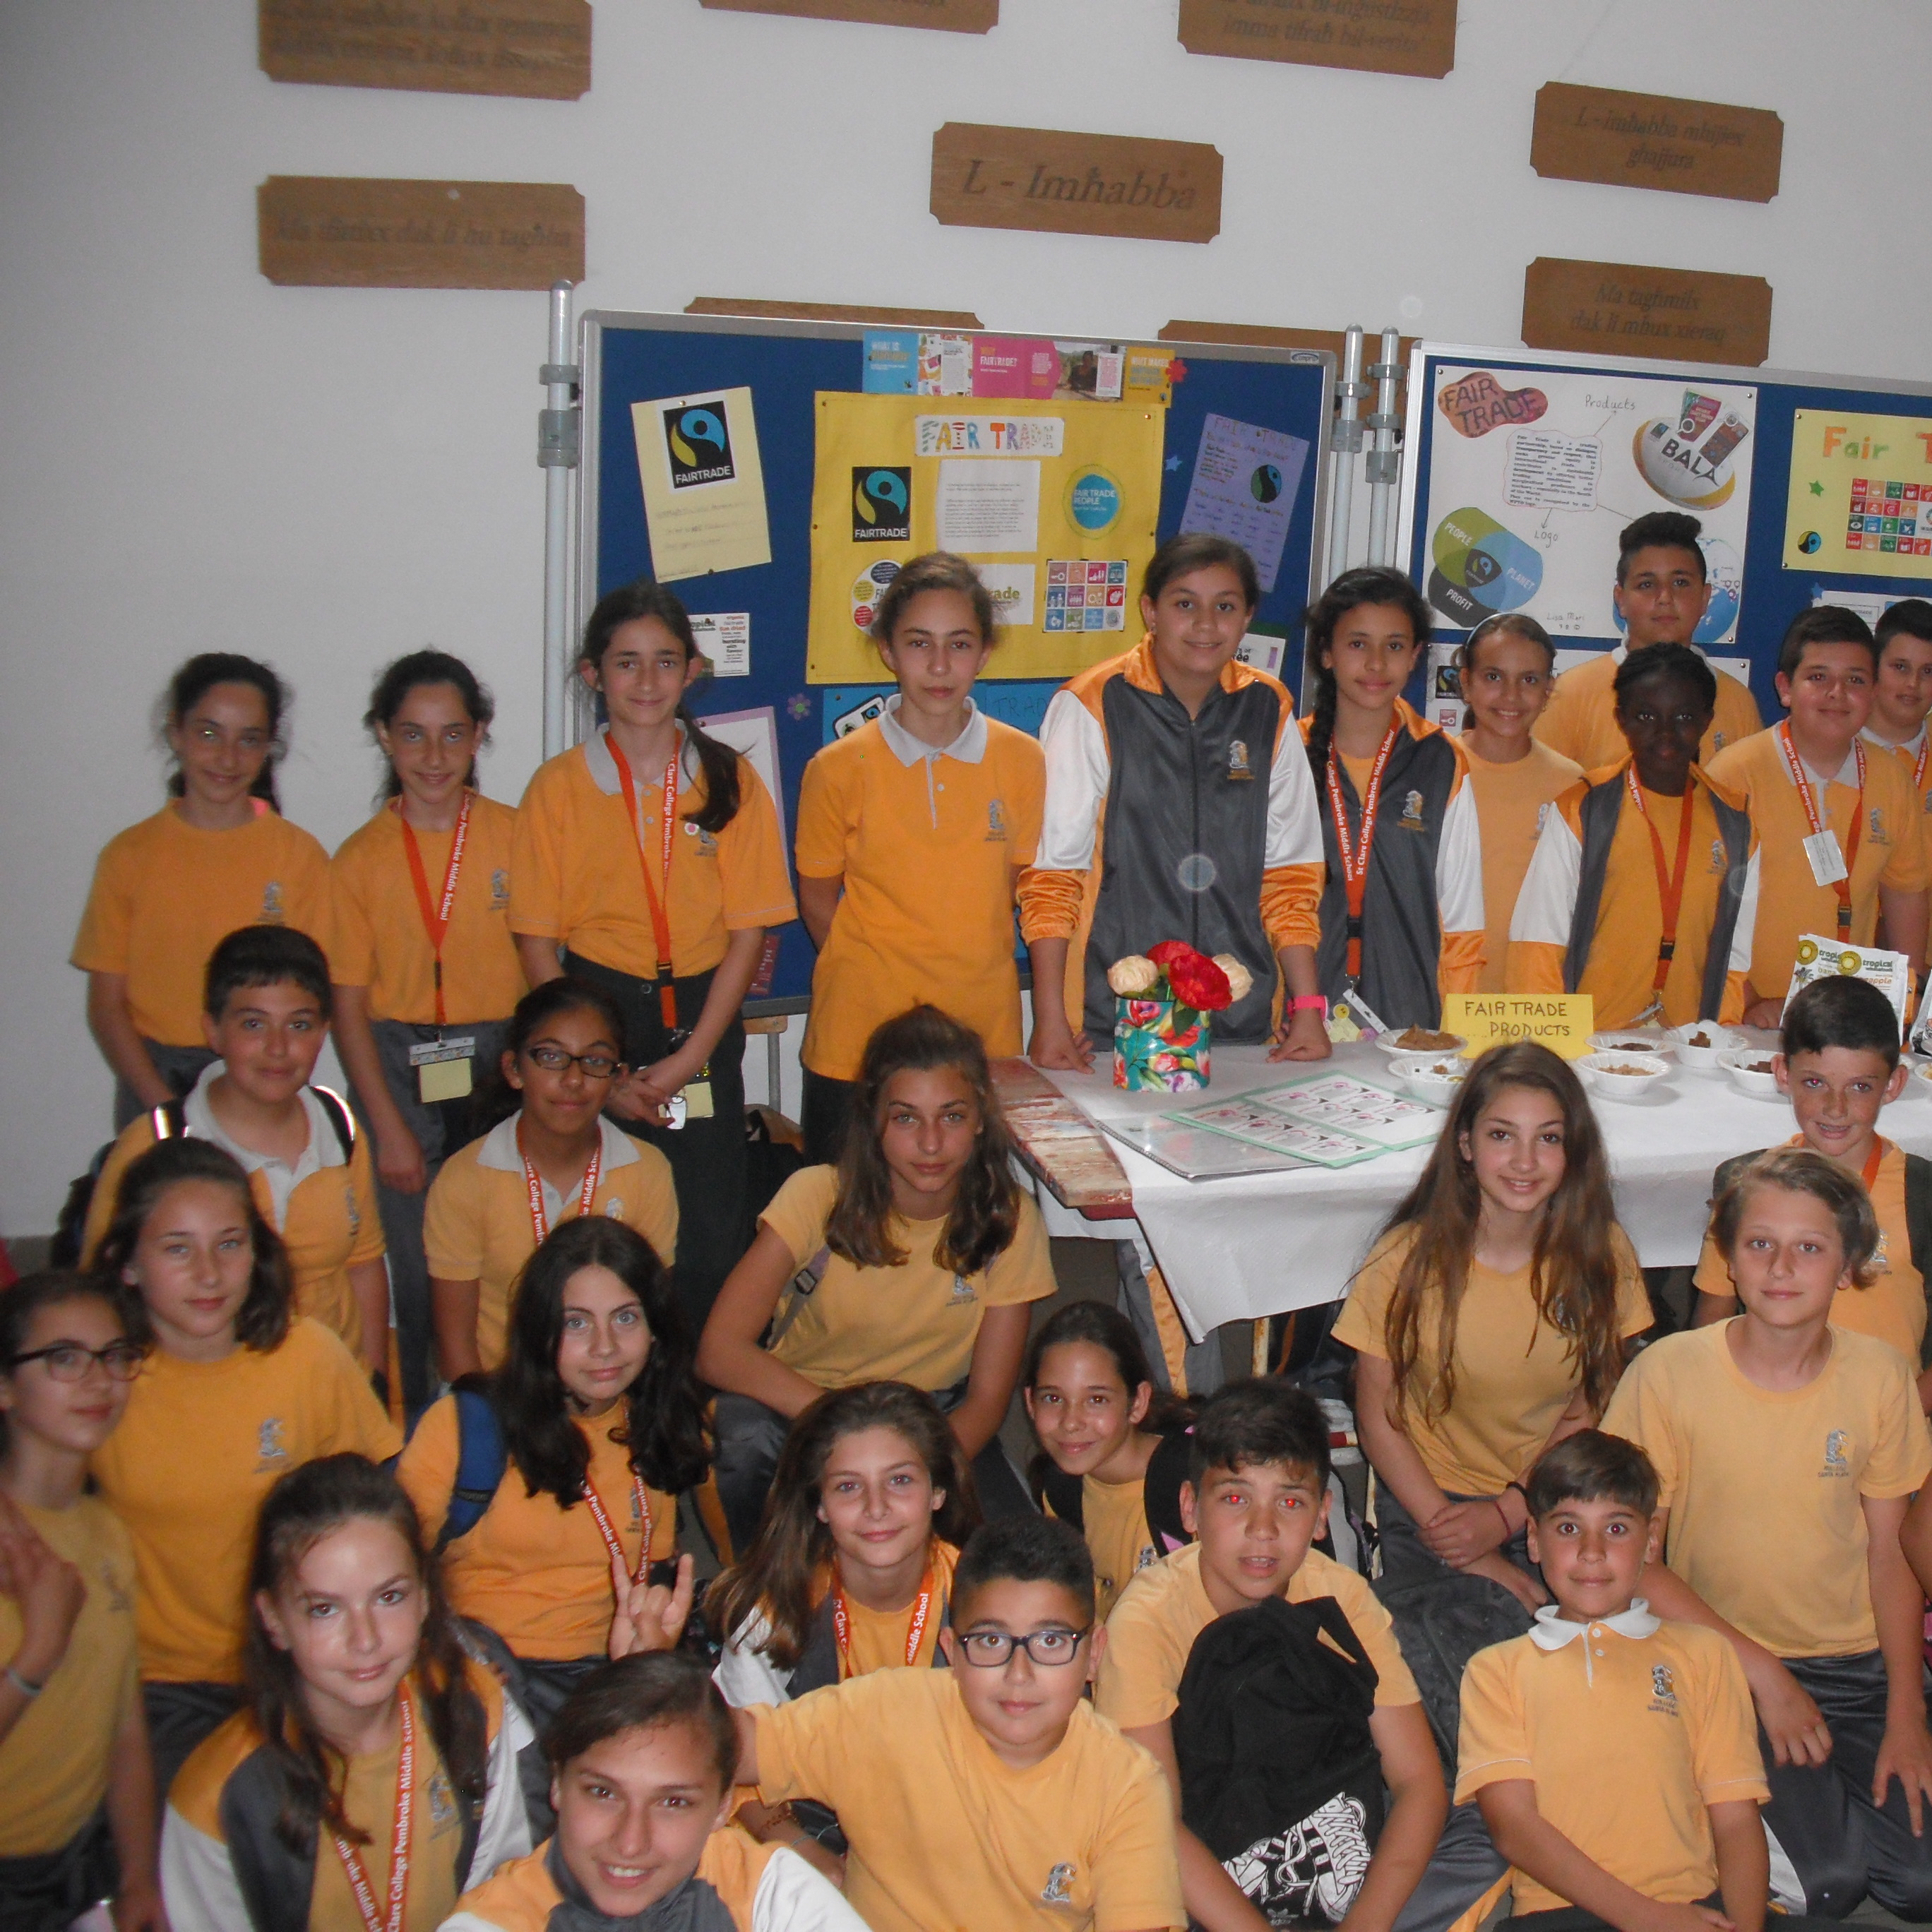
Fair Trade Workshops organised by KOPIN

Slide 5
Climate Change, Food Security and Fair Trade
How Fair Trade addresses Climate Change:
Fairtrade’s unique approach helps farmers become more resilient to climate change, whilst at the same time giving consumers, retailers and traders the opportunity to reduce their carbon footprint. All this is underpinned by the Fairtrade Climate Standard. Fairtrade helps safeguard the natural world by promoting sustainable food production through these standards – for example by prohibiting highly dangerous pesticides or cutting down trees in protected areas.

Slide 6
An interview with the Mayor of the Pembroke Local Council

Slide 7
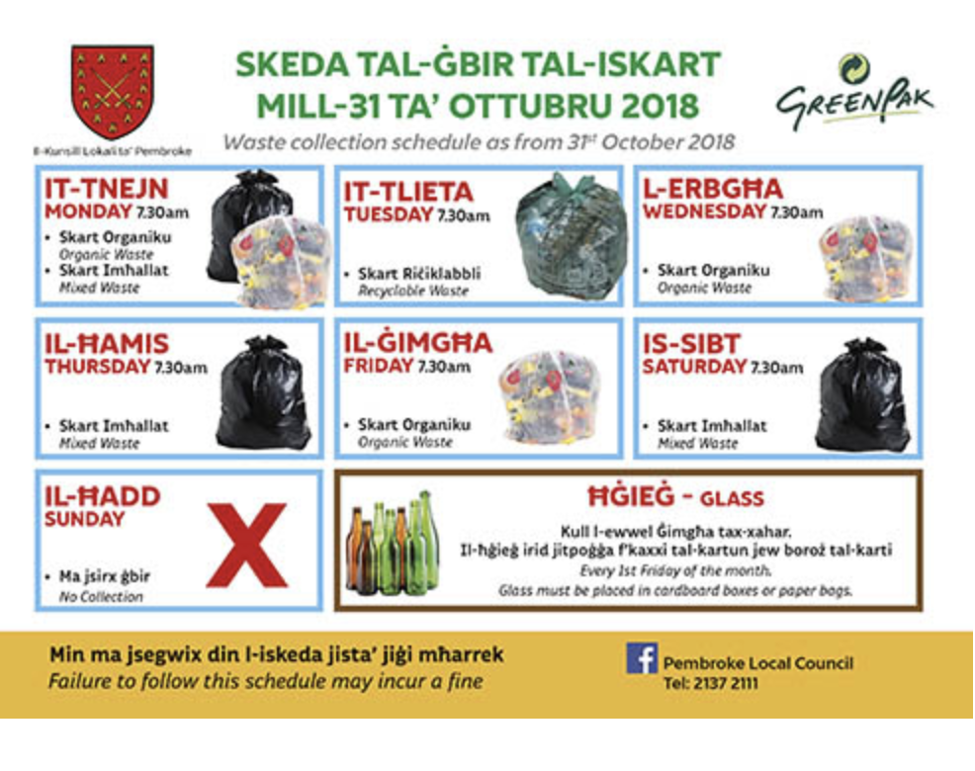
An interview with the Mayor – Local Council Pembroke
Picture 1:The revolutionary iBiNs are able to identify in real time how full they are. When the bins are full a signal will be sent to a central data centre advising that the bin has to be emptied.
Picture 2: Door to door schedule

Slide 8
What’s next?

Slide 9
Eco-Friendly Practices
To reduce plastic
To replace water bottles with flasks
Less litter in classrooms, corridors and grounds
Food waste campaign - encouraging students not to waste food
To plant indigenous trees and caring for them
Other projects

Slide 10
Thank you.

