Slide 1
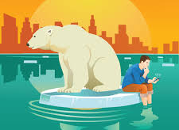
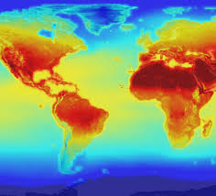
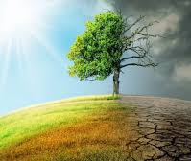
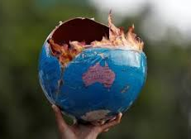
CLIMATE CHANGE
Pete Stewart (yr 7.10)

Slide 2
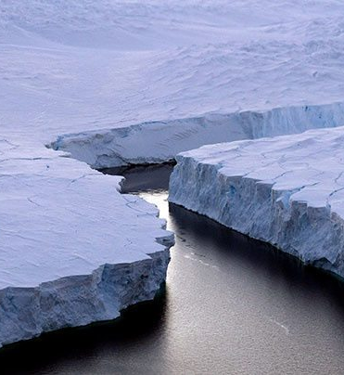
What is Climate Change?
Climate change is the process of our planet heating up.
The Earth has warmed by an average of 1°C in the last century which means big things for people and wildlife around the globe.
The changing climate will actually make our weather more extreme and unpredictable.

Slide 3
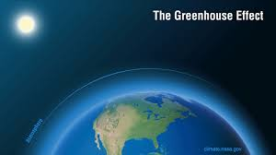
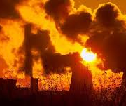
Causes of climate change
Burning fossil fuels
Many countries burn large amounts of fossil fuels such as oil and gas.
The gases released into the atmosphere during this process act like an invisible ‘blanket’, trapping heat from the sun and warming the Earth.
This is known as the “Greenhouse Effect”.

Slide 4
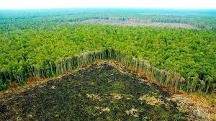
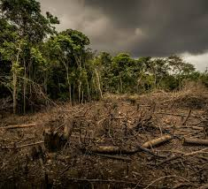
Causes of climate change
Deforestation
Forests absorb huge amounts of carbon dioxide – a greenhouse gas – from the air, and release oxygen back into it.
Sadly, many rainforests are being cut down to make wood, palm oil and to clear the way for farmland, roads, dams and any type of building.

Slide 5
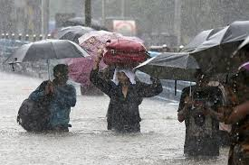
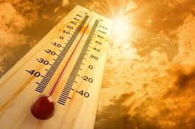
Impact of climate change
Heavy rainfall
Heavy downpours are becoming more common in many locations, sometimes causing major flooding.
Heat waves
Heat waves are long periods of time with above-normal temperatures. As the Earth warms, more areas will be at risk for hotter and more frequent extreme heat waves.

Slide 6
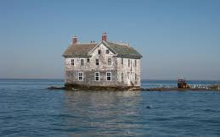
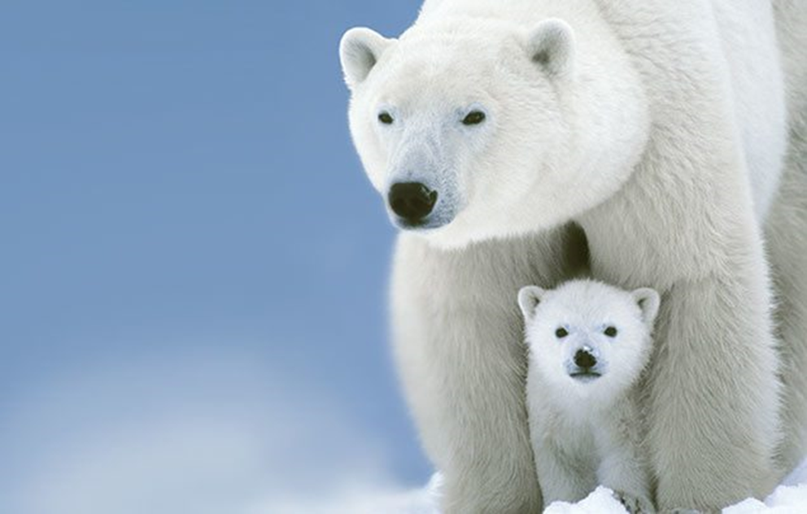
Impact of climate change
Sea Level Rise
Sea level has risen about 8 inches due to the melting of glaciers and ice sheets. The warming of seas and oceans is also making coastal storms more damaging.
Threats to habitats and animals
As temperatures warm, many plants and animals are migrating to higher elevations. Some animals may have difficulty moving or adapting to new habitats.

Slide 7
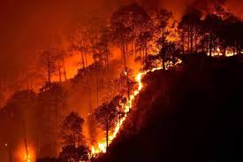
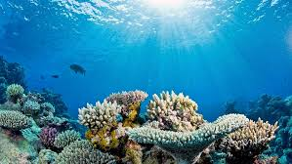
Impact of climate change
Wildfires
These are large fires that burn vast amounts of forests and brush. When they are not controlled, wildfires can destroy homes and be deadly. The number of large wildfires and the length of the wildfire season have been increasing in recent decades.
Ocean acidification
Extra carbon dioxide in the atmosphere is absorbed by the oceans, making them more acidic. This can make it difficult for corals and microorganisms that form shells to survive, disrupting the food supply for other sea animals.

Slide 8
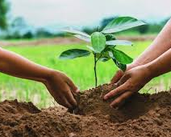
What can I do as an 11 year old to help?
Reduce the green house effect
Plant a tree to help reduce Coշ in the air.
Learn how to grow my own fruit and vegetables.
Reduce my carbon footprint
Turn off TVs, computers, lights when I no longer need them.
Walk or ride a bike.

Slide 9
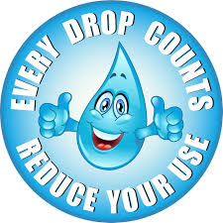
What can I do as an 11 year old to help?
Recycle
Cans, paper, cardboard, plastic. Recycle
everything.
Eliminate the use of plastic and use less
packaging
Save water
In time regions will be hit by drought so
we need to look after our water.

Slide 10
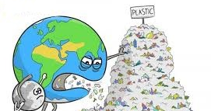
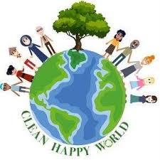
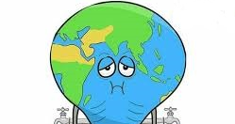
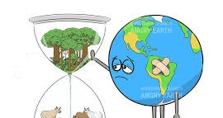
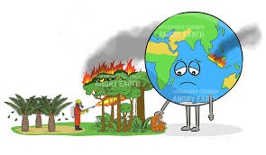
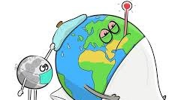
Let’s save our planet Reduce climate change NOW!

