Slide 1
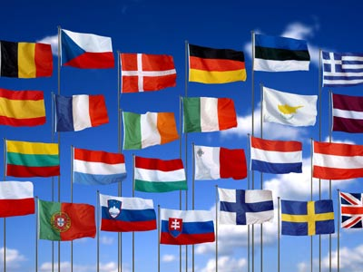
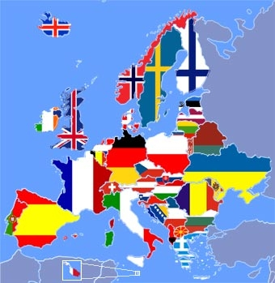
Welcome to the participants of the quiz dedicated to the European Day of Languages

Slide 2
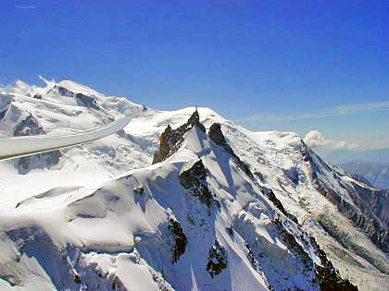
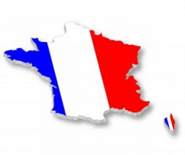
1. Mont Blanc (White Mountain) is on the border with ...
1.
Spain
2.
Belgium
3.
Germany
4.
Italy

Slide 3
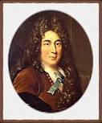
2. Charles Perrault wrote a story …
1.
Little Red Riding Hood
2.
The Little Prince
3.
Ms. Snowstorm
4.
Three little pigs

Slide 4
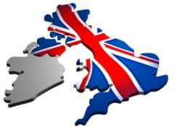
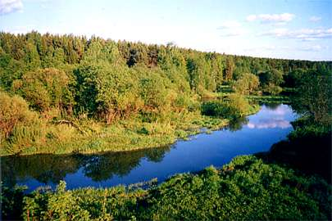
3. The longest river in the UK …
1.
Thames
2.
Severn
3.
Clyde
4.
Trent

Slide 5
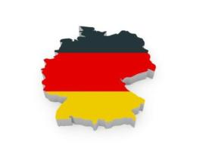
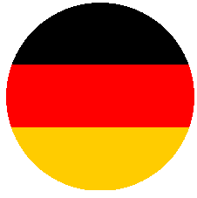
4. In Germany, this card can be sent…
1.
to Christmas
2.
to Easter
3.
to Trinity
4.
to St. Martin`s Day

Slide 6
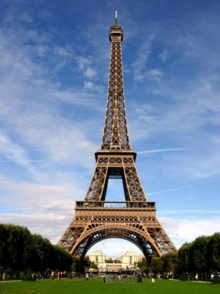
5. The Eiffel Tower was built in …
1.
1885
2.
1889
3.
1895
4.
1899

Slide 7
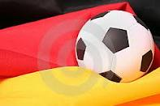
6. July 1, 1912 in Stockholm (Sweden), the German football team won with a score of 16: 0 the team of…
1.
Russia
2.
France
4.
Italy
3.
Poland

Slide 8
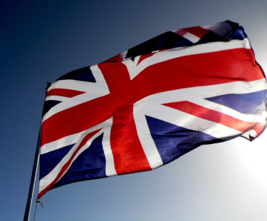
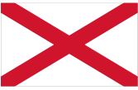
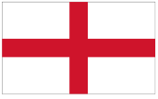
7. Cross of St. George on the state flag of United Kingdom of Great Britain and Northern Ireland looks ...
1.
2.
3.
4.

Slide 9
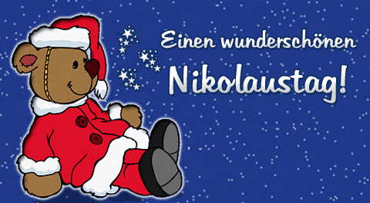
8. Saint Nicholas puts presents for German children …
1.
in shoes
2.
under the pillow
3.
under the fir-tree
4.
in stockings

Slide 10
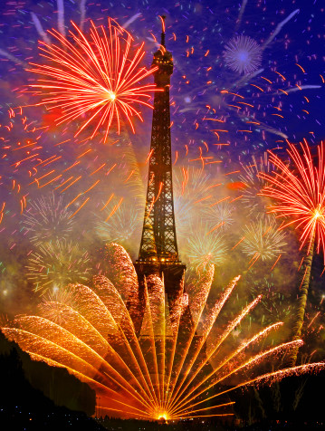
9. France celebrates Independence Day …
1.
1 May
2.
14 July
3.
25 December
4.
15 August

Slide 11
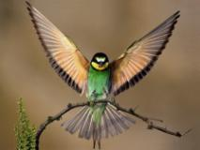
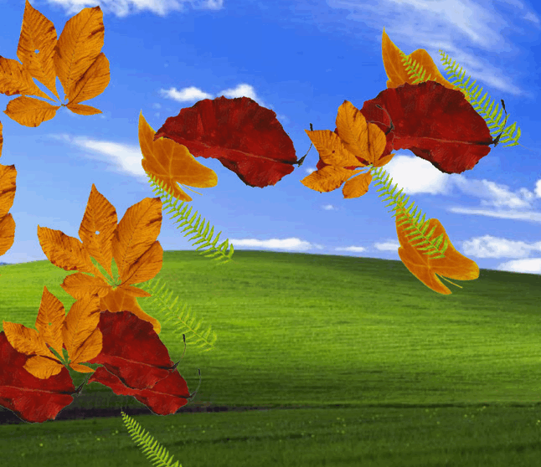
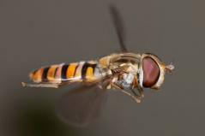
10. In Britain it is luck to catch…
1.
a singing bird
2.
a falling leaf
3.
a snowflake
4.
a flying bird

Slide 12
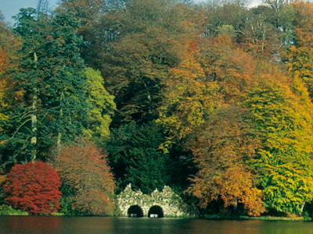
11. The most widespread tree in England…
1.
birch
2.
Fir-tree
3.
maple
4.
ash

Slide 13
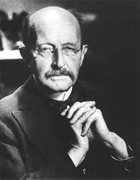
12. The world- famous German physicist Max Planck dreamed of becoming …
1.
a chemist
2.
an astronomer
3.
a musician
4.
Chancellor of Germany

Slide 14
13. The longest river in France …
1.
Seine
2.
Loire
3.
Rhone
4.
Haron

Slide 15
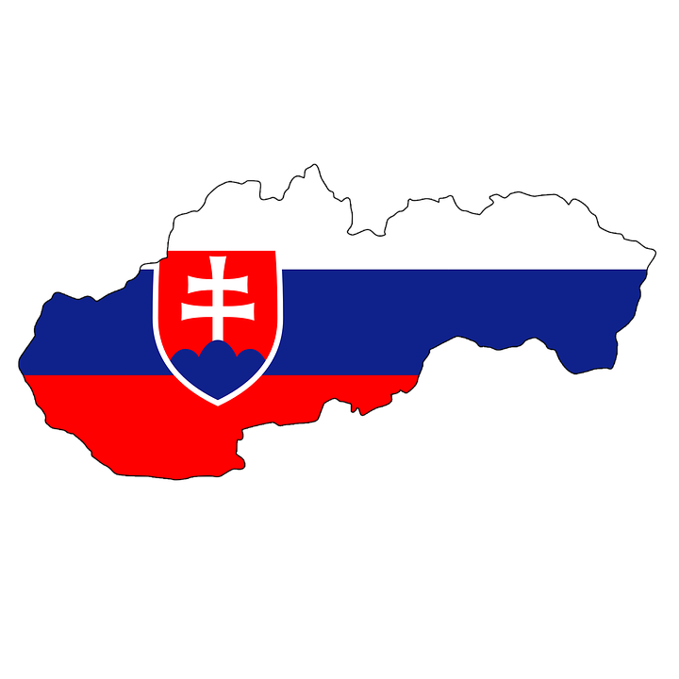
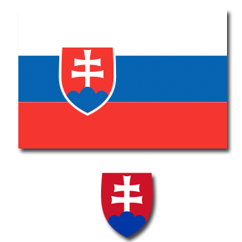
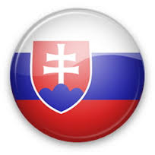
14. Slovakia borders on …
1.
Germany, Spain , Poland , Italy
2.
Sweden, Austria, Belgium , the Netherlands
Czech Republic, Austria , Ukraine , Poland, Hungary
3.
4.
Spain, Greece , Portugal, Ukraine

Slide 16
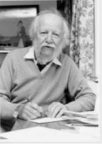
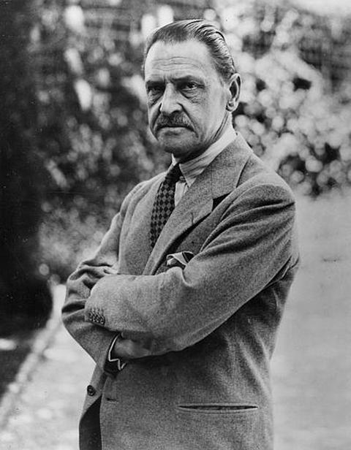
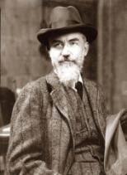
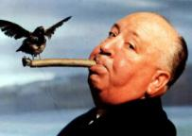
15. The famous English director who worked in the genre of thriller …
1.
William Golding
2.
Bernard Shaw
3.
Somerset Maugham
4.
Alfred Hitchcock

Slide 17
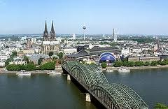
16. Christmas cookie in Cologne is ...
1.
apple
2.
cherry
3.
almond
4.
walnut

Slide 18
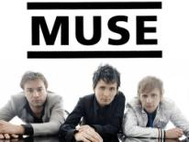
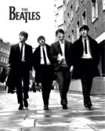
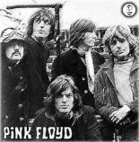
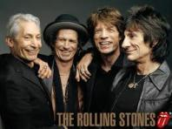
17. World-famous Liverpool band is…
1.
Rolling Stones
2.
Muse
3.
Pink Floyd
4.
Beatles

Slide 19
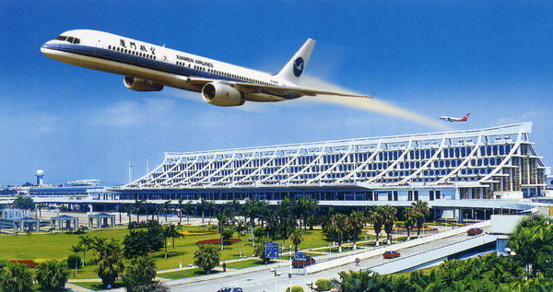
18. The biggest German airport is in…
1.
Berlin
2.
Hamburg
3.
Frankfurt
4.
Dresden

Slide 20
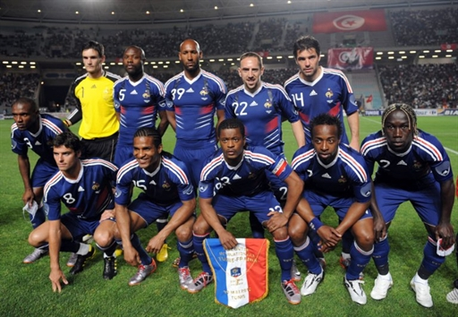
19.Head coach of the France team - …
1.
Michelle Platіnі
2.
Zіnedіn Zіdan
3.
Laurent Blanc
4.
Jan Kozak

Slide 21
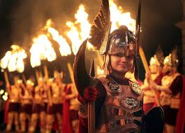
20. Hogmanay is…
1.
Irish Easter
2.
Welsh Fasting
3.
Scottish New Year
4.
English Halloween

Slide 22
Thank you for participating

