Slide 1
Proverbs in english and serbian presentation by jovana krneta class 8/1
comparison

Slide 2
PROVERB NO.1
Eng: ’’Two wrongs don’t make a right’’.
Serb: ’’Ko drugom jamu kopa, sam u nju pada’’.
Description: When someone has done something bad to you, trying to get revenge will only make things worse.

Slide 3
PROVERB NO.2
Eng: ’’The pen is mightier than the sword’’.
Serb: ’’Reči su oštrije od mača’’.
Description: Trying to convince people with ideas and words is more effective than trying to force people to do what you want.

Slide 4
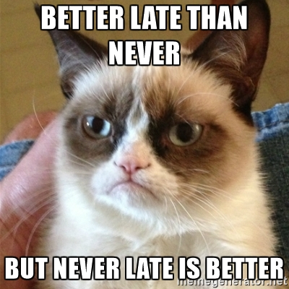
PROVERB NO. 3
Eng: ’’Better late than never’’.
Srb: ’’Bolje ikad nego nikad’’.
Description: It's best to do something on time. But if you can't do it on time, do it late.

Slide 5
PROVERB NO. 4
Eng: ’’No pain no gain’’.
Srb: ’’Bez muke nema nauke’’.
Description:
If you want to improve, you must
work hard

Slide 6
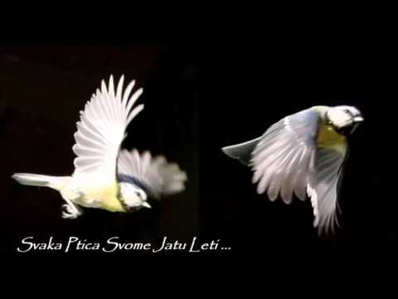
Proverb no. 5
Eng: ’’ Birds of a feather flock together’’.
Srb: ’’Svaka ptica svome jatu leti’’.
Description: People like to spend time with others who are similar to them.

Slide 7
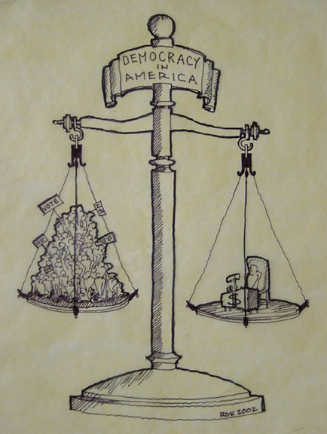
Proverb no. 6
Eng: ’’A picture is worth a thousand words’’.
Srb: ’’Slika govori više od hiljadu reči’’.
Description: Pictures convey emotions and messages better than written or spoken explanations.

Slide 8
PROVERB NO. 7
Eng: ’’The early bird catches the worm’’.
Srb: ’’Ko rano rani, dve sreće grabi’’.
Description: You should wake up and start work early if you want to succeed.

Slide 9
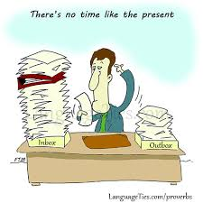
PROVERB NO. 8
Eng: ’’There’s no time like present’’.
Srb: ’’Ono što možeš danas ne ostavljaj za sutra’’.
Description: If you need to do something, don't wait until later. Do it now.

Slide 10
Proverb no. 9
Eng: ’’Beautiy is in the eye of beholder’’.
Srb: ’’Lepota je u oku posmatrača’’.
Description: Different people have different ideas about what's beautiful.

Slide 11
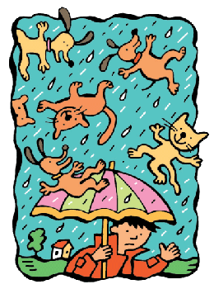
PROVERB NO.10
Eng: ’’It’s raining cats and dogs!’’
Serb: ’’Lije k’o iz kabla!’’
Description: When it’s raining heavily.

Slide 12
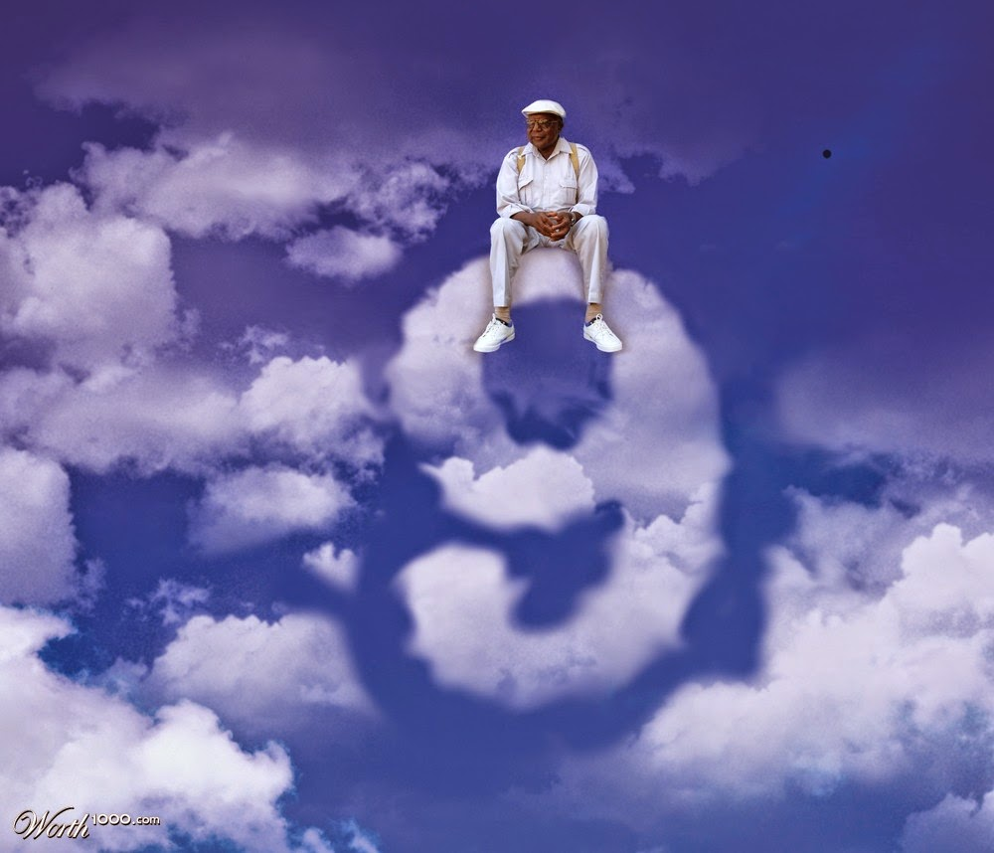
PROVERB NO. 11
Eng: ’’Be on cloud nine’’.
Srb: ’’Biti na sedmom nebu’’.
Description: When you are very happy.

Slide 13
PROVERB NO. 12
Eng: ’’Blood is thicker than water’’.
Srb: ’’Krv nije voda’’.
Description: Family relatoships are always more important than friends.

Slide 14
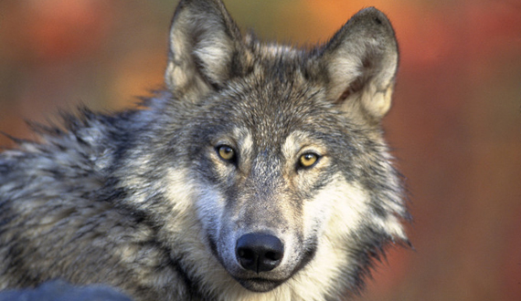
PROVERB NO. 13
Eng: ’’Talk of the devil’’.
Srb: ’’Mi o vuku a vuk na vratima’’.
Description: Talk about a certain person, and that person appears.

