Slide 1
serbia

Slide 2
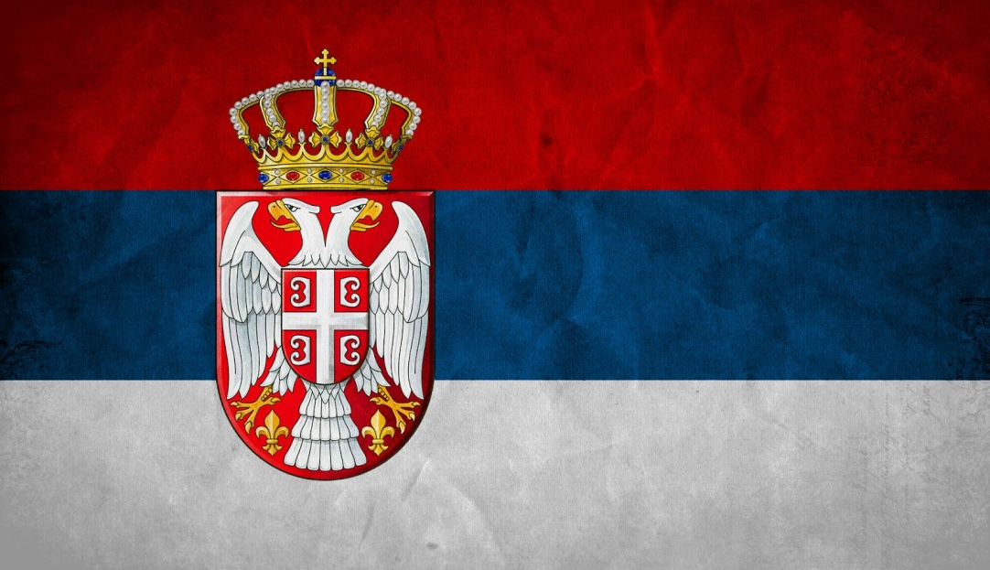
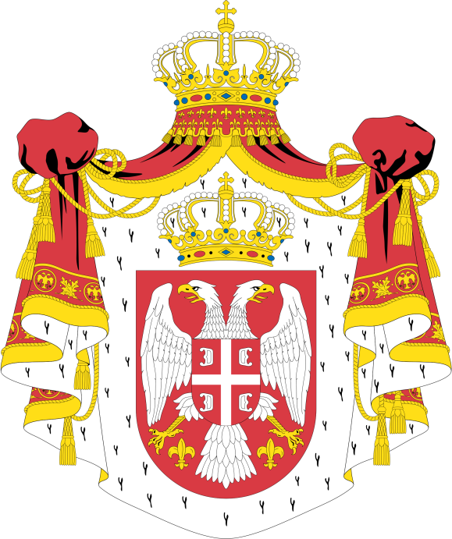
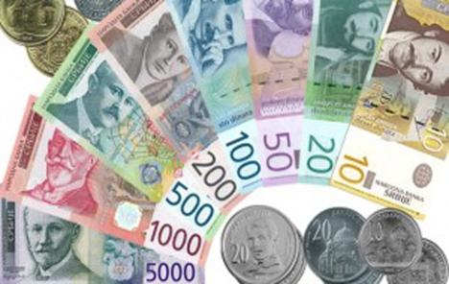
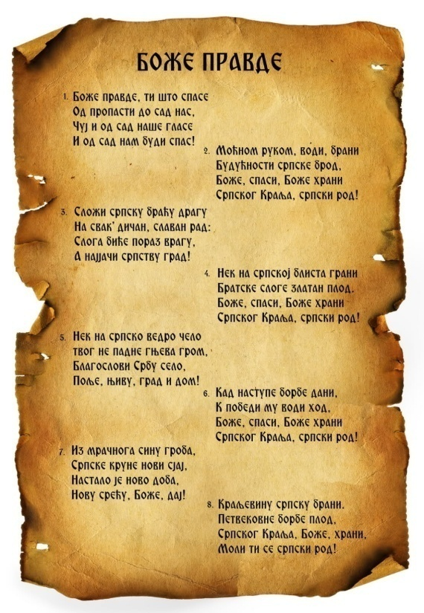
Money - dinar
Coat of arms of Serbia
https://www.youtube.com/watch?v=_9Grp5tYrYI
Serbian flag
The capital city- Belgrade
Anthem

Slide 3
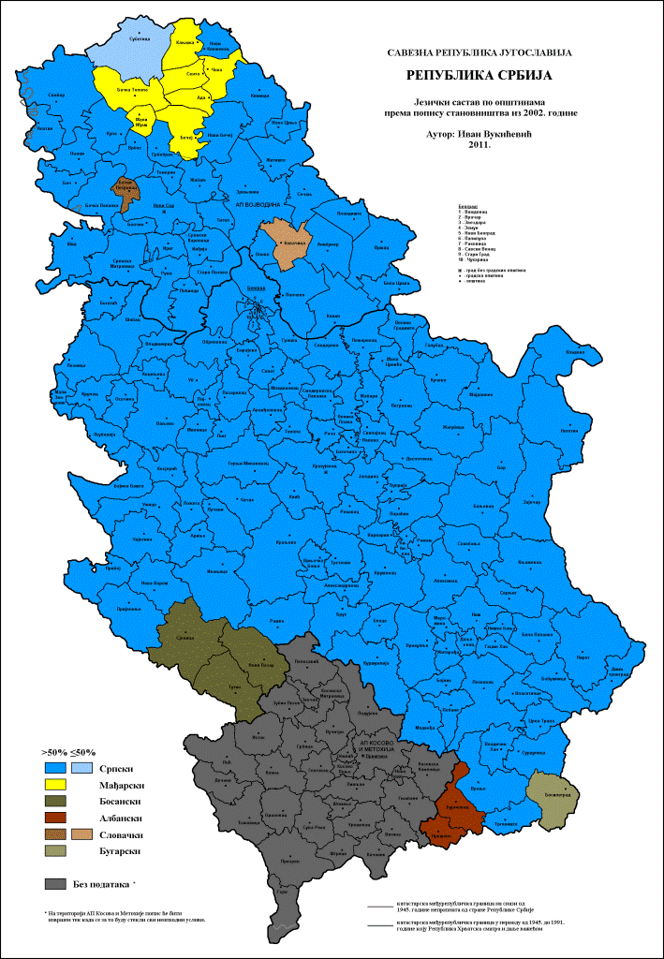
Languages in Serbia
Dark blue Serbian
Yellow Hungarian
Dark red Albanian
Dark grey Bosnian
Light pink Slovakian
Light grey Bulgarian

Slide 4
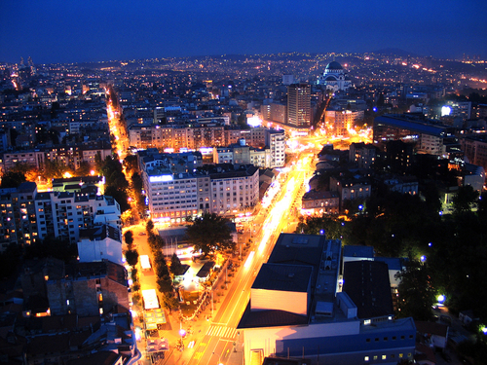
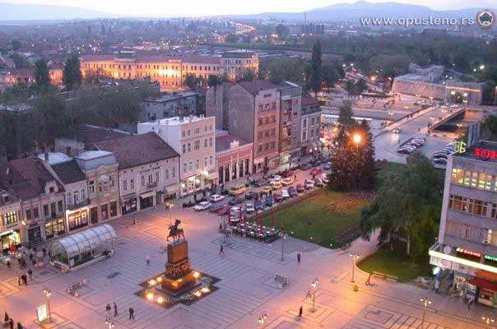
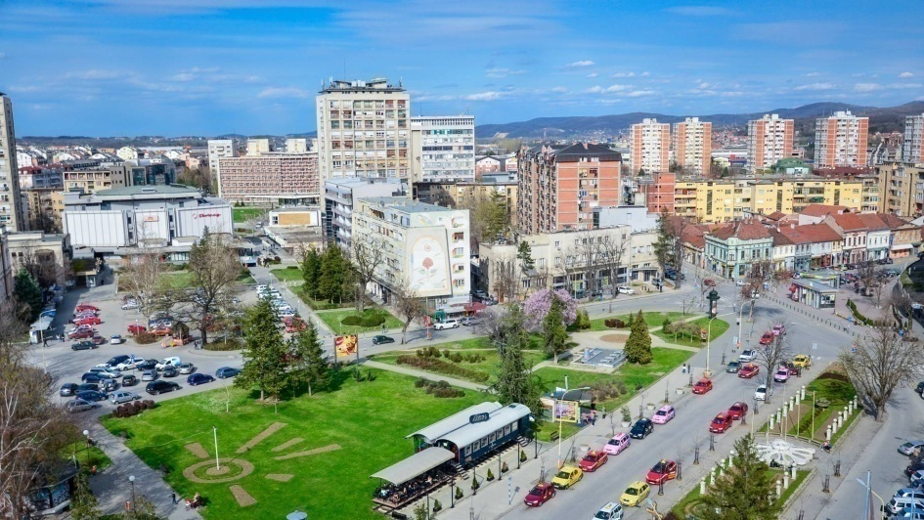
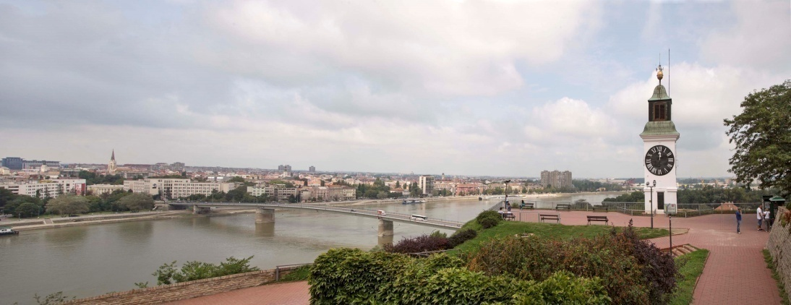
Belgrade
Niš
The largest cities in Serbia
Kragujevac
Novi Sad

Slide 5
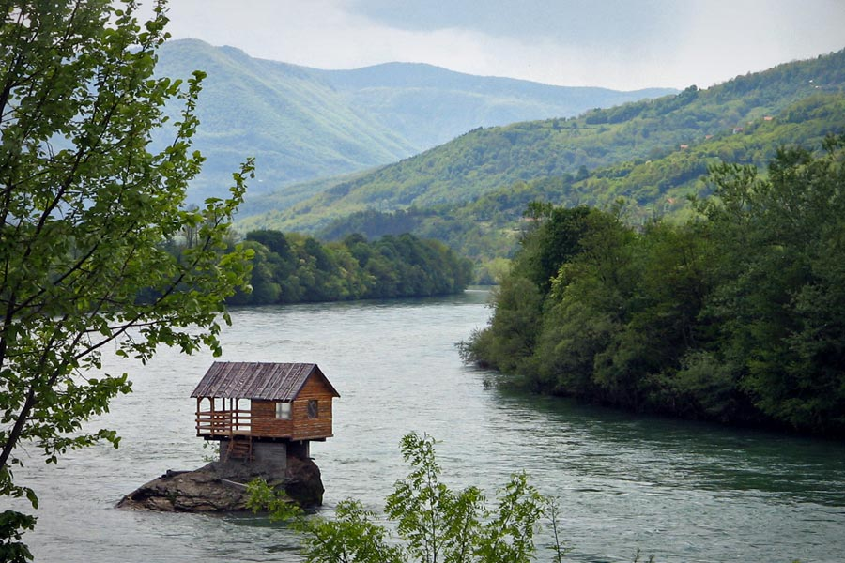
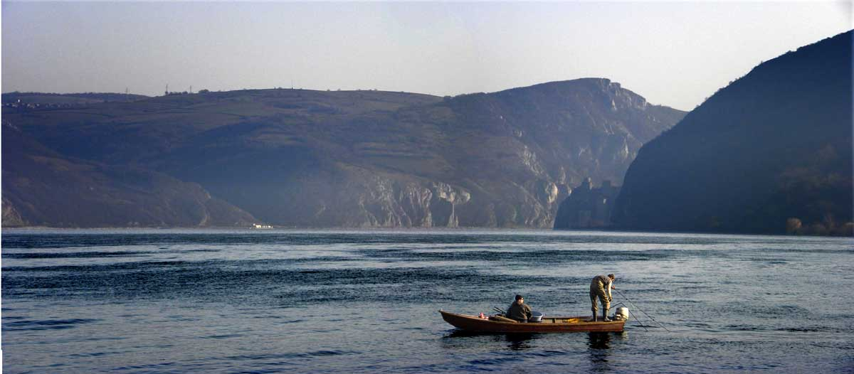
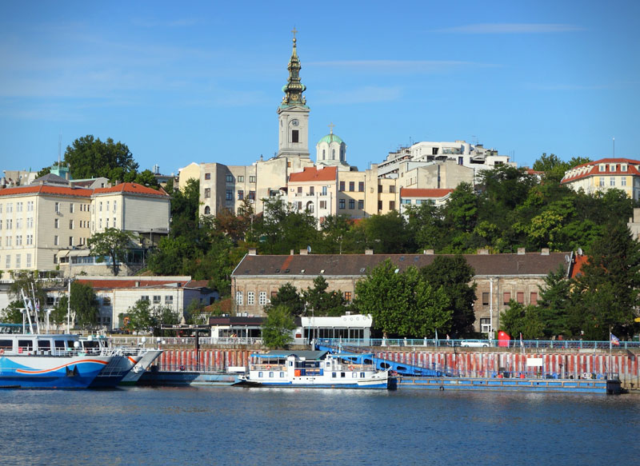
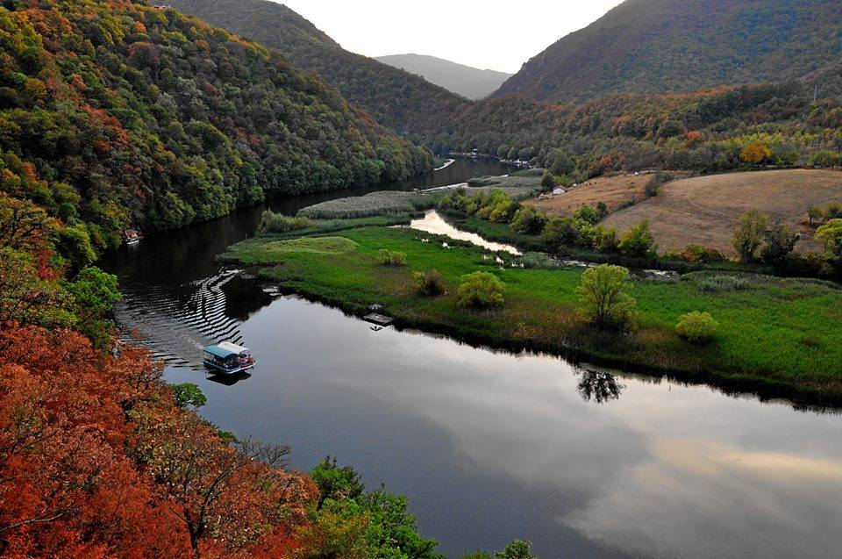
The Drina
the Danube
Rivers
The Sava
The Morava

Slide 6
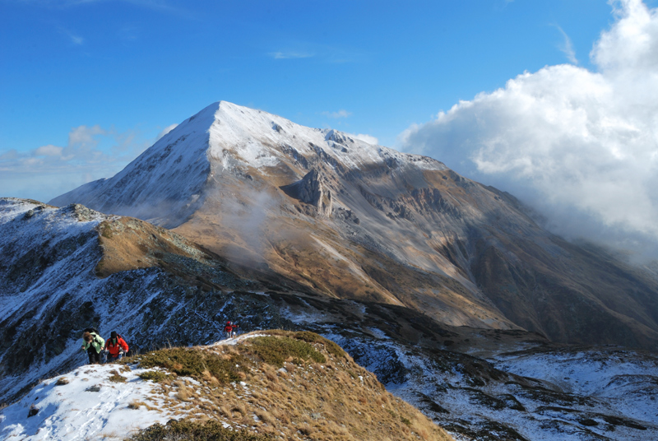
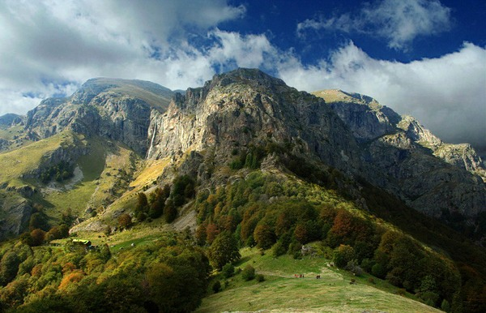
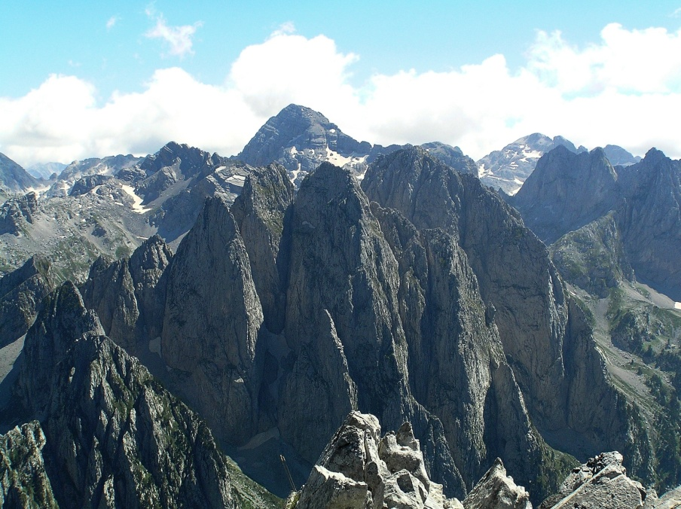
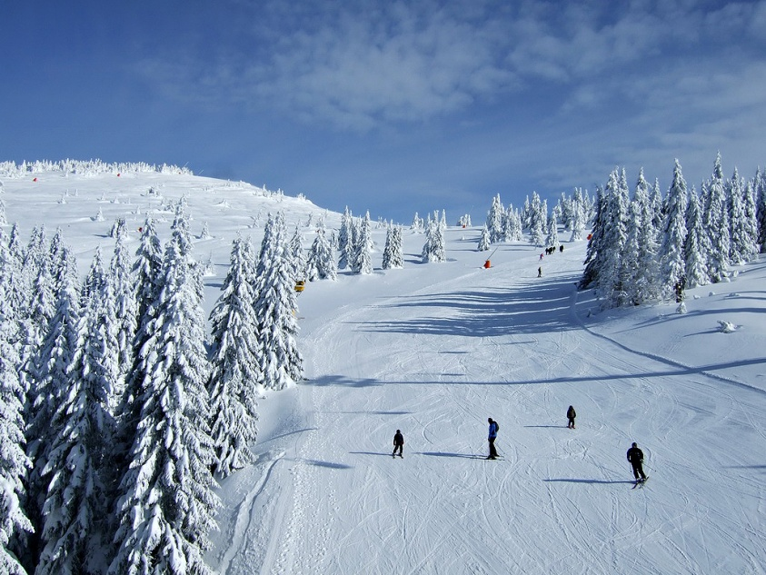
Stara (Old)
Šara
Mountains
Kopaonik
Prokletije

Slide 7
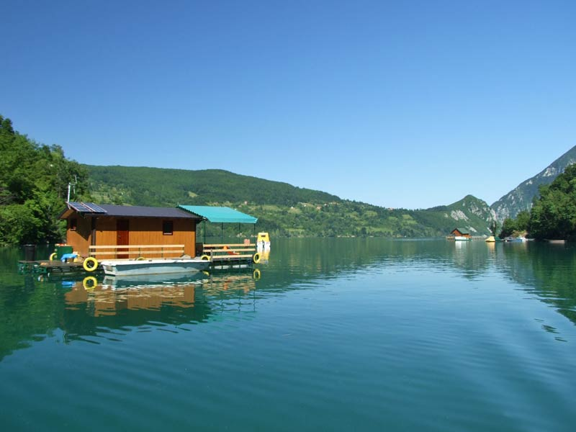
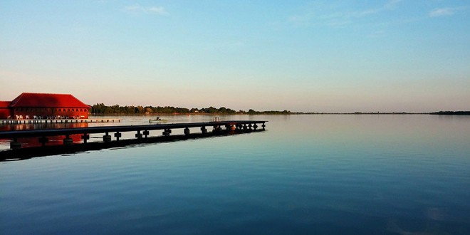
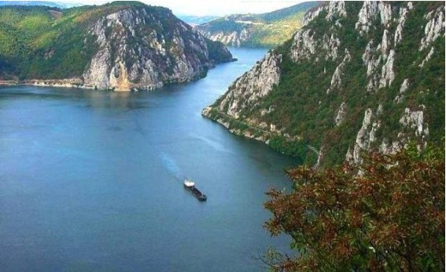
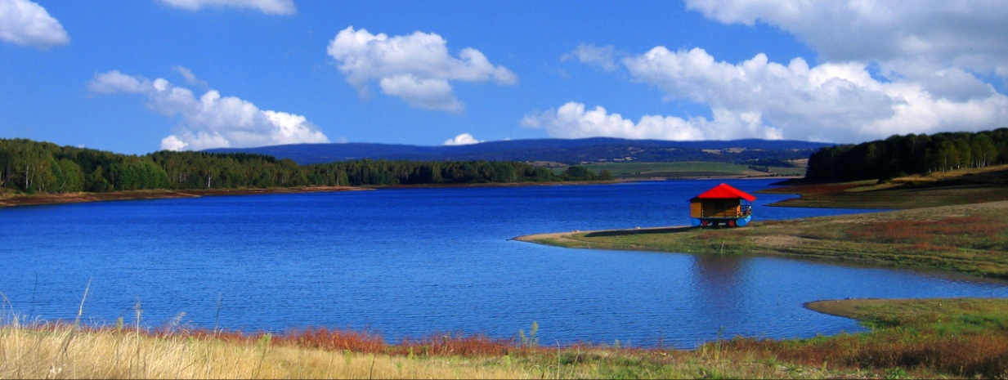
PeruĆac
Lakes
PaliĆ
DJerdap
vlasinA

Slide 8
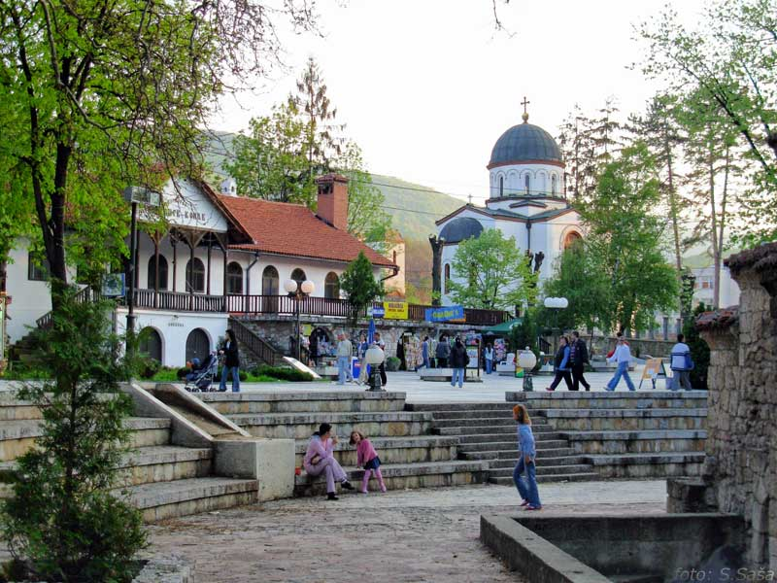
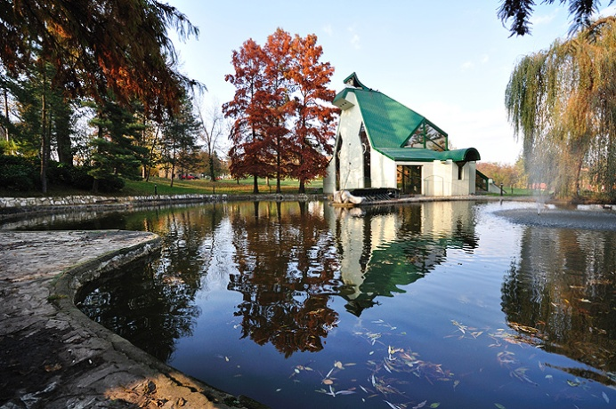
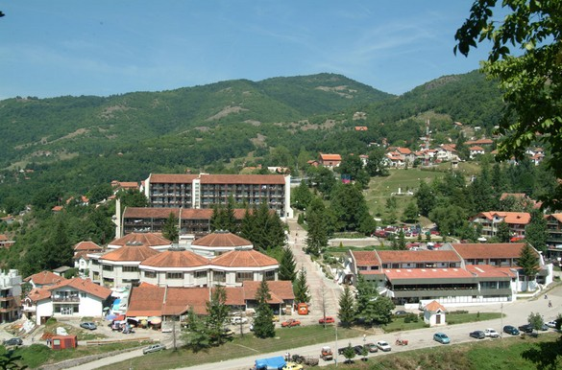
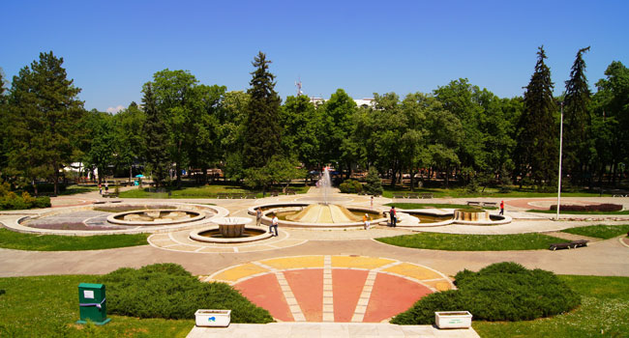
Vrnjačka
Sokobanja
Prolom
Niška
Spas

Slide 9
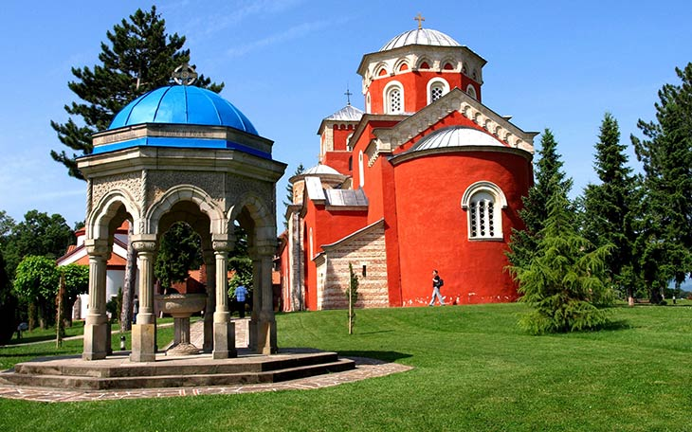
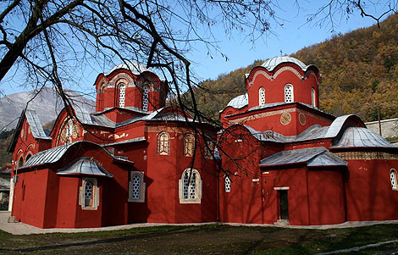
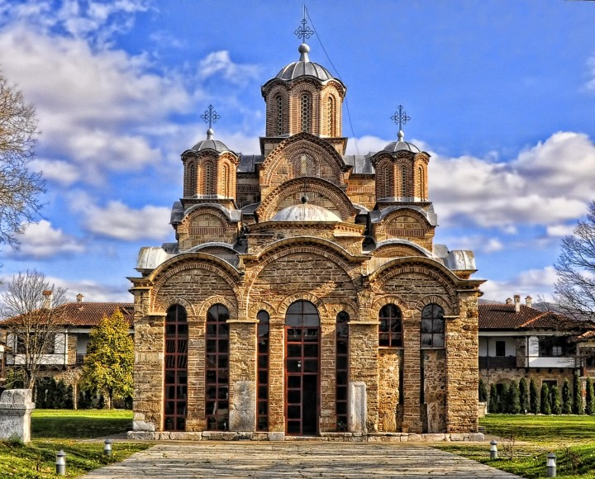
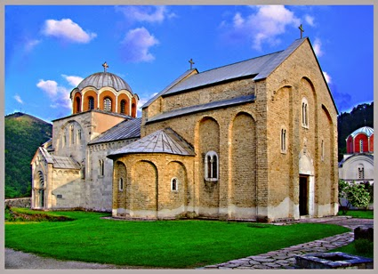
Zica
Monasteries
Pecka Patrijarsija
Decani
Gracanica

Slide 10
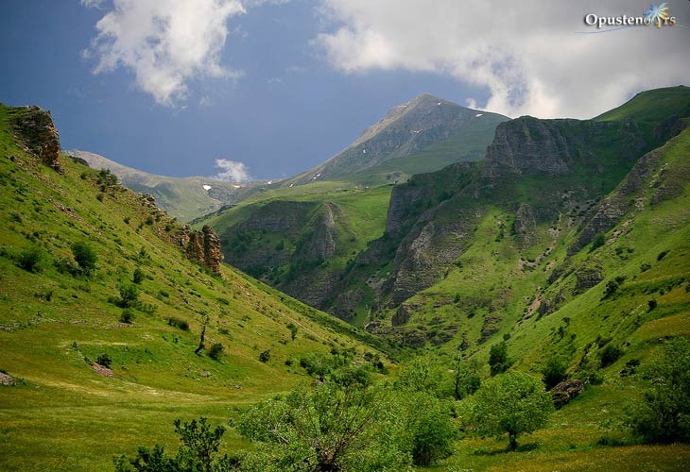
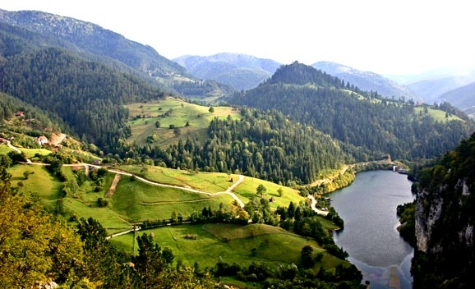
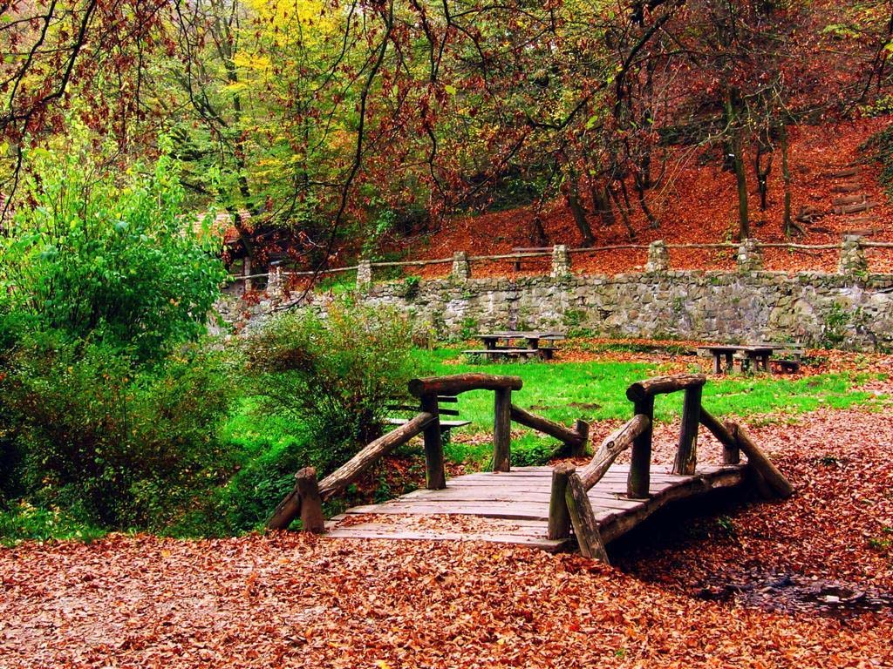
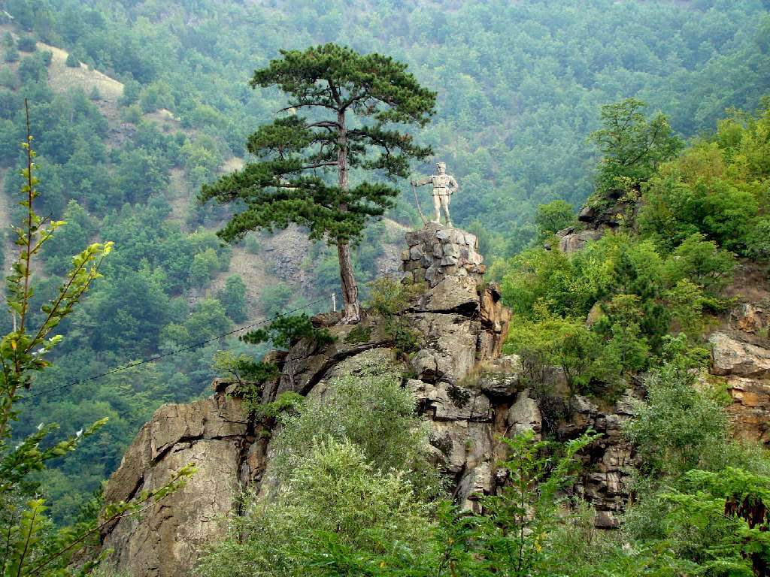
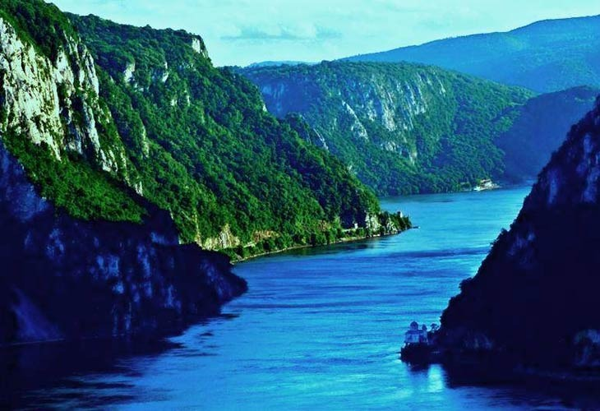
šara
National parks
Tara
Fruška gora
Kopaonik
DJerdap

Slide 11
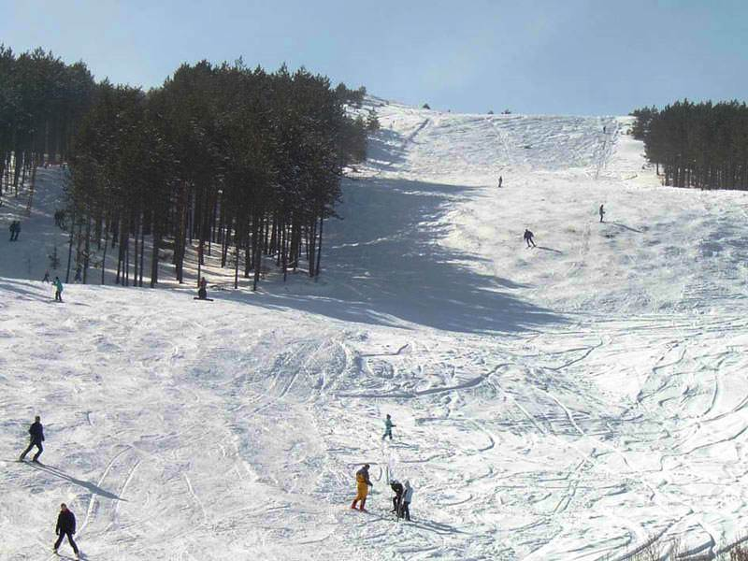
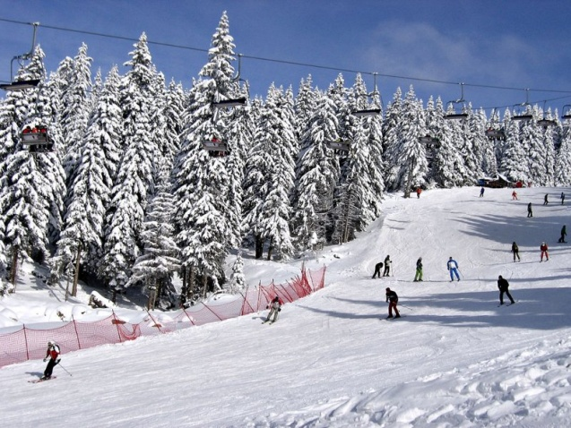
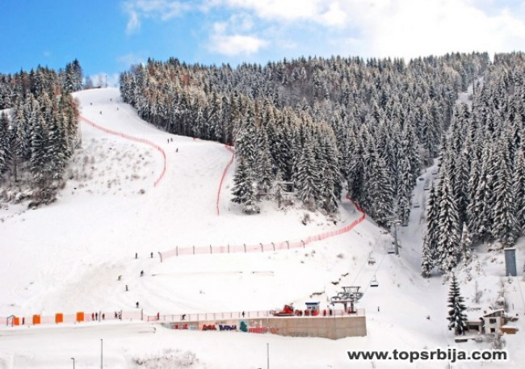
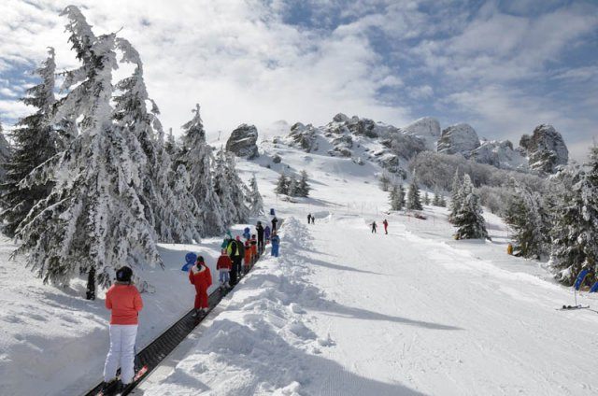
Goč
Kopaonik
Ski runs
Zlatar
Stara

Slide 12
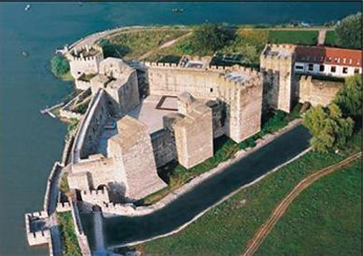
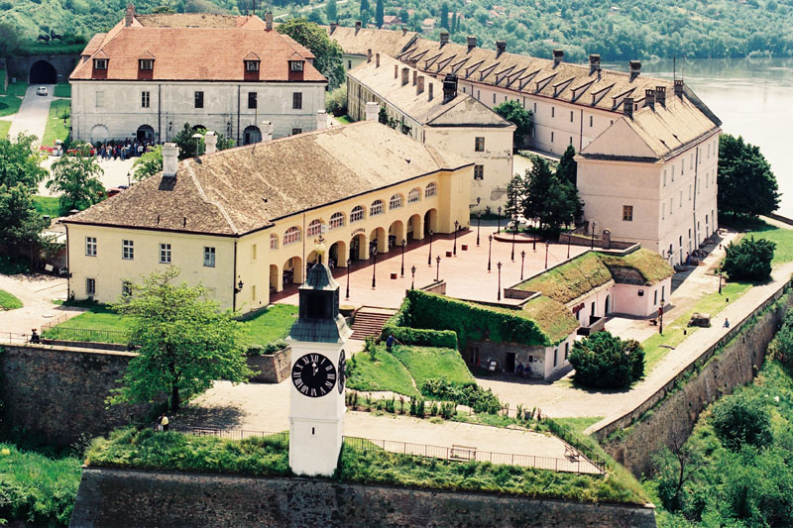
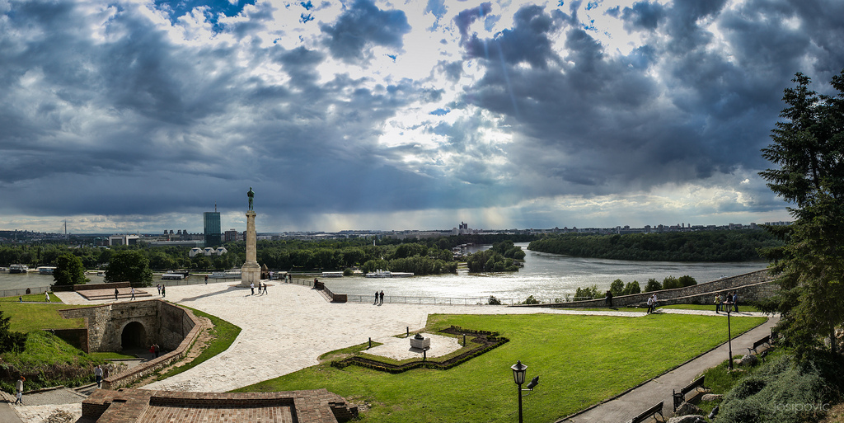
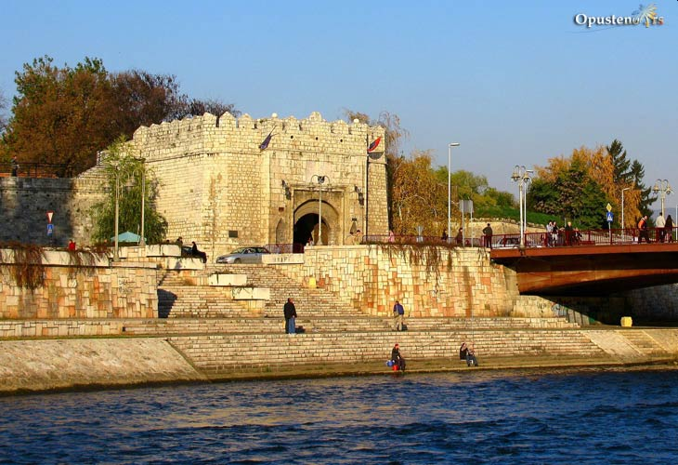
Smederevo fortress
Petrovaradin fortress
Kalemegdan
nišKa
Fortresses

Slide 13
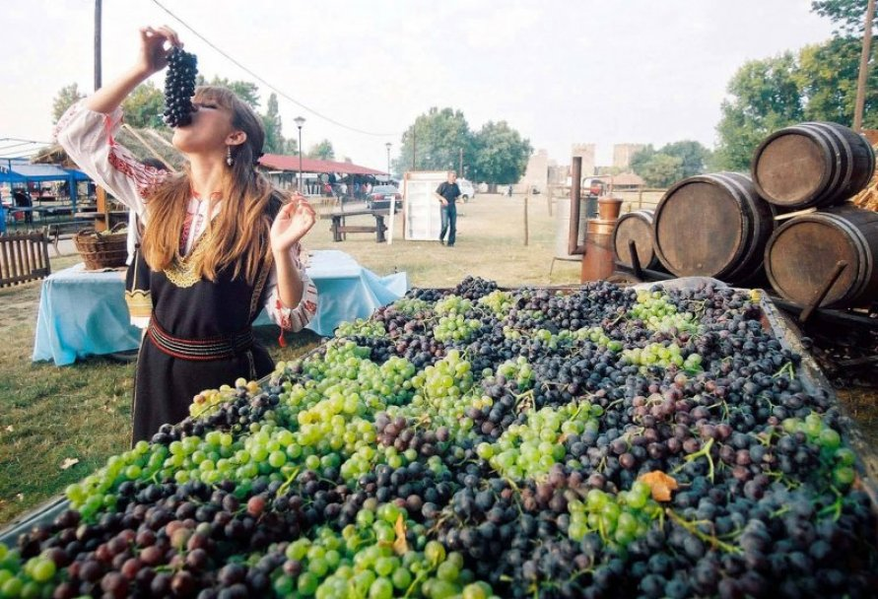
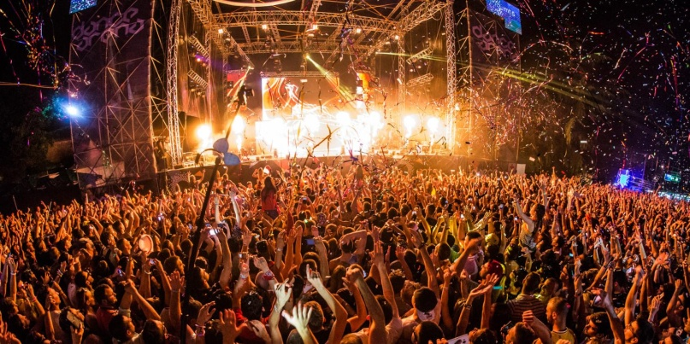
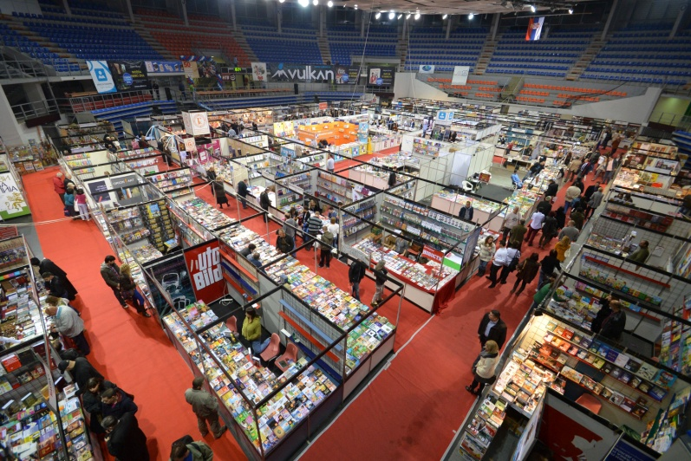
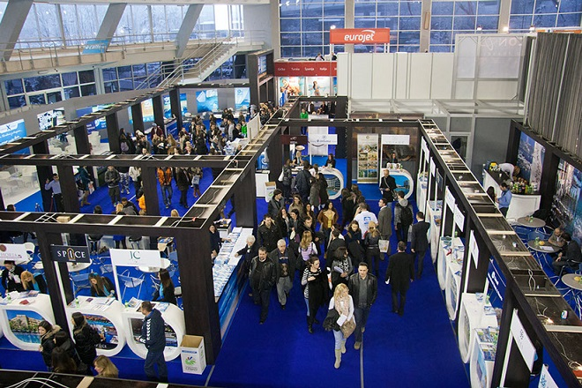
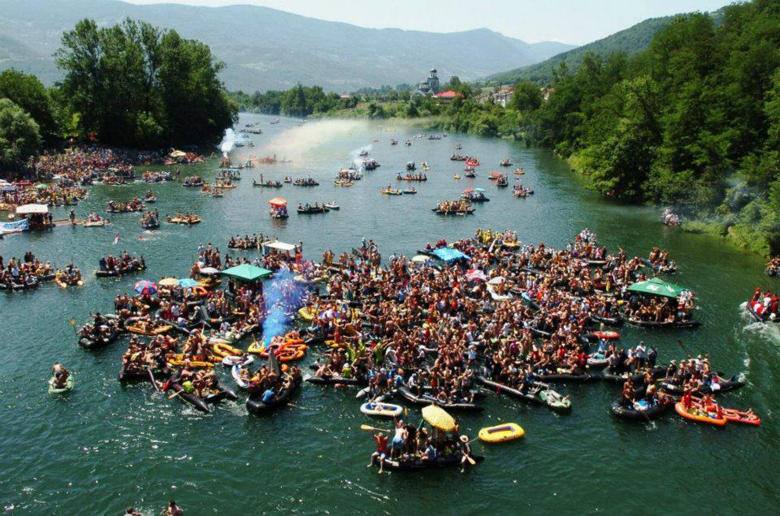
Events in serbia
Vršac grape harvest
Exit festival
Book fair
Tourism fair
Drina regatta

Slide 14
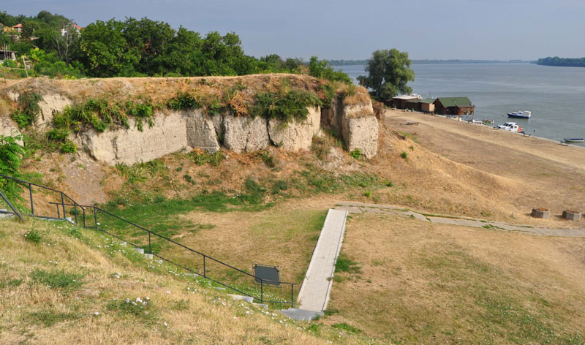
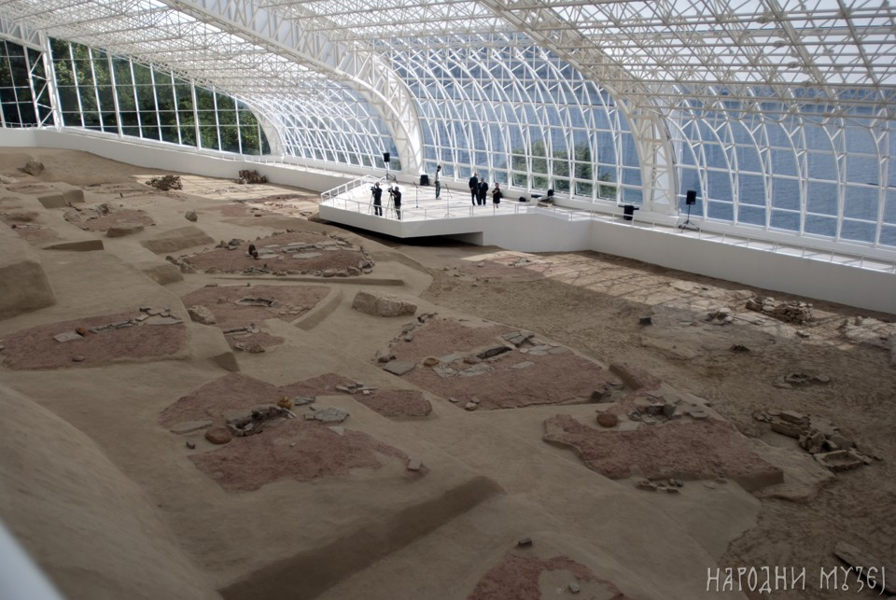
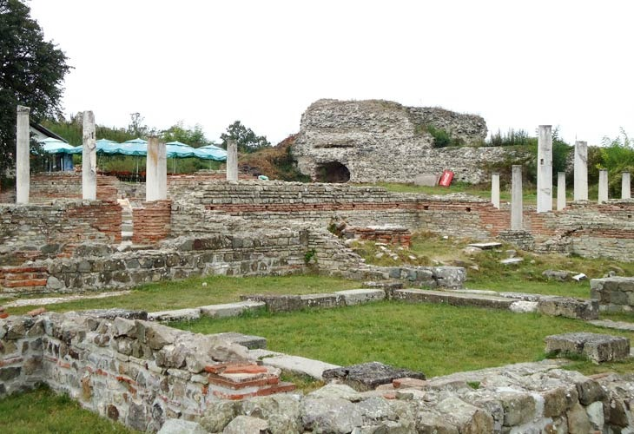
Archeological finds
Vinča
Lepenski vir
Gamzigrad
Viminacium

Slide 15
Babina reka
Koštunići
Tiganjica
Gostoljublje
Ethno villages

Slide 16
Saint Sava
Prominent Serbs
Milutin
Milankovic
Ivo Andric
Mihajlo Pupin
Nikola Tesla

Slide 17
Monuments under UNESCO patronage
Stari Ras
Studenica
Decani
Rumuliana

Slide 18
Jovana Potkonjak 6/2
Nevena Paunovic 6/2
Marta Ralević 6/2
Nikolina Kosić 6/2
PRIMARY SCHOOL ‘VASA CARAPIC’, BELGRADE, SERBIA

