Slide 1
Elderly homes in Estonia
Lyganuse Secondary School
Lyganuse Secondary School

Slide 2
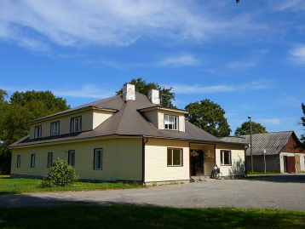
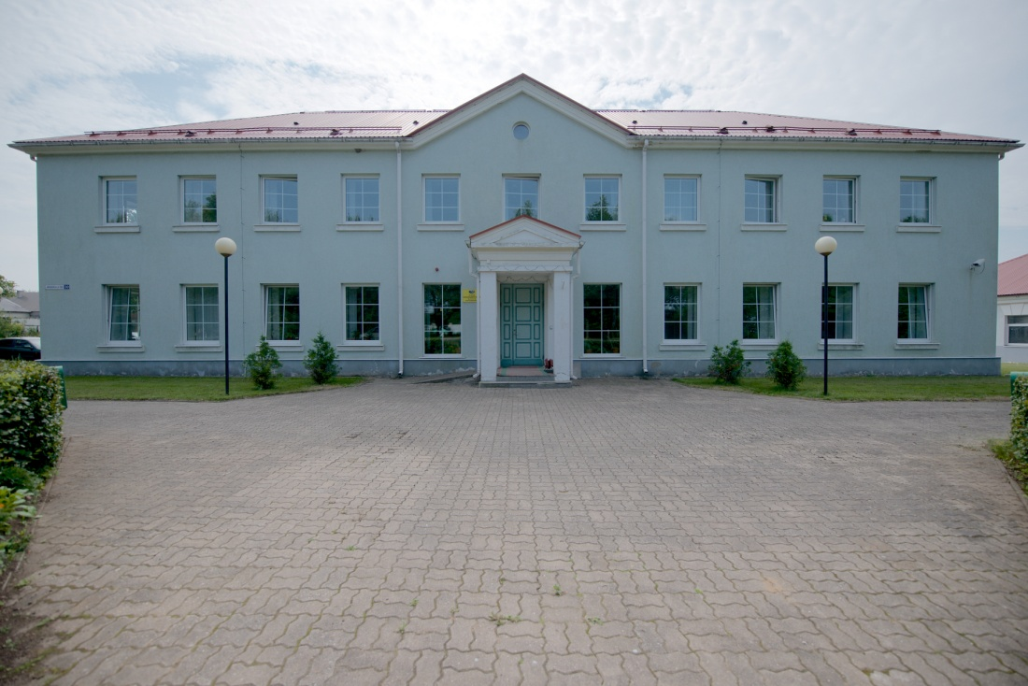
Elderly homes

Slide 3
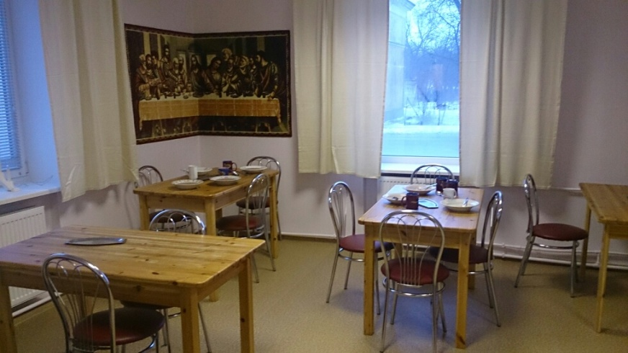
Healthy food Junk food
The elderly think healthy food is:
Fruits
Vegetables
Eating a big variety of food
Food that makes you stay healthy
Food with lots of nutrients and vitamins
Most of them have tried it
They didn’t like junk food
They don’t eat it very often due to this

Slide 4
Meals
3-4 meals a day
All of them eat breakfast
Breakfast food is porridge
Lunch: Soup, meat with potatoes
Dinner: Soup, meat with potatoes, salad
They believe their food is healthy

Slide 5
Sweets
They like sweets
They don’t eat them often
If they do, they eat:
Candies
Biscuits
Confectioneries

Slide 6
Fruits, vegetables
The elderly like them
They eat them:
When they get
Every other day
Every day
They think they are healthy

Slide 7
Health problems
All of the elderly have some kind of health problems
Some of them were: bad eyesight, lack of mobility in limbs
All of them have had /have illnesses
For example:pneumonia, chicken pox and smallpox
Most of the elderly don’t have any allergies
Most of them only visit the doctor when they need to
All of them go visit the doctor when they have health problems
None of them have ever been on a diet

Slide 8
Physical activity
Due to health problems, most of the elderly don’t have an active lifestyle
They would change their lifestyle if they were healthier
Most of them think their weight is normal
None of them do sports anymore
They used to do sports such as ball games, boxing, wrestling and skiing
One of them had a personal trainer
The elderly exercise every day or every other day

Slide 9
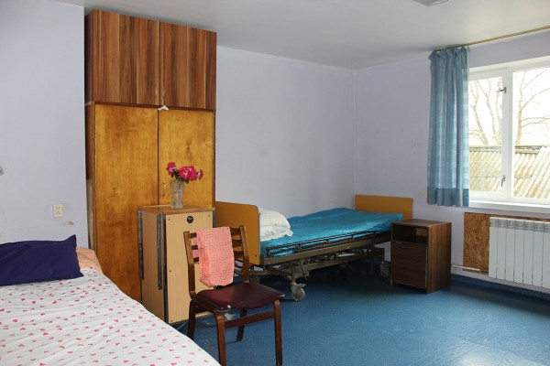
Sleep
Our elderly sleep 8-9 hours
They usually sleep well
They sleep enough to rest

Slide 10
Smoking
Some of the elderly have addiction
A few used to smoke, 2 still do
They started when they were younger
They smoke due to habits
They smoke a whole packet of cigarettes
Smoking has affected their health

Slide 11
Drinking and drugs
Most of them have tried alcohol
None of them drink alcohol now
One elderly person has tried drugs
They don’t do drugs now

Slide 12
Thank you for listening

