Slide 1
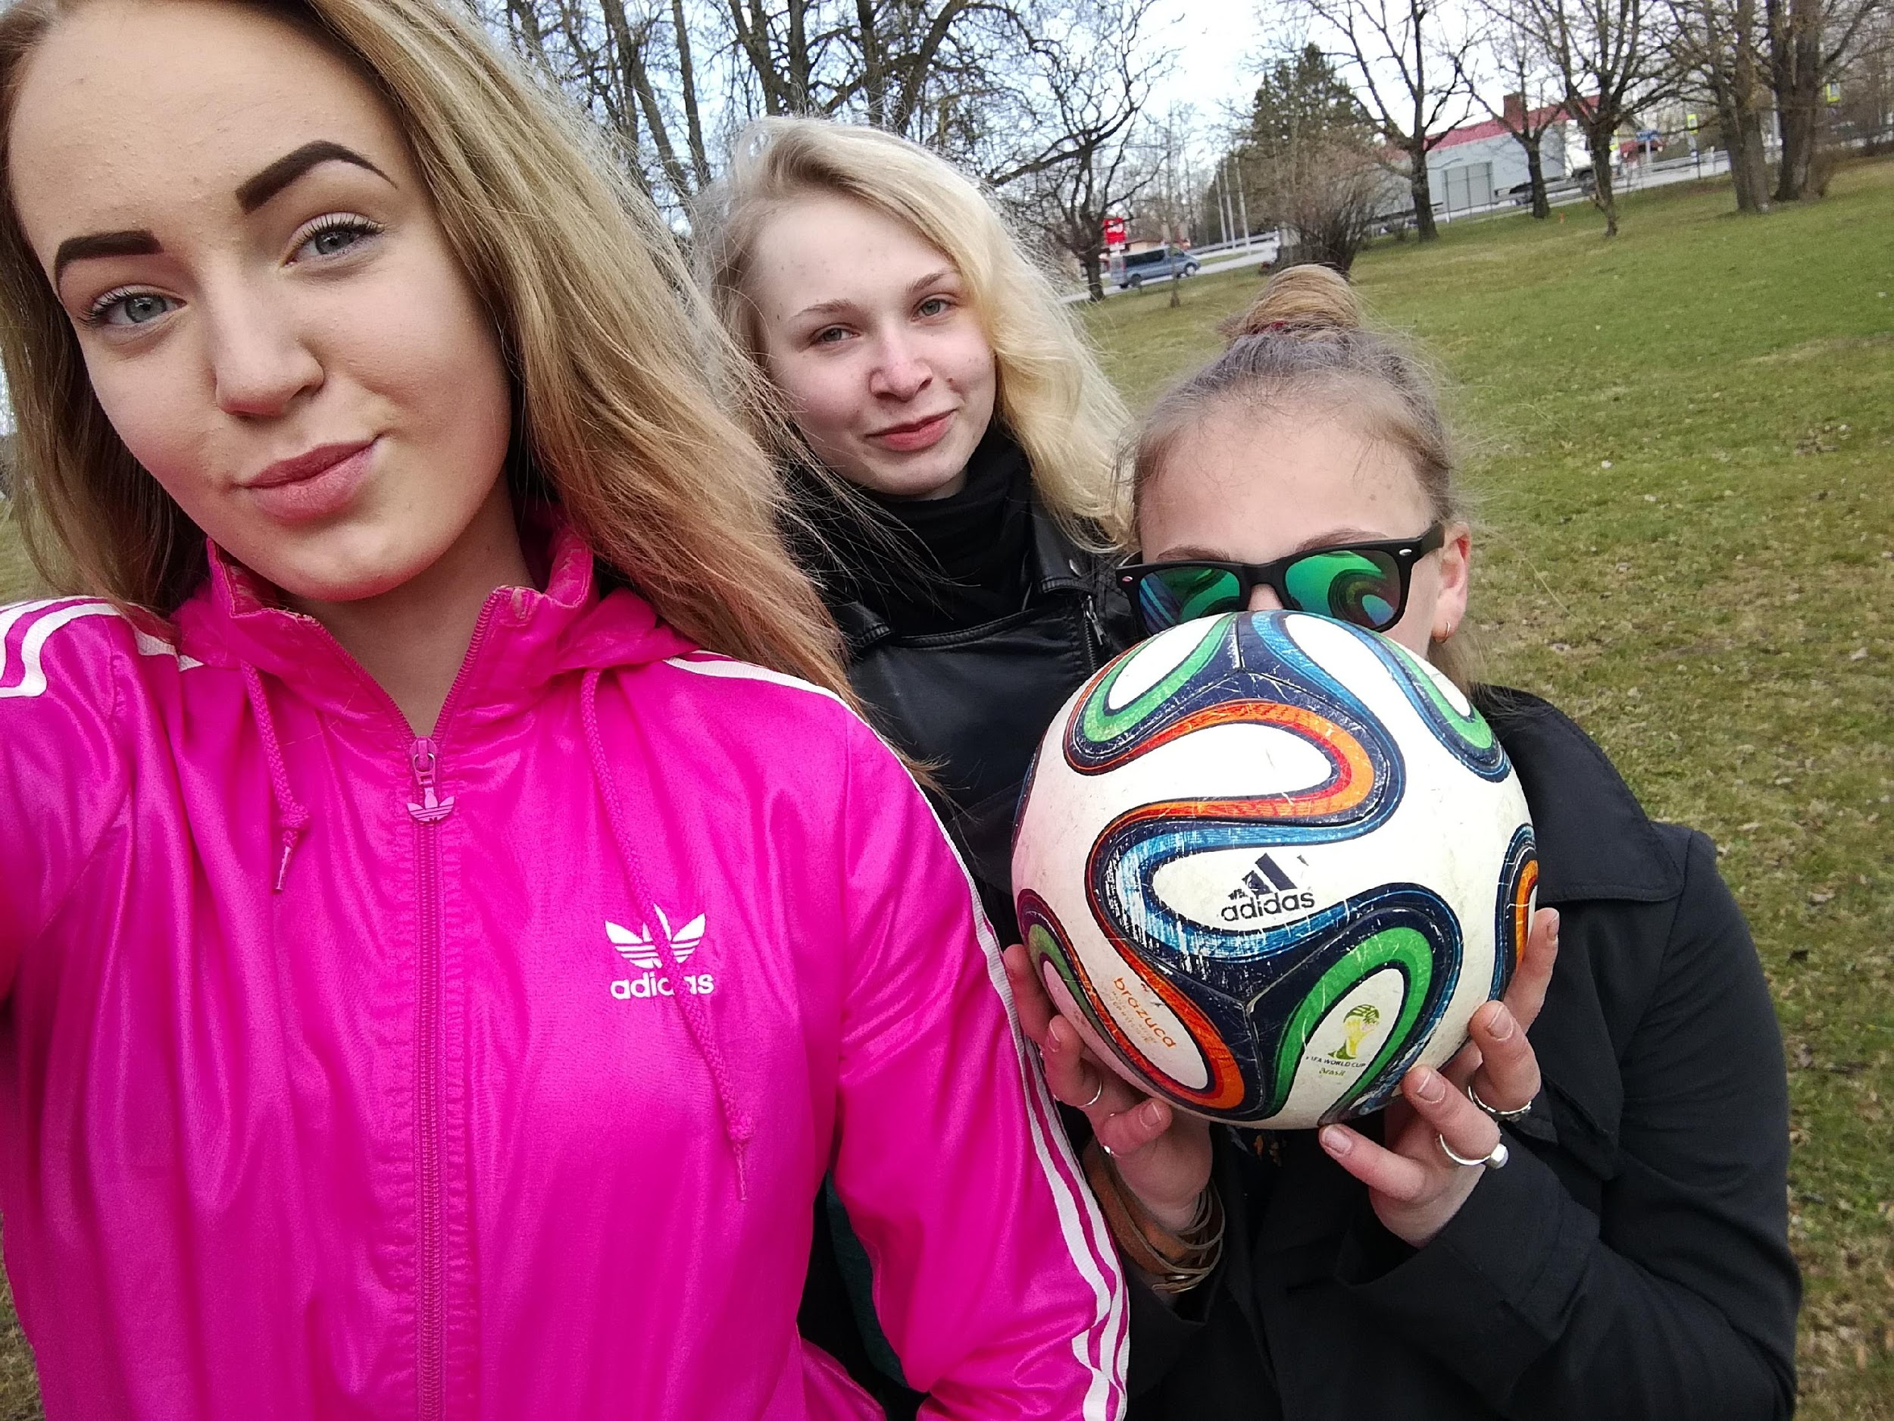
Our indoor and outdoor activities

Slide 2
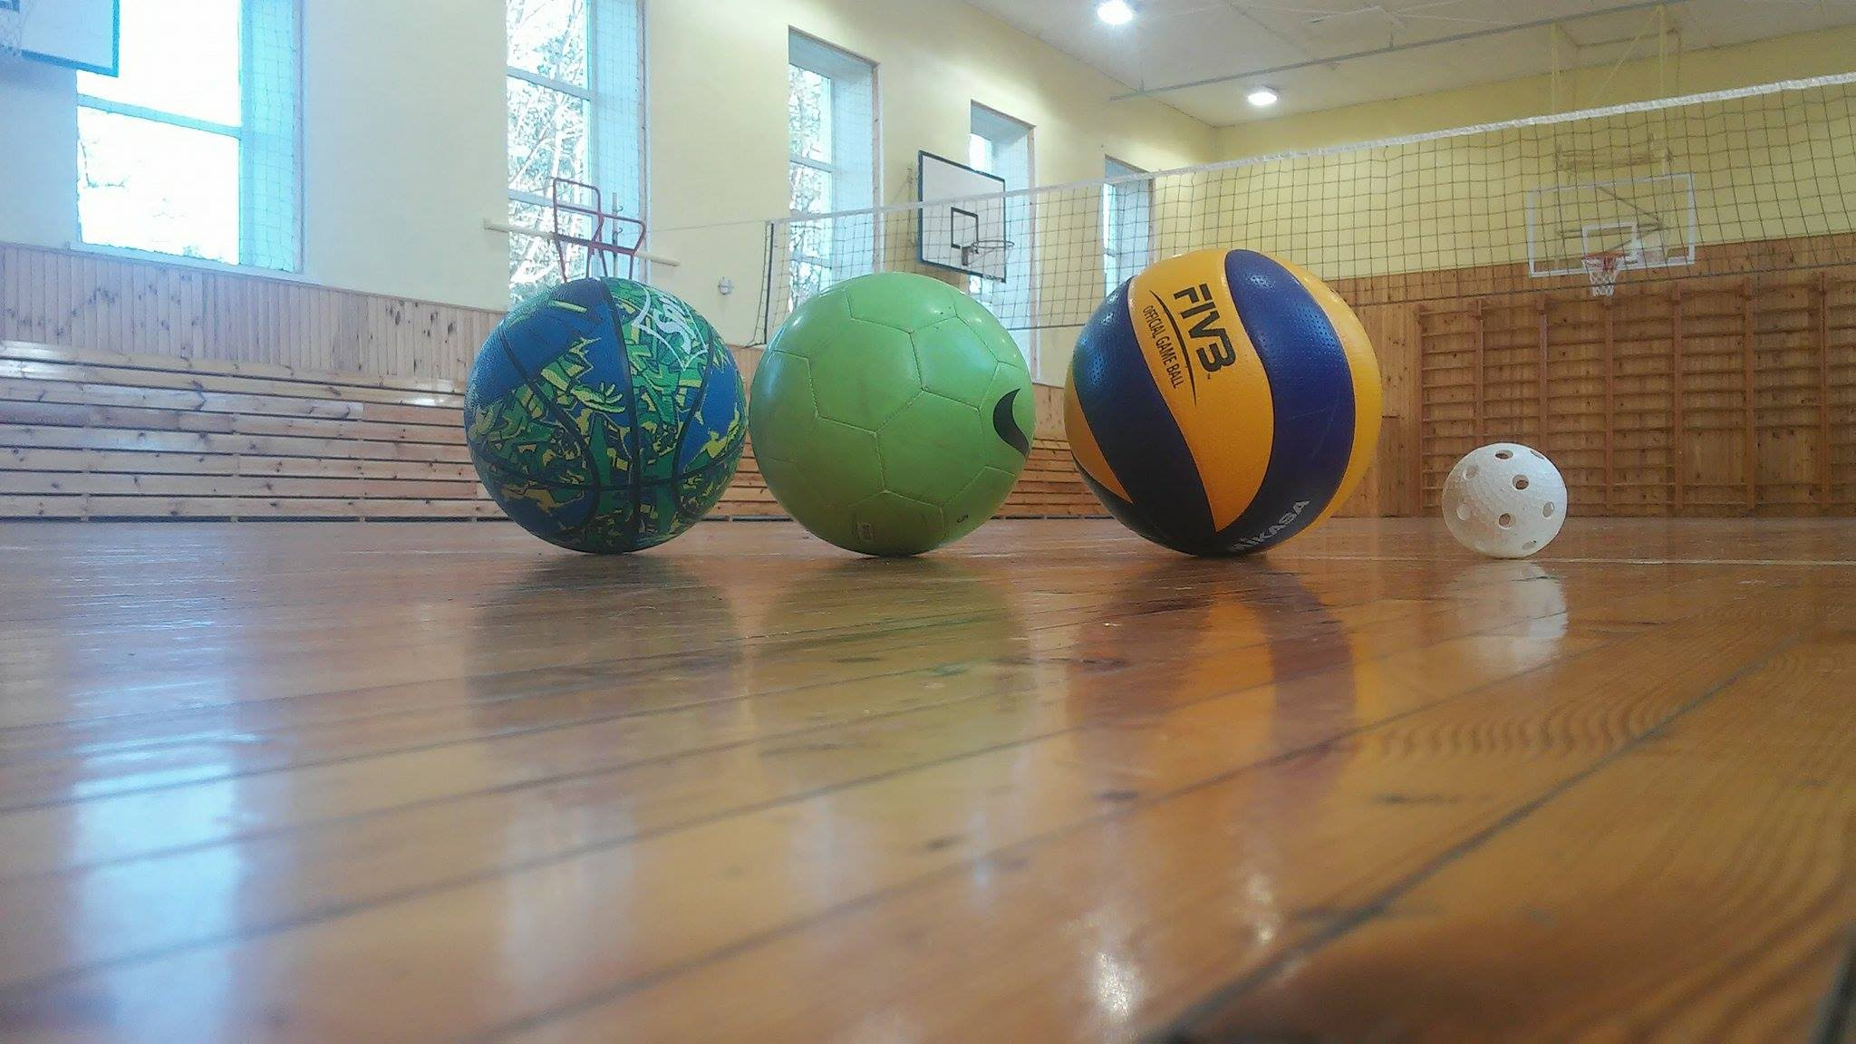
We like sport
Volleyball
Basketball
Floorball
Running or jogging
Long jump
Football

Slide 3
What we don´t like to do
Elisbeth doesn´t like to eat peas and do long distance running
Liisa doesn´t like swimming because she can´t swim
Susanna hates doing nothing
Indrek-Ivari...

Slide 4
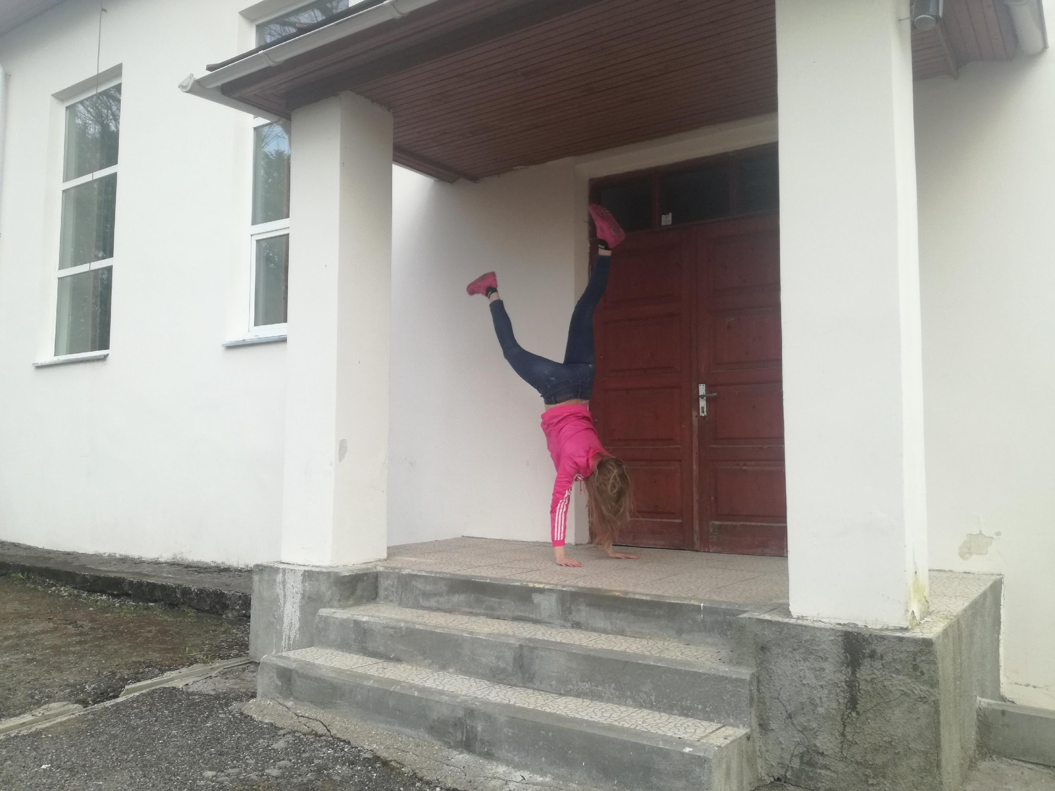
Individual activities
Dancing
Taekwondo
Motocross
Rowing
Sailing
Athletics
Darts

Slide 5
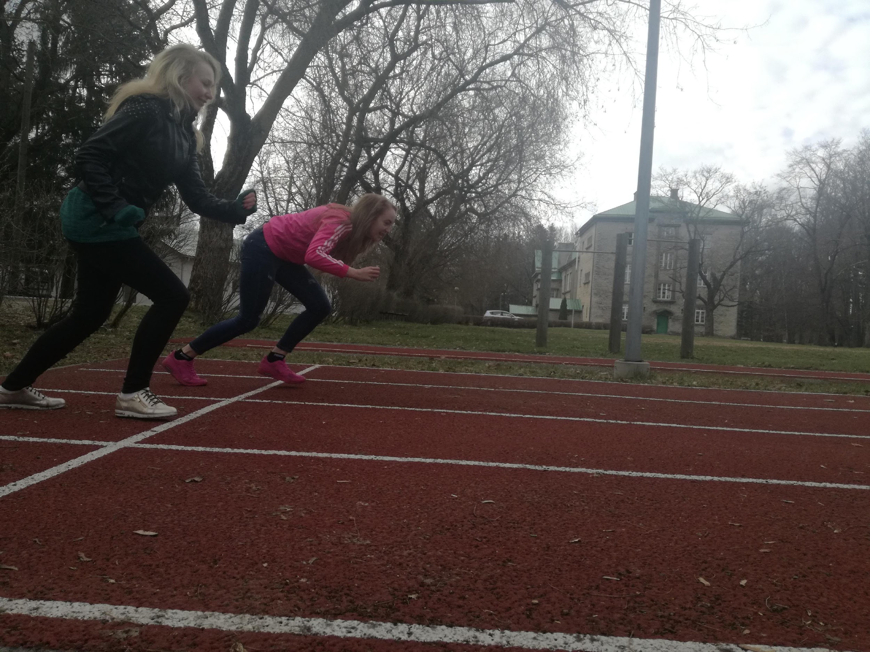
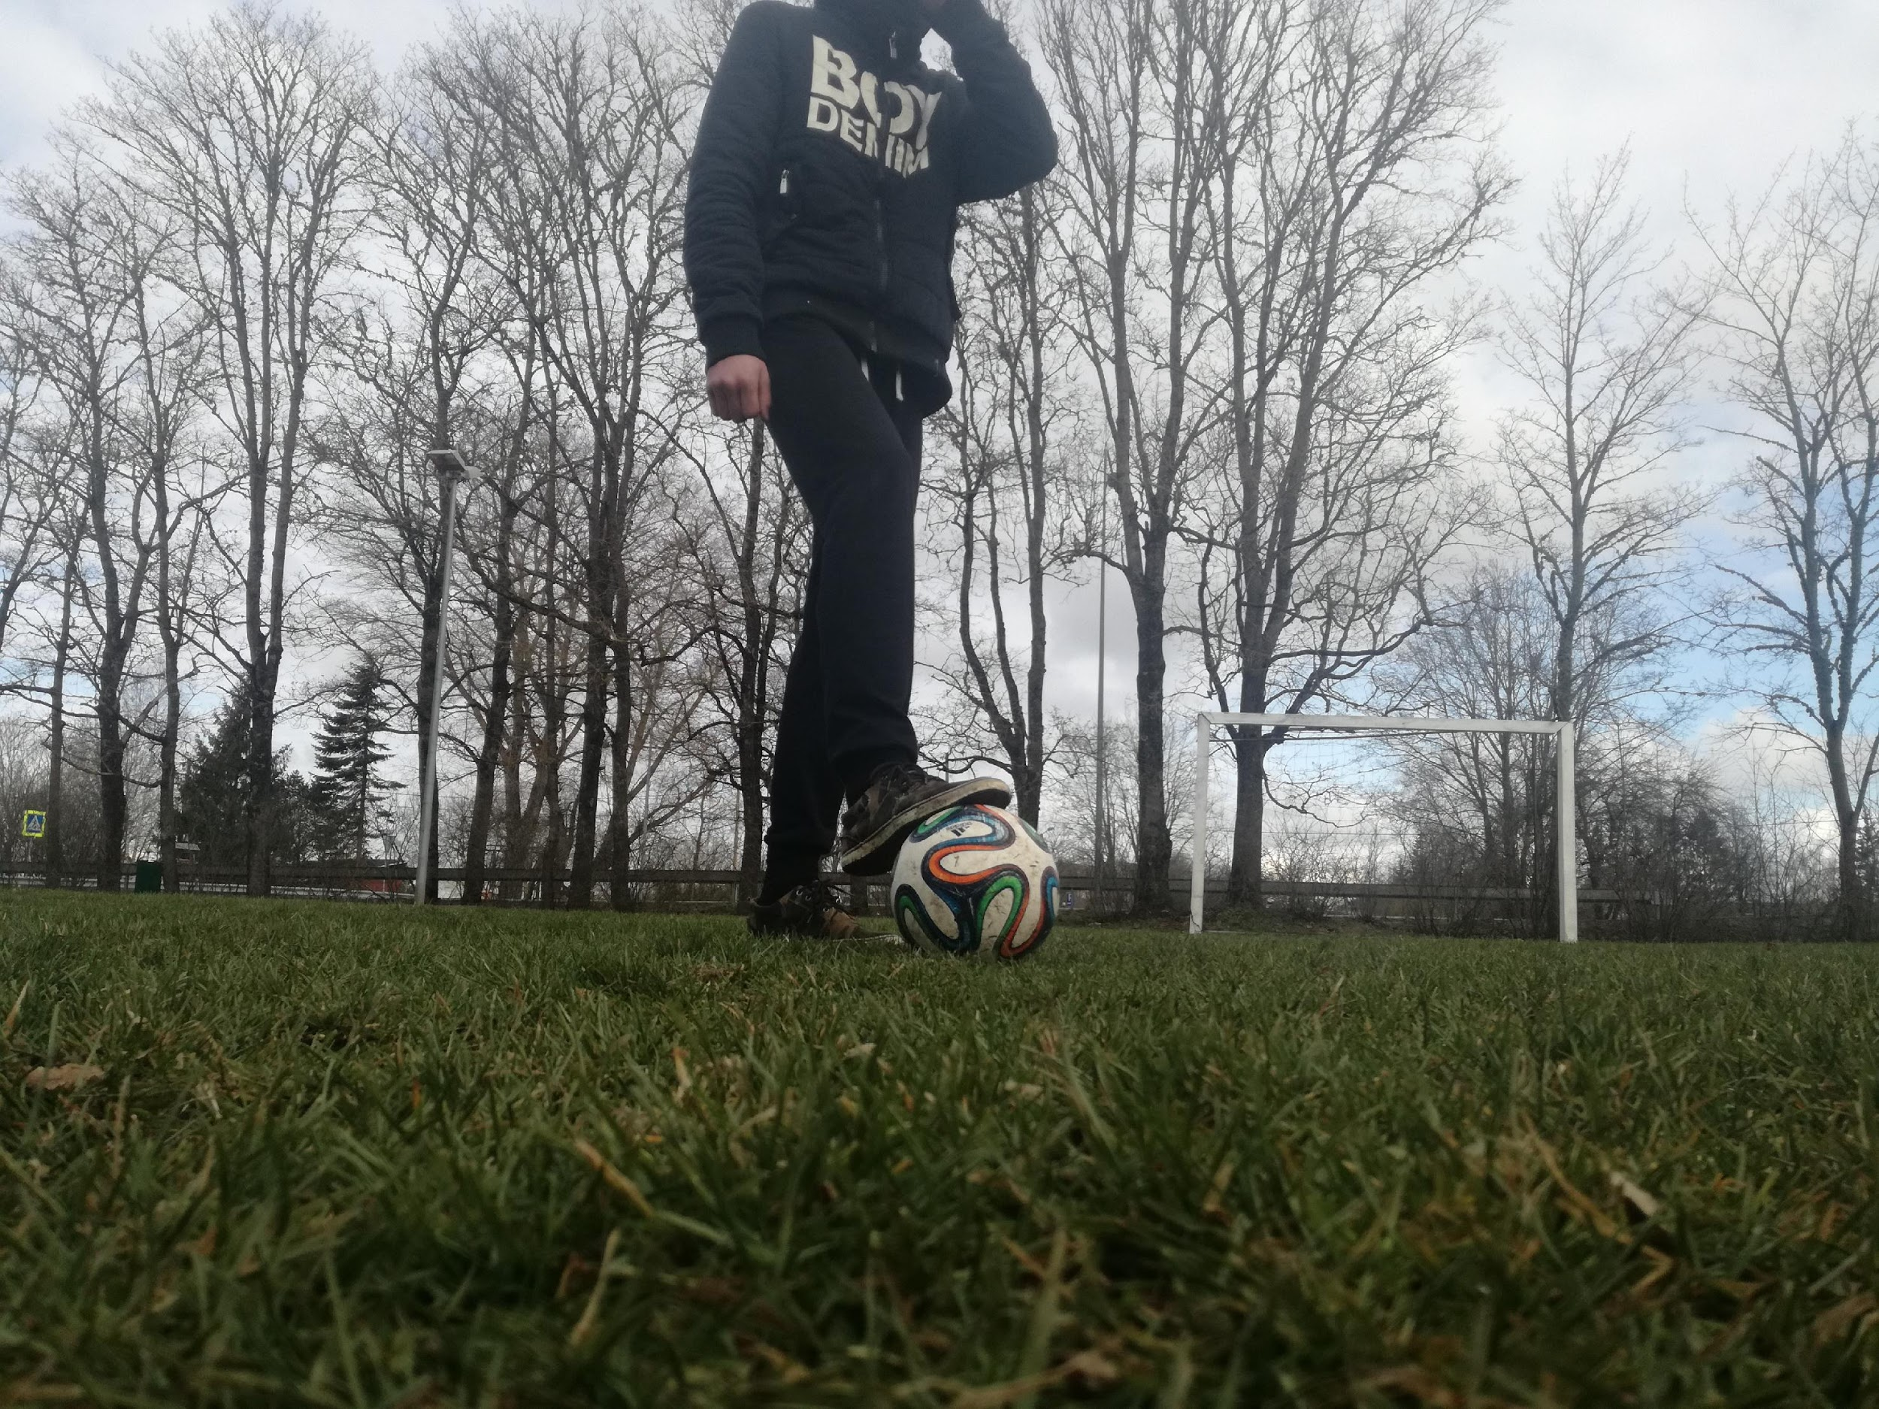
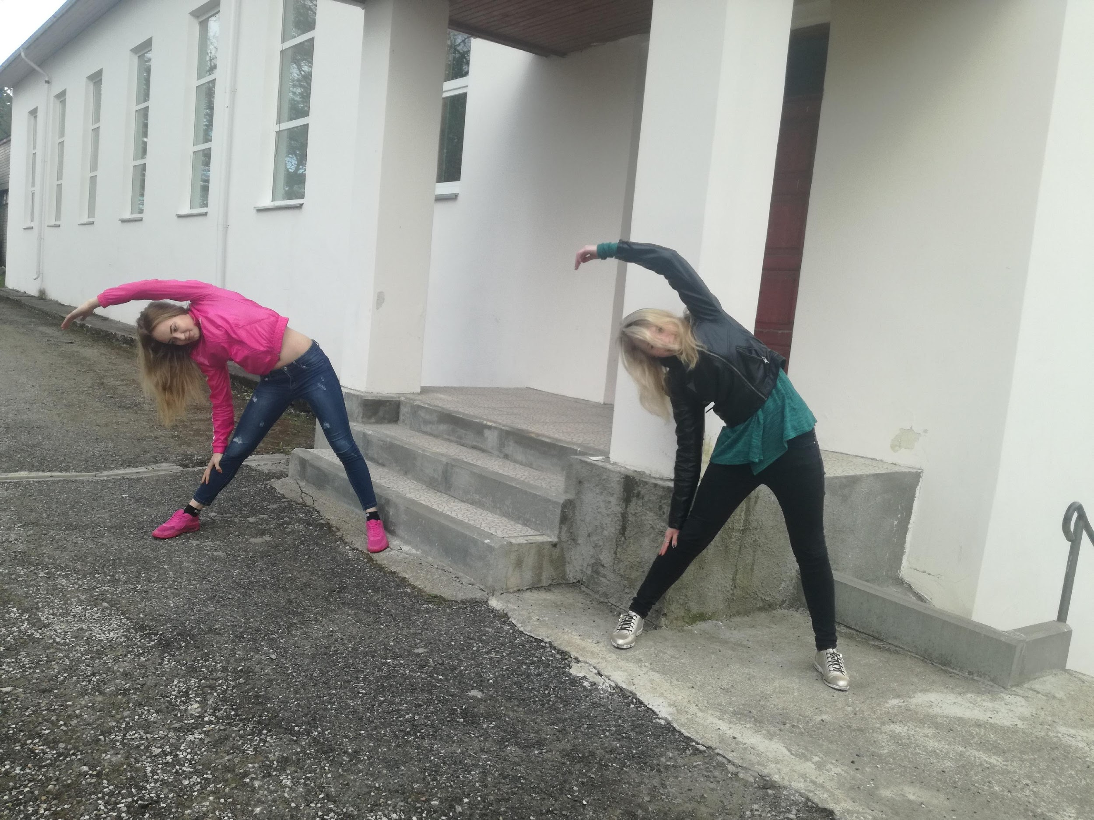
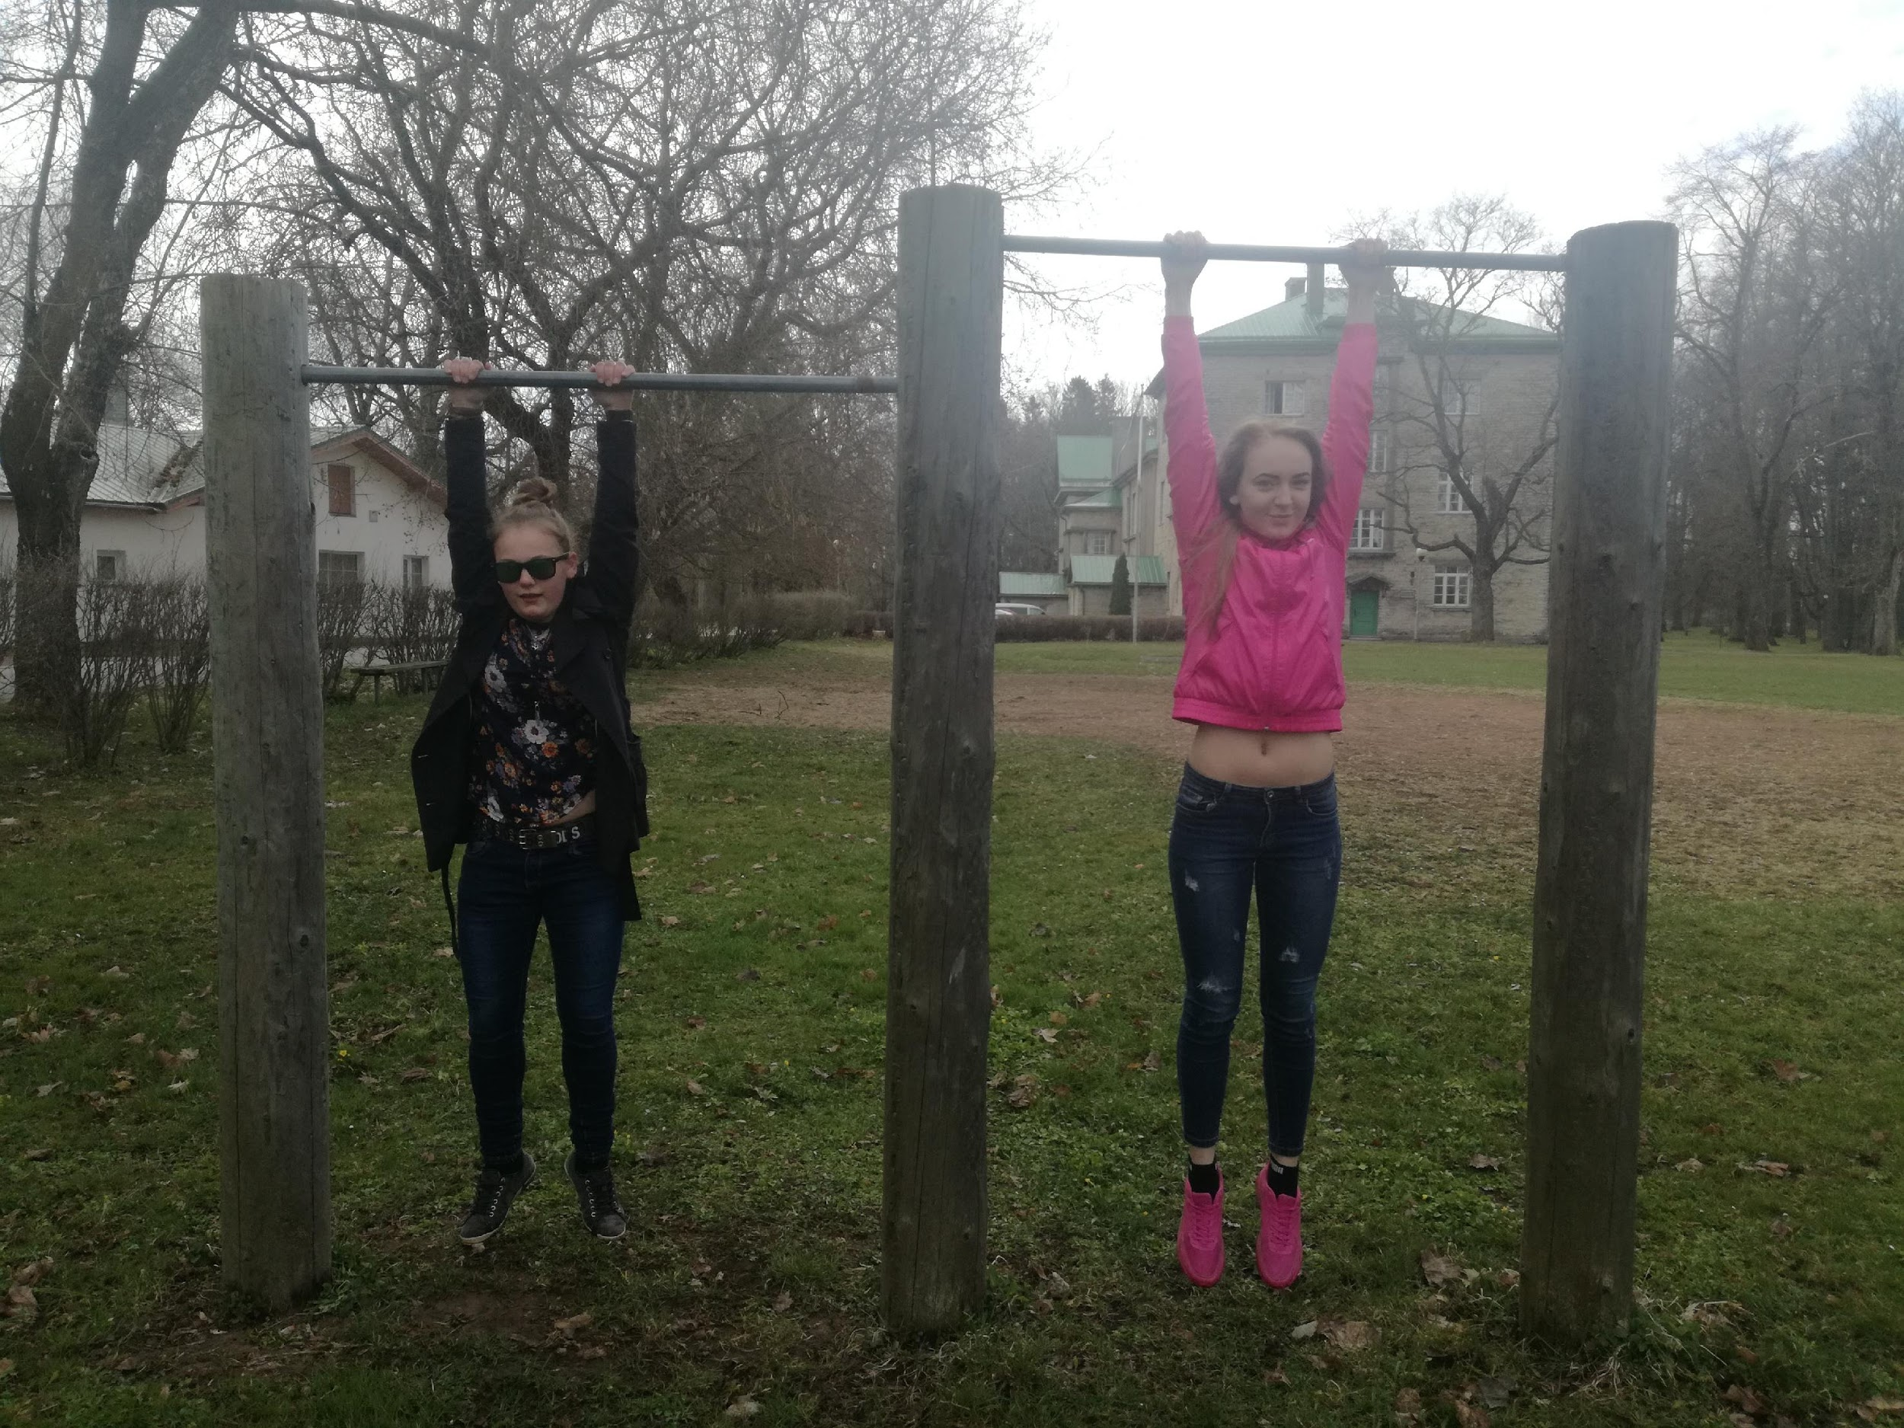
Outdoors...

Slide 6
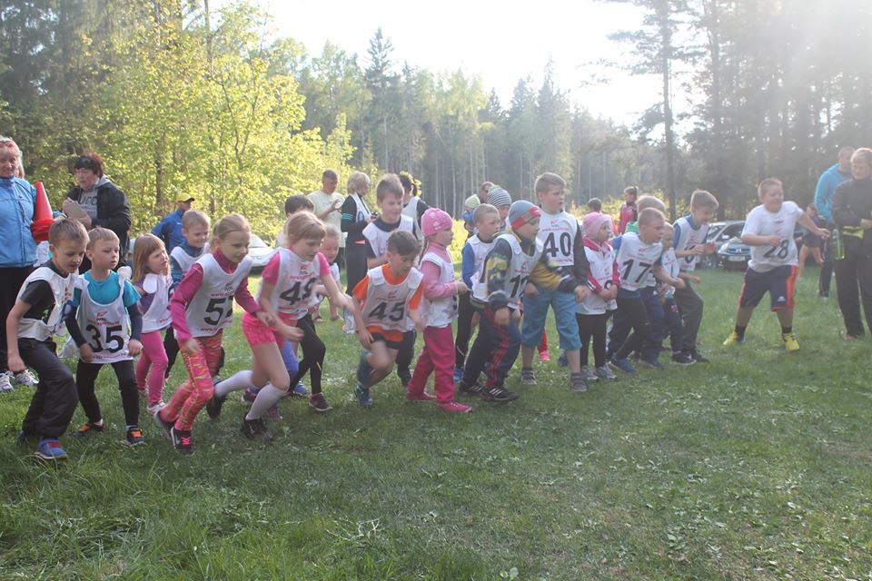
Collaboration with a local sports club
Every year Lüganuse Kultuurikeskus organizes a series of running competitions where our students and community participate

Slide 7
Thank you and keep moving!

