Slide 1
ERASMUS + School canteen survey
Danute, Linda

Slide 2
3 popular foods
We asked questions to 68 students to know what kind of food they would like to eat at school.
Pancakes
Fruit salad
Soup

Slide 3
Soup day
In Auce Secondary school there are 491 student

Slide 4
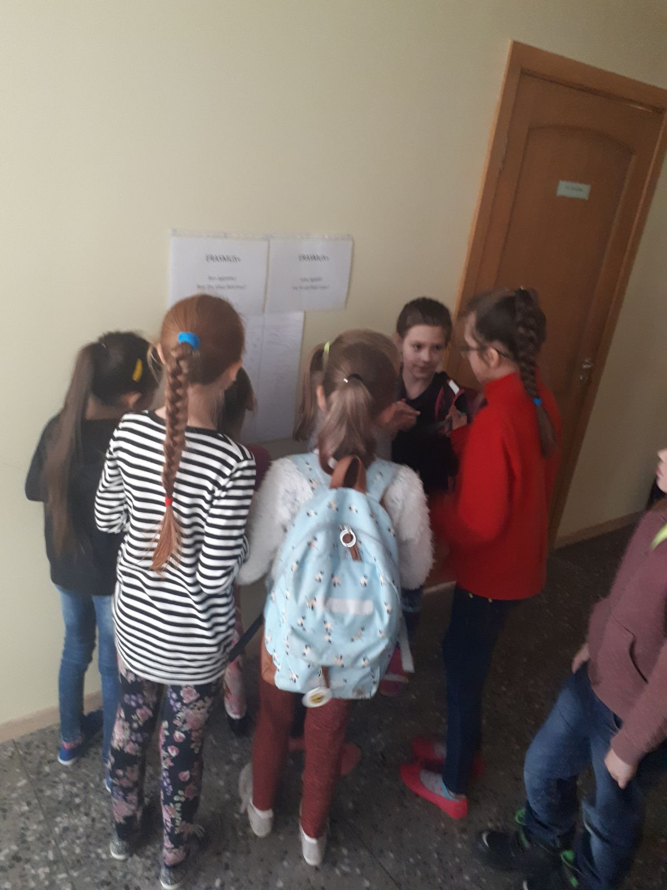

Slide 5
Did you like the soup?

Slide 6
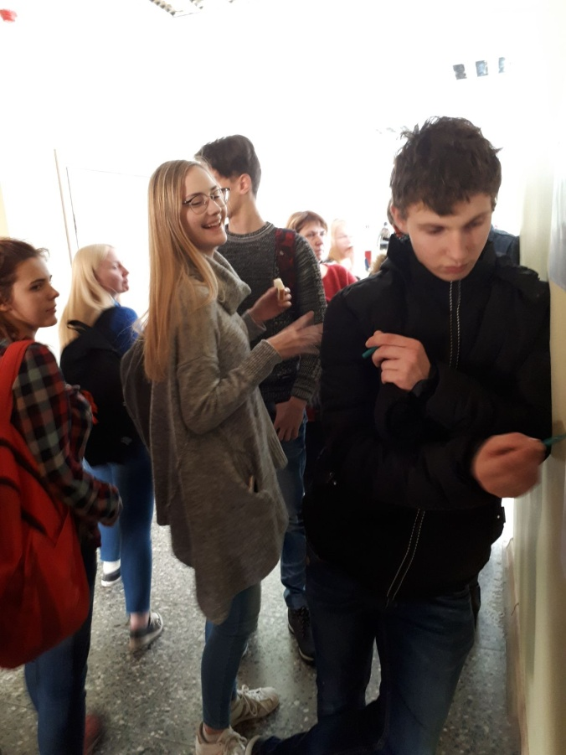
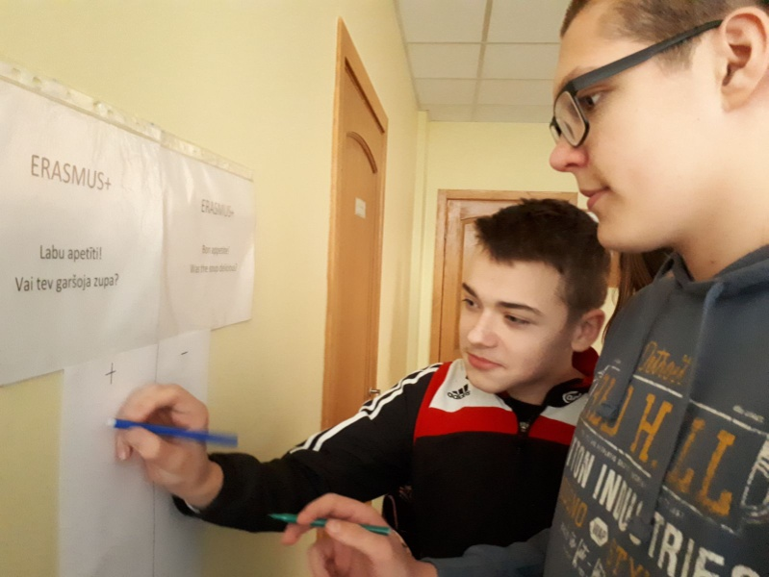

Slide 7
Would you like to eat the same soup again?

Slide 8
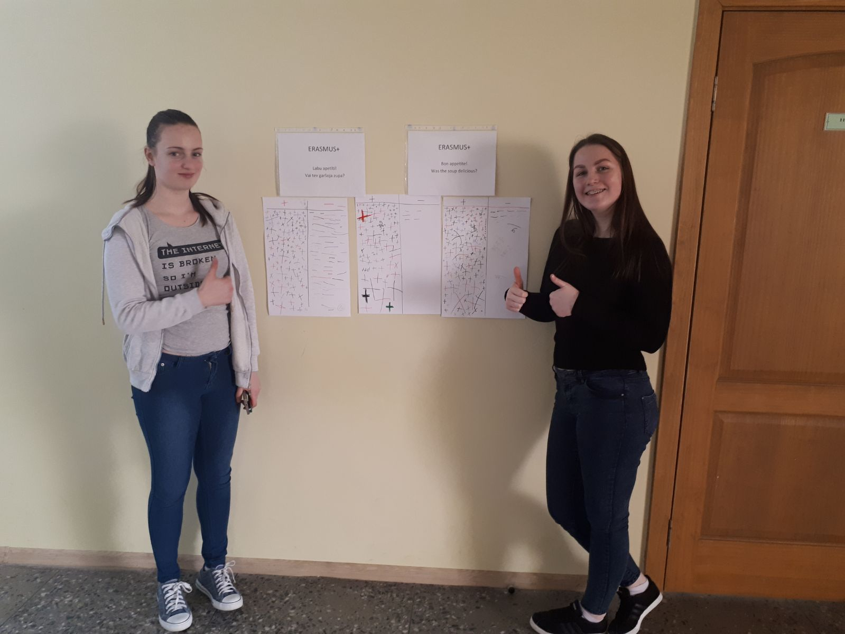

Slide 9
This soup was:

Slide 10
How many times a week do you eat soup ?

Slide 11
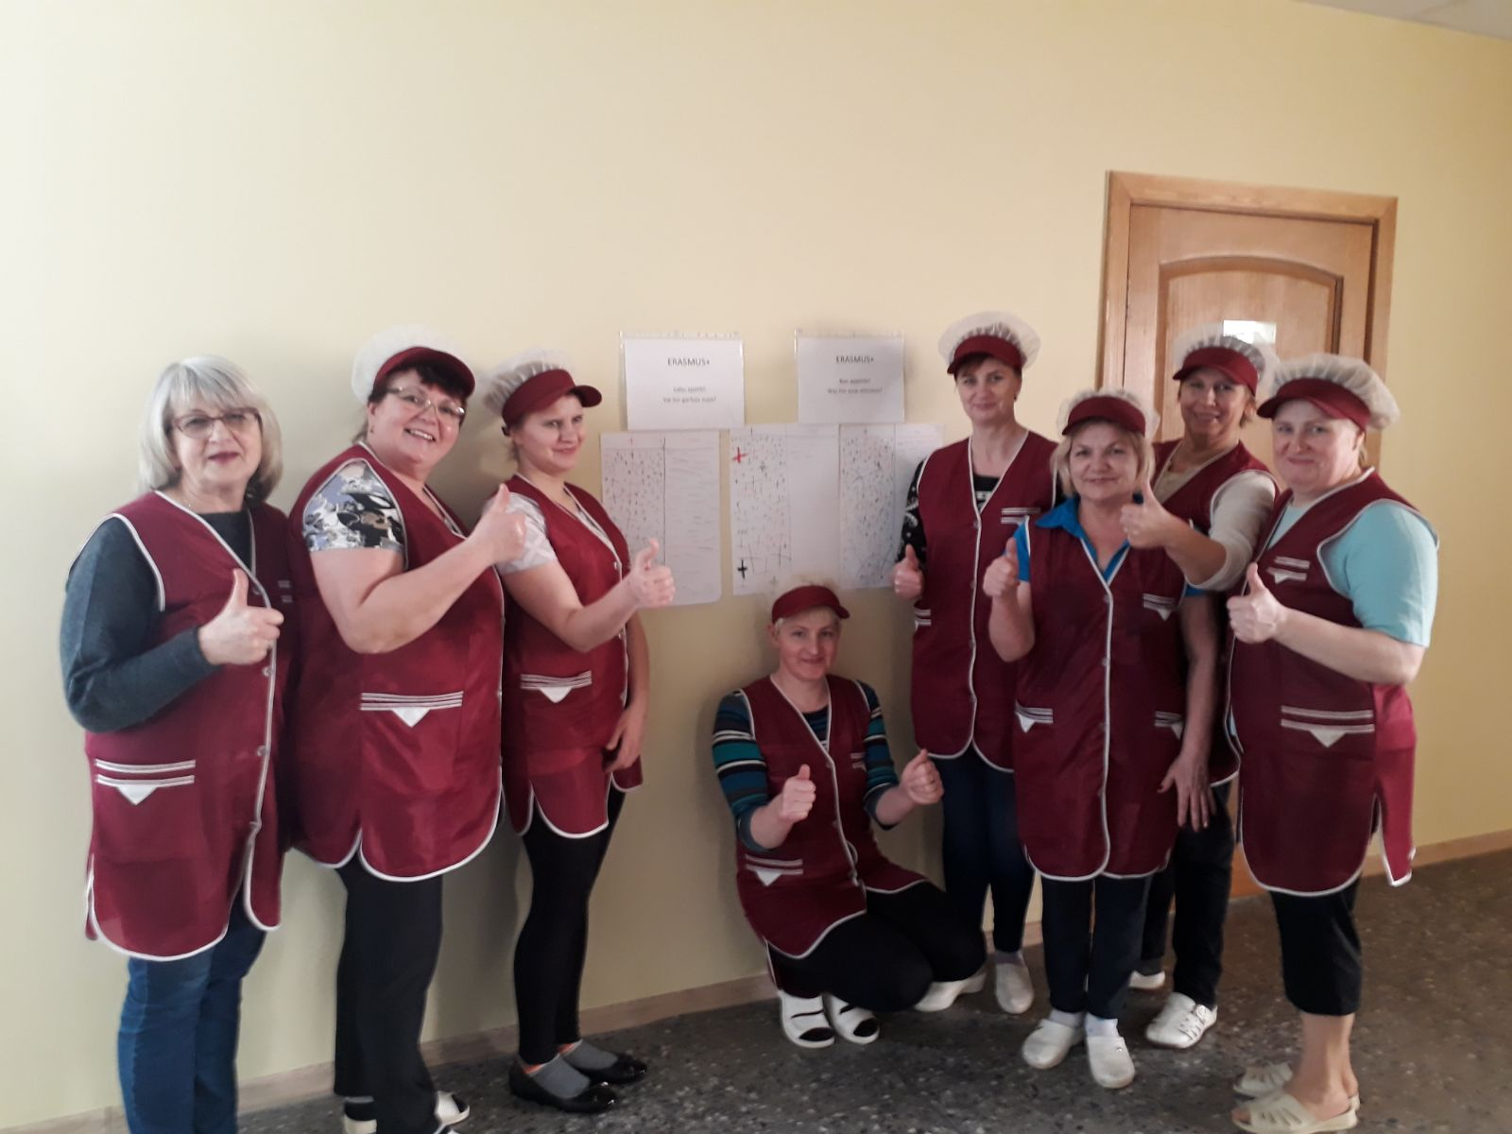

Slide 12
Thank you for your attention!

