Slide 1


“Food and Health; it’s better to prevent than to cure”
Nr.2016-1-NL01-KA219-022900_3
Questions for the survey to elderly people

Slide 2
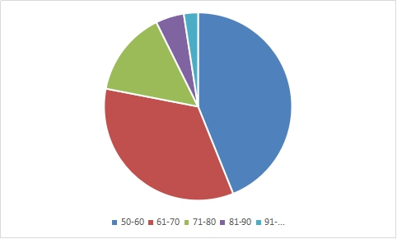
Age 50-60 (18) 61-70(14) 71-80(6) 81-90(2) 91-...(1)

Slide 4
Food habits
1. What does healthy food mean to you?
Eat fruits and vegetables,meat, salads, eggs.
Good health.
Eat all what I need to my organism.
Healthy eating.
People are more active.
Eat homemade meals.
It is energy.
I t is lifestyle.

Slide 5
2. How much has your lifestyle been changed over years, concerning food habits?
Eat healthier.
Not much has changed.
A lot.
Use more milk products.
I eat vegetables and more fruits.
Do more sport.
Regular meals.
Better lifestyle.

Slide 6
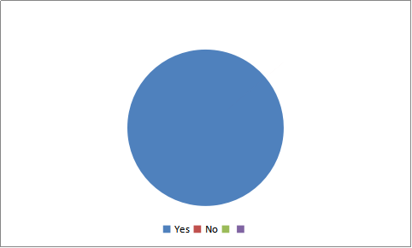
3.Have you ever tried junk food? Yes (42)/No (-)

Slide 7
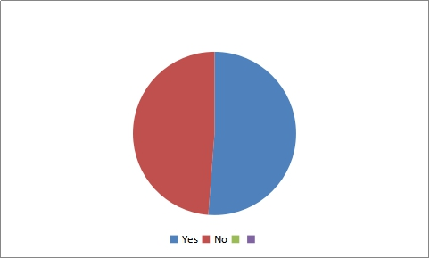
4.Do you like junk food? Yes (21)/No (20)

Slide 8
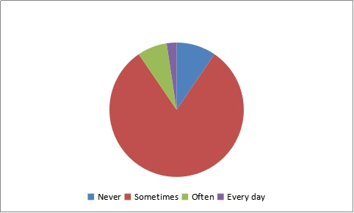
5. How often do you eat junk food? Never (4) / sometimes (34)/often (3)/ every day (1)

Slide 9
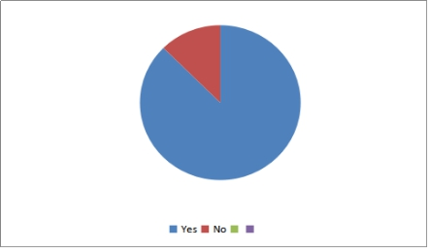
6. Do you eat healthy food? Yes (35)/No( 5)

Slide 10
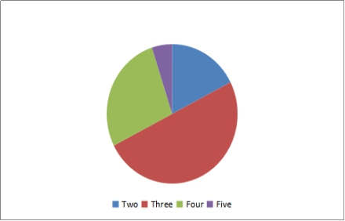
7. How many meals do you have a day? Two (7)/Three (20)/Four (11)/Five( 2)

Slide 11
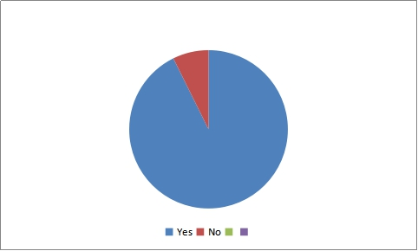
8.Do you usually have breakfast? Yes (38)/ No (3)

Slide 12
9. What do you usually eat for breakfast?
Sandwich with coffee.
Salad.
Cookies.
Eggs.
Sausages and apples.
Toasts with tea.
Porridge.
Meat and cheese.

Slide 13
10. What do you usually eat for lunch?
Salad.
Soup.
Sandwiches with tomatoes.
Potatoes or rice , meat, vegetables and fruits.
Fish.
11. What do you usually have for dinner?
Yoghurt and tea.
Tea, sandwiches and fruit.
Meat or chicken with potatoes.
Pancakes.
Soup.
Vegetable salad.

Slide 14
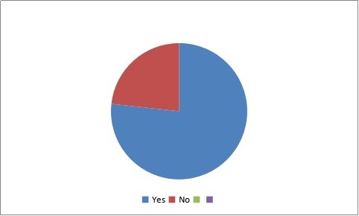
12.Do you like sweets? Yes (33)/No (10)
1.

Slide 15
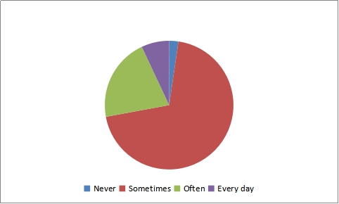
13.Do you eat sweets? Never (1)/Sometimes (30)/ Often (9)/ every day (3)

Slide 16
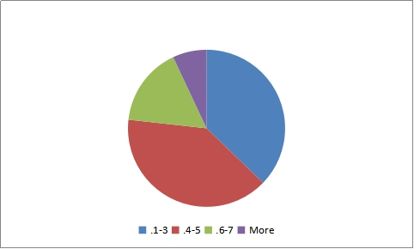
14.How many glasses of water do you drink a day? 1-3 (16)/ 4-5 (17)/ 6 -7 (7)/ more (3)

Slide 17
15. How often do you eat fruit? Never (1)/ Once- twice a week (16)/every day (23)/more than once a day (4)

Slide 18
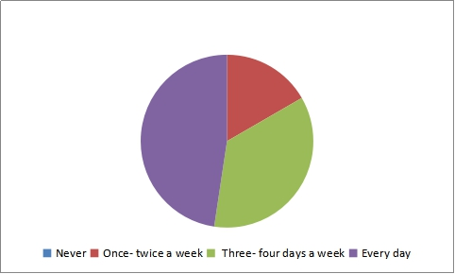
16. How often do you eat vegetables? Never (-)/ Once- twice a week (7)/three-four days a week (15)/every day (20)

Slide 19
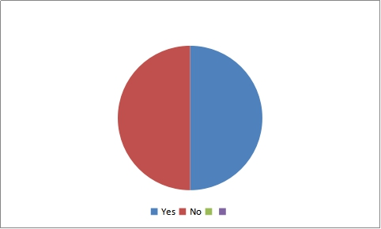
Health
1. Do you have any health problems? Yes (21)/ No (21)
If yes, what kind of problems?
Diabetes.
Heart problems.
Have a headache.
Problems with eyes.
Blood pressure.

Slide 20
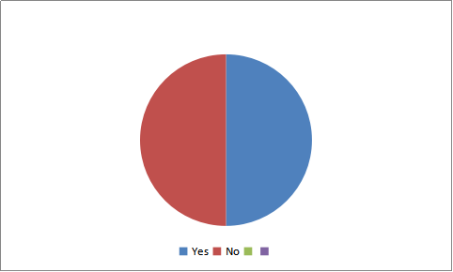
2. Do you have or have had any illness? Yes (21)/ No (21)

Slide 21
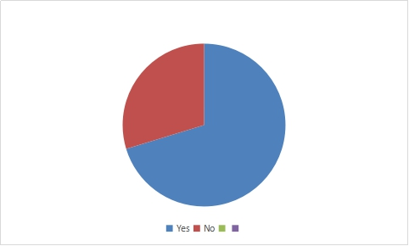
3. Have your healthy habits changed since you were younger? Yes (26)/ No (11)

Slide 22
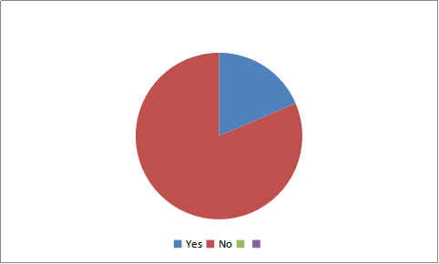
4. Do you have any addiction? Yes (8)/ No (35)

Slide 23
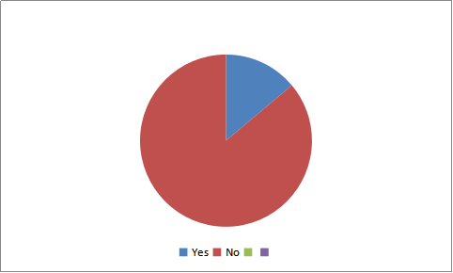
5. Do you have any allergies? Yes (5)/ No (31)

Slide 24
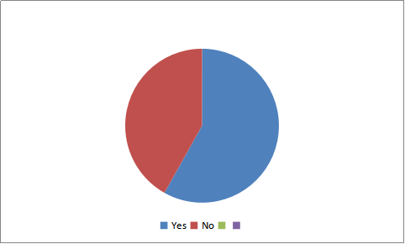
6. Do you have any medication? Yes (25)/ No (18)
If yes, what kind of medication?
Medication for eyes, heart, legs, diabetes, blood pressure.
Some vitamins.

Slide 25
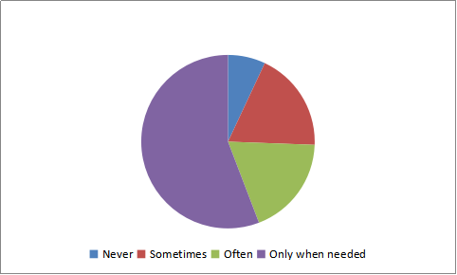
7. How often do you visit your doctor? Never (3)/ Sometimes (8)/ Often (8)/ Only when needed (24)

Slide 26
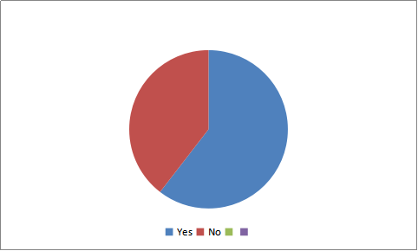
8. Do you visit your doctor immediately when you have health problems? Yes (26)/ No (17)

Slide 27
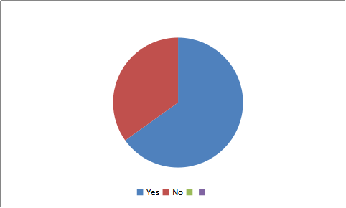
9. Do you have an active lifestyle? Yes (28)/ No (15)

Slide 28
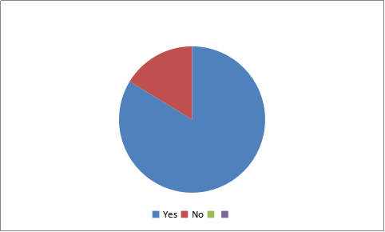
10. Do you train your brains, for example by reading, doing (mind-)puzzles, playing chess? Yes (36)/ No (7)

Slide 29
11. How do you improve your mind? (For example solve puzzles, play chess, draughts,cards, drama....)
Read books, newspapers, magazines.
Play cards.
Play chess.
Crosswords.
Knitting.

Slide 30
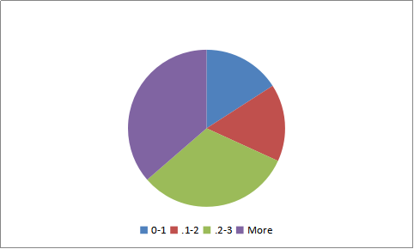
12. How many hours a day do you spend outside, in fresh air? 0-1 (7)/ 1-2 (7)/ 23 (14)/ more (16)

Slide 31
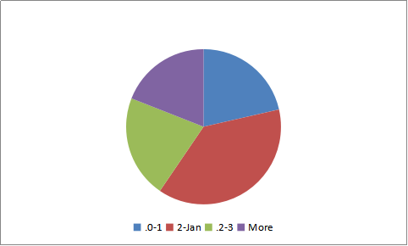
13. How many hours a day do you spend watching TV ? 0-1 (9)/
1-2 (16)/ 2-3 (9)/ more (8)

Slide 32
14. What do you do in your free time?
Read books.
Watch TV.
Work in the garden.
Do shopping.
Listening to the radio.
Do cooking.

Slide 33
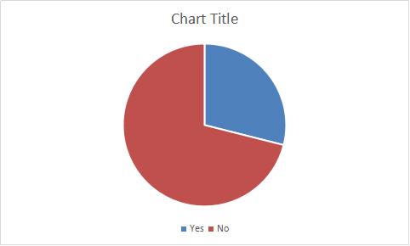
15. Would you like to change your lifestyle? Yes (11)/ No (27)
How?...................
Walk more.
Do some sport exercises.
Eat healthy food.
Running.
Why?........................
To be more healthier.
To look better.
Want to be active.
Because I have problems with legs.
I spend much time at home.

Slide 34
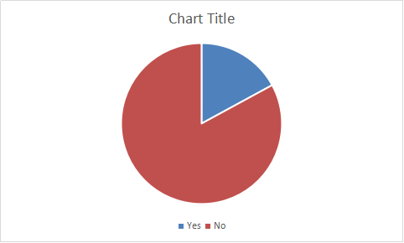
Weight
1. Do you weigh yourself every day to see if you get fatter or thinner? Yes (7)/No (34)

Slide 35
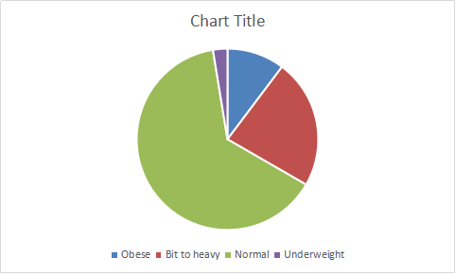
2. How would you describe your weigh? Obese (4)/ bit too heavy (9)/ normal (25)/ underweight (1)

Slide 36
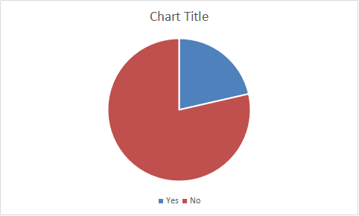
3.Have you ever been on a diet? Yes (9)/ No (33)

Slide 37
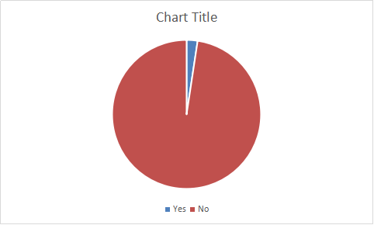
4.Do you make a specific diet at the moment? Yes (1)/ No (41)
-If yes, which one ?
-

Slide 38
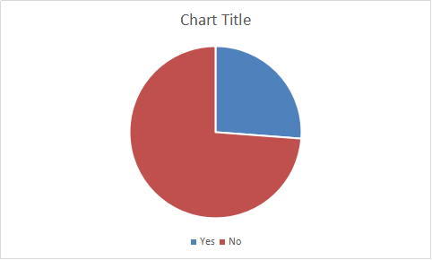
Sports
1. Do you usually do sports? Yes (11)/No (31)
What sports do you play?
Basketball, hockey, walking, riding a bike, running,.
Since when?
9 years ago.
In the evenings.
3 times a week.

Slide 39
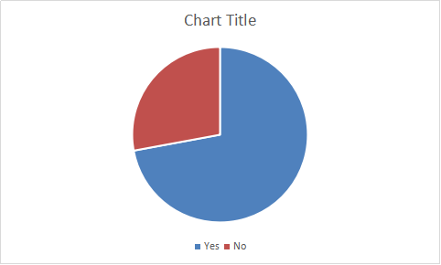
2. Do you do any excercises (for example Nord walking, walking, running, fishing, dancing, cycling,gardening, ..other? Yes (31)/ No (12)
If yes, what kind of excercise?............
Do gymnastics.
Walking.
Running.
Dancing.
Cycling.
Gardening.

Slide 40
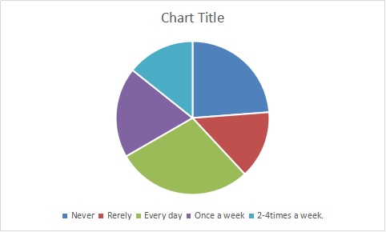
3.How often do you do exercise? Never (10)/ rarely (6)/ once a week (8)/ 2-4 times a week (6)/ every day (12)

Slide 41
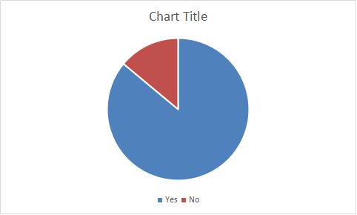
4. Did you use to do sports when you were younger? Yes (37)/ No (6)

Slide 42
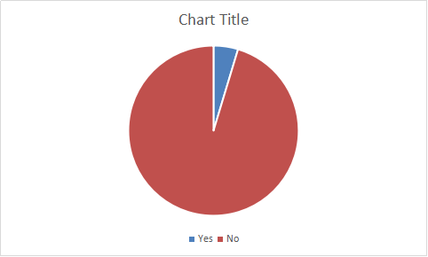
5.Have you ever had a personal trainer? Yes (2)/ No (41)

Slide 43
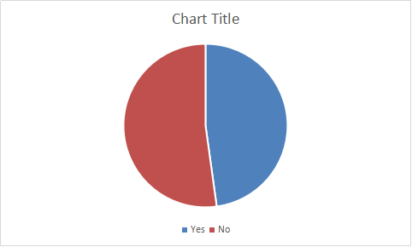
Smoking
1. Have you ever smoked? Yes (22)/No (24)

Slide 44

2.Do you smoke nowadays? Yes (9)/No (31)

Slide 45
3.How many cigarettes do you smoke a day?
One packet.
4.Why do you smoke?
It is just a bad habit, because sometimes I am nervous.
I like it.

Slide 46
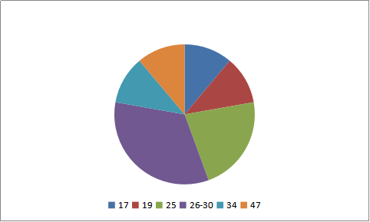
5.When did you start smoking?
Ages 17; 19; 25(2); 26-30; 34; 47

Slide 47
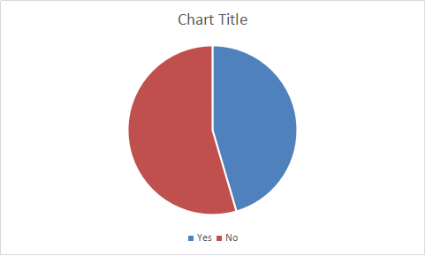
6. Did smoking affect your health? Yes (5)/ No (6)
How?
-

Slide 48
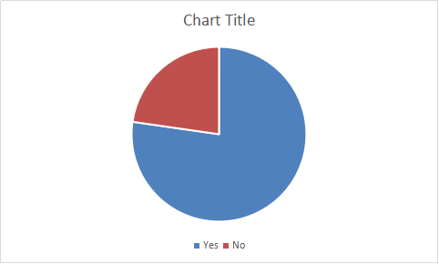
Alcohol
1. Have you ever drunk alcohol? Yes (34)/ No (10)

Slide 49
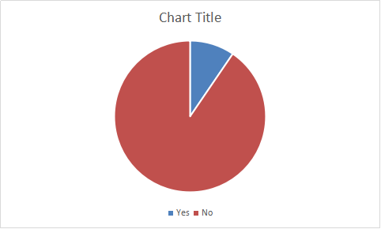
2.Do you usually drink alcohol? Yes (4)/ No (38)

Slide 50
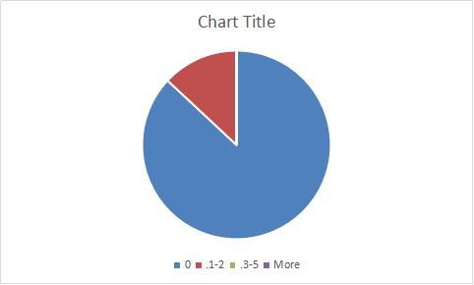
3.How much glasses of alcohol do you drink a day? 0 (20)/1-2 (3)/3-5(-)/more(-)

Slide 51
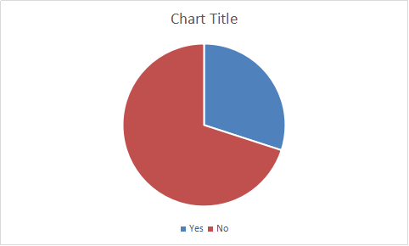
4.Why do you drink?
Sometimes on birthday or holiday to relax.
5.Did drinking affect your health? Yes (6)/ No (14)

Slide 52
Drugs
1. Have you ever tried drugs? Yes (1)/ No (41)

Slide 53
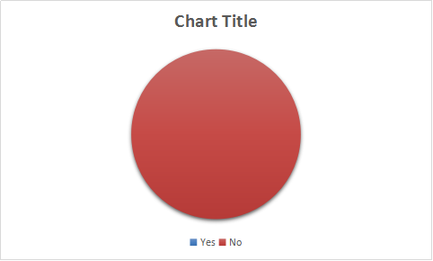
2. Do you take drugs nowadays? Yes (0)/ No (40)

Slide 54
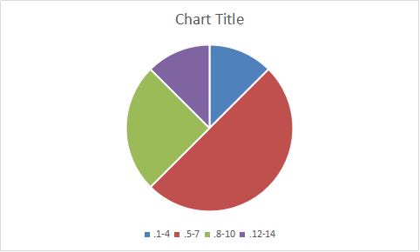
Sleeping habits
1. How many hours do you sleep a day?
1-4 (1); 5-7 (4); 8-10(2); 12-14(1)

Slide 55
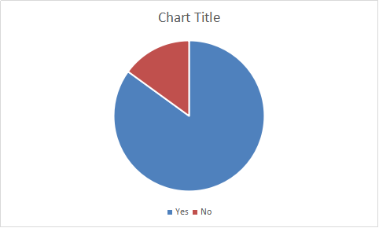
2. Do you sleep enough to rest? Yes (34)/ No (6)

Slide 56
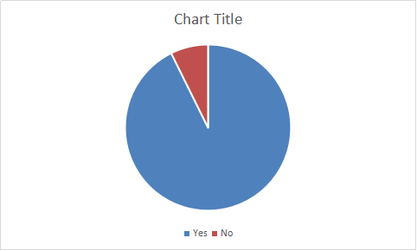
3.Do you sleep well? Yes (38)/No (3)

Slide 57
Thank you for your attention!

