Slide 1
FAST FOOD
Monta Mestere,Ance Marga
Annija Brahmane,Zane Jadcenko

Slide 2
FAST FOOD
Fast food is a mass-produced food that is prepared and served very quickly. The food is typically less nutritionally valuable compared to other foods and dishes.

Slide 3
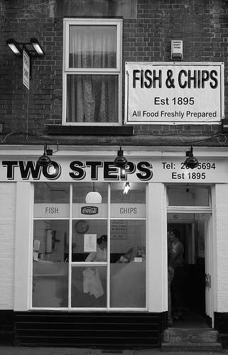
Fast food began with the first fish and chip shops in Britain in the 1860s. Drive-through restaurants were first popularized in the 1950s in the United States. The term "fast food" was recognized in a dictionary by Merriam–webster in 1951.

Slide 4
FAST FOOD RESTAURANT
A fast food restaurant, also known as a quick service restaurant (QSR) within the industry, is a specific type of restaurant that serves fast food cuisine and has minimal table service.

Slide 5
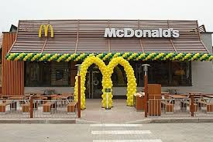
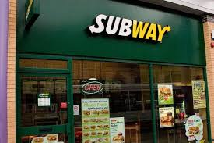
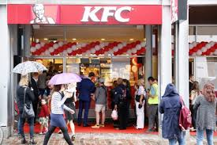
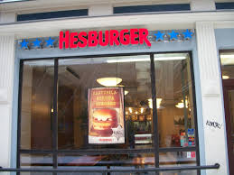
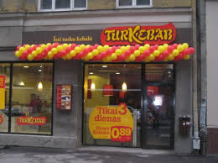
The most popular fast food places in Latvia
Mcdonalds -90
Chilly pizza-23
Hesburger-20
Picu darbnīca-10
Turkebabs-10
Lulu pizza-6
Pakistānas kebabs-5
Subway-3
Kfc-1
Pizza hut-1

Slide 6
TOP 10 fast food places in Latvia
Mcdonalds (burger restaurant)
Hesburger (burger restaurant)
Lido (fast food restaurant)
Subway (sandwich shop)
Narvesen (fast food place)

Slide 7
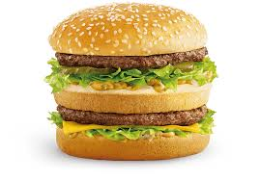
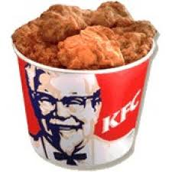
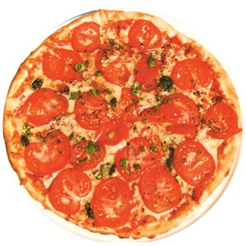
Čili pica (pizza reastaurant)
Lulu pica (pizza restaurant)
KFC (burger restaurant)
Cancan pica (pizza restaurant)
Pakistan kebab (kebab restaurant)

Slide 8
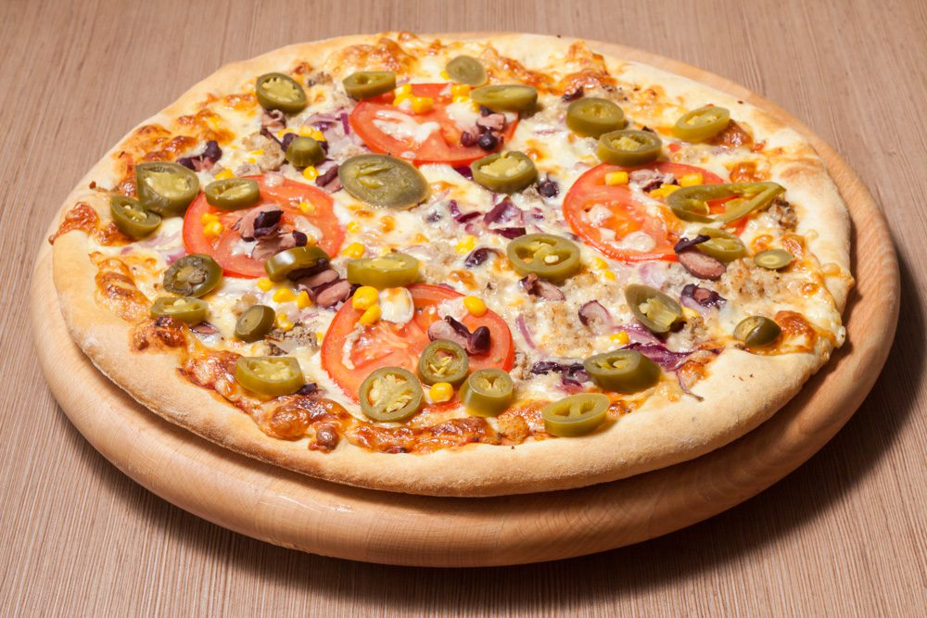
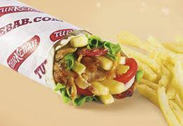
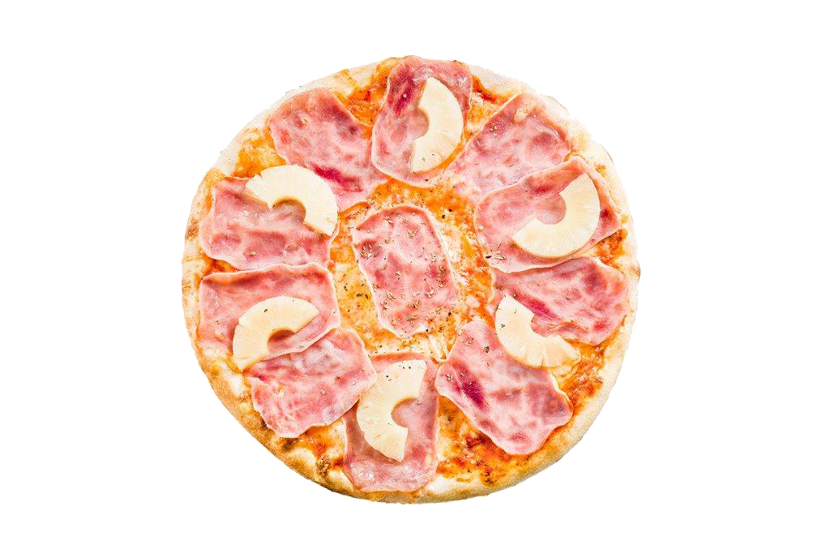
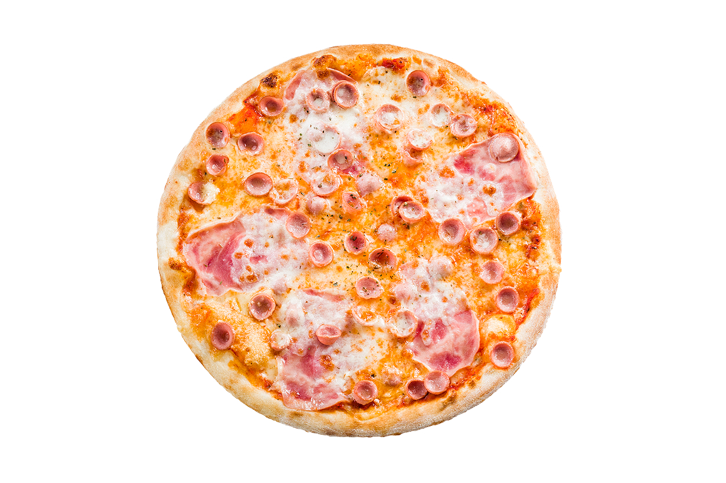
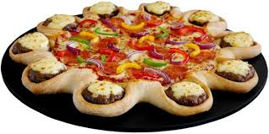
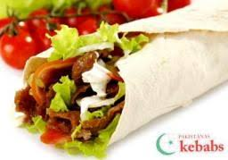
.
Turkebab -ankaras kebab
Picu darbnīca- flamenco pizza
Pakistānas kebabs- xxl jumbo kebab
Pizza hut - the cheeseburger crust pizza
Čilli pica – student and hawaii pica

Slide 9
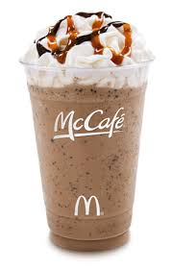
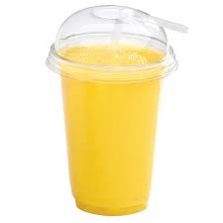
The most popular drinks in latvia
Mcdonalds – mccafe frappe chocholate chip and fruit smoothies
Hesburger –fruit smoothies
KFC- krushers( smoothie drinks with cookies or cereals)
Subway –hot coffee and coca-cola

Slide 10
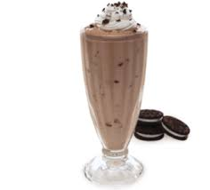
.
Turkebab- coca-cola (0.3 l)
Picu darbnīca- coca-cola(0.5 l)
Pizza hut – oreo milkshake
Čilli pica-dessert cocktails and hot drinks

Slide 11
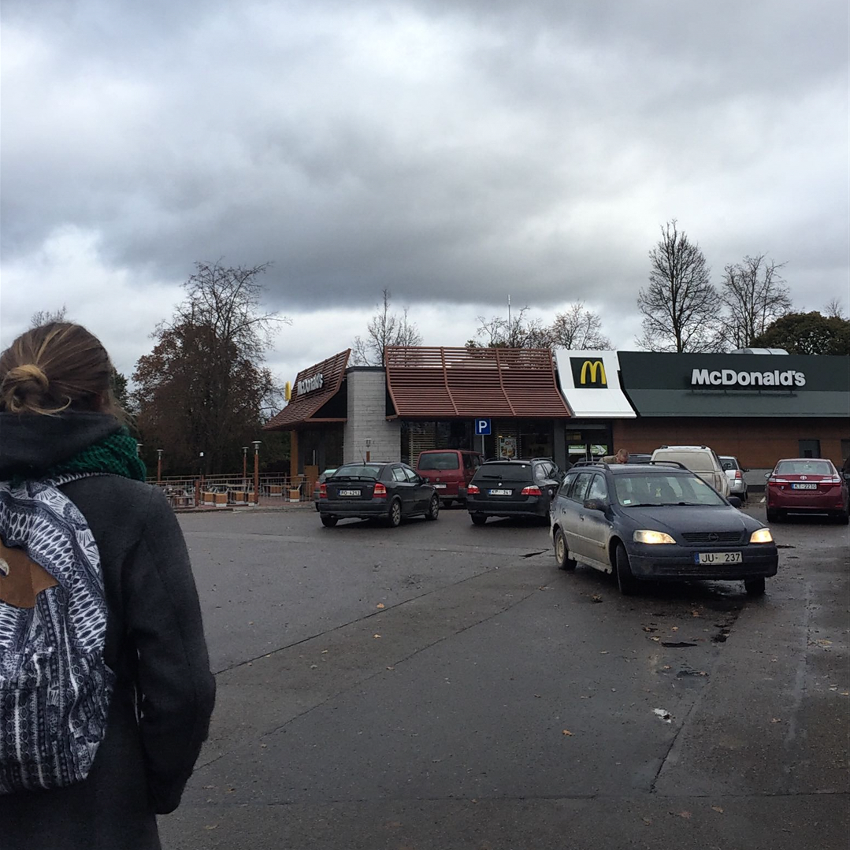
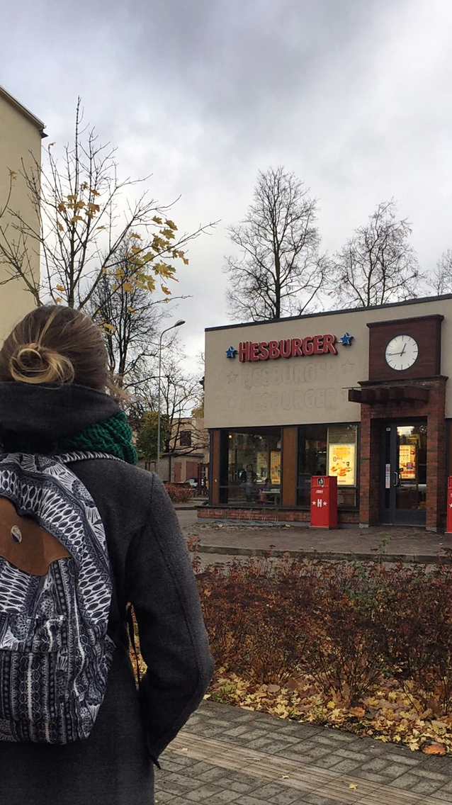

Slide 12
Survey about fast food in my class

Slide 13
Nr. | Favorite fast food restaurant. | The frequency of visits. | Favorite fast food. | What healthy you get from this food.
1. | Hesburger | Two times per year | Cheese burger | I have eaten very well
2. | McDonalds | Once a month | Burgers | At least i have eaten.
3. | McDonalds | When i go on tours or at least once a year | French fries | There is nothing healthy
4. | Streetburger | Three times per month | Burger | This burger is healthy because it has lamb meat, tomatoes, lettuces and gvakamole
5. | Subway | Once a month | French fries with tomatoe souce and orange juice | There is nothing healthy only orange juice.
6. | McDonalds | Three times per month | French fries | Nothing healthy
7. | Karavāna | Two times per month | Pizza | Actually nothing
8. | Hesburger | Once a month | Cheese burger | Nothing
9. | Hesburger | Two times per month | Ice cream milkshake and french fries | I think there is nothing healthy
10. | Čili pica | Once a year, because i don’t like fast food at all | pizza | Nothing , because i think there is nothing healthy in this food
11. | McDonalds | 1-2 times per month | Burger and nuggets | This food makes me feel good
12. | Hesburger | Once per month | Nuggets | Nothing
13. | Lulu pica | Two times per month | Pizza or burger | Something from this food is healthy
14. | McDolnalds | Two times per month | Pizza or french fries | Nothing
15. | McDonalds | Once per month | Burger | Nothing healthy
16. | McDonalds | Twice a year | French fries or Big Mac | Nothing healthy at all
17. | McDonalds | Once per month | French fries | This food isn’t healthy because i get fat
18. | Hesburger | Three times per month | burger | I feel very good
19. | KFC | Once a year | Fried chicken | This is just snack
20. | McDonalds | Four times per month | Cheese burger and mcflury | Nothing

Slide 14
Fast food in Auce
ELVI (supermarket,burgers,hot dogs,mini pizzas,french fries)
TOP (supermarket,hot dogs)
Ieva (café,french fries)

Slide 15
Nutritions in a hamburger…
One hamburger weights about 80-135g

Slide 16
Obesity in Latvia
In Latvia, 21.3% of the adult population of the country has been diagnosed with obesity, the second highest indicator
among the European Union (EU) member states.(1st place is Malta)

Slide 17
In Latvia, every fourth third grader and every fifth first-year student are overweight or obese, according to a World Health Organization study. In contrast, the parents of a large number of the children do not perceive this as a problem.

Slide 18
Thank you for your attention!

