Slide 1
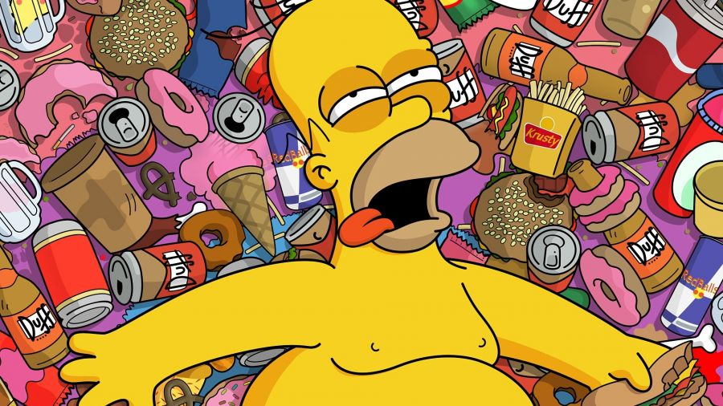
JUNK FOOD
By arnau, ANA, Josema, Martín.

Slide 2
1. index
- Definition.
- Short-Term Consequences.
- Long-Term Consequences.
- Junk Food most consumed.
- Conclusion.
- The end

Slide 3
2. Definition AND EXAMPLES.
Food that is high in calories but low in nutritional content or something that is appealing or enjoyable but of little or no real value.
PIZZA
BURGUER
CHIPS
CAKE

Slide 4
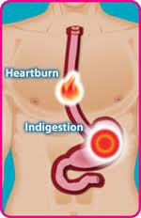
3. SHORT-TERM CONSEQUENCES.
Poor Brain Function.
Poor Exercise Capabilities.
Insulin Resistance and Weight Gain.
Indigestion and Heartburn.
Poor Sleep.
Mood Problems.

Slide 5
4. LONG-TERM CONSQUENCES.
Obesity Kills
Development of Diabetes
Watch Your Sodium
Scale Back on Fat

Slide 6
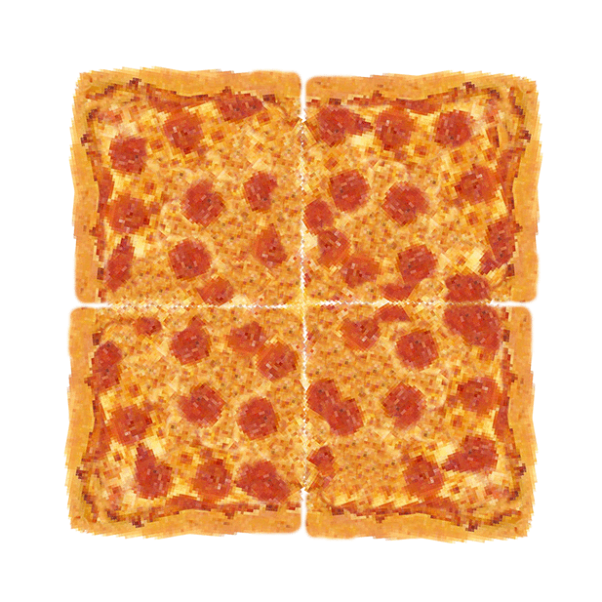
5.junk Food most consumed

Slide 7
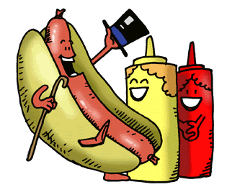
7. CONCLUSIONS

Slide 9
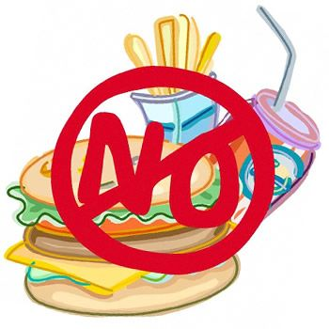
8. The end

