Slide 1
HEALTH TALKS

Slide 2
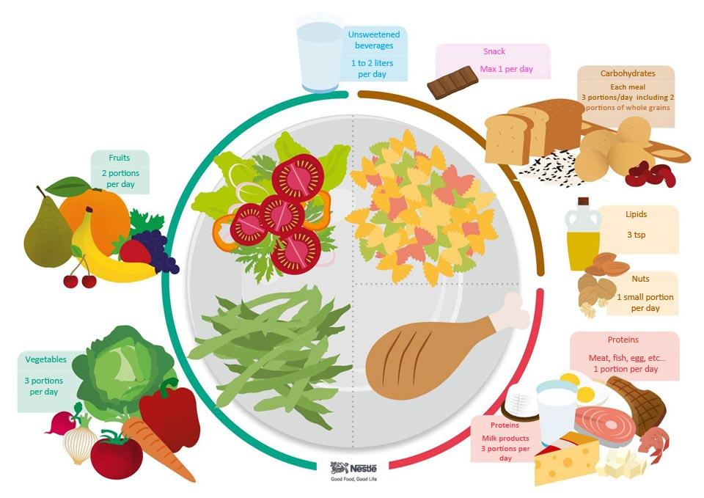
1. NUTRITION
The students attended a talk on nutrition at school. It was given by Encarna, who is a nurse at Rotaꞌs community health centre. Learning how to eat well was its main purpose. That means we must follow a balanced diet to keep good health and prevent diseases, including carbohydrates (57%), oils (25%), proteins (15%) and fiber (3%).

Slide 3
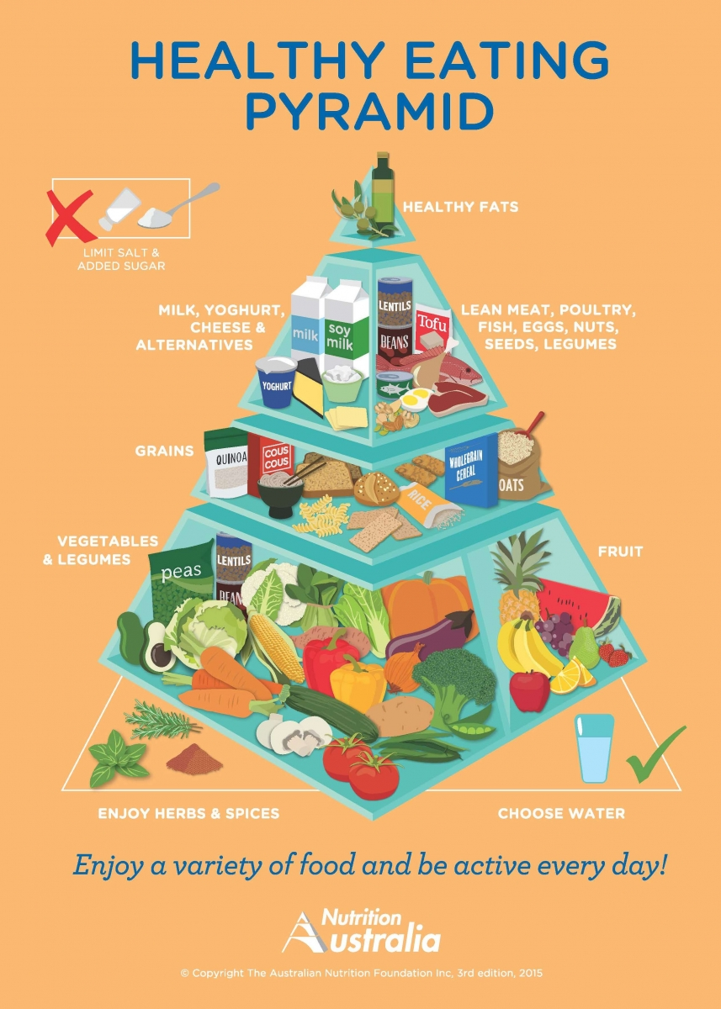
She also showed the students the Healthy Eating Pyramid, stressing the importance of getting the correct amount of nutrients from the different shelves of the pyramid.
The students got quite involved and took turns to speak about their own eating habits. Encarna warned them that having a good breakfast every morning was the most important thing as it gives us energy to live. Finally, she emphasized the idea that you are what you eat, so we can’t forget to eat varied and healthy food.

Slide 4
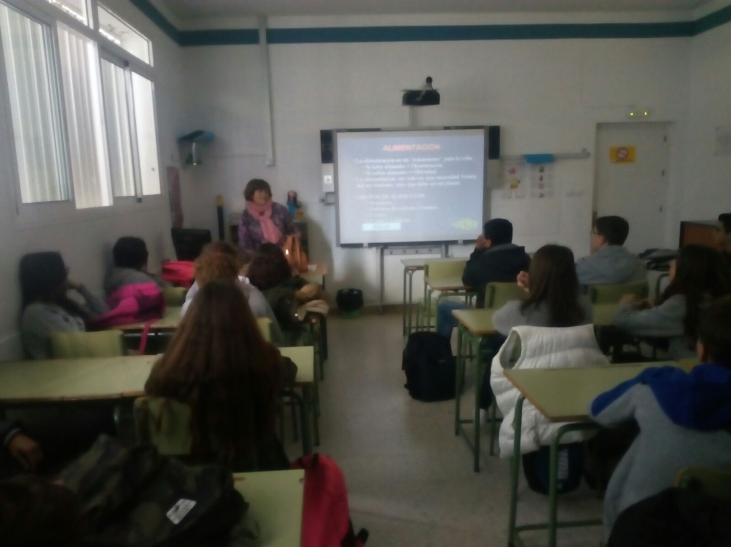
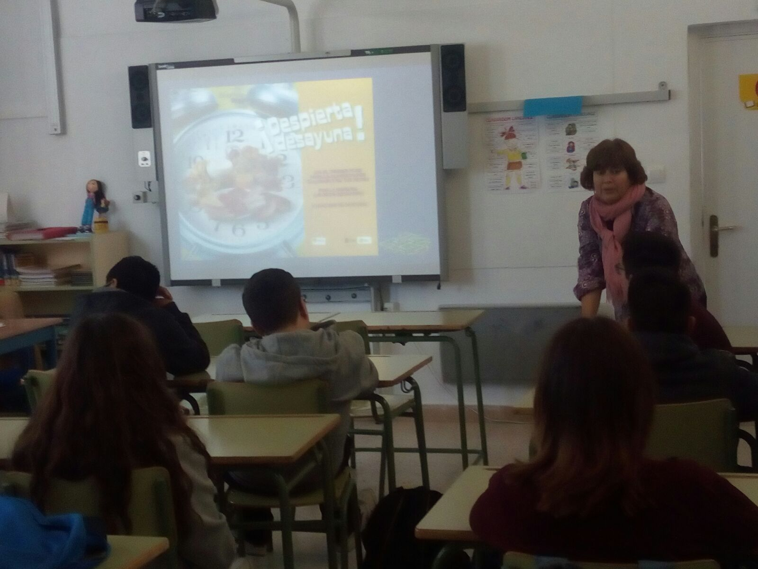
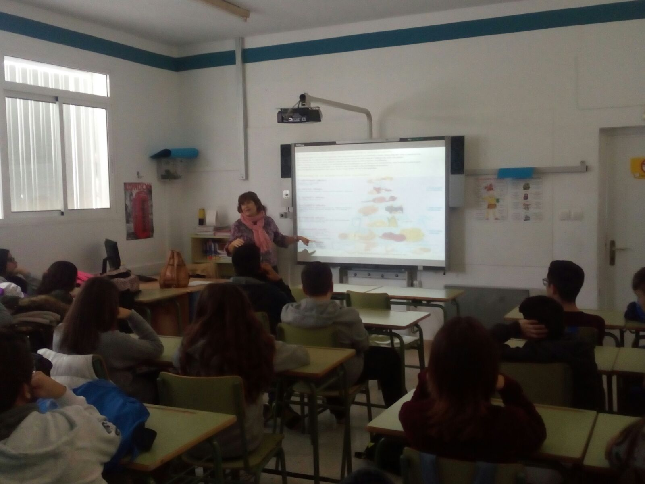
The students attended a talk on nutrition at school. It was given by Encarna, who is a nurse at Rotaꞌs community health centre. Learning how to eat well was its main purpose.

Slide 5
2. AIDS
A nurse at the health center and a student nursing practice exposed on AIDS:
♦What’s AIDS?
♦Historical of AIDS.
♦Causes and how it spreads: They especially insisted on unprotected sex as the main form of infection.
♦Other sexually transmitted infections that could be prevented by using condoms.

Slide 6
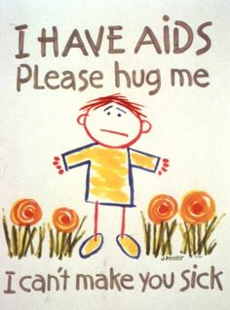
♦The issue of unwanted pregnancies and how they affect teenagers.
♦The boys commented that using condoms isn’t enjoyed just like without condoms. We talked about this subject also using a gender perspective.
♦AIDS data in the world.
♦Current treatments and recommendations to be followed by people diagnosed to be HIV positive.

Slide 7
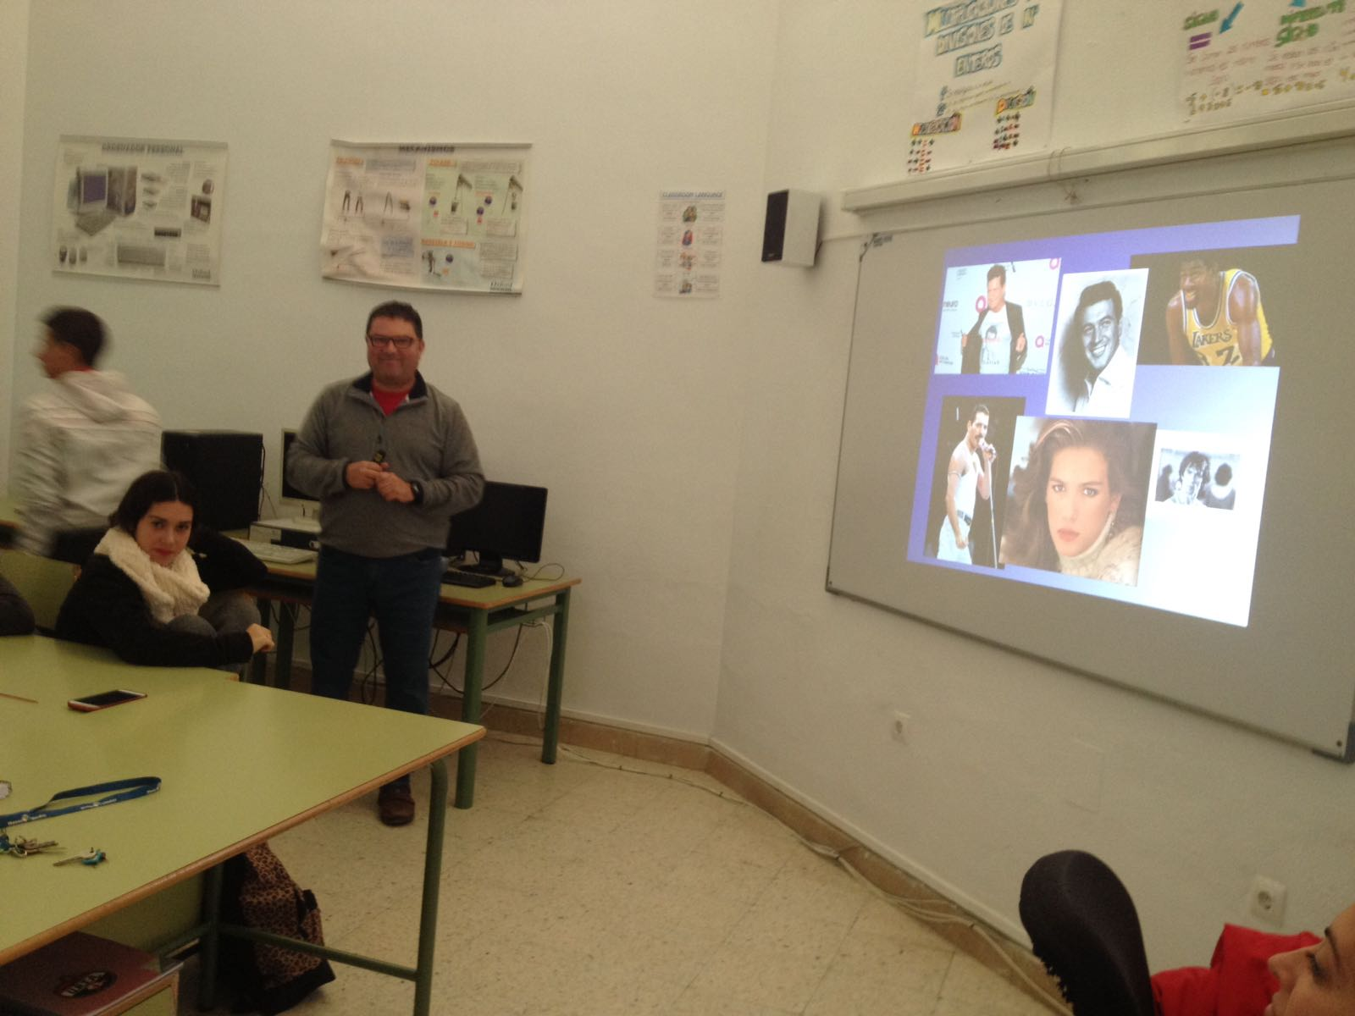
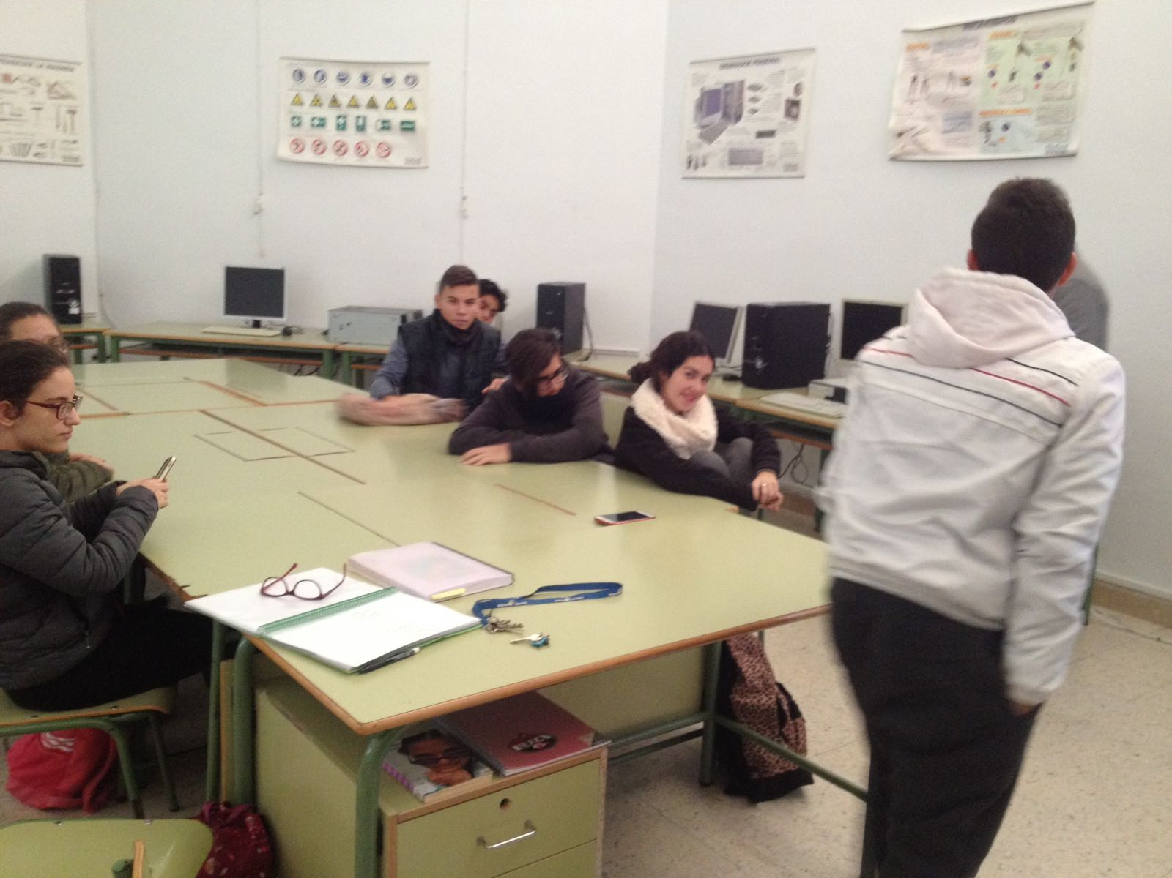
A nurse at the health center and a student nursing practice exposed on AIDS:
♦What’s AIDS?
♦Historical of AIDS.
♦Causes and how it spreads: They especially insisted on unprotected sex as the main form of infection.

Slide 8
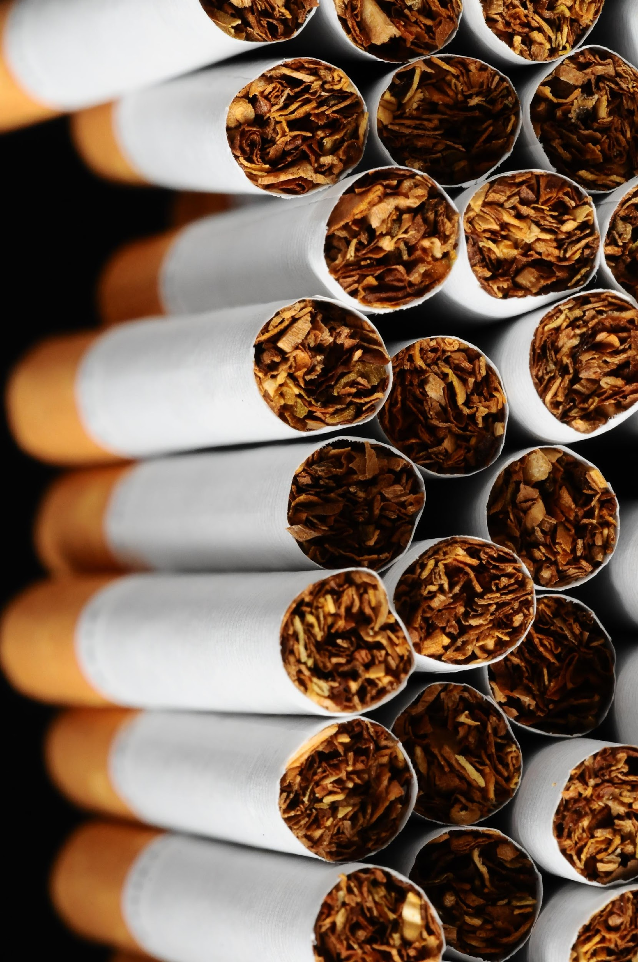
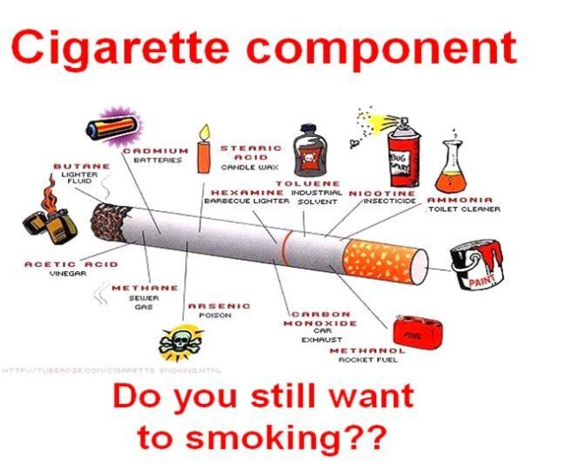
3. TOBACCO
A nurse from the health center gave a talk about tobacco to try to prevent its use among young people. He commented that approximately 30% of the population smokes and he talked a little about the tobacco plant and its origins.
The students were surprised to hear that tobacco is the first drug consumed by young people and informed us of all the toxic substances that each cigarette contains in small doses.

Slide 9
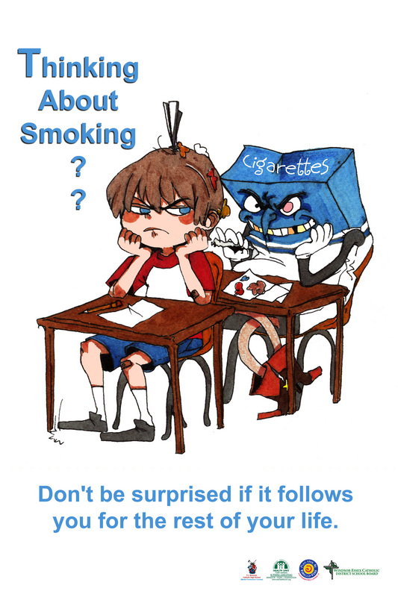
On the digital display, he put different ads which dealt with tobacco toxicity and explained that teenagers are initiated into consumption by integration, freedom or otherwise.
Finally, he commented on the long-term effects but what impacted the students were the short-term effects.

Slide 10
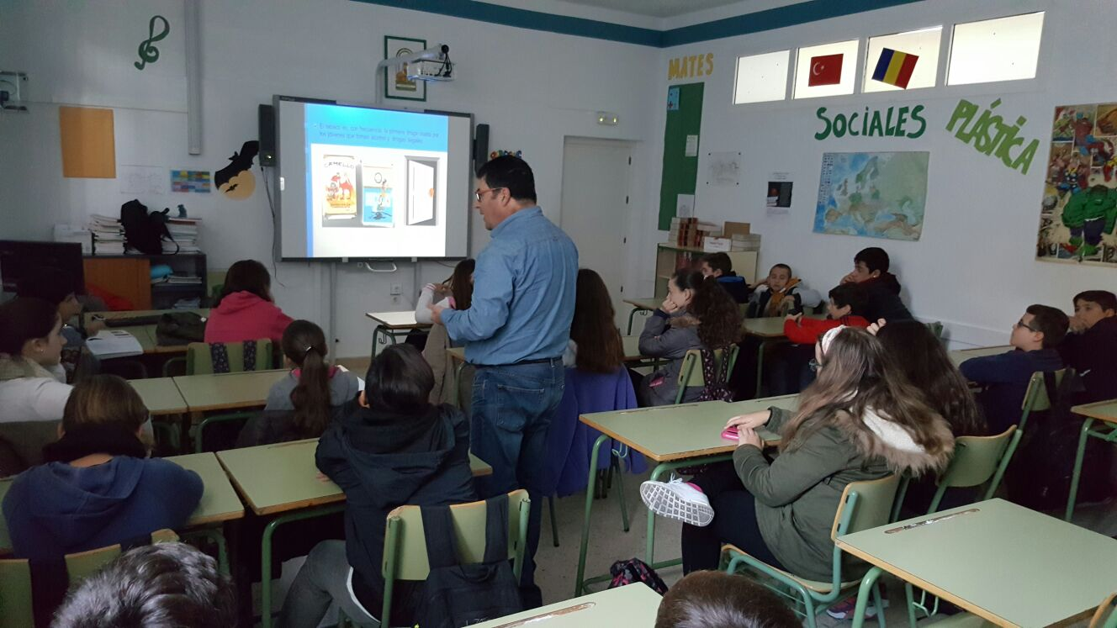
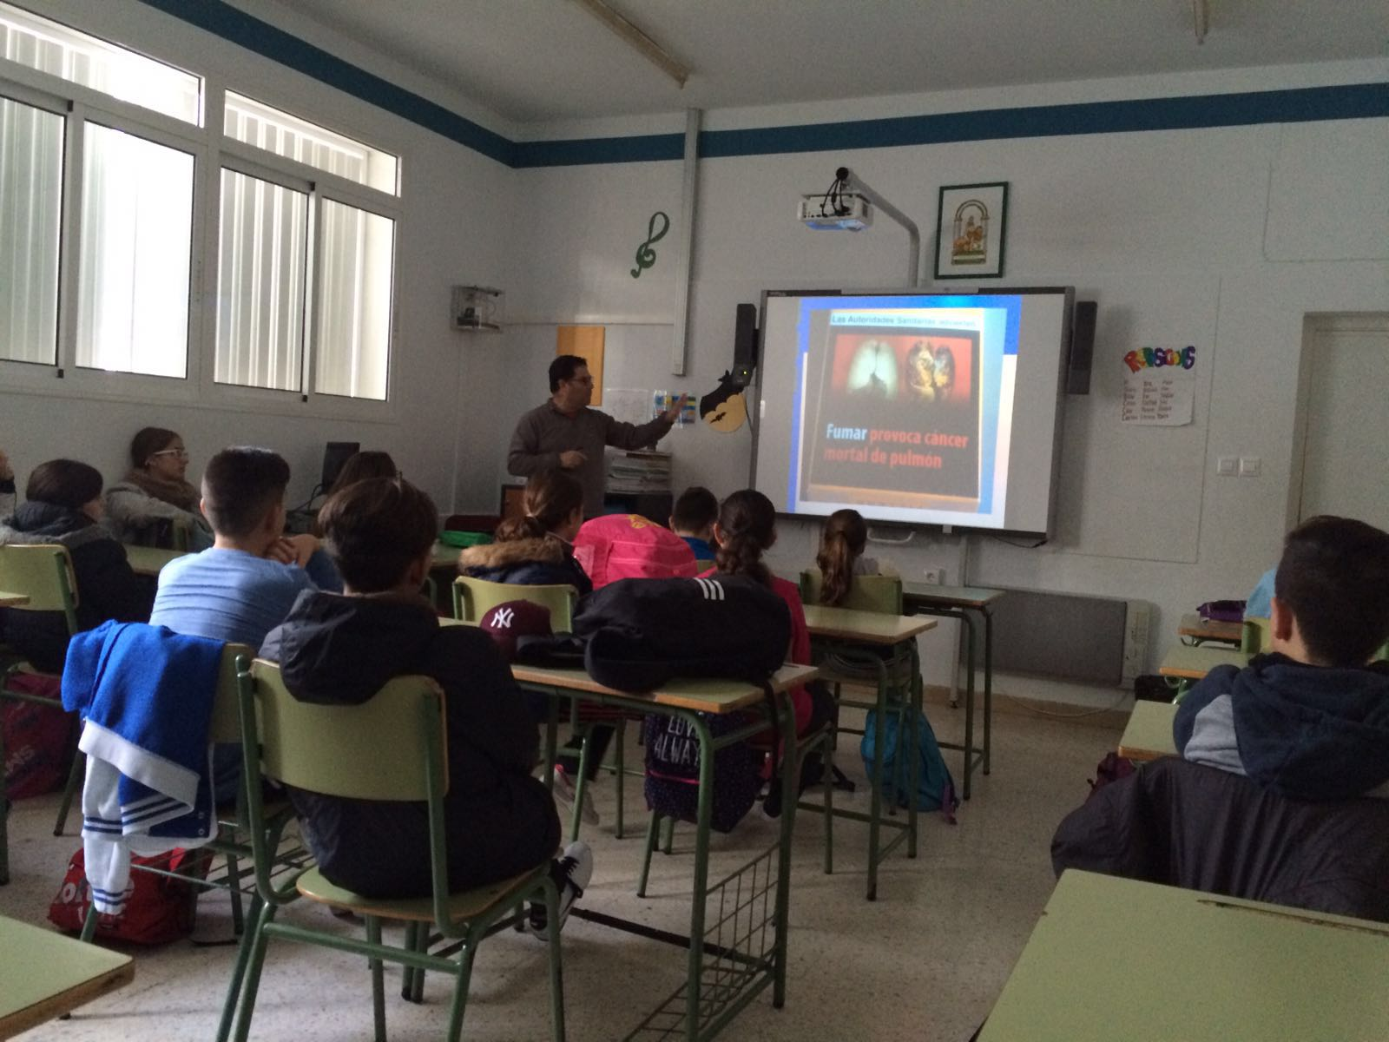
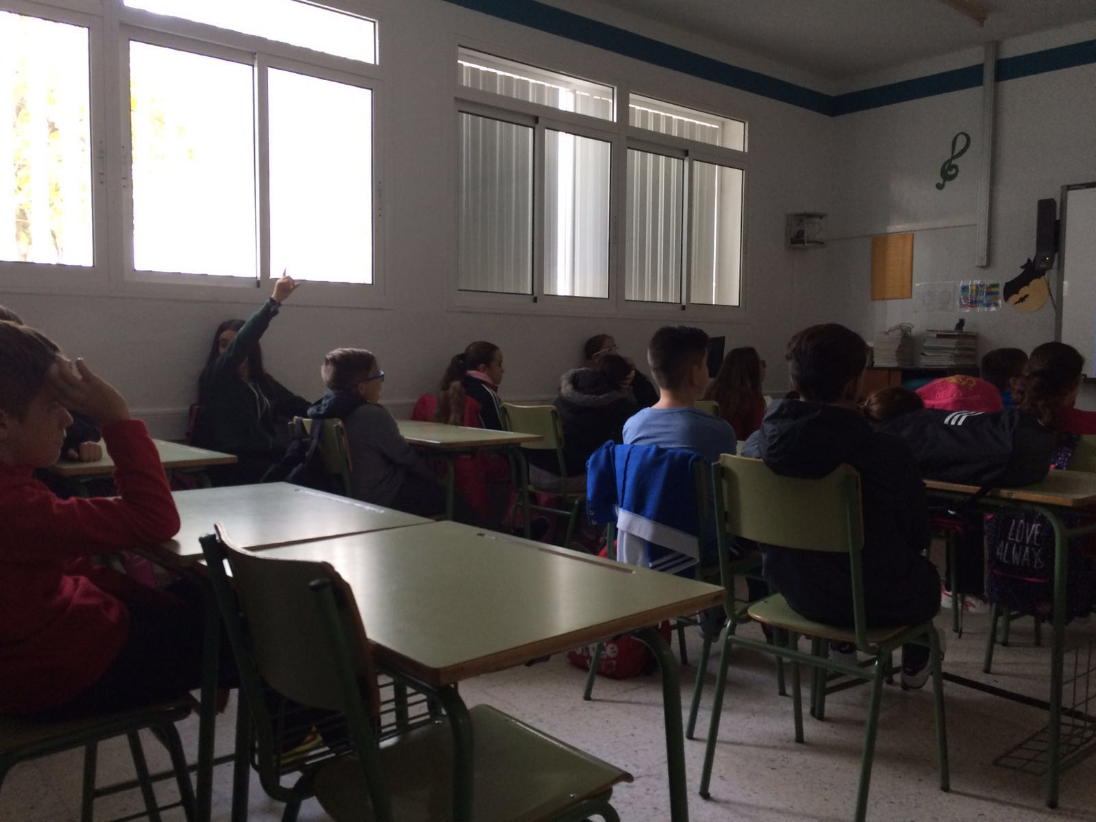

Slide 11
4. SEXUALITY AND THE YOUNG
The talk on sexuality started by stressing the importance of knowing our body, noticing the physical changes caused by the hormonal development. The Young begin to know their erogenous zone and should share this with their partners. Masturbation was also said to take place naturally at this age.

Slide 12
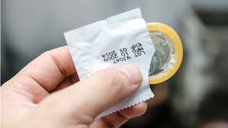
In this connection, the students learnt about healthy sex, this being much more than sexual intercourse. They were told to avoid inappropiate places, alcohol and other drugs, fear in case of homosexuality, and they got information about the rigth use of condoms. They were also encouraged to have affective relations for being more suitable.

Slide 13
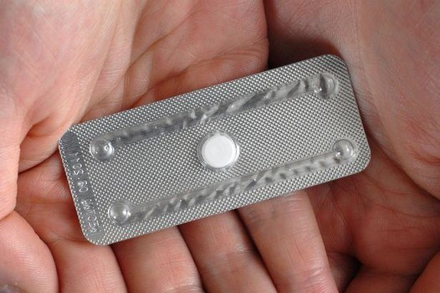
The last part of the sesion was devoted to sexual transmission diseases and contraceptive methods, highlighting that postcoital pills are not abortion pills not a contraceptive method but an emergency postcoital contraception option which provides no protection against sexually transmitted infections, hence the importance of using a condom

Slide 14
