Slide 1
MEDITERRANEAN DIET MADE BY ALICIA CABALLERO AND LUCIA VALDERRAMA

Slide 2
INDEX
What is the mediterranean diet?
Why is a healthy diet?
Characteristics of the Mediterranean diet
typical mediterranean meals

Slide 3
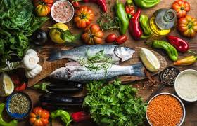
WHAT IS THE MEDITERRANIAN DIET?
The Mediterranean diet consists of a lifestyle based on a balanced and varied diet in which the foods obtained from the traditional crops of this geographic zone bathed by the Mediterranean predominate: wheat, olive and grapevines.

Slide 4
WHY IS A HEALTHY DIET?
Its discovery as a healthy diet was made from nutritional studies in Greece where an incidence of arteriosclerosis, cardiovascular diseases and degenerative diseases was detected below average.

Slide 5
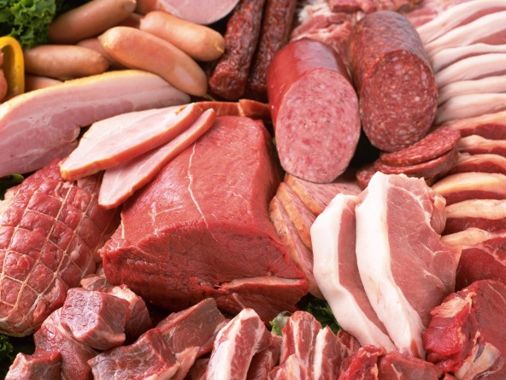
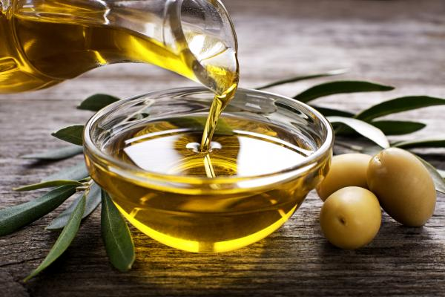
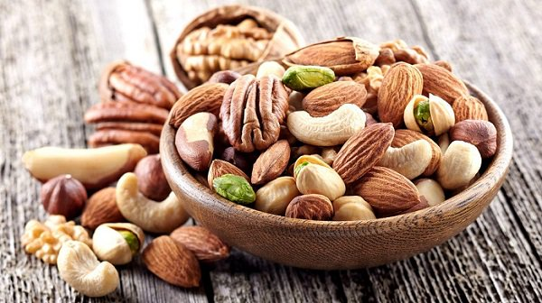
CHARACTERISTICS OF THE MEDITERRANEAN DIET
The fat used in meals is mostly olive oil.
Low in saturated fats.
High in monounsaturated fats.
Balanced in polyunsaturated fatty acids.
Low in animal protein.
Rich in antioxidants.
Rich in fibers.

Slide 6
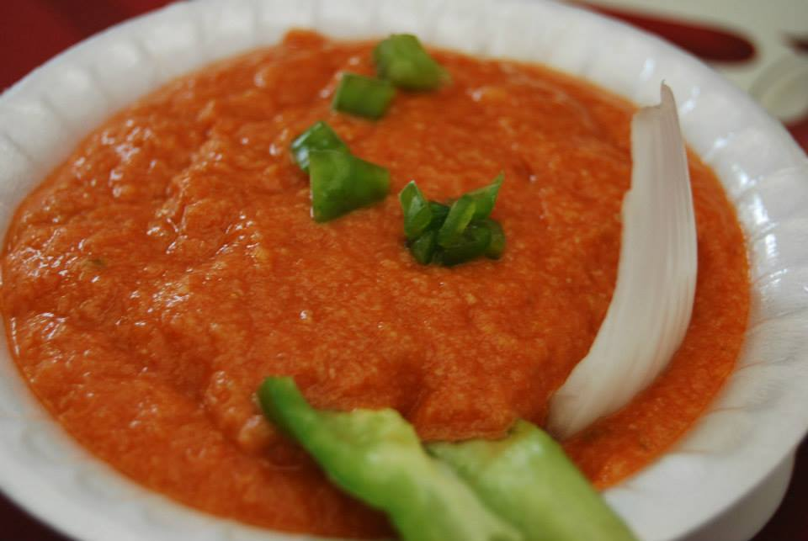
ARRANQUE
It is a crushed mixture of tomato, pepper, bread, oil, and salt.

Slide 7
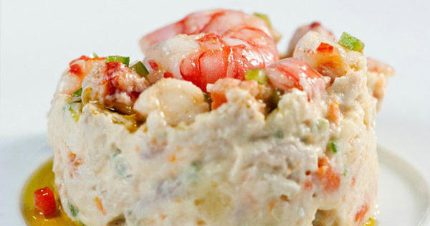
ENSALADILLA
It is a mixture of cut potatoes, mayonnaise, peas, carrot, tuna and pepper.

Slide 8
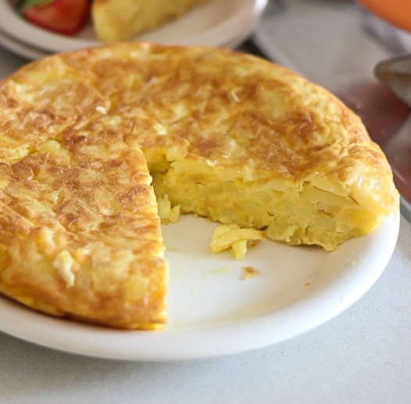
SPANISH OMELETTE
It is a mixture of potatoes, salt, eggs and oil

