Slide 1
Youth Guards ‘’Jaunsardze’’
.

Slide 2
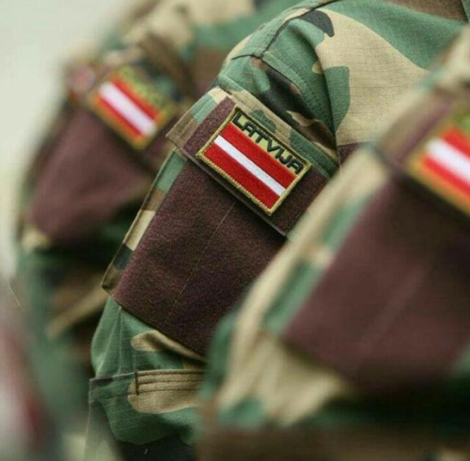
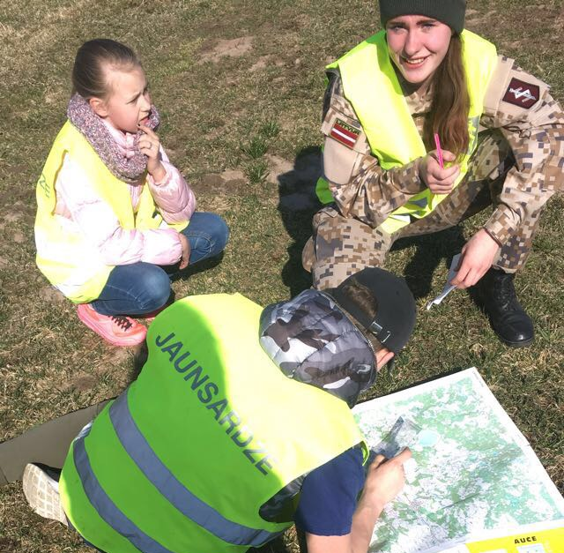
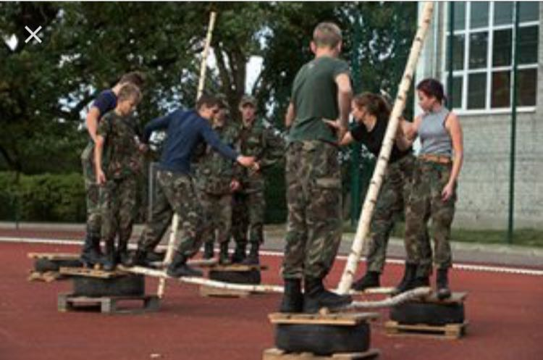
What is the Youth Guard
It is the largest youth organization in Latvia which brings young people from the age of 12 to 18 together.
The main tasks of the Youth Guards are to withstand physical activities, learn how to handle with weapons, provide first aid, learn how to orientate and do other activities. But the main thing is to be a patriot and to participate in national holiday parades.

Slide 3
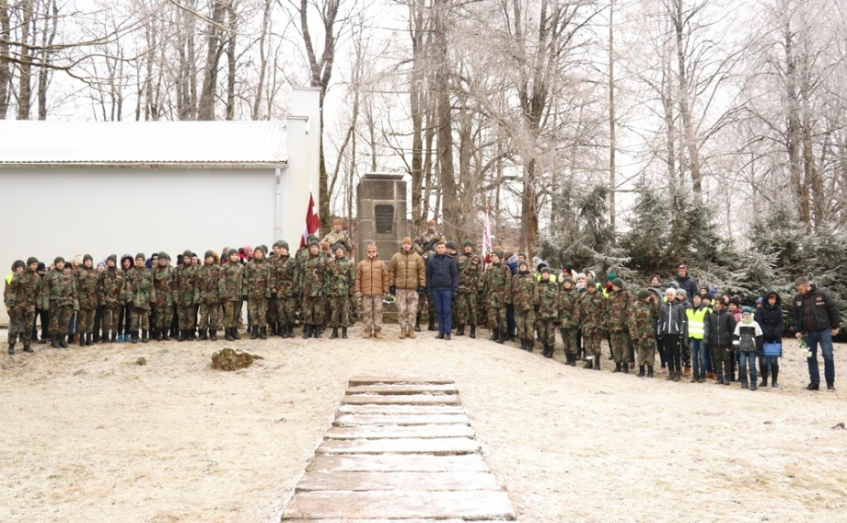
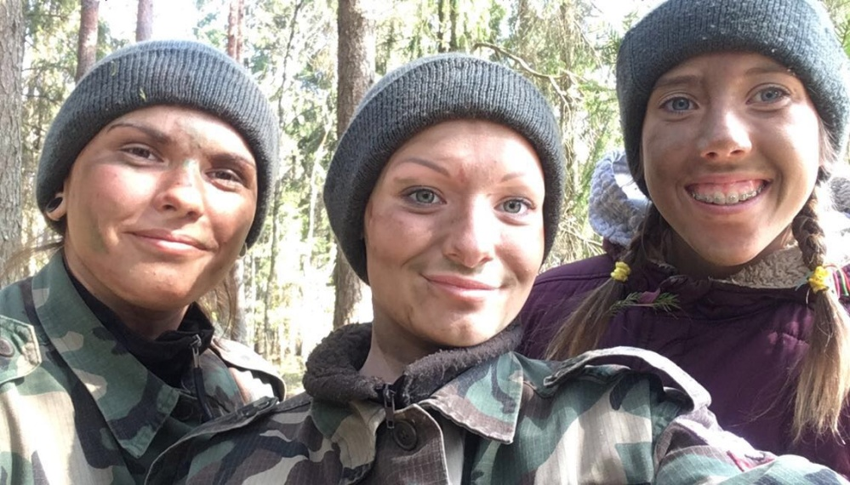
Youth Guards in Auce
In Auce Secondary School there are 17 young Youth Guards and a lot of beginners. Auce is in Dobele’s battalion ,so there are more Youth Guards who cooperate with each other.
There are lessons every Friday at 3pm.All Youth Guards have to follow the exact rules and commands. They stand in a line and wait for commands. Then they go to the class and write down important things about the army. Sometimes they have to disassemble and assemble weapons, to learn labels, to do physical exercises and learn everything about the army and discipline.

Slide 4
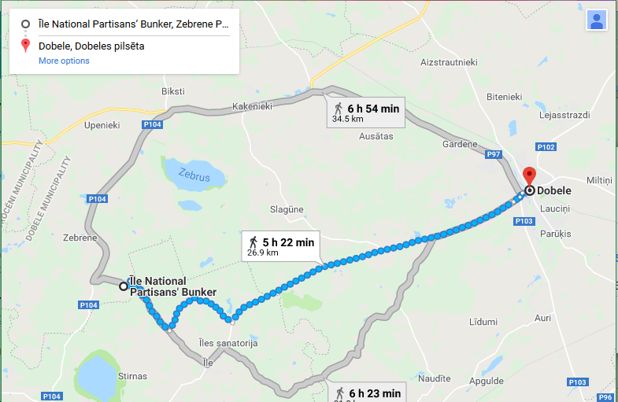
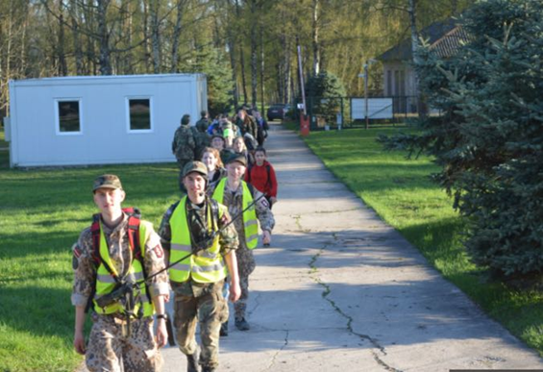
.
Every spring, the Youth Guards walk 60 km in two days from Dobele to the Īles bunker. On the way they encounter various challenges, but at the end, everybody who has passed it all, gets an emblem for the uniform and becomes an official Youth Guard.

Slide 5
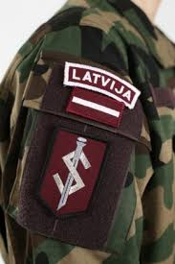
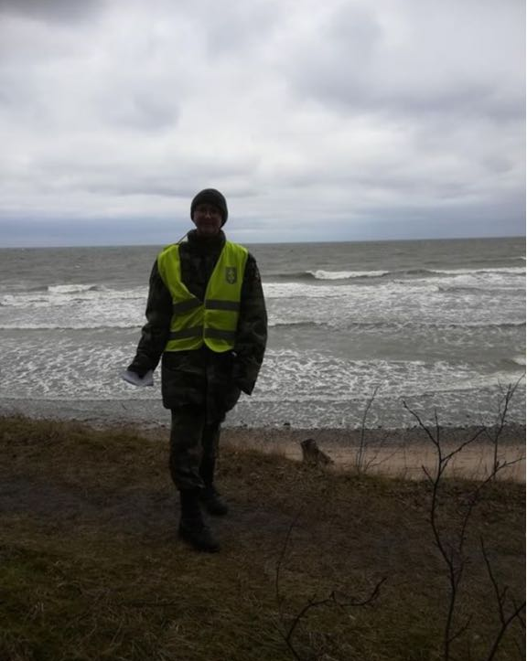
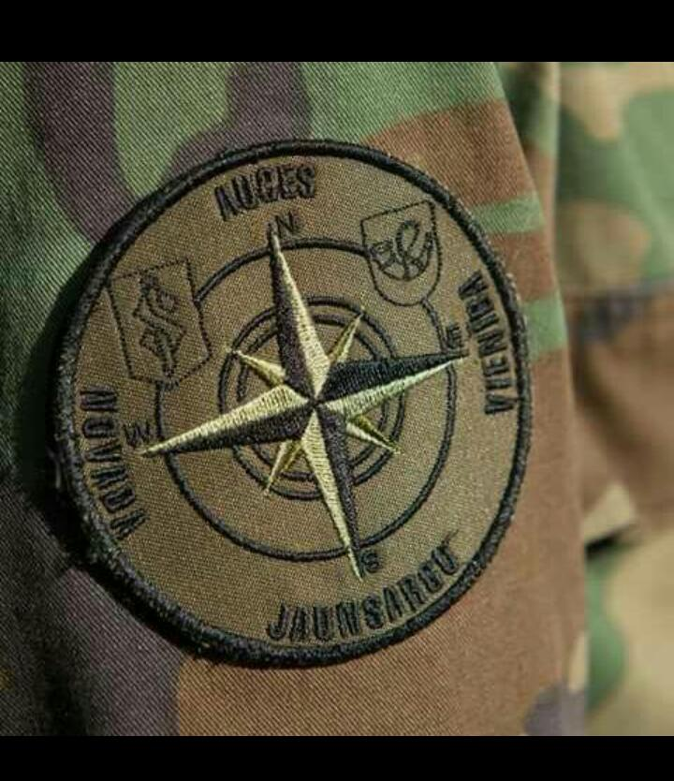
Youth Guards emblems and uniforms
.

Slide 6
Thank you for your attention!
.

