Slide 1
Winter sports in Auce, Latvia

Slide 2
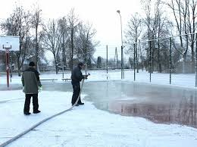
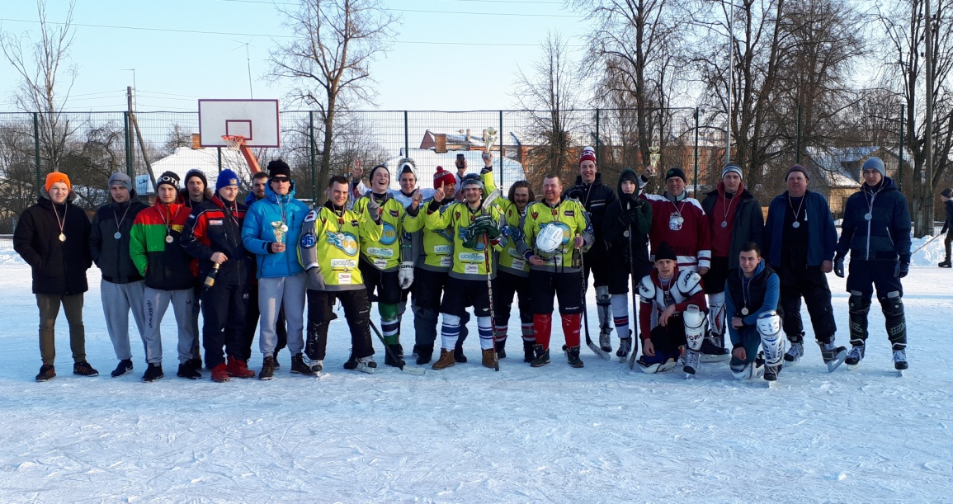
HOCKEY
During winter we have hockey matches in our hockey rink.
In the winter we use our school’s new multifunctional stadium as a hockey rink by pouring water over it.

Slide 3
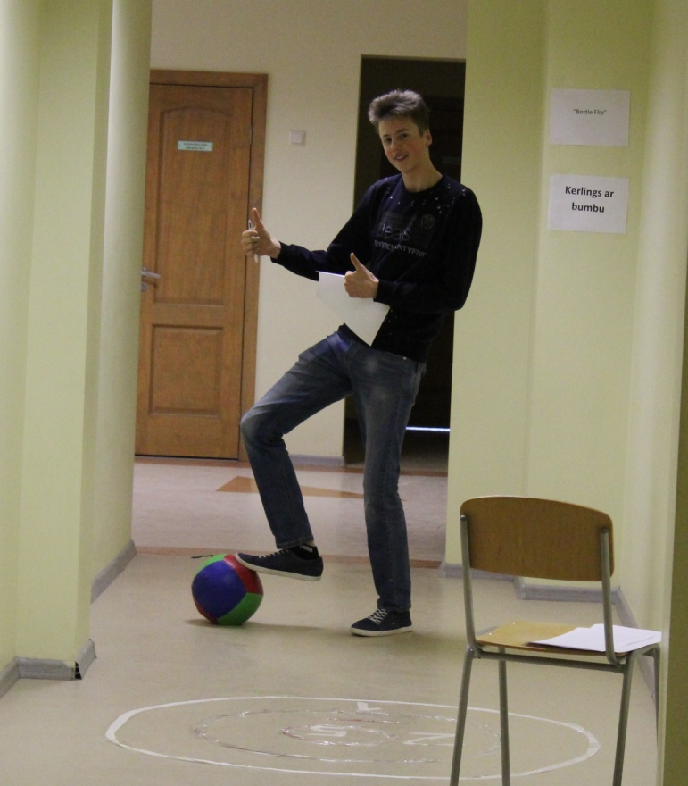
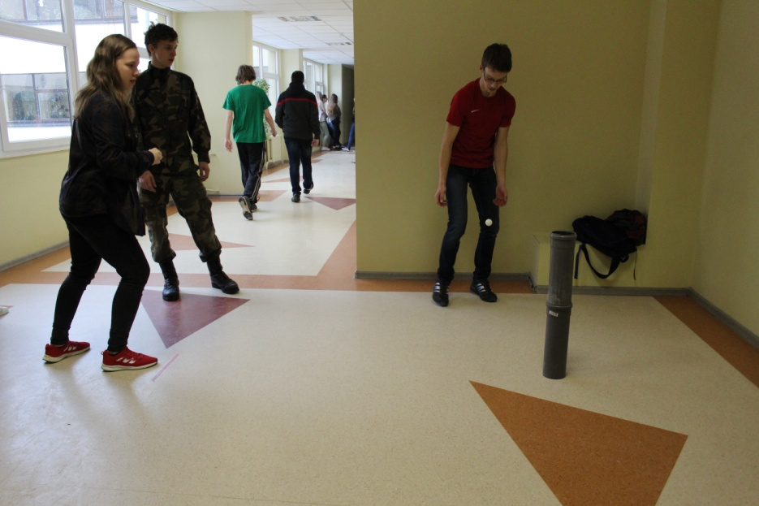
Indoor sports
In the winter we have indoor sports
(indoor Olympics).

Slide 4
