Slide 1
Olympic day 2016
Latvia Auce

Slide 2
Olympic day 2016 Latvian motto is “Hand me the ball”, because it is dedicated to the promotion of Olympic sport- volleyball .
Students are active and fun people who are able not only to learn and have fun, but also to participate in different sports. Our families also have and love active ways of relaxation, bringing together both large and small families for exciting sports matches.
The Olympic day is the only global event, which is annualy organized by the Olympic movement.
On the Olympic day there is a chance to get a closer look to the Olympic sports,to meet up with Olympians in person and try out different sports together.

Slide 3
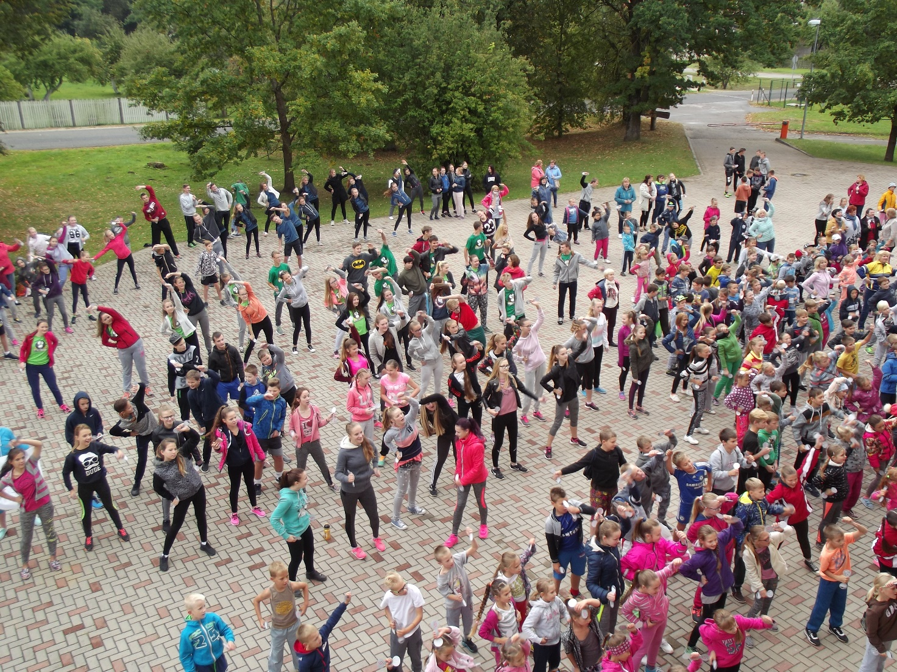
On the 23 September in Latvia there was “The Olympic day 2016” which gathered 123 353 participants in 531 places.

Slide 4
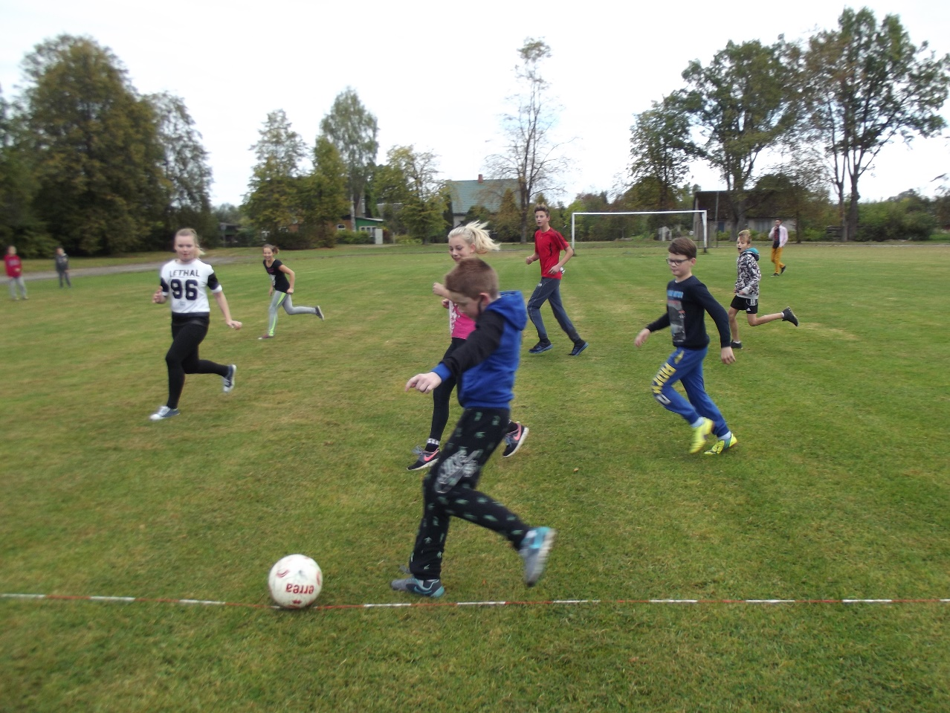
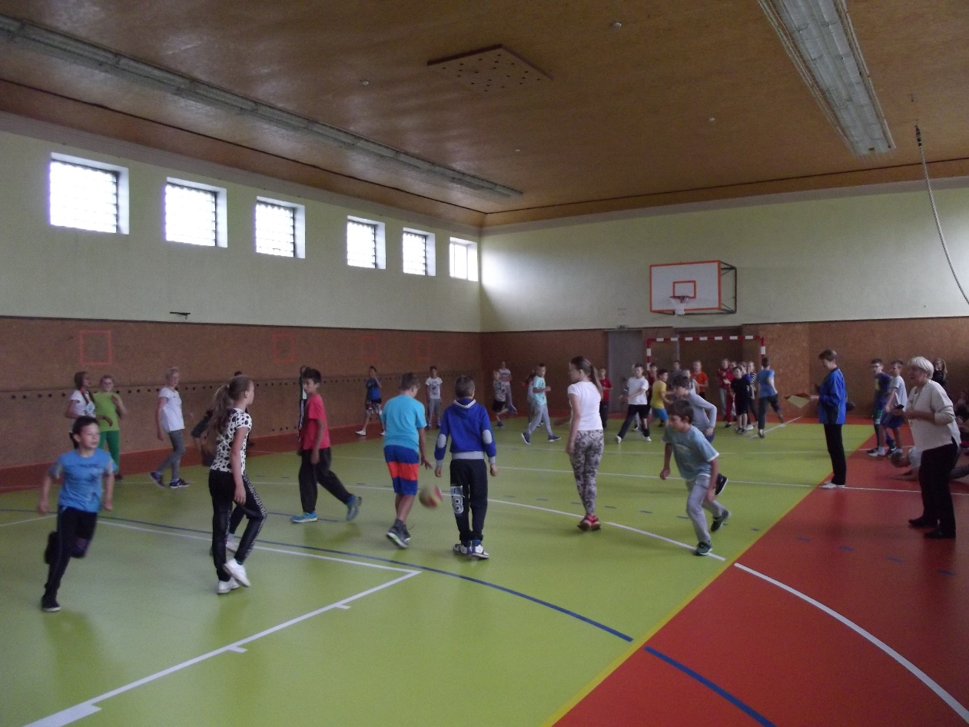
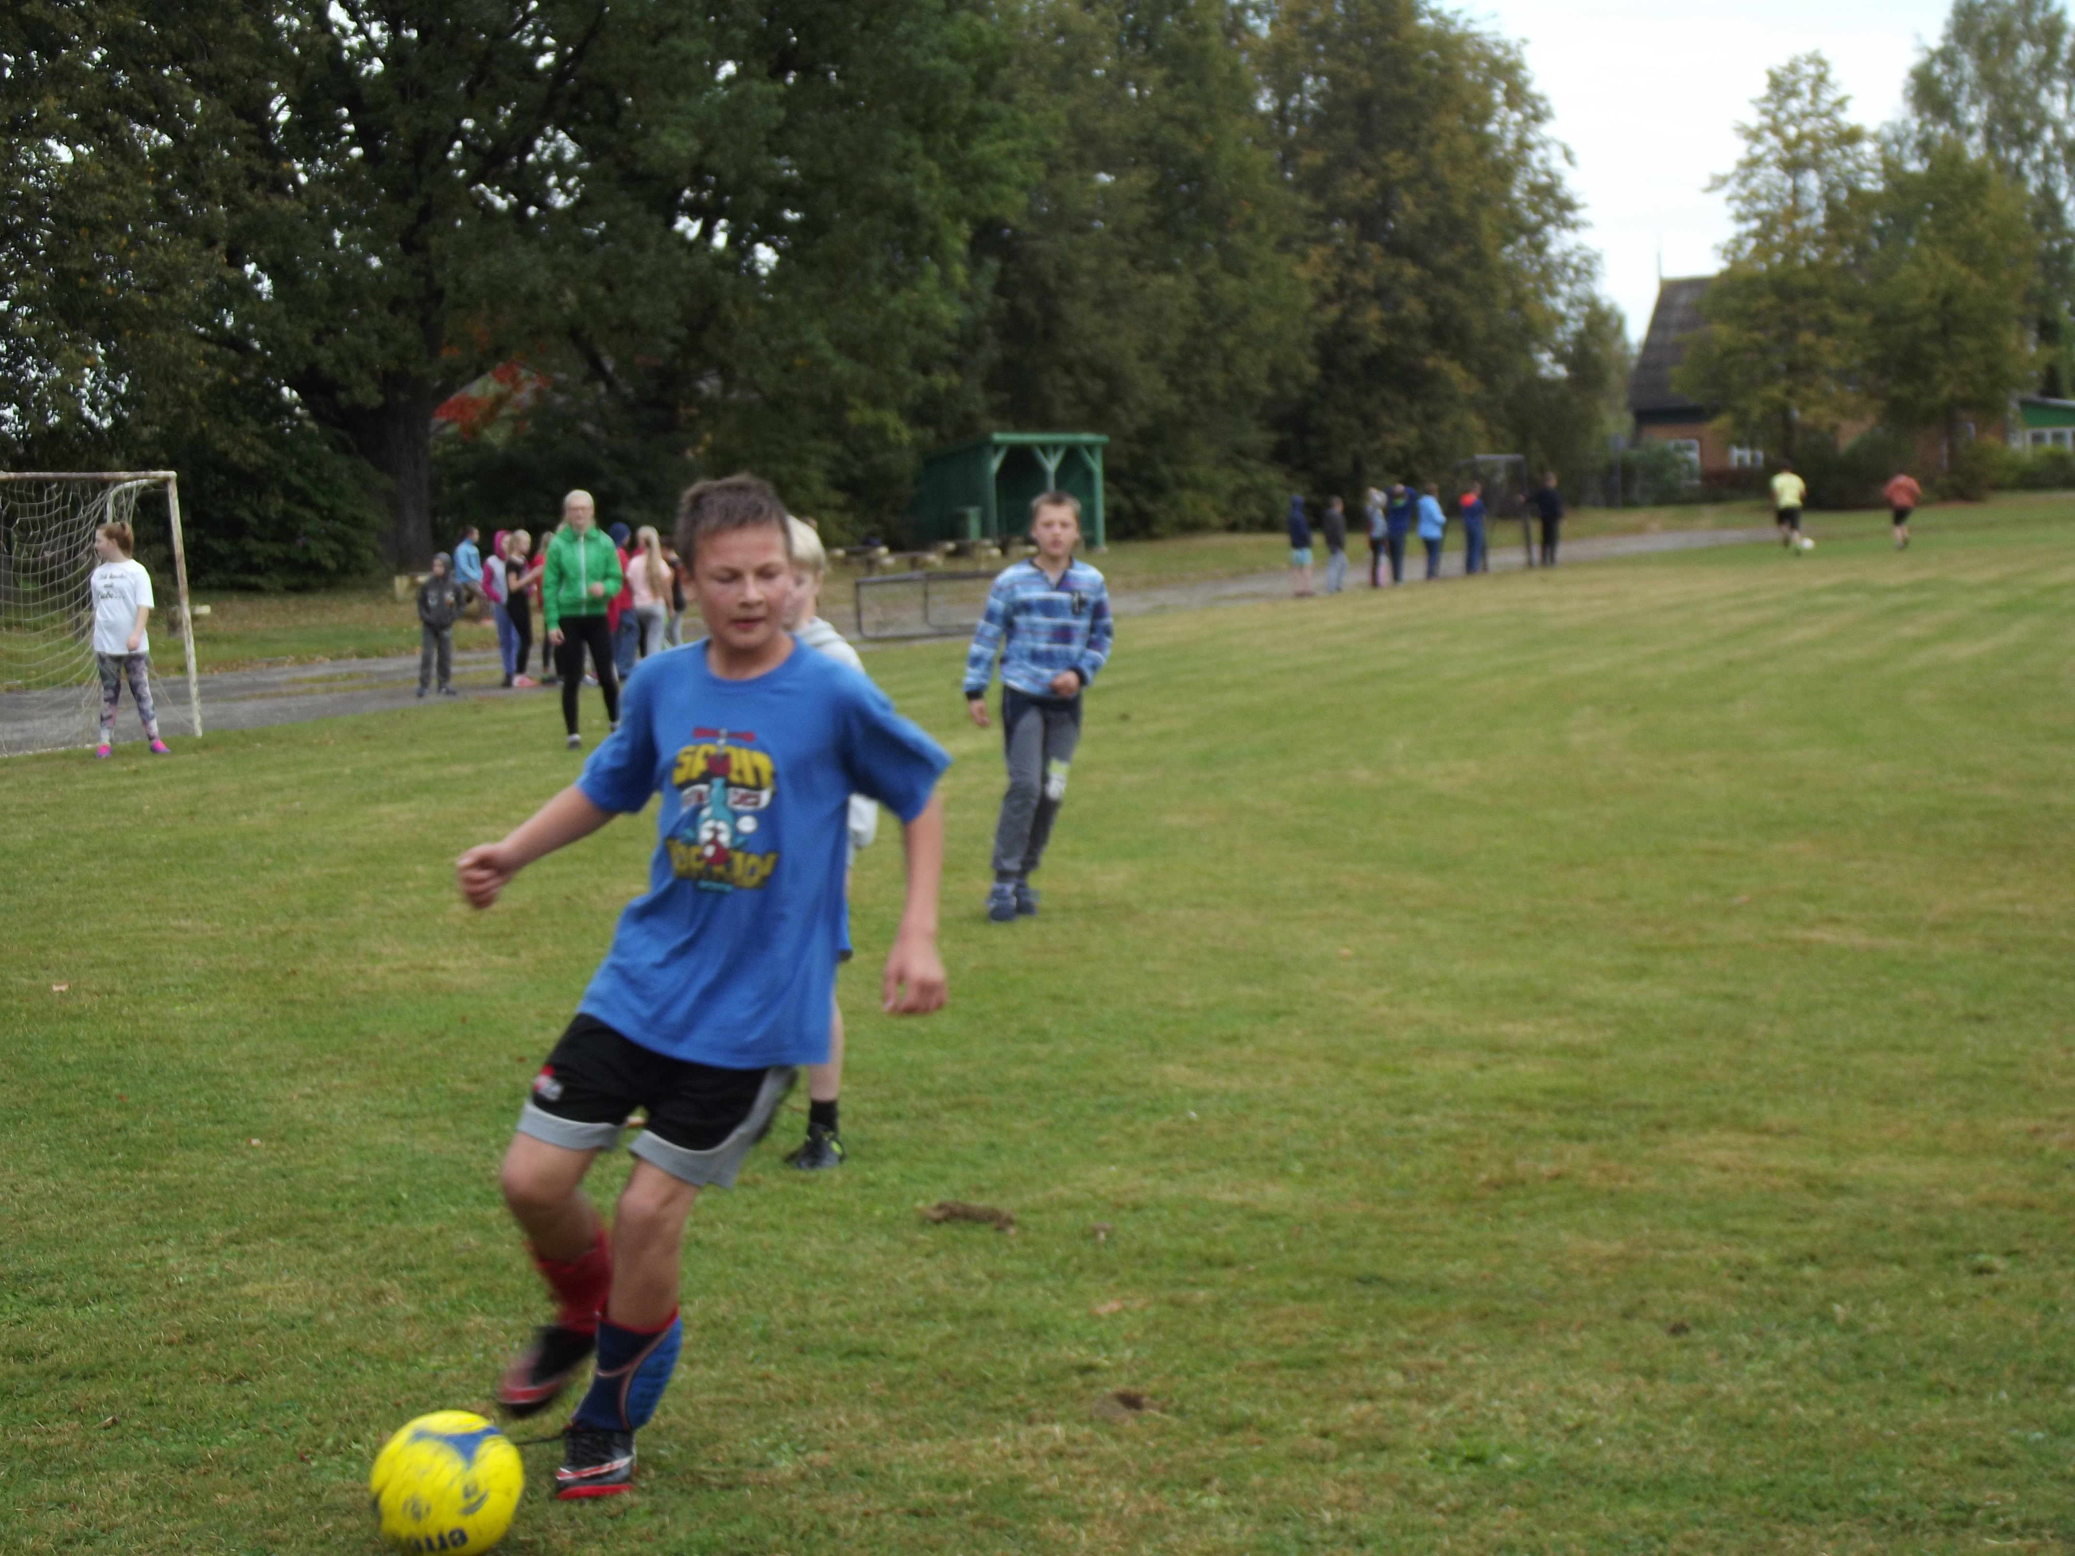

Slide 5
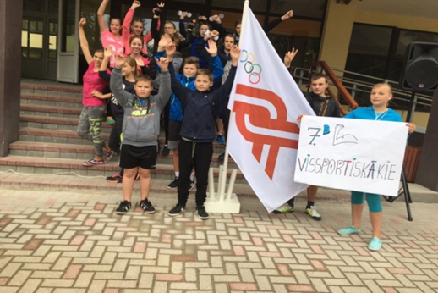
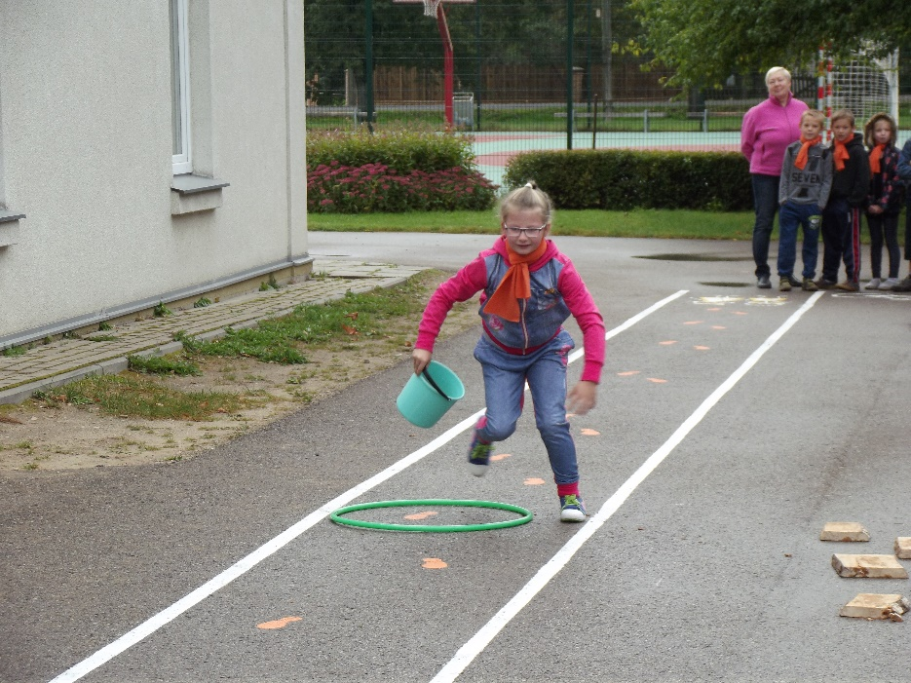
All students from our school paticipate in Olympic Day. We always are close to the victory but still lack of a few points do not let us to win. We know that we are the greatest anyway!

Slide 6
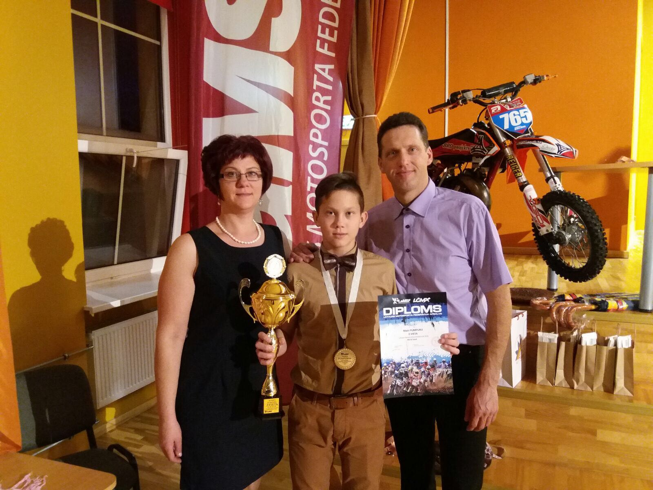
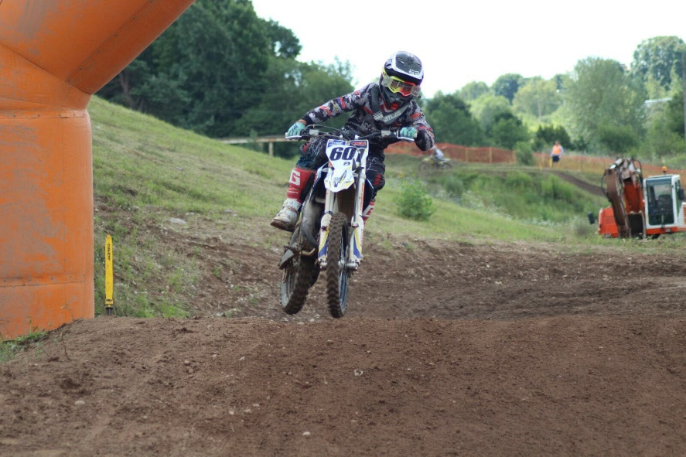
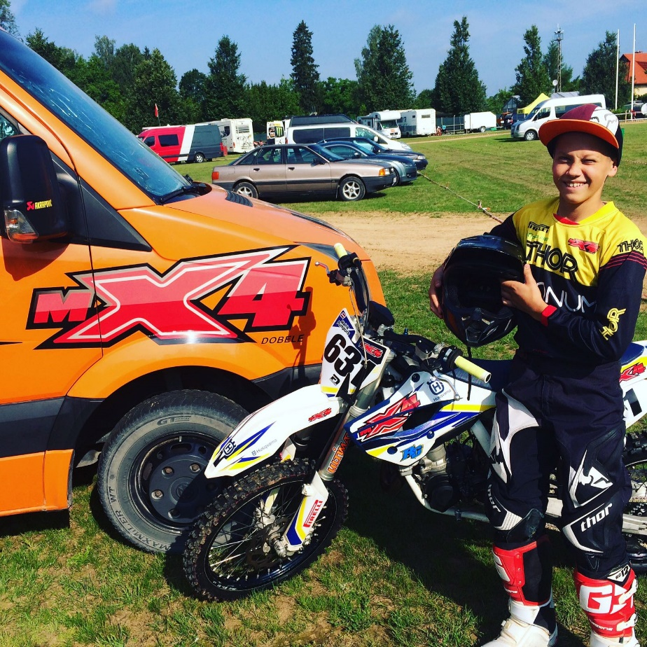
Some of our classmates are more active than others. They train in motorcycle racing, handball, ice hockey etc.
Mairis Pumpurs-motorcycle racing

Slide 7
Thank you for your attention!

