Slide 1
The school’s vision: "En glad skole med aktive og nysgjerrige elever." ”A happy school with active and curious students”
Hof is situated approximately a 45 minutes drive south of Oslo. It is a rural area with around 3000 inhabitants. There are three lakes in Hof, and the environment really encourages outdoor activities. There is only one school in the municipality, Hof school.
The school has all together 430 pupils aged 6-16. The staff counts 68 allocated on the primary level and the lower secondary level.

Slide 2
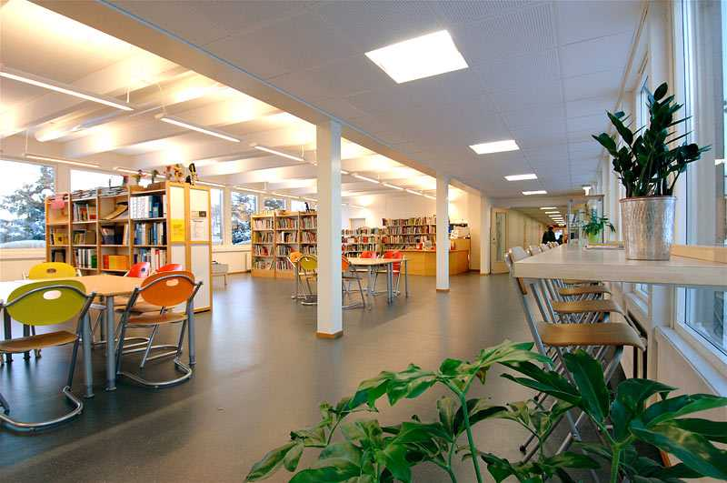
The pupils have their own council with two representatives elected from each class. The council has a focus on taking care of the pupils’ interests.
Facilities: We have a canteen for the students in grade 8- 10. The pupils take part in running the canteen. The canteen is a pupil enterprise where they can buy healthy food or enjoy their own packed lunch. The library is situated in the middle of the school. All the pupils can use the library’s facilities during the school day. It is a popular place to sit and read books and magazines.
The lower secondary level grade 8-10 (age 13-16) has approximately 130 pupils and is a separate department. The subjects being taught are Norwegian, English, Social Studies, Science, PE, Religious and Ethical Education, Mathematics, Arts and Crafts, Foreign Languages (French, German and Spanish), Music, Food and Health (grade 6 and 9).

