Slide 1
Food and Health- It’s better to prevent than to cure
Different work-outs in Auce secondary school
Latvia

Slide 2
Our school has two sports halls, But they do not reside in the same building. boys exercise In One of them, but girls in the other one.

Slide 3
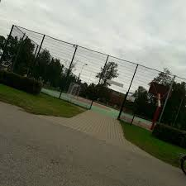
When it is warm, sports lessons are held outside in the fresh air in the new sports field.the outdoor training machines are located next to it

Slide 4
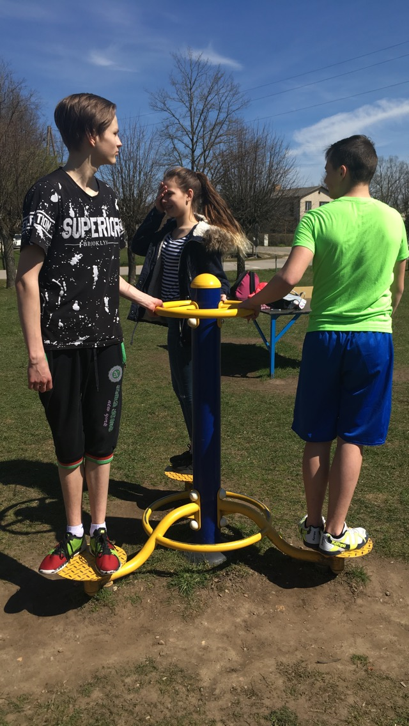
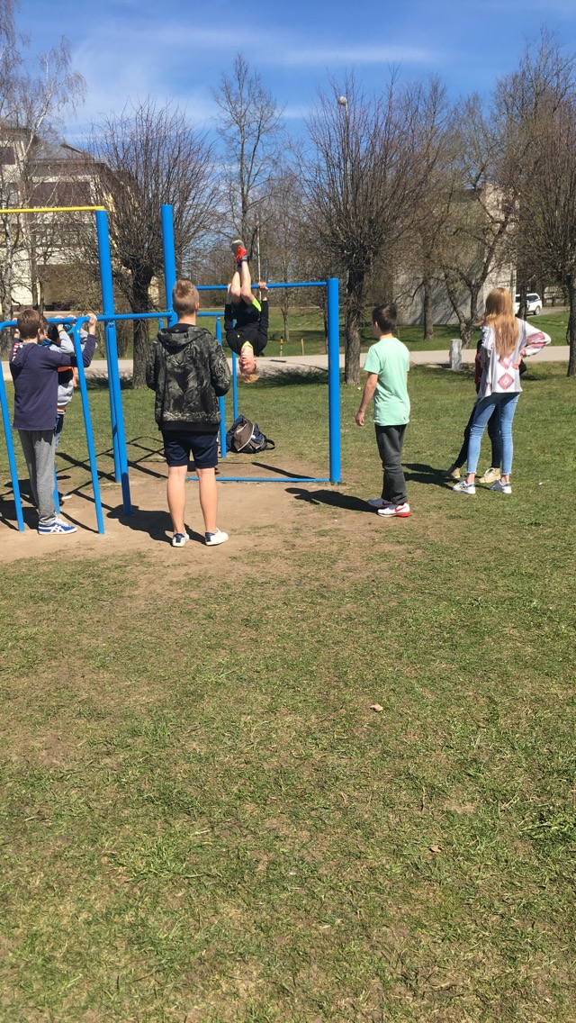

Slide 5
In Sports lessons we warm up our bodies by running, doing various strength exercises and activities, playing basketball, football, handball.

Slide 6
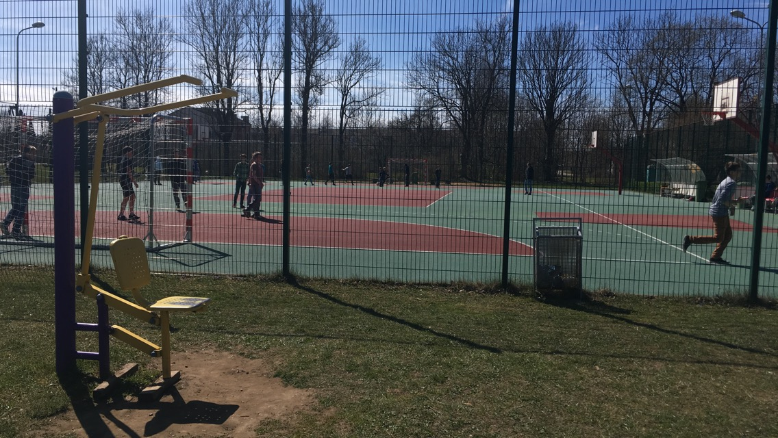

Slide 7
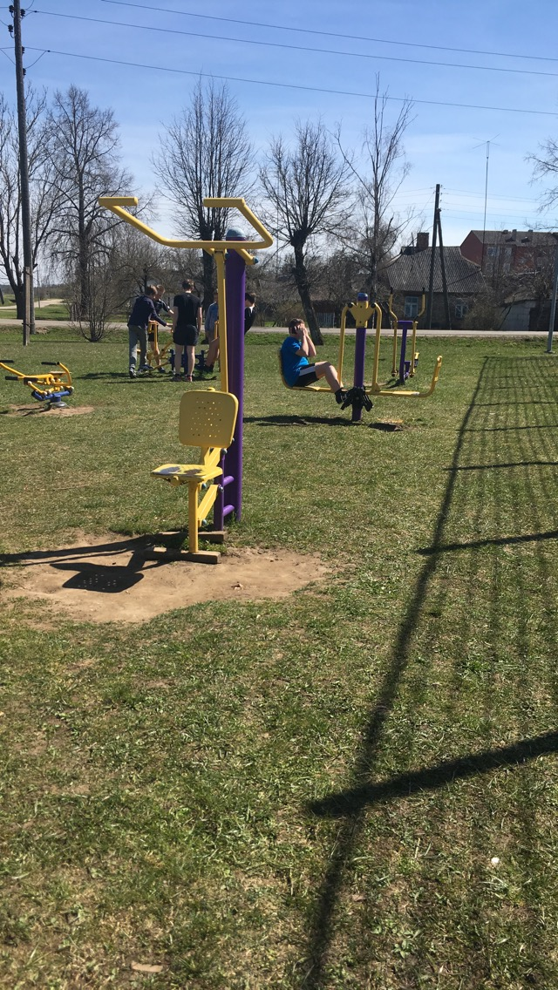
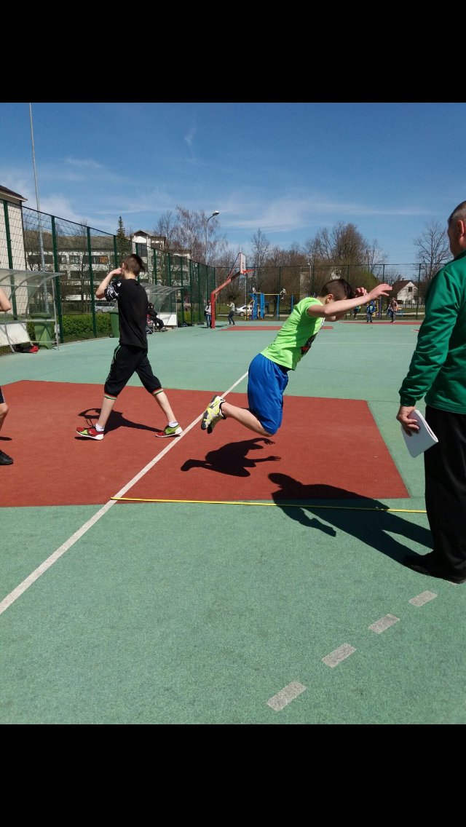

Slide 8
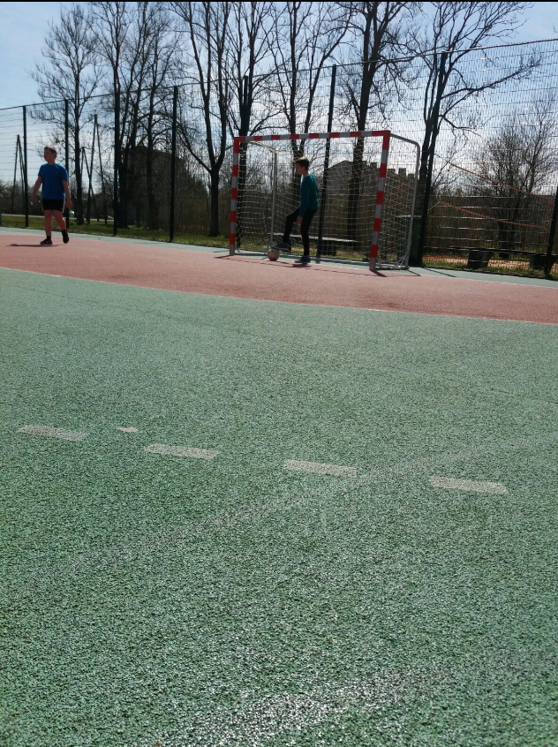
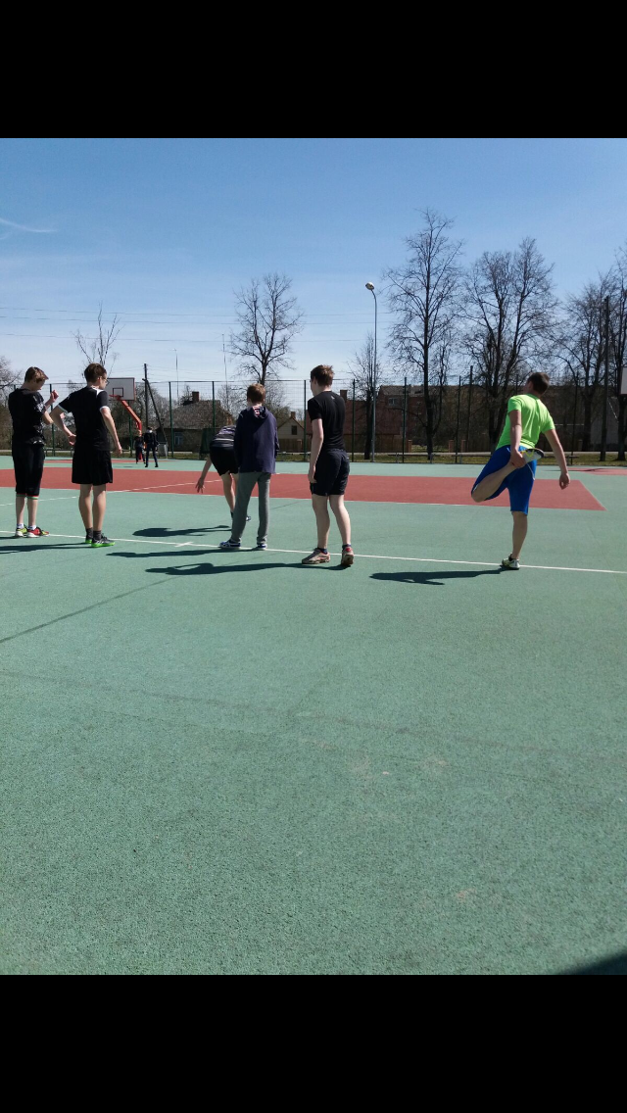

Slide 9
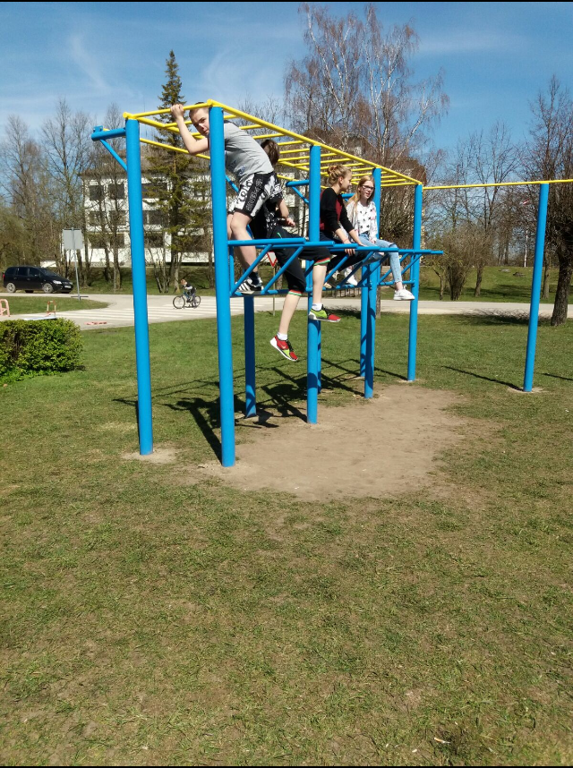

Slide 12
thank you, for your attention!☺

