Slide 2
Karel Čapek
R.U.R
Adam Skokan

Slide 3
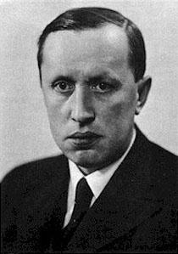
Karel Čapek
Karel Čapek was a writer, journalist, dramatist, philosopher, photographer and a translator
The genre of his works is a science fiction and his theme was literature for teenagers
In 1915 he finished his studies at Filosofická fakulta Univerzity Karlovy in Prague and received his doctorate.

Slide 4
Other important works
Karel Čapek's most famous works are:
R.U.R
Loupežník 1920 komedie
Ze života hmyzu
Věc Makropulus
Válka s Mloky
Bílá nemoc
Matka
Krakatit

Slide 5
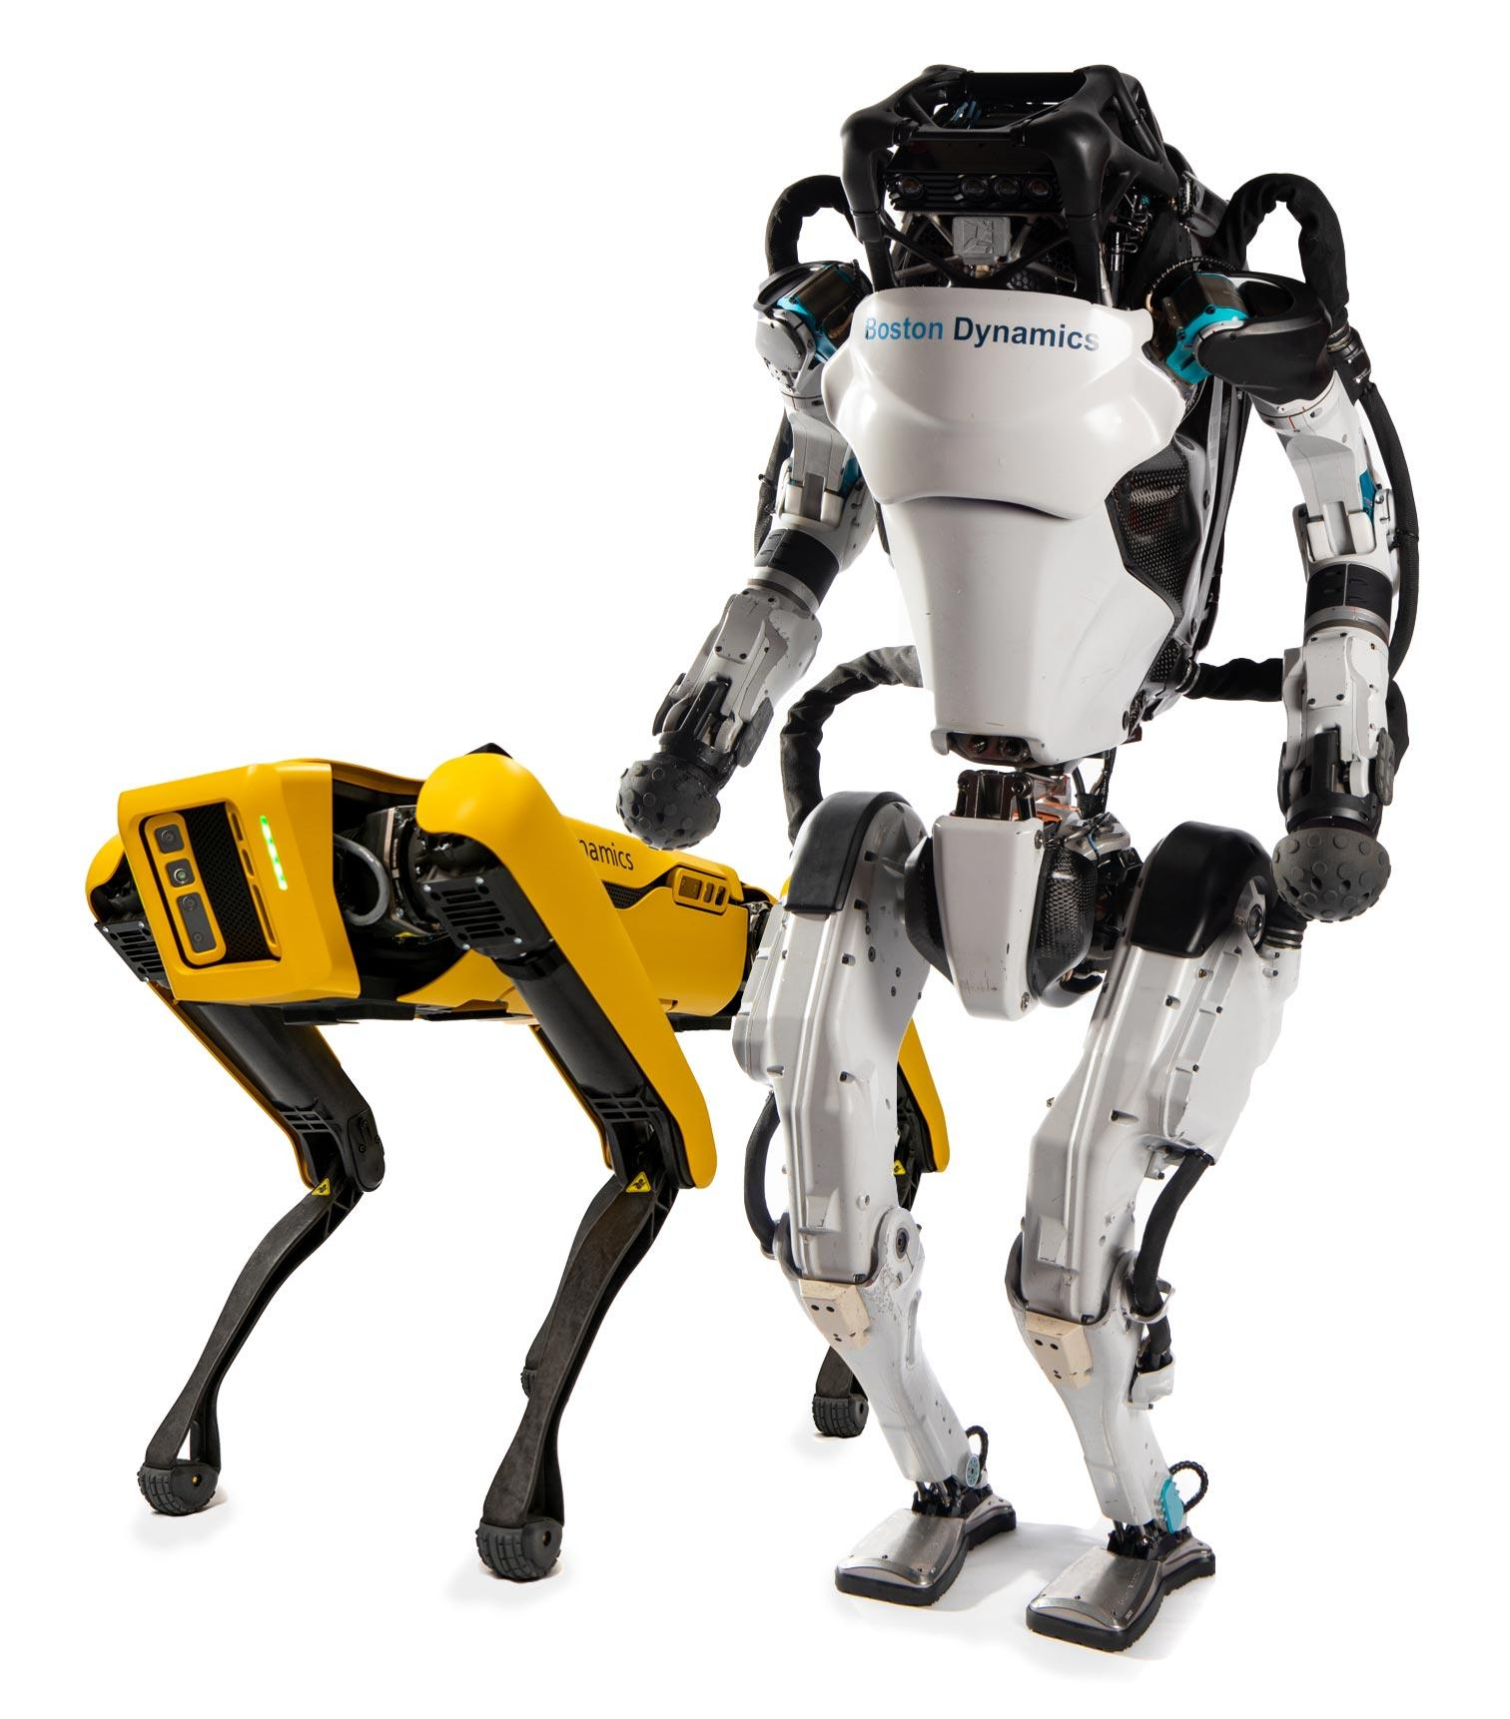
What does R.U.R. mean?
R.U.R. is an abbreviation for Rossum’s Universal Robots.
The word robot was created by Karel's brother Josef because Karel didn't know how to name a machine, that looks just like a human but doesn't have feelings.
The word robot is derived from a word robota - work in English

Slide 6
Analysis of the book R.U.R.
Rossum’s Universal Robots - R.U.R.
Released: 1920
Literary form: prose
Literary genre: science fiction
R.U.R. was Karel's first international success.
The theater play was translated into many languages.

Slide 7
R.U.R. - Story
The story begins with the president’s daughter Helena, that wants to see the production of the robots. She wanted to find out why robots don’t mind being treated like machines. Robots cannot be distinguished from humans but they don’t have human feelings. At first, Helena thinks that the robot assistant Sulle is a woman but in reality, she is a robot. Helena stays in the factory and marries Domin and the story transfers 10 years into the future. After 10 years the robots are being used in wars. The world begins to be full of robots and humans are not having children. The robots begin to rebel against humans. Helena is not happy about the robots controlling the world so she burns the blueprints for their production. In the end, the robots almost murder the whole population but after 20 years without help from humans, the robots will eventually extinct too but 2 robots Helena and Prima will survive.

Slide 8
Analysis of the main characters
Helena Gloryová - young, pretty, intelligent lady, later Harry’s wife.
Alquist - robot builder, work, and human life are most important for him.
Harry Domin - central manager of the factory R.U.R., he wanted to create a heaven on earth.
Dr. Gall - manager of the physiological research department of robots.

Slide 9
Side characters
Nana - maid, representative of the common people
Consul Busman - General manager of R.U.R. - short-sighted, fat jew
Ing. Fabry - general technical manager of R.U.R - He often sees things from a technical perspective
Dr. Hallemeiner - Head of the Institute for Psychology and Robot Education

Slide 10
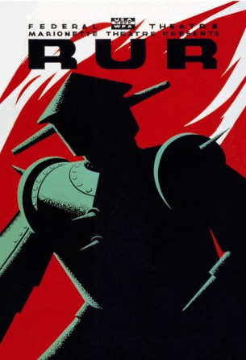
Robot development
a) manpower in human service
b) soldiers
c) organized power that wanted to rule
d) murderers

Slide 11
My own opinion
The book was fun to read and I think that the motive of the book is true. Nowadays robots are being used more and more and there are people that are worried about a potential rebellion.

Slide 12
The end
Thanks for the attention

