Slide 2
Karel Čapek: R.U.R
Michael Oulehla

Slide 3
History of R.U.R
R.U.R is a drama in three acts
a theatrical play that first appeared in Aventine in 1920
it premiered at the National Theater in Prague on January 25, 1921 and achieved 63 reruns
drama R.U.R was the first to reach truly global significance
soon it was released in France, Germany, USA, Norway and even in Japan and other countries

Slide 4
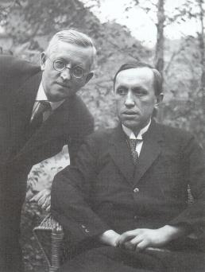
PhDr.Karel Čapek
born January 9, 1890 (Malé Svatoňovice) and died December 25, 1938 (Praha)
he was well-known Czech writer, intellectual, journalist, playwright, translator and amateur photographer
he was the younger brother of the painter and writer Josef Čapek
the genre of his works was predominantly Science fiction

Slide 5
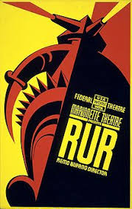
Famous works
His most famous works include:
R.U.R
Válka s Mloky
Bílá nemoc
Krakatit
Věc Makropulos
Matka
Ze života hmyzu
Dášenka

Slide 6
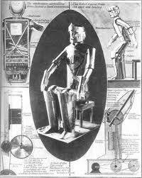
R.U.R = ROSSUM’S UNIVERSAL ROBOTS
a science fiction drama that expresses concern for the future of humanity
in this work the word “ROBOT” was used for the first time, which is still used all over the world, it was invented by Josef Čapek
the word robot is devired from the word robota (= work)

Slide 7
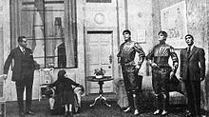
Book analysis
Release: 1920
Literary form: Prose
Literary type: scientifically fantastic drama
the book has been translated to 30 languages
it has foreplay and three acts
it was the first international success of Karel Čapek

Slide 8
A brief story of the book
The story begins in the office of a robot factory, where Helena, the daughter of President Glory, arrives to come and see the production of artificial people. At first, she didn't want to believe they were really living robots. She wanted to find out why the robots didn't mind treating them like machines. These robots were indistinguishable from humans, they just had no feelings. Harry Domin, who is the central director, is sitting in the office, and Helena will marry him later. The story moves 10 years later, when robots are also used as soldiers and humans are childless. Helena still promotes the idea that robots should have the same rights as humans.

Slide 9
A brief story of the book
And she doesn't understand why robots let themselves be manipulated. However, one day, the robots rebel and want to destroy the human race. Unfortunately, no one will be able to leave the island. Helena no longer wants more and more robots to be made, so she burns all plans to make them. Robots kill all but one person - Alquista, who works like a robot. He eventually finds two living robots, Prima and Helena, who have emotion and love in them. These two are different and may be the beginning of a new civilization.

Slide 10
The main characters
Harry Domin - Central Director of a Robot Factory
Helena Glory - intelligent, young lady
Alquist - robot builder
Dr. Gall - Head of the Physiological Research Department of Robots

Slide 11
Minor characters
Dr. Hallemeiner - Head of the Institute for Psychology and Robot Education
Nána - maid
engineer Fabry - General Technical Director R.U.R
Consul Busman - General Commercial Director R.U.

Slide 12
My opinion on the book
The book was good to read, it’s indeed interesting and also true and instructive. It predicts our possible future, as we can already witness the automation of the world today.

Slide 13
The End

