Slide 1
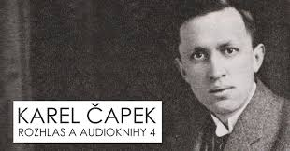
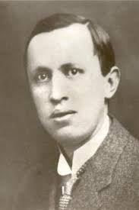
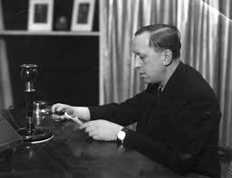
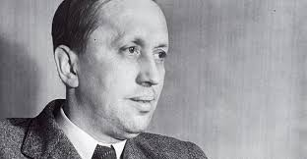
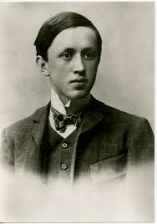
KAREL ČAPEK - R.U.R.
Aneta Šanovcová

Slide 2
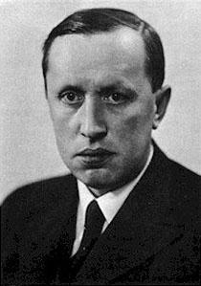
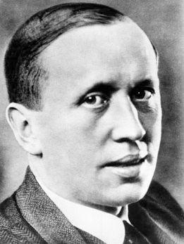
Karel Čapek
1890-1938
czech writer, journalist, politician
he wrote, for example, prose, drama, feuilletons
older brother Josef
mentally marked by 1st world war, did not trust technology because he didn’t like the progress of technologies for killing during the war
influence of civilism (shows technical conveniences, celebrates everyday things and human work)
fear of what would happen if humanity lost control of its inventions
pacifism (didn’t like wars)
1938 nominated at NC for literature
wrote between the wars

Slide 3
R.U.R.
R.U.R. = Rossum's universal robots
released 1920, premiere 1921
literary form: prose
literary type: anti-utopian drama
main idea: fear that human inventions win over people

Slide 4
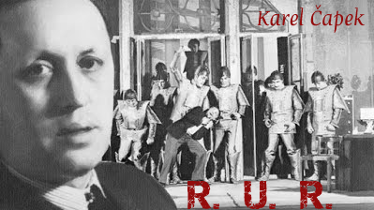
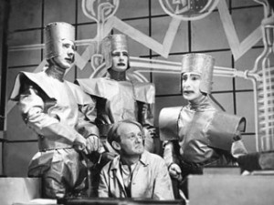
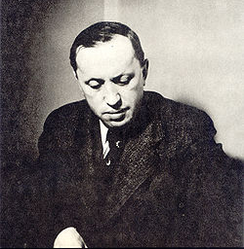
R.U.R.
The main characters:
• Helena Glory: the beautiful and intelligent wife of Harry Domino, a symbol of femininity, useless women (infertility), the most tragic character of the work
• Alquist: robot designer, likes life and human work; Čapek puts his thoughts into his mouth
• Harry Domin: factory director R.U.R., wishes to relieve people from work by creating robots, eg abolishing slavery
• Dr. Gall: Director of the Physiological Research Department for Robots, perfecting robots
Minor characters:
• Nana, Consul Busman, Ing. Fabry, Dr. Hallemeiner

Slide 5
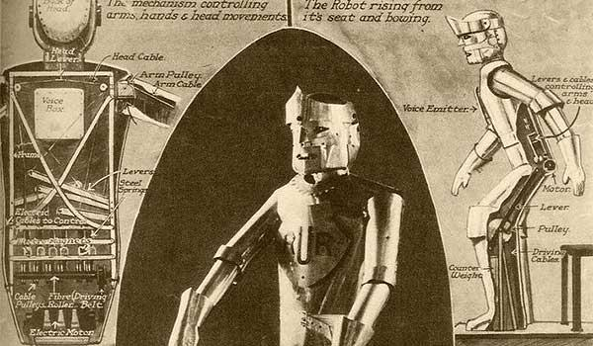
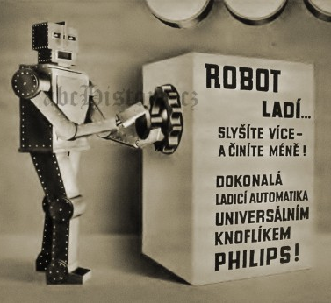
Robot
It is an international word coined by Josef Čapek.

Slide 6
How the story affects me?
The book was easy to read, but it seems pessimistic to me.
The topic is complex, but I was fascinated by the fact that Karel Čapek basically predicts the development of today's civilization.
Even today, people are increasingly dependent on their own inventions (mobiles,…)

