Slide 1
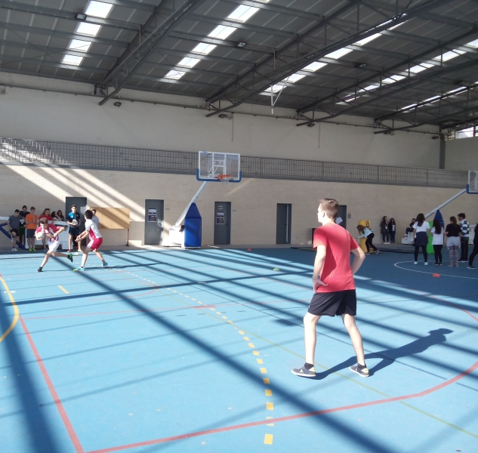
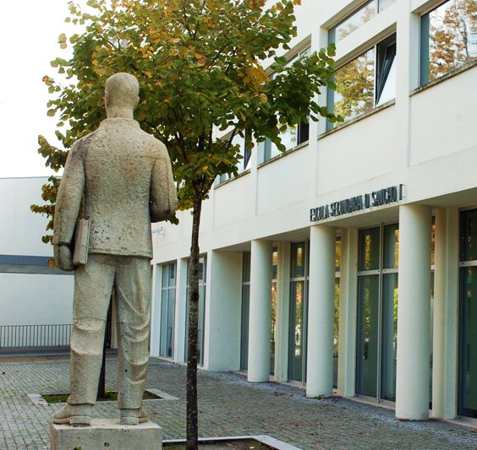
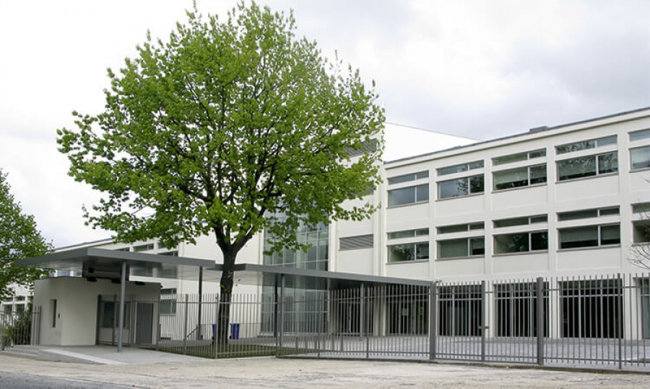
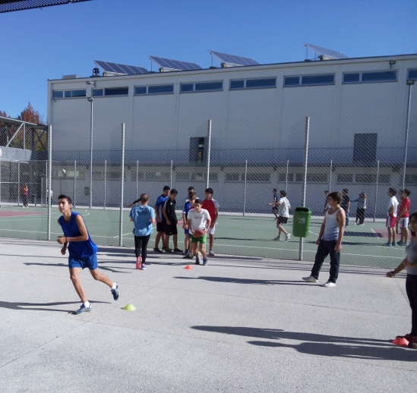
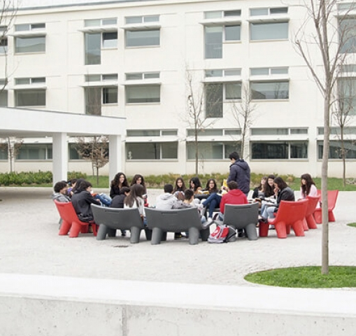
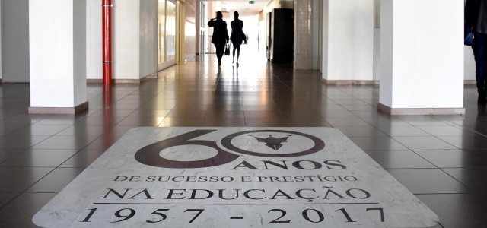
1
Agrupamento de
Escolas D. Sancho I

Slide 2
CONTEXT AND CHARACTERISATION OF THE AGGREGATION OF SCHOOLS
Agrupamento de Escolas D. Sancho I was created on 4th July 2012
It resulted from the aggregation of D. Sancho I Secondary school, the oldest in the region with the grouping of calendário schools, born in 2000.

Slide 3
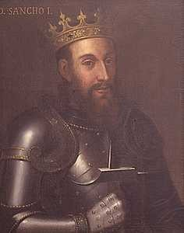
Patrono
In 1987, the commercial and industrial school became known as D. Sancho I secondary school in honor of the king who proclaimed the first out-of-town family home in 1205.

Slide 4
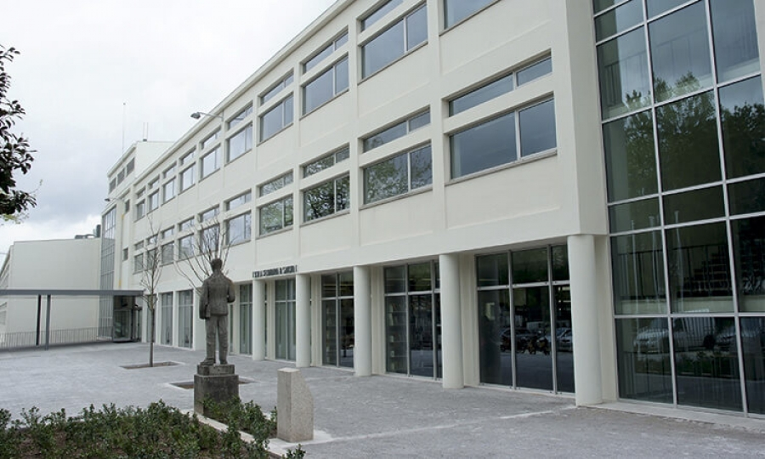
Secondary school D. Sancho I
D.Sancho I school was inaugurated on March 16th 1963
In 2010/11, it was included in the program of modernization and requalification of the school park.

Slide 5
The grouping of D. Sancho I schools is still in the process of consolidating its identity and culture. With the aggregation, schools were joined:
With different traditions and forms of work.
With very specific socioeconomic and cultural contexts.
With many typical school communnities.

Slide 6
Mission
Build a culture and own identities with common properties, and work goals that identify this new organic unit
AE D. Sancho I proposes to provide its students with:
Solid academic training to provide them with the knowledge and skills necessary for further study and lifelong learning;
Quality vocational training to access the world of work;
Training in attitudes, behaviour and values that will provide them with active and transforming agents for the region and the country and that will contribute to their development.

Slide 7
Vision
AE D.Sancho I intends to continue as an educational reference in the region. Therefore, it aims to be a grouping of schools:
Inclusive and non-discriminatory
With a paradigma based on cooperation and the ability to learn and change
With management based on democratic, shared and representative leadership

Slide 8
Educational project general objectives promote:
School success;
Educational and technological innovation;
The values of discipline and mutual respect, tolerance and autonomy;
Social equity;
The participation of members of educational community;
The collaborative and articulated work;
Education for citizenship;
Health education;

Slide 9
Compliance with rules and discipline
Although EC does not have serious problems of indiscipline, measures are implemented to improve the school environment:
Creation of the students office to solve disciplinar problems and develop actions to prevent indiscipline.
´formation of a multidisciplinary team that acts in the measurement of conflicts and individualized support to students.
…

Slide 10
Impact of schooling on students´ progress
1- Promoting and enhancing adult education, by helping to increase the academic and professional qualifications of many local authocity workers.
2- The promotion of special education in all its specific curricular aspects, in order to promote social inclusion.
3- In the preventation of dropout through the implementation of the school and vocational guidance programme for 9 years and 12 years old.

Slide 11
Development of projects, partnerships and innovative solutions
The grouping is recognized in the community for its innovate work and peranent availability to embrace projects in partnership with various institutions and companies.
It makes the facilities available for the most diverse activities collaborates with institutions for the development of projects.
It integrates a good network of partnerships.

Slide 12
END

