Slide 1
Istituto Comprensivo “Marconi – Oliva”
Piazza Mitrano, 30
70010 - Locorotondo (BA)
tel/fax: 0039.080.4311074
Email address: baic83100b@istruzione.it
Website: www.icmarconioliva.it

Slide 2
Locorotondo

Slide 3
A town with a view

Slide 4
Our School
Our school consists of 3 departments:
Infant school
Primary school
Secondary school
They are located in different buildings. The picture is of our secondary school and main headquarter.

Slide 5
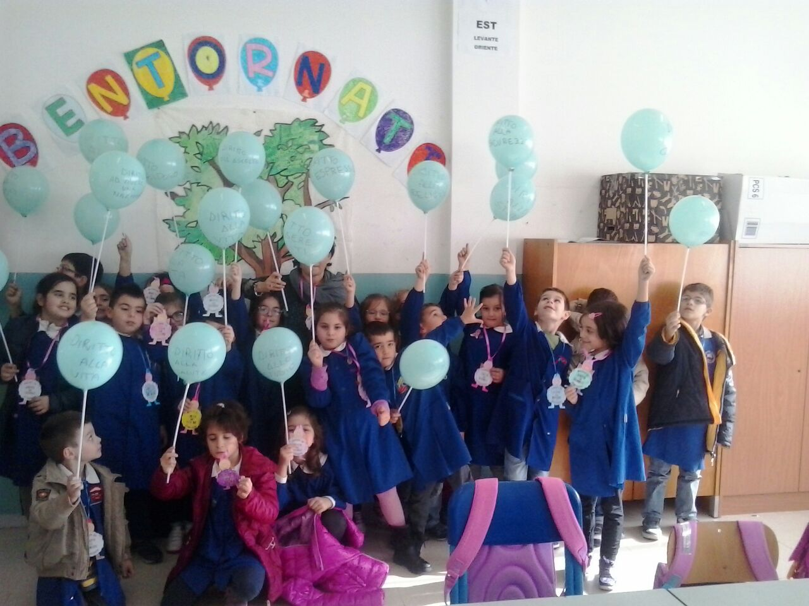
Our School
Infant School:
Teachers 35
Students 375
Buildings 4
Primary School
Teachers 52
Students 592
Buildings 3
Secondary School (junior)
Teachers 39
Students 435
Building 1

Slide 6
Our Head Mistress, Mrs Teresa Turi

Slide 7
We love our school!!!

Slide 8
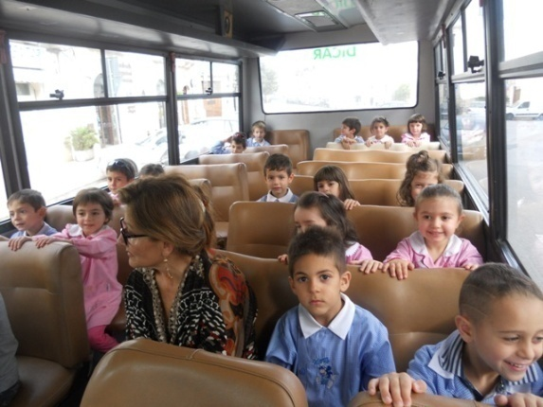
The Italian School System
Types of school:
Scuola Materna (Infant school)
Scuola Elementare (Primary school)
Scuola Secondaria di Primo Grado (Secondary School – junior)
Scuola Secondaria di Secondo Grado (High School – senior)

Slide 9
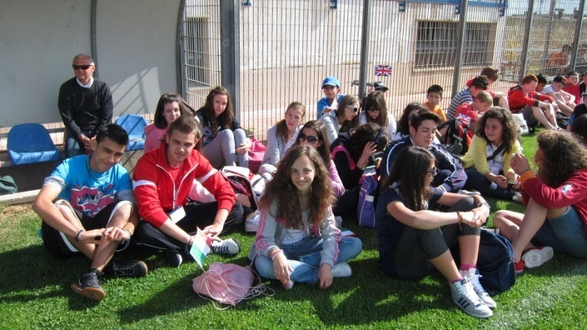
The Italian School System
Age of students
Infant School: 3 – 5
Primary school: 6 – 10
Secondary school (junior): 11 - 13
Secondary school (senior): 14 - 18

Slide 10
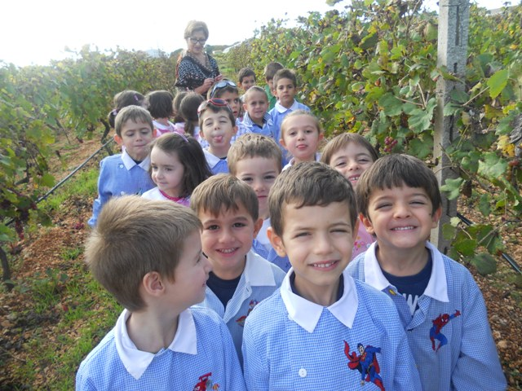
The Italian School System
School Day
Infant school: 8.30 am – 4 pm 5 days a week
Students wear uniforms
Primary school:
8.30 am – 01.00 pm 6 days a week
8.30 am - 4 pm 5 days a week
Students wear uniforms
Secondary school (junior): 8.00 am – 1.00 pm
Secondary school (senior): 8.00 am – 1.00 pm
In both Secondary levels, students do not have to wear uniforms

Slide 11
The Italian School System
National exams
Licenza Media
At 14 students have to choose a new type of school
Esami di Stato (Upper SC Diploma)
At 18 students can choose if they want to attend a University Course or start working

Slide 12
Keep your fears to yourself, but share your courage with others Robert Louis Stevenson

Slide 13
Locorotondo

Slide 14
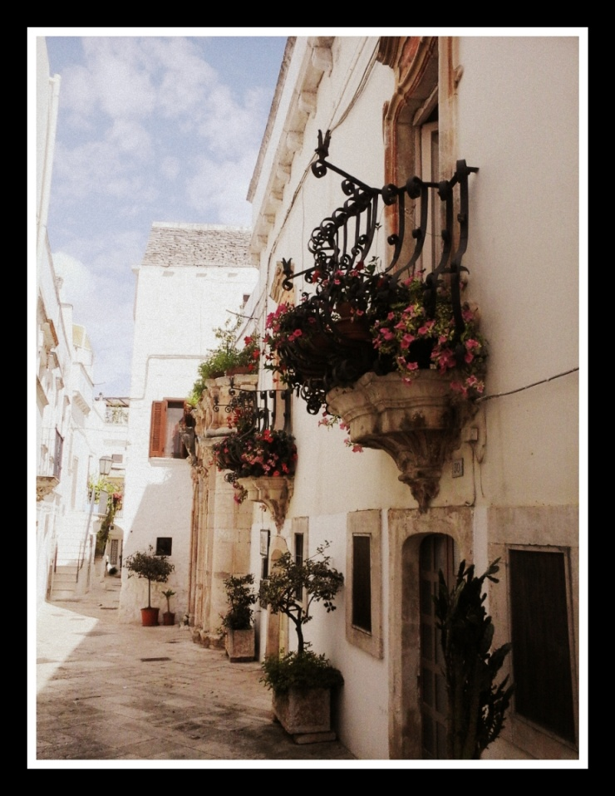
We are listed among the most beautiful villages in Italy

Slide 15
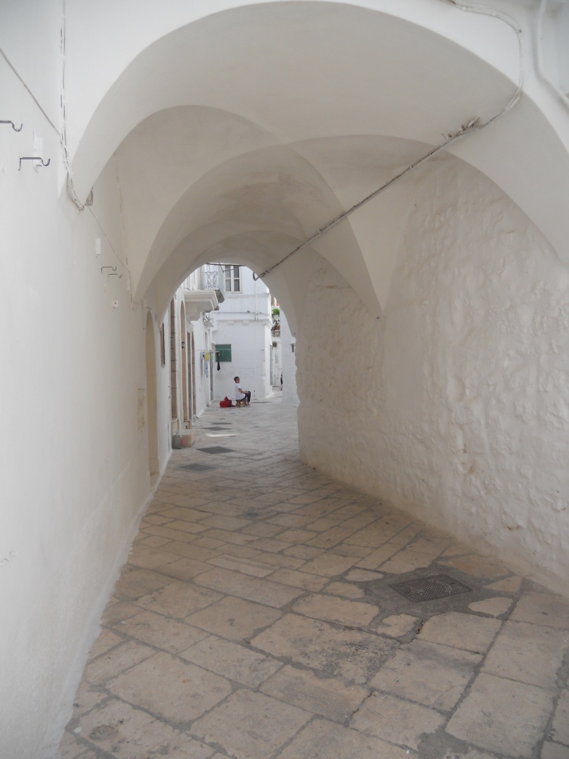

Slide 16
Main features in town
Baroque balconies
Several churches

Slide 17
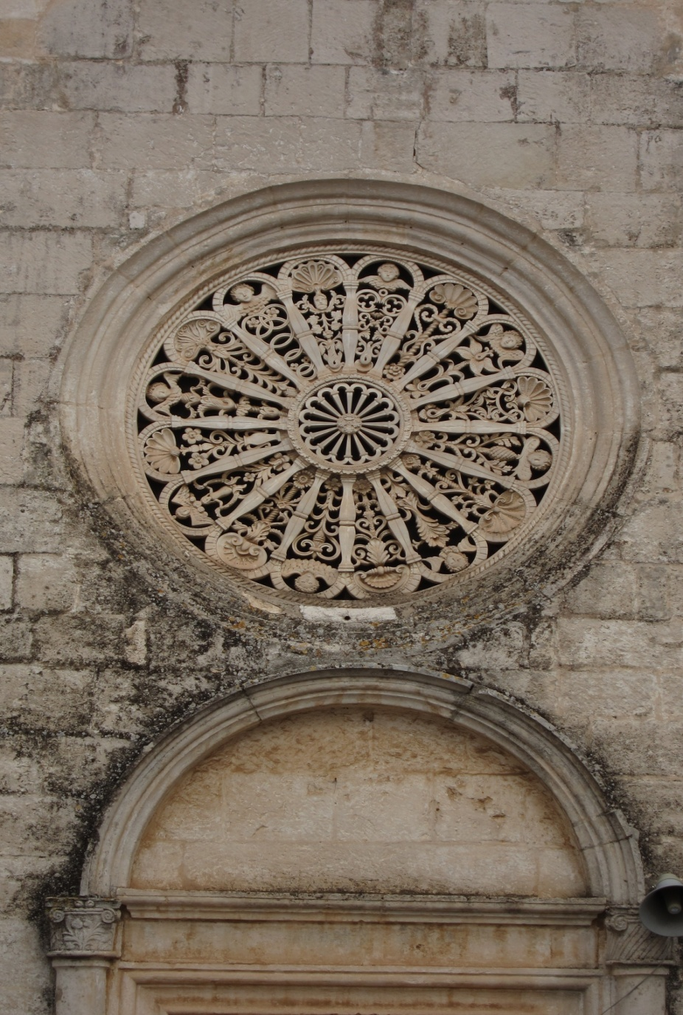
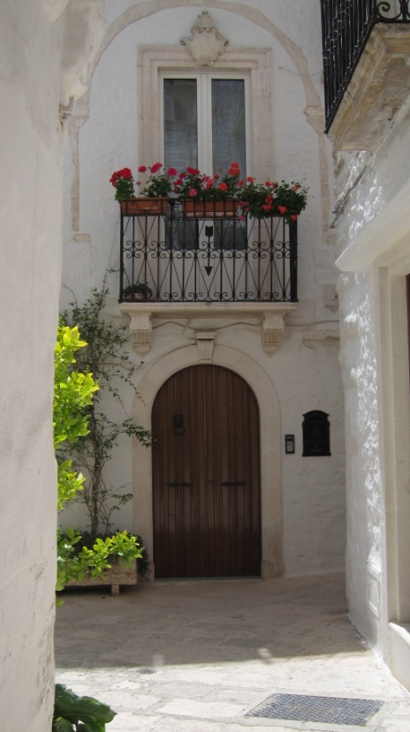

Slide 18
The gardens overlooking the Itria Valley

Slide 19
Around us...The Itria Valley
This valley gathers our typical houses, olive trees,
vegetation and our cultures…

Slide 20
Around us...
We are close to the Adriatic Sea, only 20 minutes by car .
We are between the Adriatic and the Ionian seas…

Slide 21
Alberobello, the capital of the trulli (5 miles from us) is a Unesco Site.

Slide 22
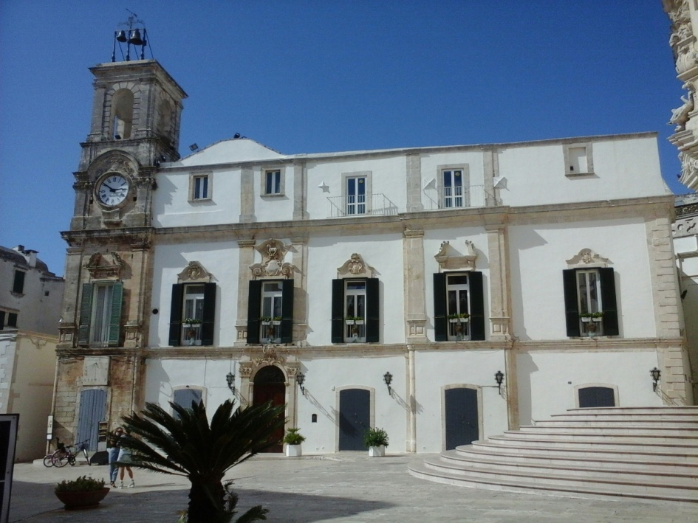
Martina Franca

Slide 23
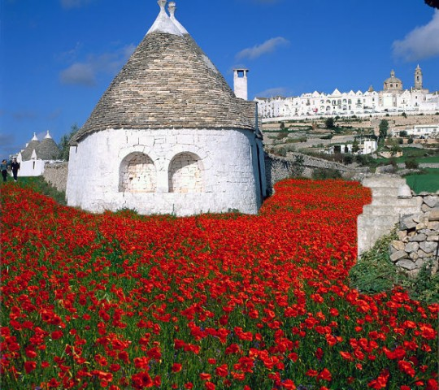
Matera, 2019 European capital of Culture is not very far from us

Slide 24
You must be the change you wish to see in the world (Gandhi)

