Slide 1
FELEKŞAN FIRAT SCHOOL
İKLİM AYTEN ÇELİK
ÖZLEM ŞİMŞEK
FADİME VERA ÇÖKEK
İREM ALKAN
DOĞA ÇAVAŞ

Slide 2
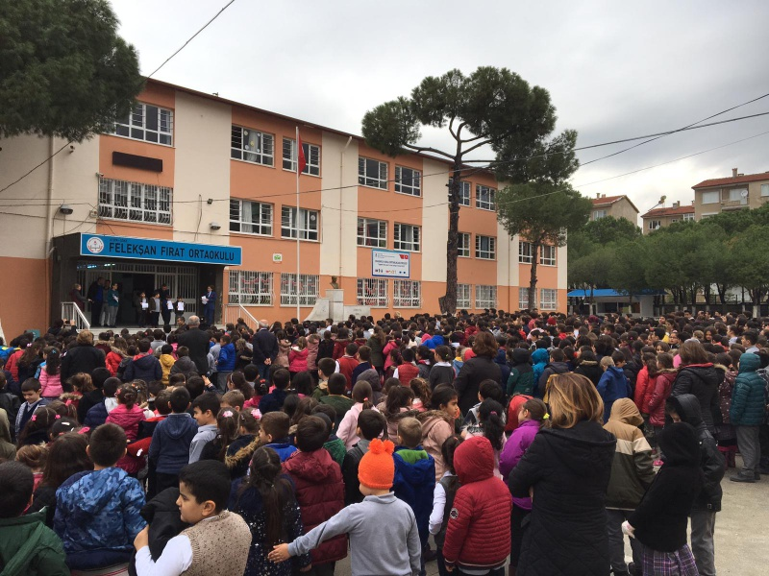
Felekşan fırat
There are fifty teachers in our school and around a thousand students.
There are about thirty students in each class.
Our school was established in 1980.

Slide 3
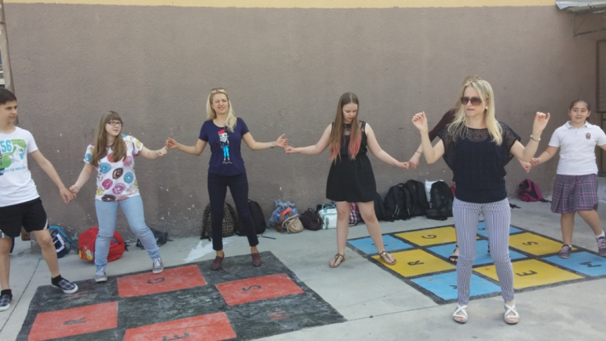
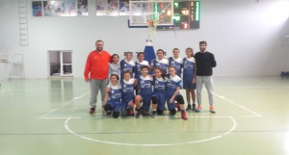
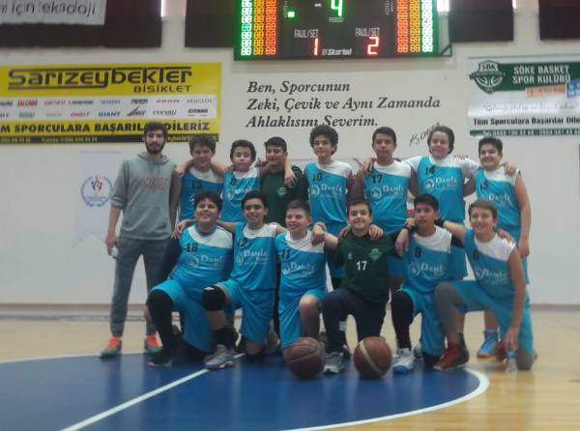
Our school has achieved success in many fields.

Slide 4
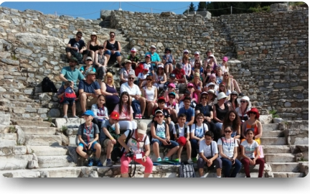
Various events are organized in our school
Schooll Trips

Slide 5
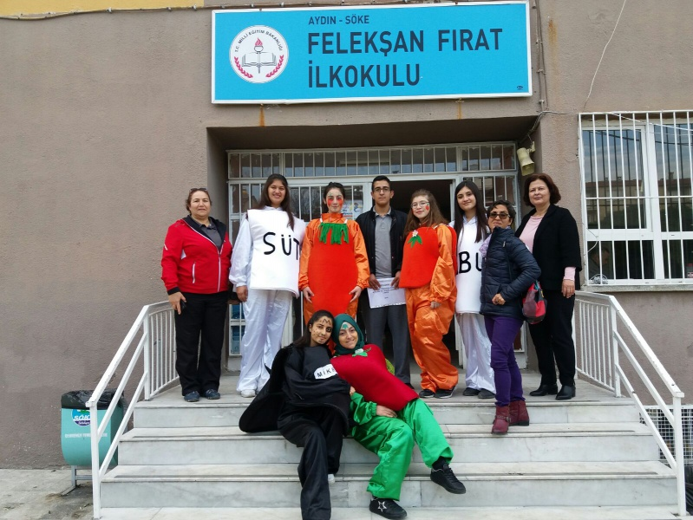
Our school regularly celebrates local goods week

Slide 6
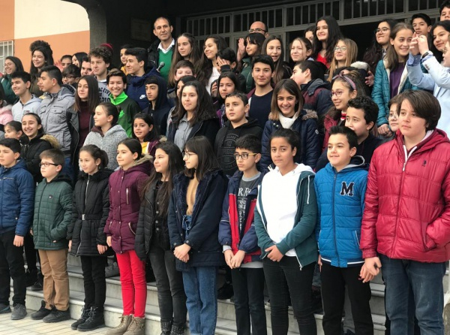
The begining of the holiday

Slide 7
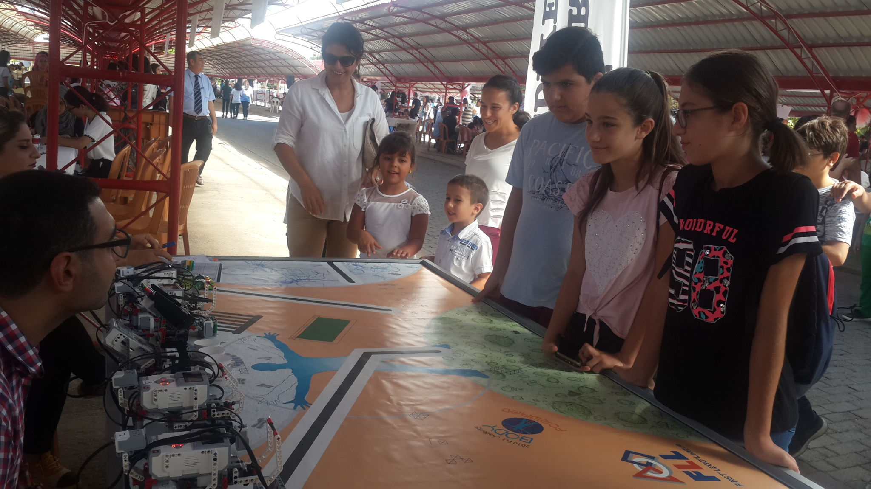
Our robotic projects

Slide 8
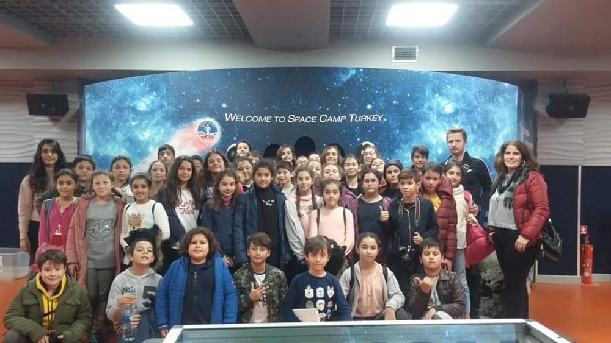
Our school's educational trips.

Slide 9
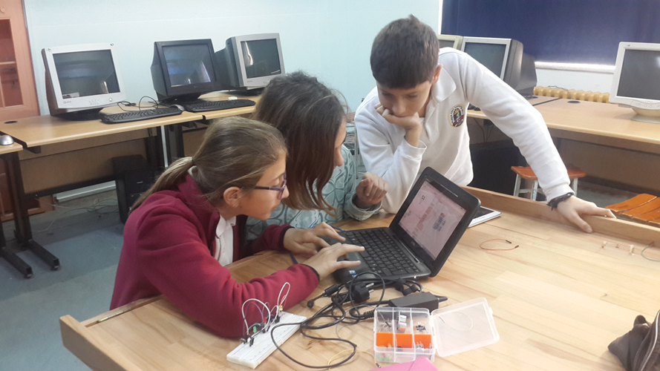
Robot training in our school

Slide 10
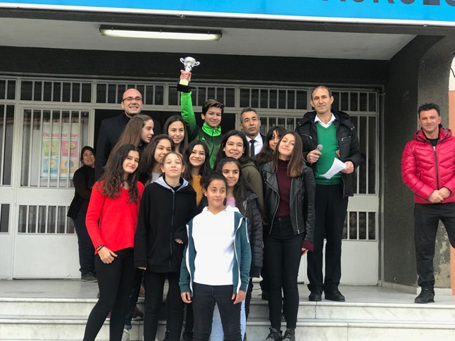
Sports activities in our school

Slide 11
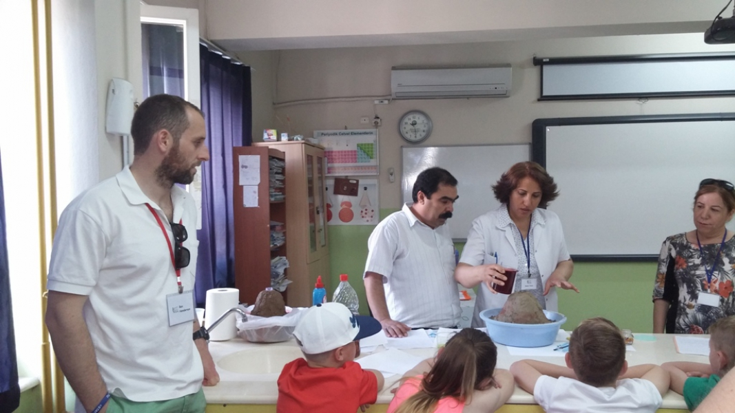
Science in our school

Slide 12
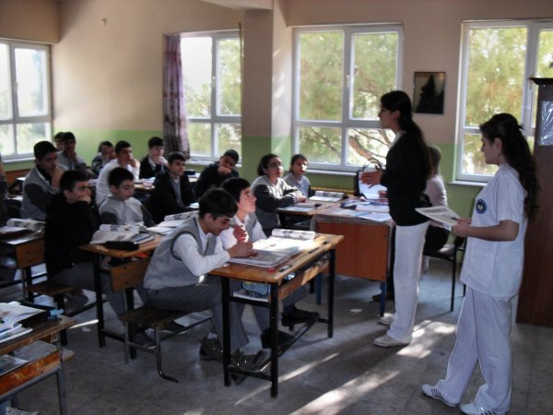
Health in our school

Slide 13
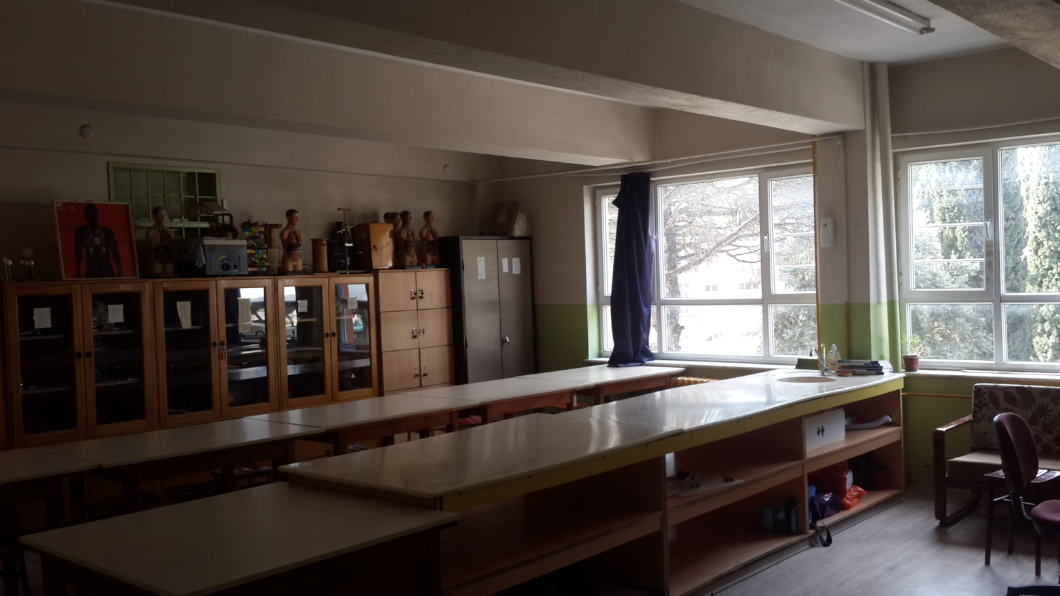
Our school laboratory

Slide 14

thanks for listening and watching us

