Slide 1
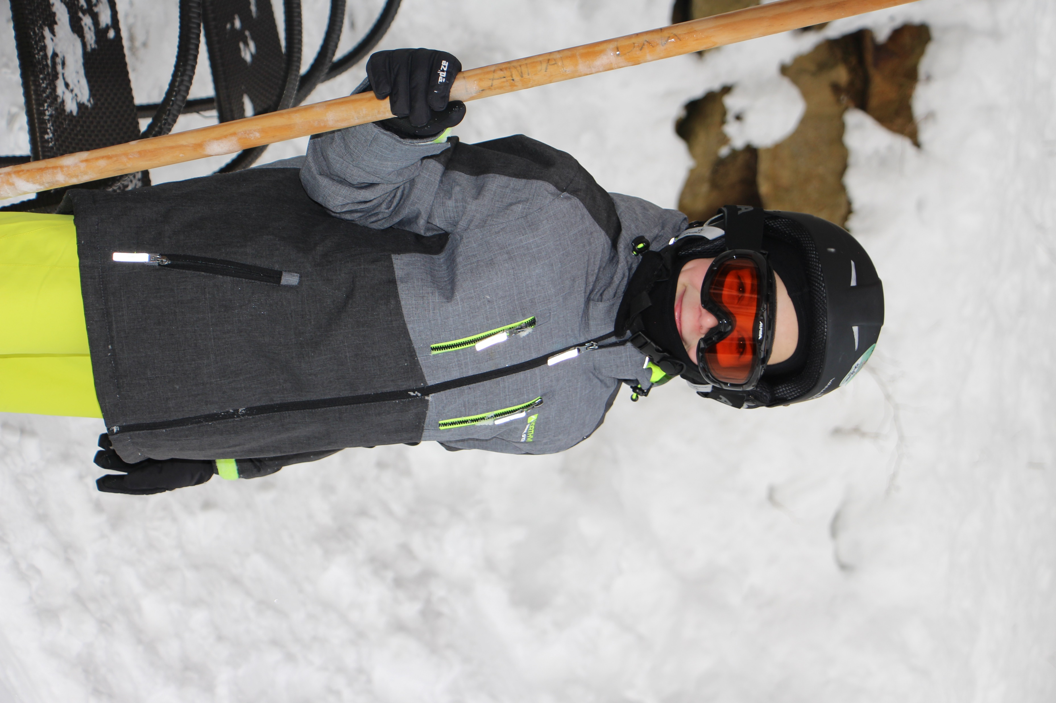

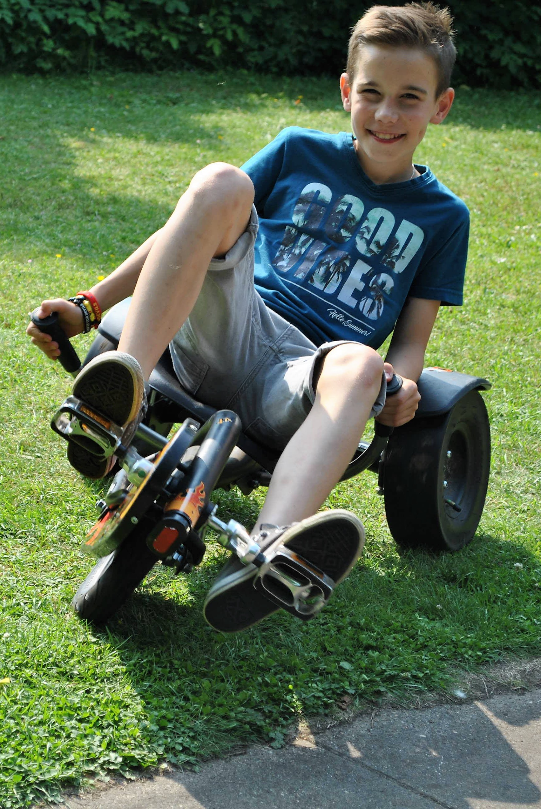
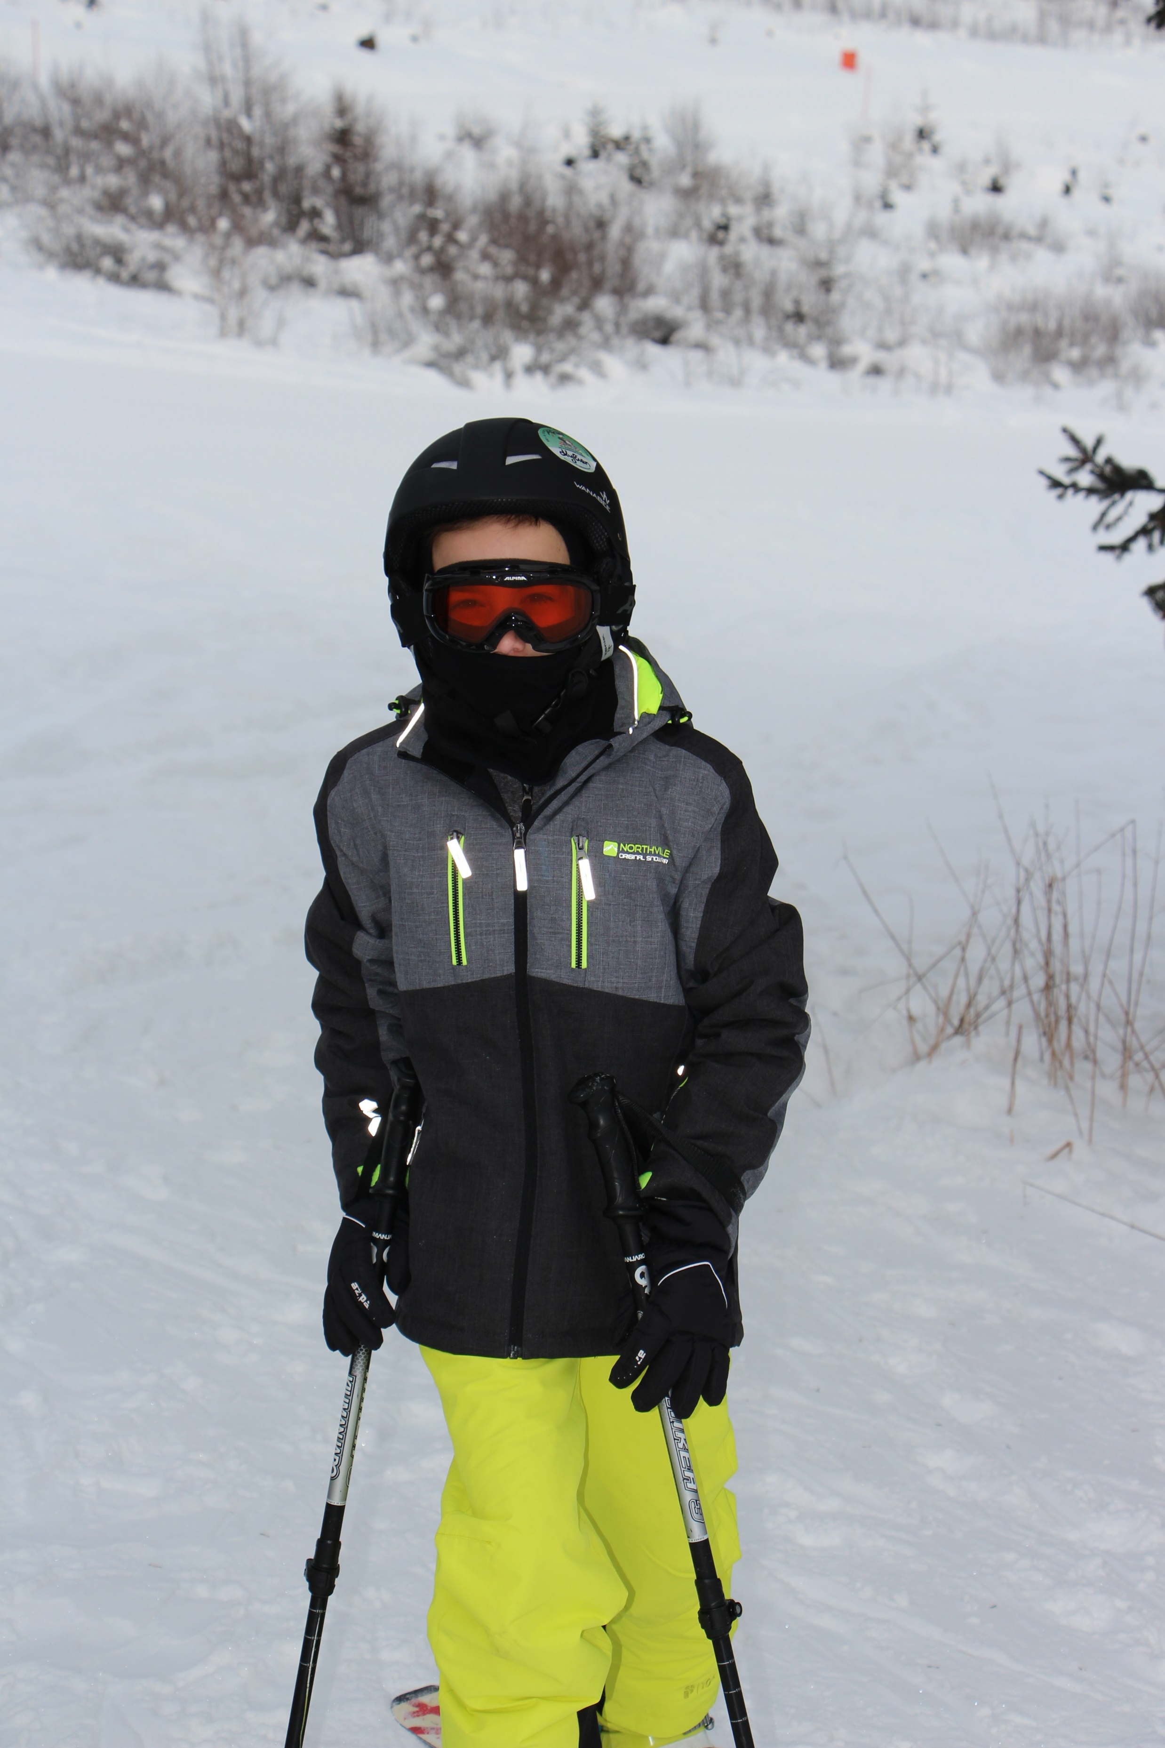
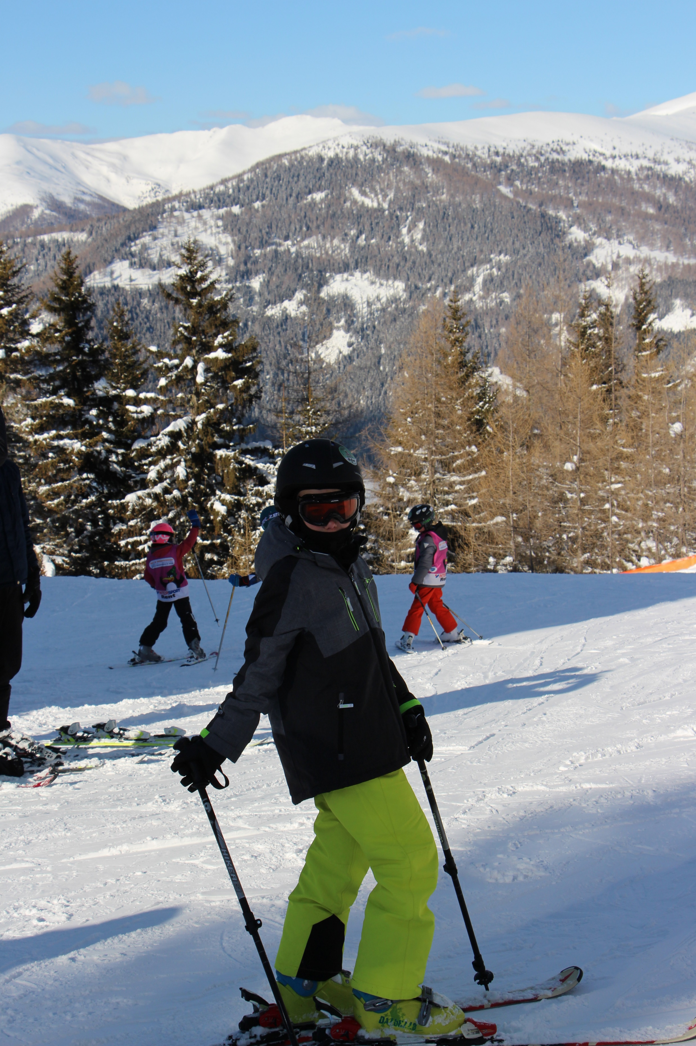
I’m Kylian pius, I’m11years old
Hello!!!

Slide 2

I’m from Ghent, Belgium

Slide 3
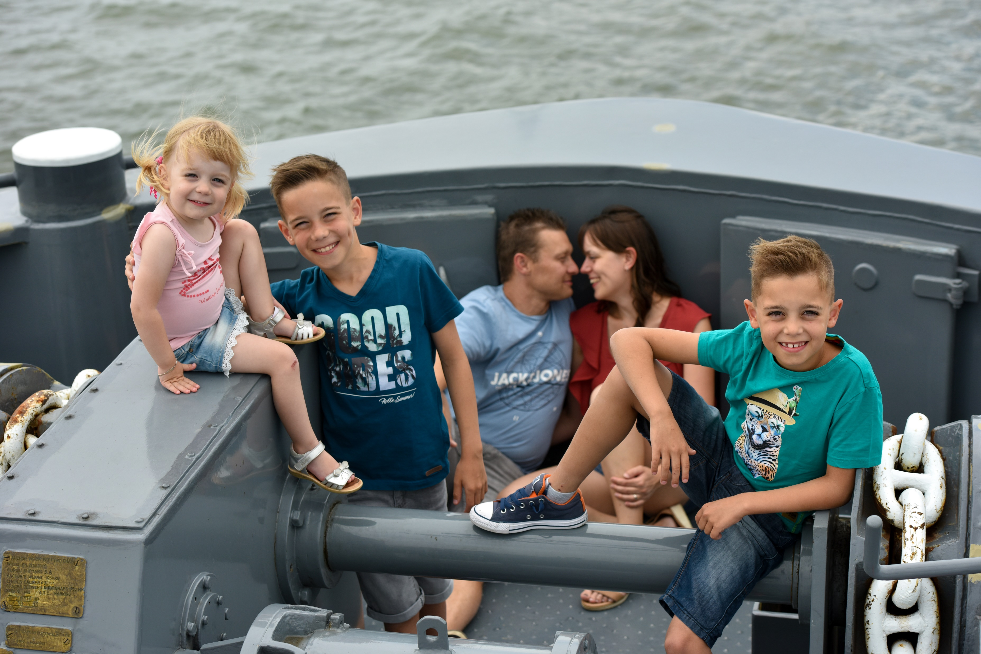
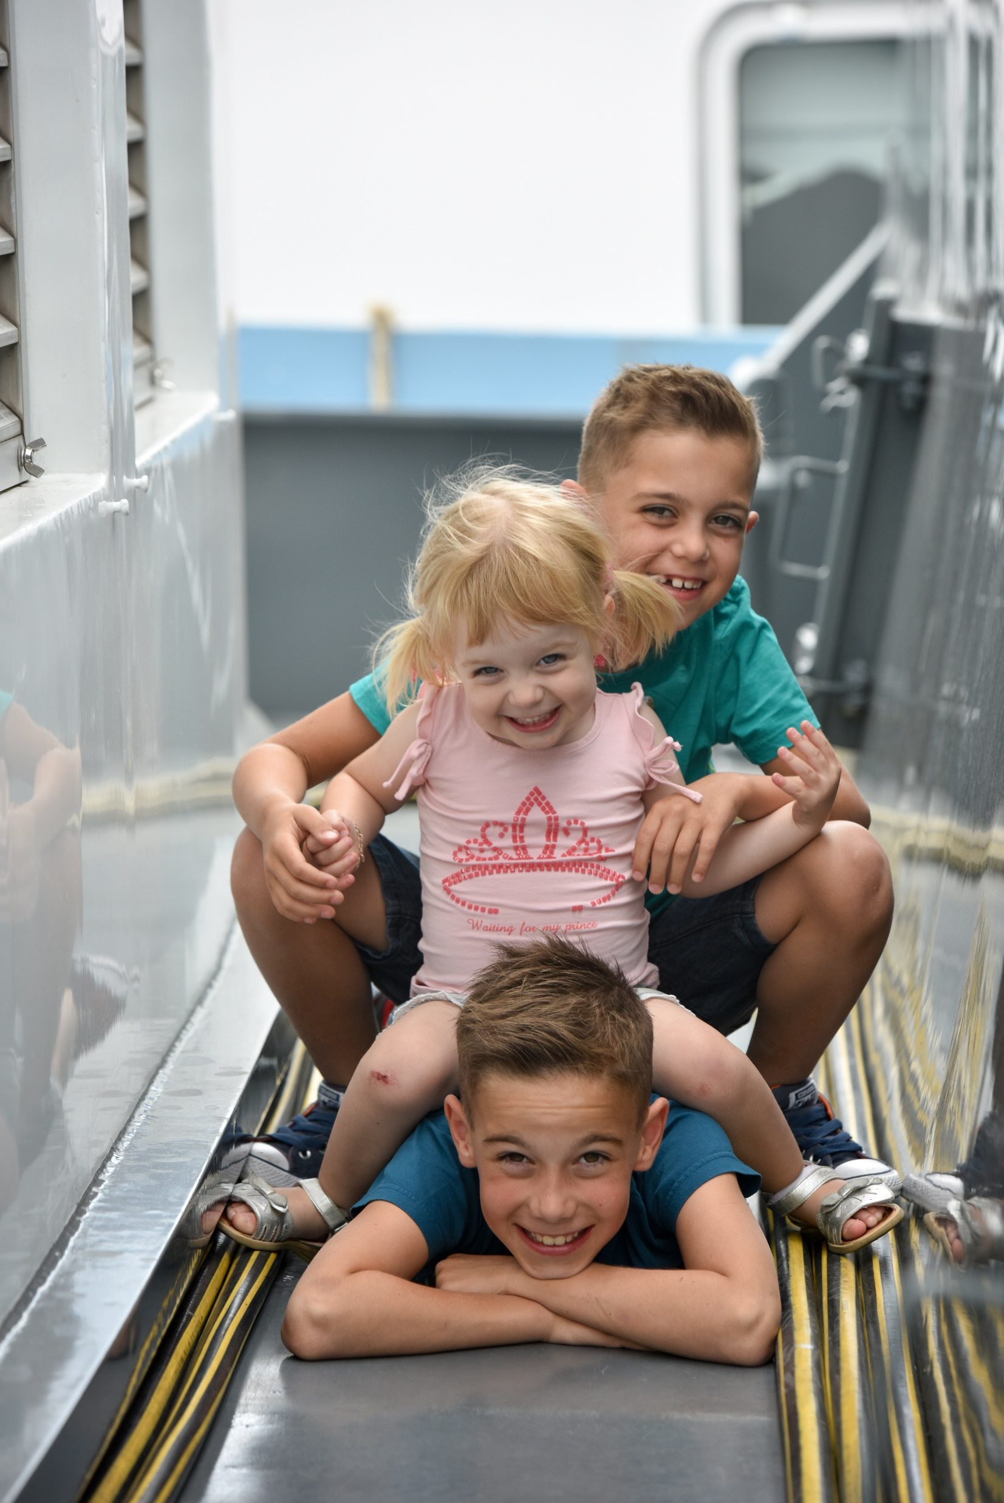
This is my family:
My mother and father are Miggy & Andy
Tiago is my younger brother, he’s 9 years old
I also have a little sister, Kato. She’s 4.

Slide 4
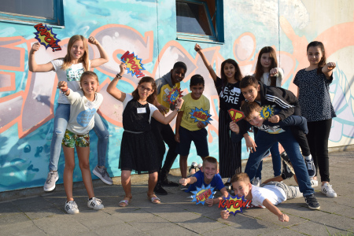
Het Molenschip is my school, my class is called L6,
My teacher is miss Ellen.

Slide 5
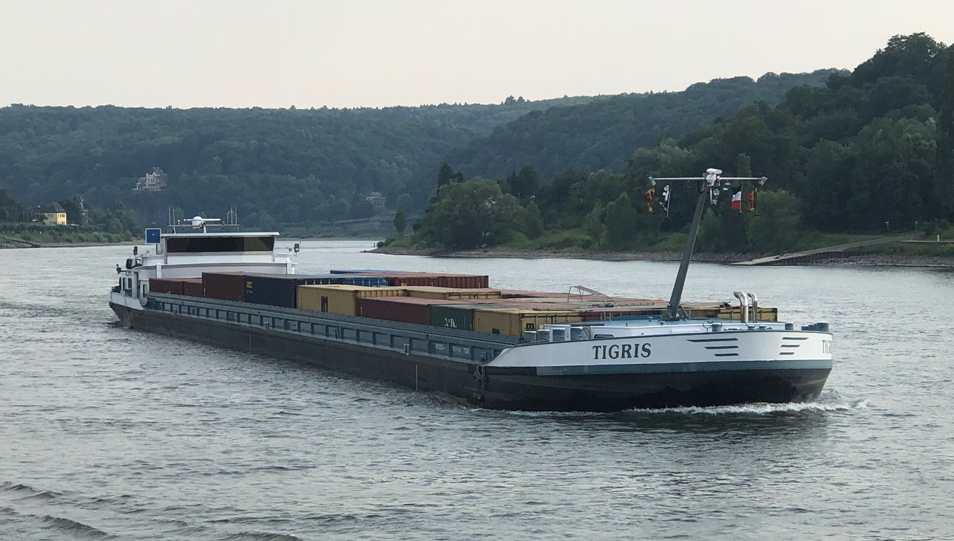
My home is a ship, she’s called ‘Tigris’
We transport containers from the port of Antwerp to Metz (France) and vice-versa.

Slide 6
My hobbies:

Slide 7
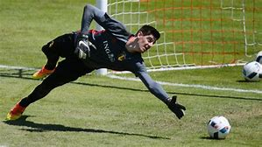
- Soccer

Slide 8

- Bicycling

Slide 9
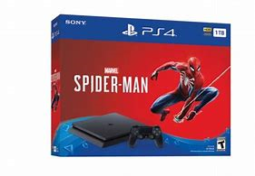
- Playing on my ps4

Slide 10
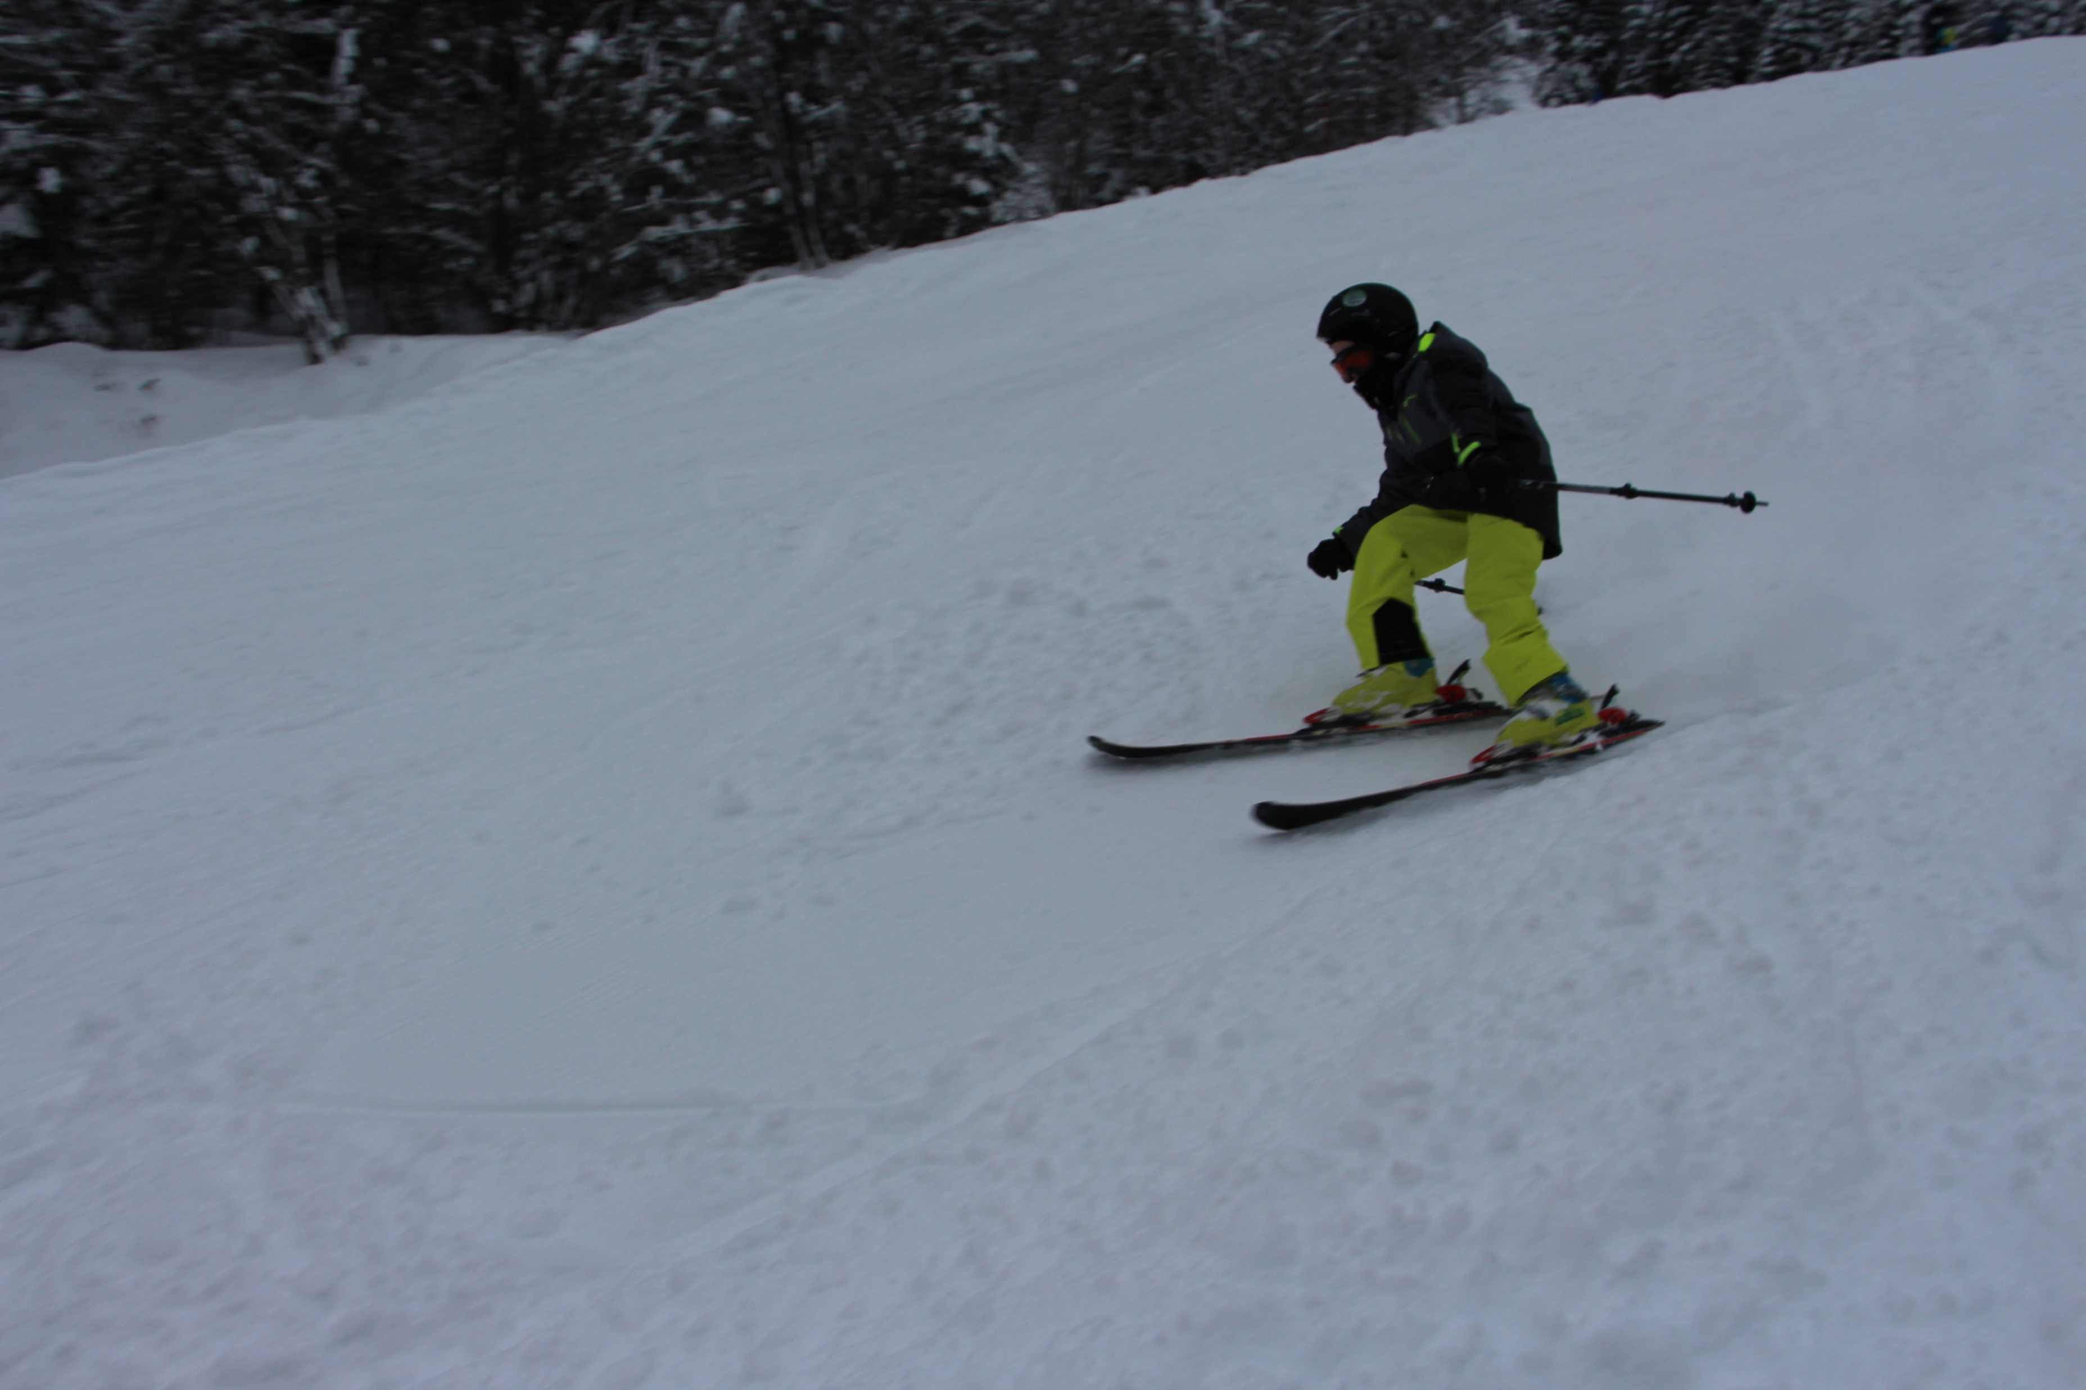
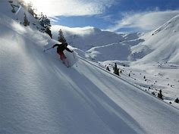
- Skiing

Slide 11
The end

