Slide 1
Päivä, I am Jade, I am 10 years old.
In this powerpoint you will learn something about me.

Slide 2
This is my family
My mother is Monica and my father’s name is Jurgen.
I have also got a brother, Noah, he is 15 and he has also visited Finland in 2015.

Slide 3
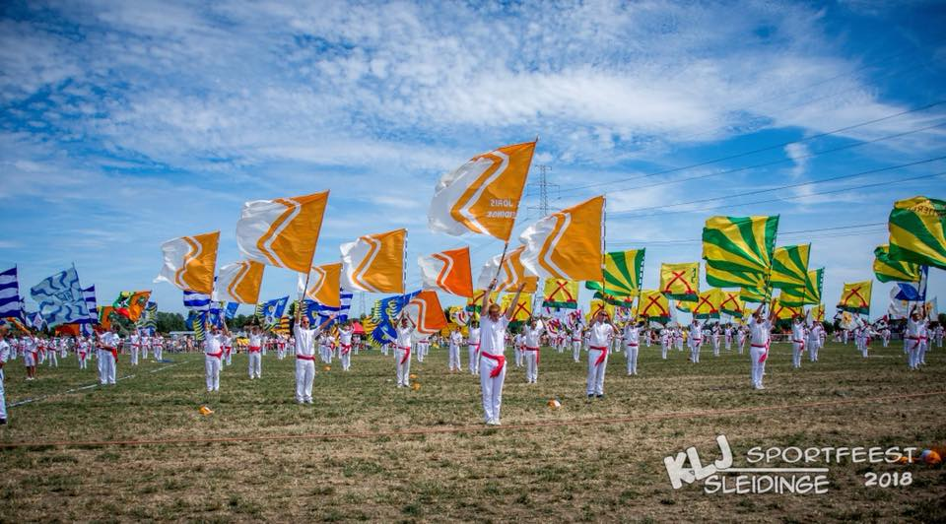
My hobbies
youth movement K L J

Slide 4
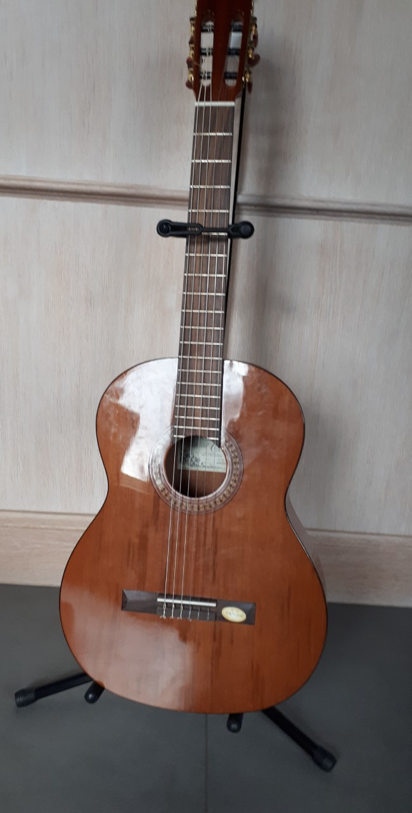
I play the guitar

Slide 5
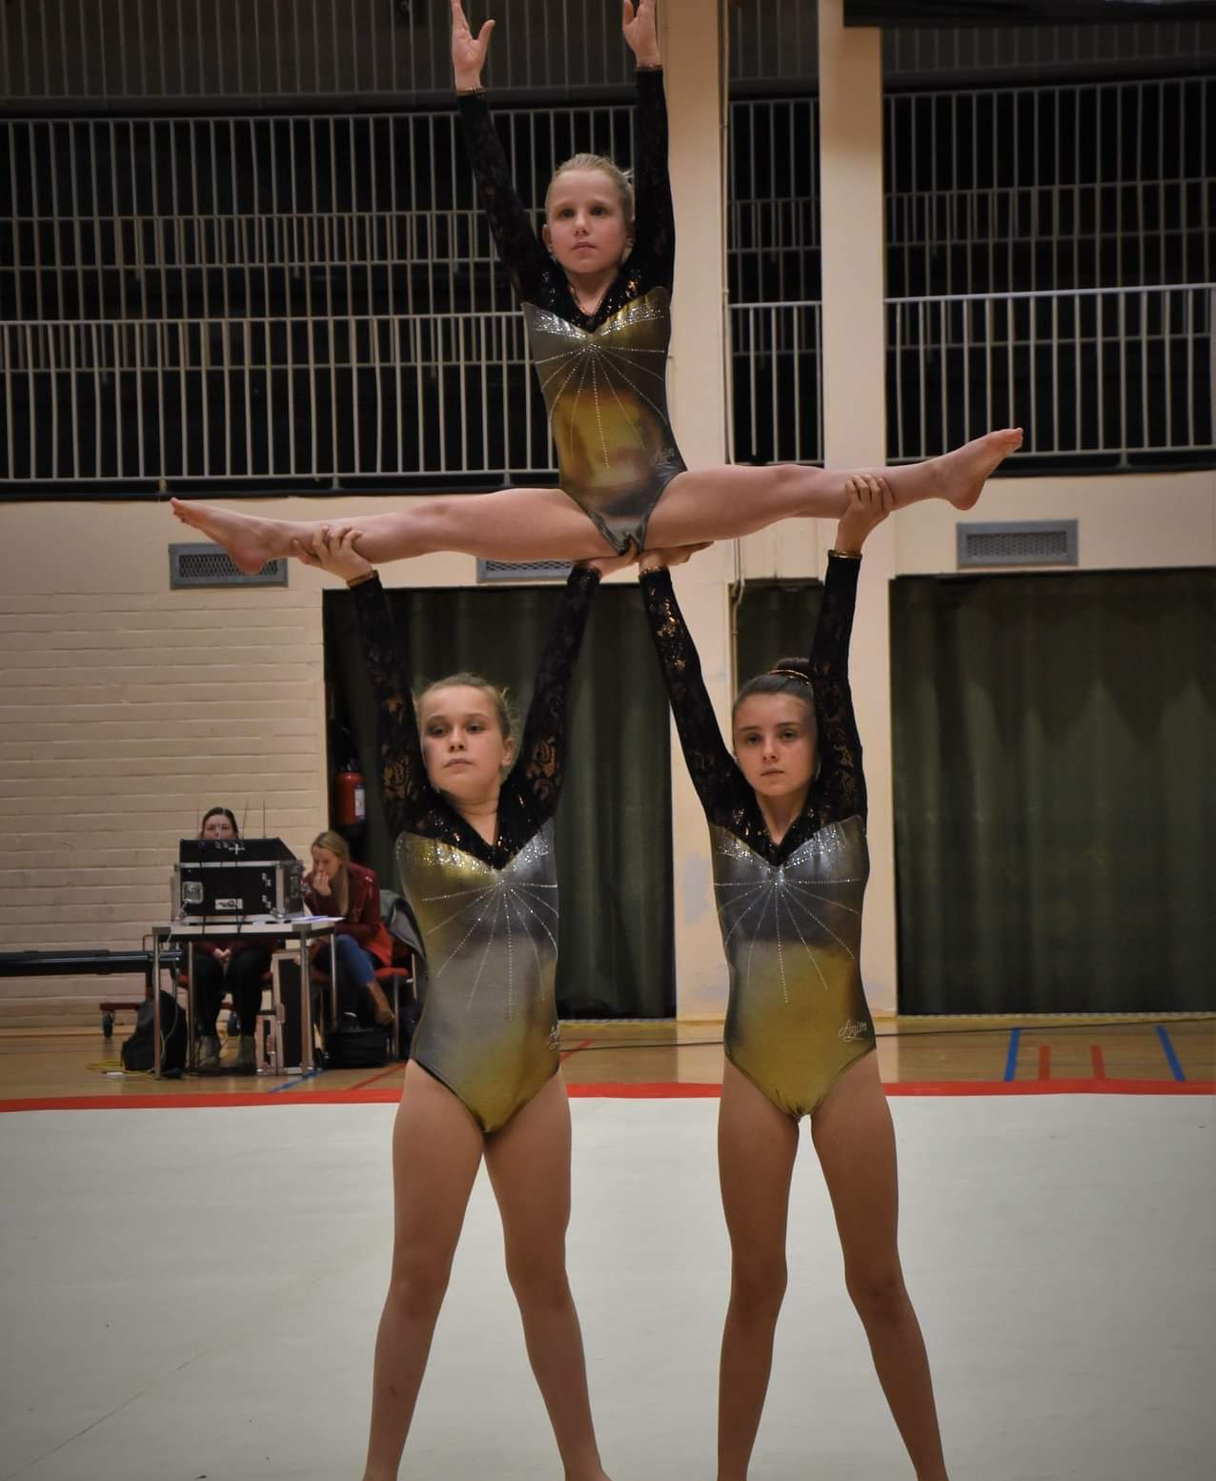
I ‘m a gymnast
We are with three girls in my team. We sometimes compete with other teams.

Slide 6
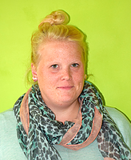
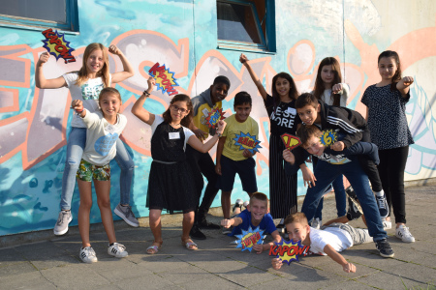
My class
This is a picture of my teacher juf Ellen.
These are my classmates:
The girls: Zorana, Neda, Ceda, Sila, Kubra and me, Jade.
The boys: Kylian, Prais, Samican, Jorne, Ignace, Abdoe.

Slide 7
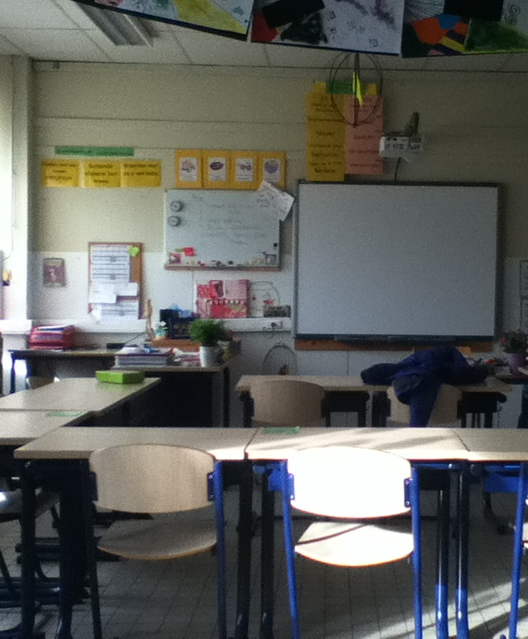
My classroom: the sixth grade

Slide 8
Our school
Our school is ‘het Molenschip’.
We’ve got a very large playground.

Slide 9
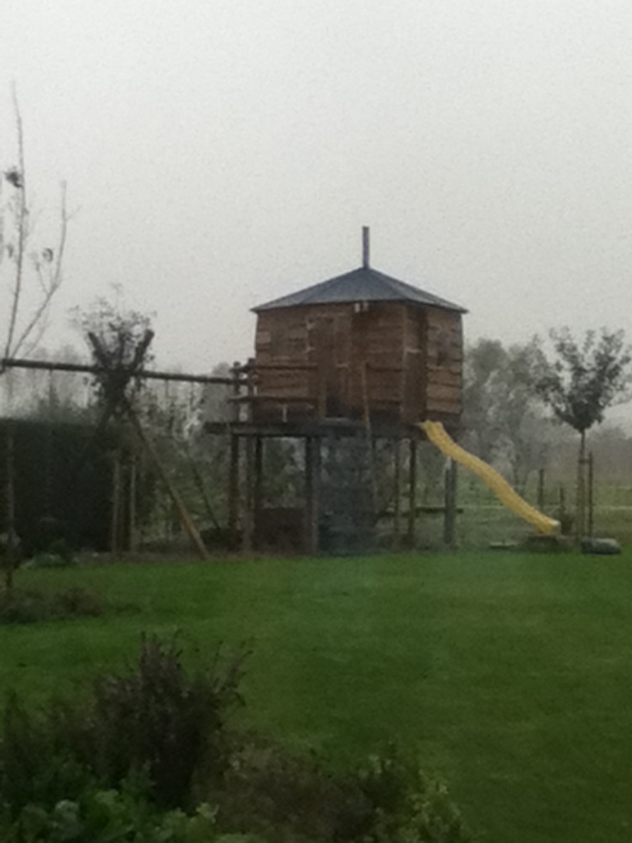
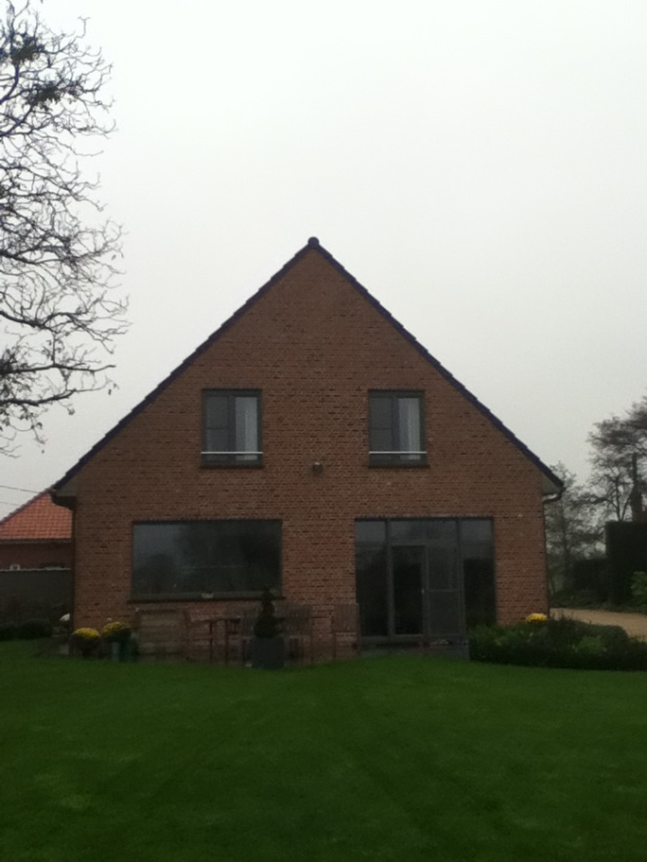
My home
I live with my family in Belgium, in a town called Sleidinge.
My treehouse My house
mijn schuur
My room

Slide 10
My parents and their profession
My dad teaches English in a secondary school.
My mother is an educator at the boarding-school of our school and a florist teacher in a gardening school.

Slide 11
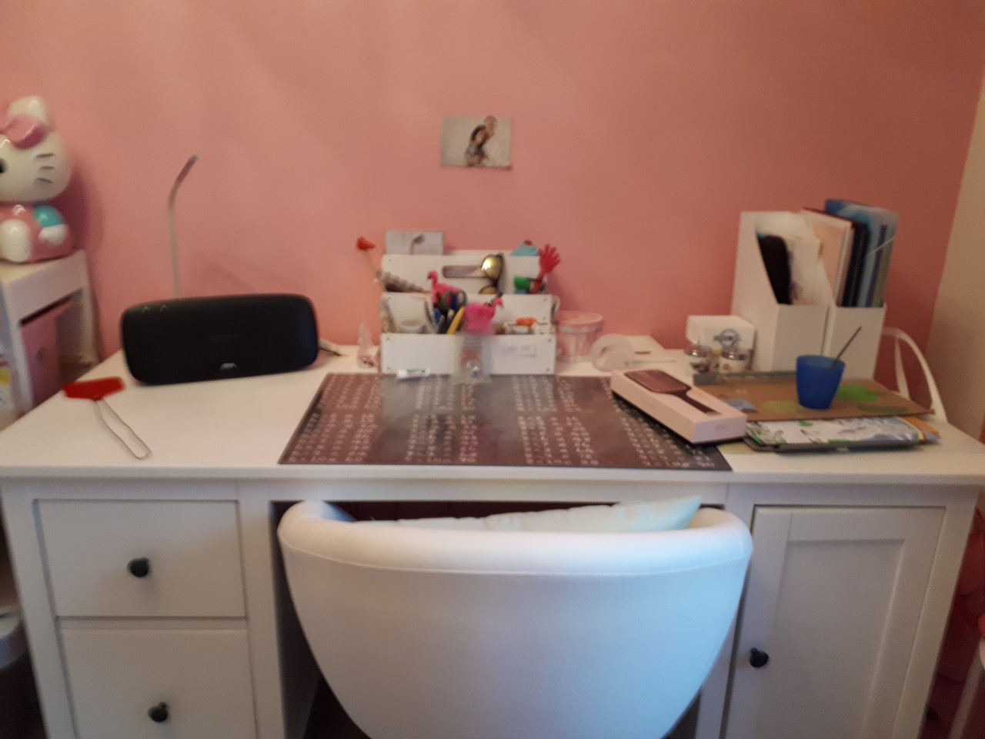
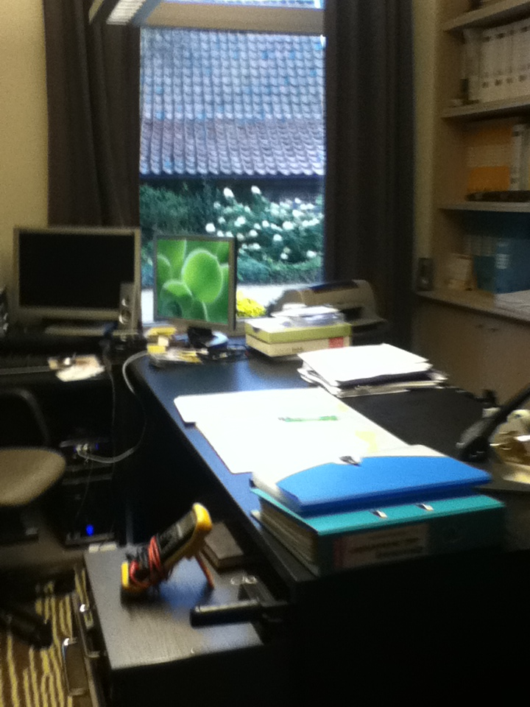
My study place
I study in my bedroom or in my father’s office.

Slide 12
February 2019
See you soon!

