Slide 1
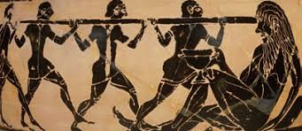
MYTHS, LEGENDS AND FOLK STORIES OF SICILY
There are many myths and legends that concern Sicily. Some of them are ancient, and they have also been able to influence the culture of the place in the time.

Slide 2
COLAPESCE
The legend narrates of a certain Nicola with the diminutive of "Cola" of Messina, child of a fisherman, nicknamed Colapesce
When he returns from his numerous immersions in sea he tells the wonder that he sees.
His fame reaches the king of Sicily that it decides to try him.
The king and his court bring him to the sea. First of all he throws a cup, and Colapesce immediately recovers it.
The king throws then his crown in a deeper place, and Colapesce again bring it back.
For the third time the king tries Nicola throwing even more a ring in a deep place, but this time he didn't return. He stays under the island to hold it up and stop Sicily from sinking into the sea.

Slide 3
LEGEND OF GAMMAZITA
Gammazita was a young, virtuous woman. She lived in Catania in the days when Sicily was occupied by the French and was engaged to be married to a Catanese boy. One day, as she went to the well to take water, a French soldier come close to her and made a vulgar proposition. Gammazita, horrified by the thought, tried to walk away, but found her exit blocked by soldier. Her only escape was to dive into the well– so that’s exactly what she did.

Slide 4
LEGEND OF HUNDRED HORSE CHESTNUT
The chestnut tree of the one hundred horses is the largest and oldest known chestnut tree in the world. The tree’s name originated from a legend:
A Queen was out hunting with a hundred knights and some chaperones. The company was surprised by a violent thunderstorm when they where close to a giant chestnut tree, so they escaped the tempest by hiding under this tree. Sunset came and the thunderstorm wouldn’t stop, so the Queen passed the night under the tree, legend has it that she spent the night with some lovers chosen among the hundred knights.

Slide 5
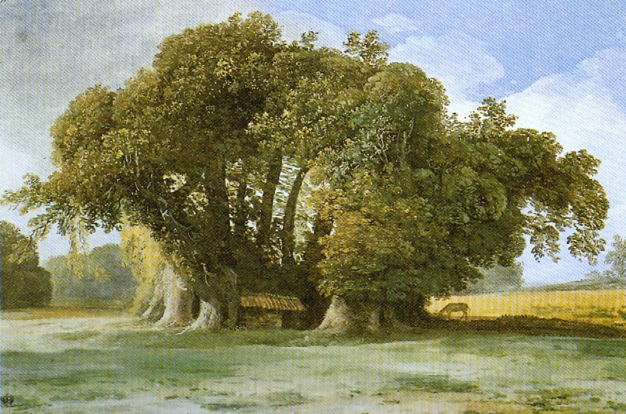
There is no way to know for sure who this queen was, but some say it had to be Joanna I of Aragon, others say it had to have been Joanna of Anjou, and in this way the queen’s night with lovers was contributed to the insurrection of the Vespers (during the 13th century). All of this is probably just another legend invented by people. For example, Queen Joanna of Anjou, although widely known for her love affairs, almost certainly never came to Sicily.

Slide 6
THE RAPE OF PROSPERINA
Proserpina, daughter of Demeter, goddess of vegetation and agriculture, is kidnapped by Ade, God of underworld, who had fallen for her, who emerges near Enna, where according to the myth Proserpina was intent on picking flowers. One day the God kidnapped Proserpina, her Mother Demeter, hearing the cry of her daughter, looked for her for nine days and nine nights. In the absence of Demeter from her role, the earth began to be sterile and unproductive.

Slide 7
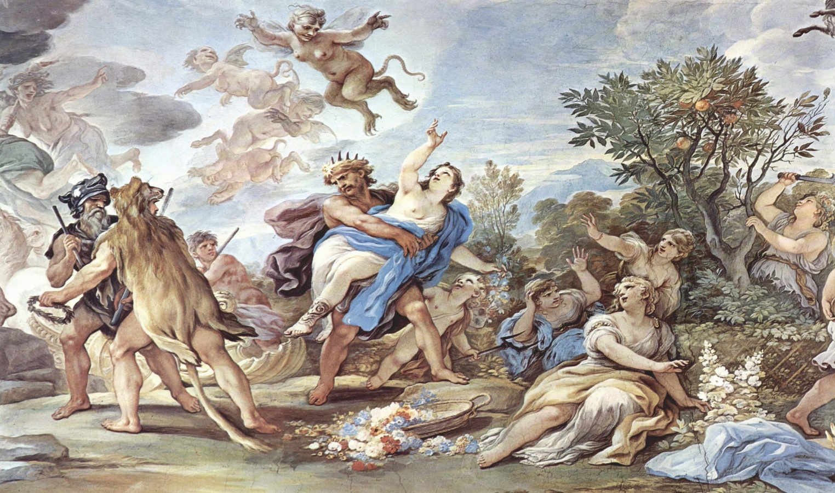
Then Zeus, worried, after trying in vain to convince Ade to return Proserpina to his mother, he made a compromise: Proserpina would stay with her mother for eight months of the year (those in which the earth it blooms and gives men all its riches) and with Ade for the other four months (winter ones, when the goddess Demeter is sad and the earth is bare and unproductive).

Slide 8
MYTH OF HEPHAESTUS
When Hephaestus was born his father Zeus wanted him to be removed from Olympus, but the Mother Era got to postpone it until she got older.
Meanwhile Hephaestus became great. One day Zeus and Era they started arguing because of Zeus' jealousy. Hephaestus took the defences of his mother and Zeus threw him down from the mountain.
His legs broke in the fall. Hephaestus refused to yield and die. He lit the fire more powerful that he had ever seen and he made himself legs of gold and silver. Hephaestus became the god of love and mystical reconstruction. It brings a special love to those who have dreams or the soul shattered and refuse to yield and die.

Slide 9
THE STORY OF MARTA AND GRIFONE
In Messina lived a beautiful girl of great Christian faith, daughter of King Cosimo II from Casteluccio; her name is Marta.
In 970 after Christ the giant Hassan Ibn-Hammar landed in Messina, with his own pirates and began to steal in the lands where it passed. One day the boy saw the beautiful girl and falls in love, asks her in marriage but gets a refusal.

Slide 10
This provoked anger by the pirate who killed and stole more than before. The parents, worried, they hid Marta, but he managed to kidnap her with the hope of convince her to marry him.
Marta did not reciprocate his love finding in prayer the strength to continue. In the end, he converts to Christianity and changes his name in Griffin. Marta appreciates the gesture and decides to marry him.

Slide 11
GIUFA’, HIS WIFE AND THE DONKEY
When his wife died, Giufa was not able to shed a single tear, but when, after a few days, the donkey died, he did nothing but cry.
As soon as a friend asked him how he was, he immediately began to cry for the loss of the donkey and to those who pointed out to him this strange behaviour, Giufa answered: - I do not accept your reproaches and try to understand my pain !! When my wife died all my friends came to comfort me.

Slide 12
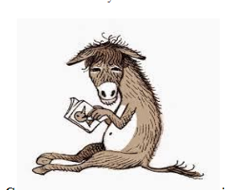
"Do not worry, over time, you'll see a wife, there are many women," you told me. "My sister could be the right wife for you!" someone told me. And still others offered me their daughter without having to pay anything! But when my donkey died, none of you said, "Do not worry, I'll give you another donkey in his place!"

Slide 13
GIUFA’ AND THE KEY OF THE SAFE
Following a theft to the Municipality, Giufa, who had the reputation of being honest and trustworthy, was commissioned by the mayor to keep the key to the safe. Giufa took office, felt very empowered and took with him, wherever he went, the key and never left it.
One day, while he was home in the dark, Giufa could no longer find the key. Then he started to looking for it, but being pitch dark, he went out looking for it outside because there was a bit of light.
The friends who saw him so busy, asked him: - Giufa, where did you lose the key?
- At home!! - answered Giufa. - So why are you looking for it on the street? - Because in the house there is no light!

Slide 14
The day after Giufa found the key at home and said to his wife: - If I had lost the key and if the box had been stolen again, I would have been the only one responsible! I have to find a way to protect the safe and the key!
And he began to think until he found the solution.
When the mayor met Giufa, asked him if he had found a safe place for the key.
Giufa, triumphant, said: - It's a very safe place! So sure that from now on the safe can no longer be opened!
- What do you mean, Giufa? - I put the key in the safe and then I closed it definitively. Nobody can open it anymore.

Slide 15
GIUFA’ AND THE EGGS
Leaving for a long business trip, Giufa went to a farmer to buy hard-boiled eggs to eat during the journey. But, not having enough money, he borrowed the eggs, promising to pay them on their return.
Giufa, stayed away from the country for a few years, as he had found a job. When he had enough silver coins, he decided to return home, where he was welcomed by everyone. The farmer who had sold his hard-boiled eggs, also knew that Giufa had made some money, so he came to Giufa's house to collect the credit and asked for 500 dinars.
Giufa, amazed by the exaggerated request, refused to pay and, given the insistence of the farmer, decided to turn to a judge. Having set the day for the hearing, the peasant presented himself to the court punctually, but Giufa did not arrive.
When everyone was almost impatient with waiting, Giufa arrived in court.The judge began the hearing and first wanted to hear the farmer, who said:- I asked five hundred dinars, because, he didn’t pay me the eggs and went away for a lot of time.

Slide 16
From those eggs, Mr. judge I could get 12 chicks which once grew would have created other chicks, which in turn would have created so many roosters and hens to make me a huge breeding. The judge seemed convinced by the peasant's reasons, but he correctly wanted to hear Giufa's reasons and said:
- Giufa, explain why you arrived so late and then let me hear your reasons! Giufa answered: - I apologize for my late arrival Mr. judge, but at home I had some boiled beans left and then, I decided to plant them in the garden so as to have new plants for the harvest next year. The judge, already fed up with waiting, became very angry and told Giufa in a loud voice:
- You're a stupid presumptuous! How do you think that a plant can be born from cooked beans? Never heard such a thing! ! Giufa, then answered:- You're right, Mr. Judge. But, why don’t you ask the farmer how chicks can be born from boiled eggs? Does this not seem incredible to you?
Convinced by the reasons explained with wit, the judge won Giufa, who paid only the cost of 12 hard-boiled eggs.

