Slide 1
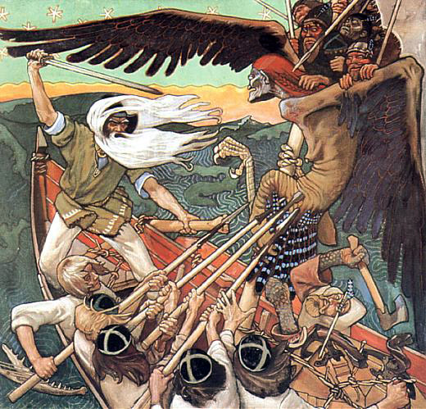
KALEVALA

Slide 2
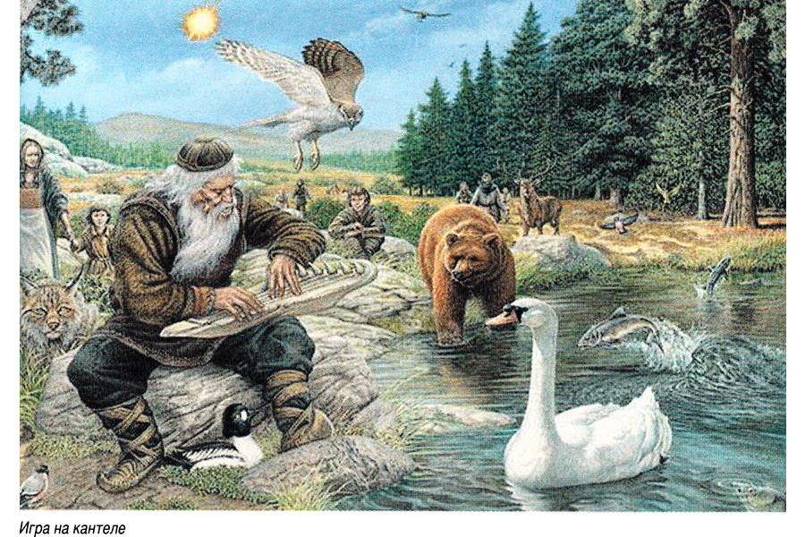
-Kalevala is a finnish folk story
- Elias Lönrot had gathered stories and poems from finnish people from all over the country and he put it together in one piece.
-Kalevala is Finland’s national epic.
-Through the stories of Kalevala there were a lot of different versions of how the world was born.
-Many people thought that the world was born from Kalevala’s character Väinämöinen when an egg hatched on his knee.
-Some people thought that two characters from Kalevala created the world by singing.
-The stories are really fictional but they made a great start for finnish culture and inspired literature, arts and music. Kalevala was the start of Finnish identity.
video1
Video2

