Slide 1
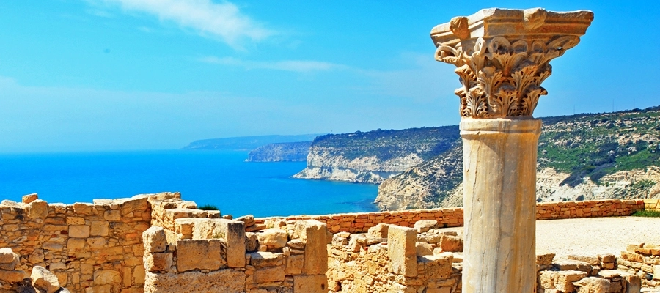
Cyprus: THE ISLAND of contrast
CYPRUS:THE ISLAND OF CONTRAST

Slide 2
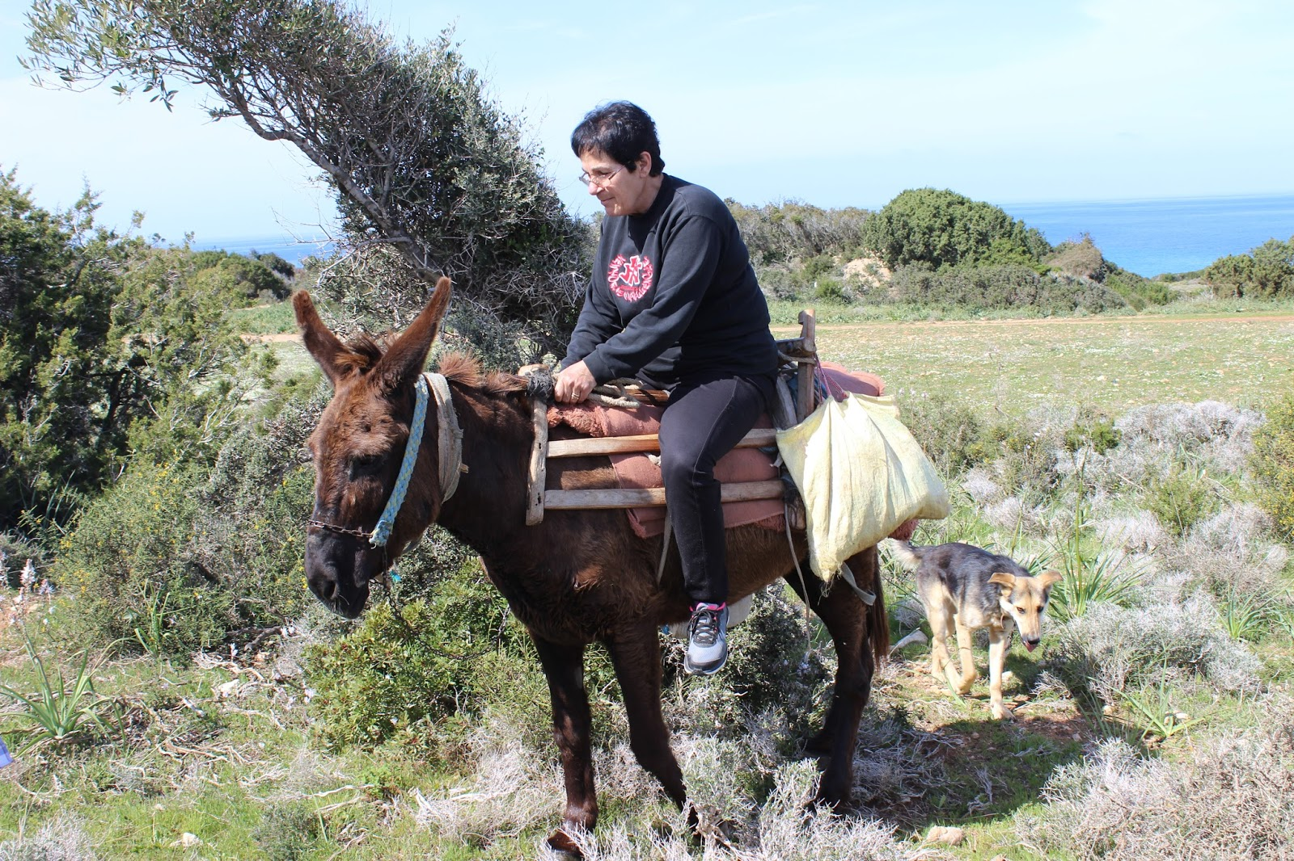
How people used to travel in the Cypriot villages
Donkeys were used in track-creation
for the people in the villages.
Not only the donkeys but also
carts had an equally important role.

Slide 3
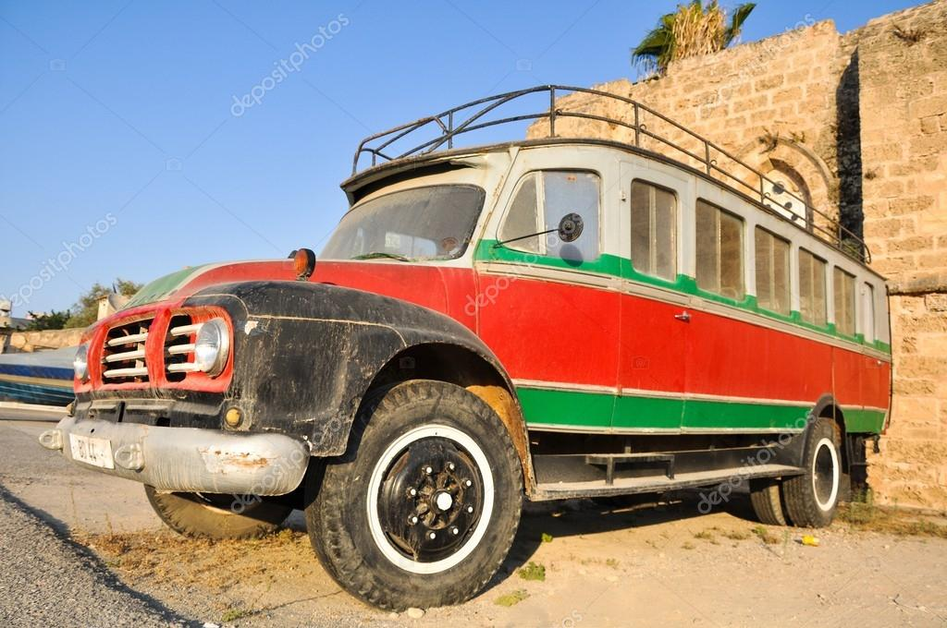
TRANSPORTATION IN THE MIDDLE OF 20th century
Around 1940s, people used to use buses to go to different cities. The bus lines were very limited, so the people had to wake up early in the morning if they wanted to travel.

Slide 4
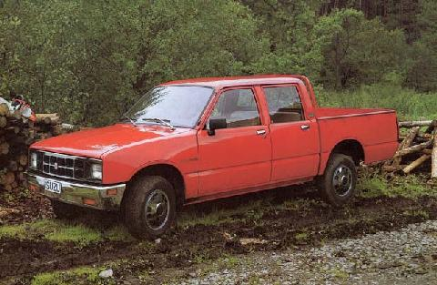
TRANSPORTATION NOWADAYS
Nowadays people have numerous ways of transportation, such as vehicles which are the most common mean of transport in our country. Buses and taxis have also a tremendous impact in transportation.

Slide 5
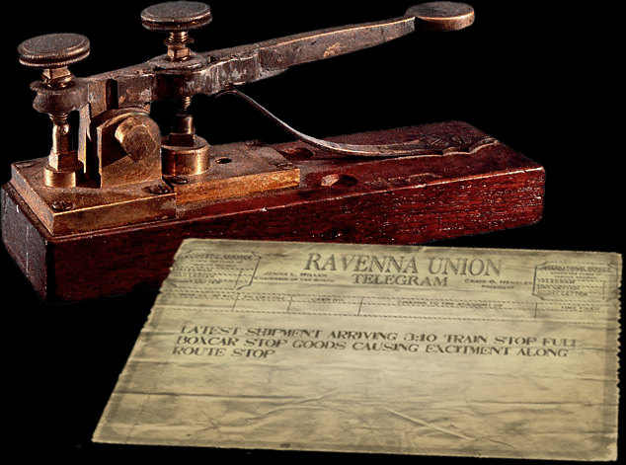
THE OLD WAYs OF COMMUNICATION
One way to communicate with other people in the 19th century was no other than telegraphs. They were small texts which were for communicating with other people, it worked by transmitting electrical signals over a wire laid between stations. In addition to help invent the telegraph, Samuel Morse developed a code (bearing his name) that assigned a set of dots and dashes to each letter of the English alphabet and allowed for the simple transmission of complex messages across telegraph lines. In Cyprus people used to go to the communication centre to send the telegraphs.

Slide 6
Telephones were a revolutionary creation of the 19th century that affected the worldwide community and Cyprus. Specifically the wired telephones were mostly used in the coffee shops and some houses.

Slide 7
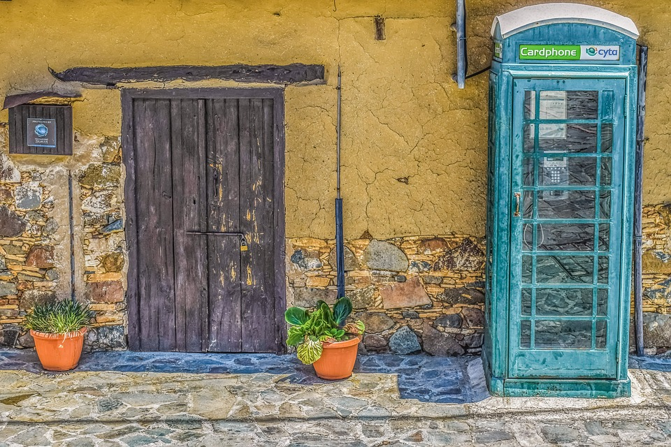
Telephone boxes
Until 1955,Cyprus was a British colony. Due to that fact there was an impact ın different sectıons.One of those sections was in communication. So telephone booths reached to villages. There was only one telephone booth in the center of each village for all the villagers in order to communicate.

Slide 8
Communication nowadays
In Cyprus most of the people use mobile phones and laptops to communicate. Moreover, many apps are used to communicate with other people such as Gmail, Messenger, Instagram and Skype.

Slide 9
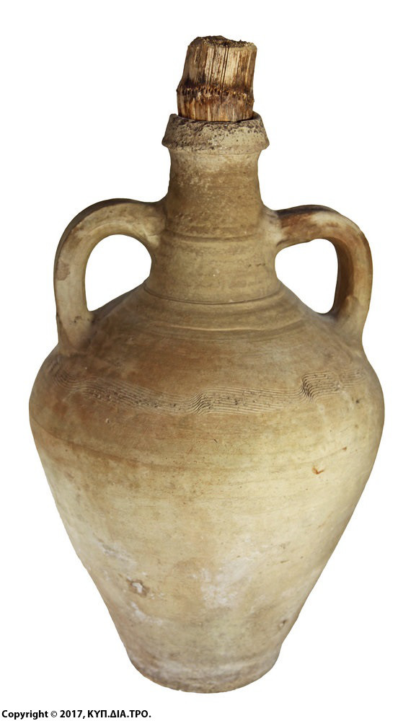
FOOD AND WATER ISSUES
In Cyprus the most people were poor and they couldn’t afford to eat fancy food, so they had no other choice than making a living by growing their own goods. In addition, they had to go to the fountain with the “cuza”(clay pot) to collect water and transport it to their homes.

Slide 10
WINERY IN CYPRUS
Due to the Mediterranean climate in Cyprus, our land was easy to be cultivated. People in villages were planting vineyards in order to produce wine. Except from the white and red wine, wine makers produced a traditional wine as well called ‘Koumandaria’. Cyprus, is the country of origin of Commandaria, which is a famous sweet wine. Many centuries ago, was under the name of “Nama”. Homer called it the sweet wine of Cyprus and its production dates back around 6500 BC. After analyzes of pottery remains, from excavations in the city of Erimi, was showed that they contained sweet wine. So this is probably the oldest wine in the Mediterranean and, perhaps in Europe.

Slide 11
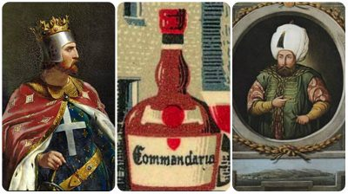

Slide 12
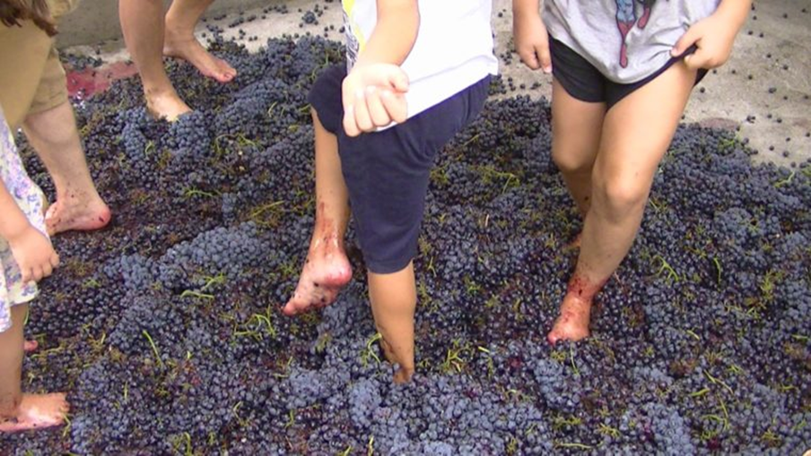
They used to put the grapes in a massive barrel and people were crushing them with their feet

Slide 13
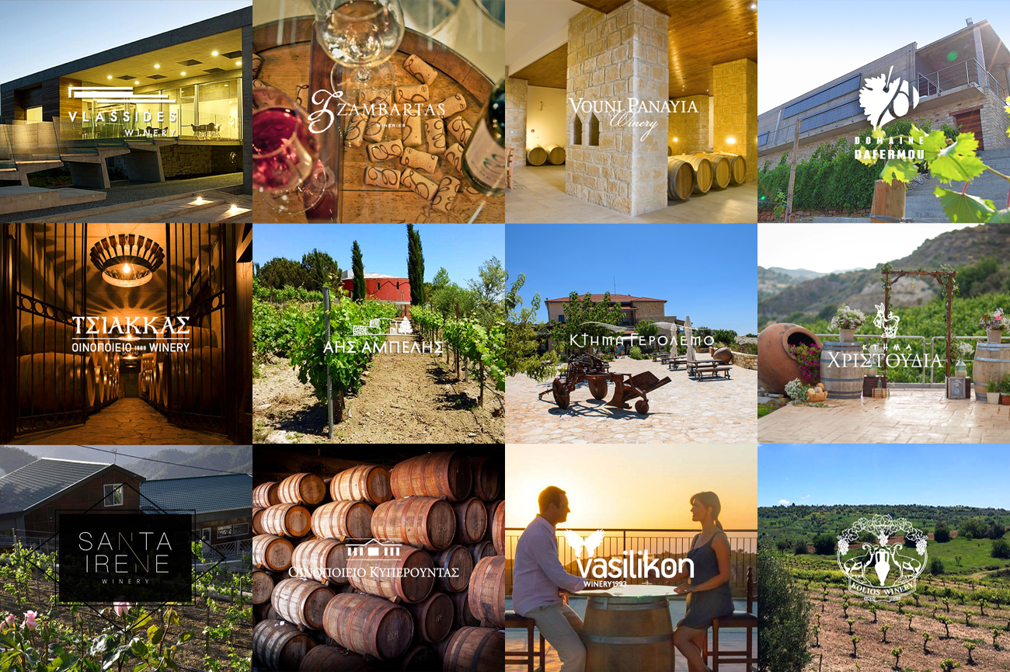
Wine nowadays
Nowadays in Cyprus there are a lot of wineries which produce wine and ‘Commandaria’. The wine industry is a significant contributor to the Cypriot economy through cultivation, production, employment, export and tourism

Slide 14
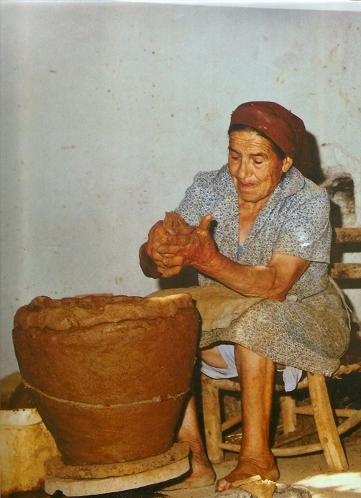
Cyprus POTTERING
The potters processed the clay in order to satisfy the needs of the people for storage, transportation and maintenance of their products as wine, oil, olives etc.

Slide 15
Evolution of consumption
Our diet undergoes changes based on time periods, economic changes as well as inventions that come about in the course of time. When we compare what we consume today to what our forefathers did, a lot of differences are visible

Slide 16
Eating
Years ago, technology wasn’t improved as it is today and that means that many house devices, such as fridge, didn’t exist. That means that people couldn’t store products like meat and dairy products .Meat was a delicate food that people ate only two to three times a year at certain situations like Christmas and Easter. Cyprıots were used to butcher animals like pig that they were breeding them before that procedure. They were using as many parts of animals they could, either for consumption or for secondary products.

Slide 17
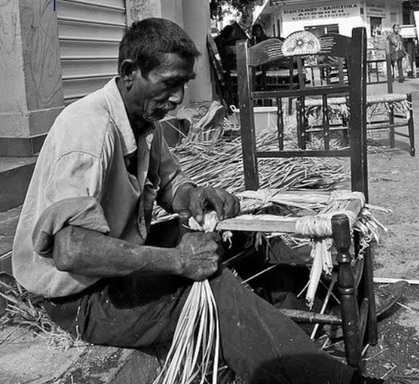
THE CHAIR MAKER
The chair maker, was a craftsman who was knitting the base of a wooden frame with a kind of cane. He used a special grass for his knitting, which in many places was called “floudi". This grass was picked up by the chairman in the summer from the rivers and swamps and put in the sun to dry. He then bundled it up, wrapped it around his shoulder and he was walkıng around neighbourhoods and villages on foot to sell or craft chaırs.

Slide 19
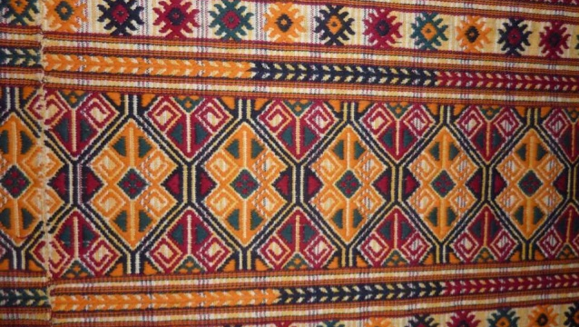
THE WEAVER
Phytosanitary is the most well-known type of Cypriot weave. Its name comes from the village of Phyti, in Paphos district, which seems to have played an important role in its development.

Slide 20
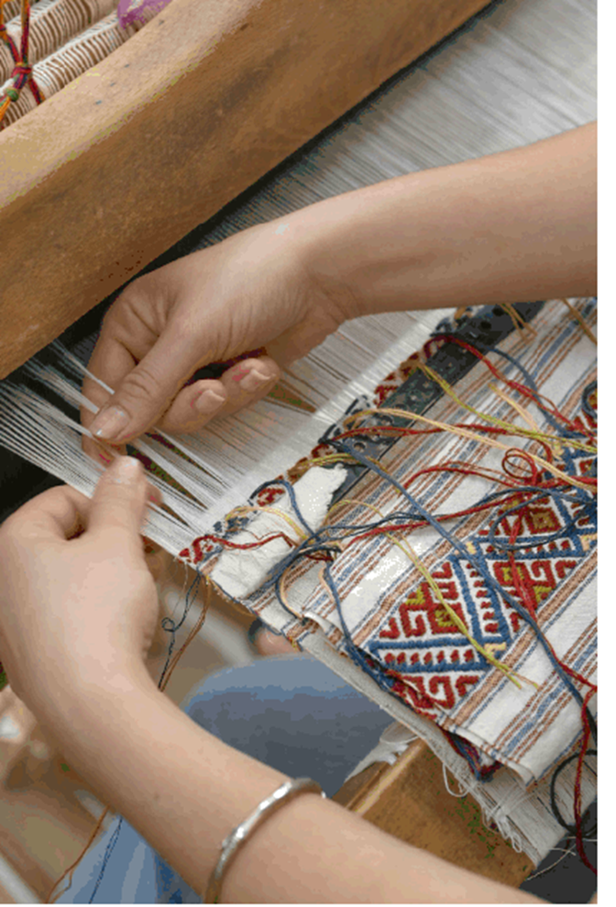
weavıng
Weaving art in Cyprus has been known since antiquity. However, the great boom in Cypriot weaving, according to written testimonies, was during the Middle Ages, especially during the time of the Lusignan kings.

Slide 21
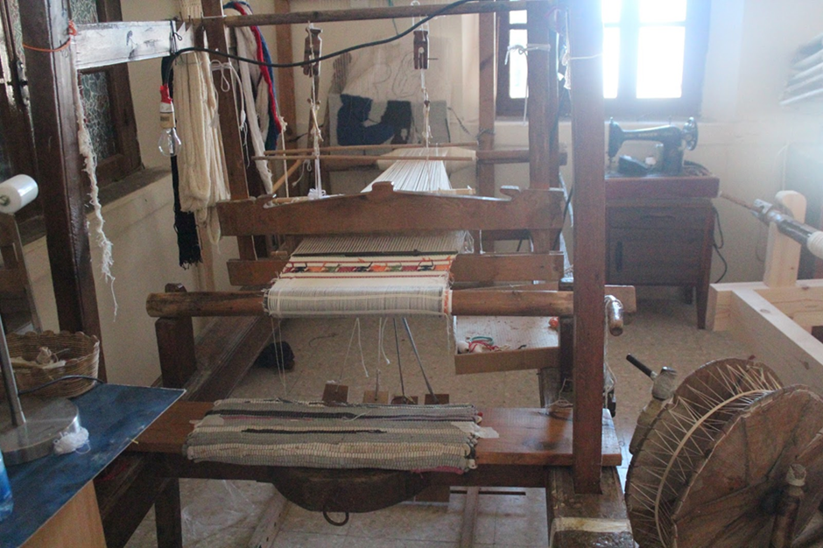
LOOM
The loom is a manual weaving machine, more common in earlier times. After the industrial revolution, the classic, wood-powered, muscle-powered loom was replaced by the mechanical loom. Today it is almost eliminated, as the weaving process is mechanized and the loom is used as a weaving machine.

Slide 22
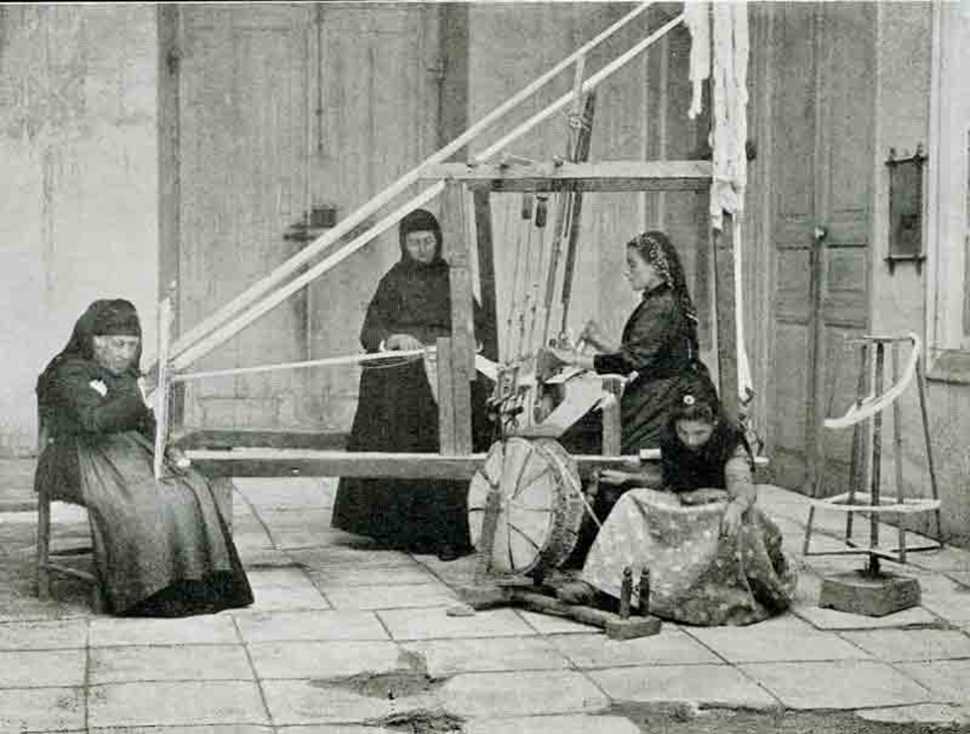

Slide 23
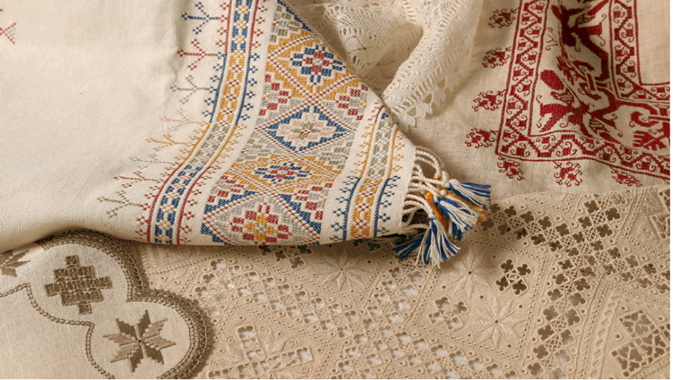
Embroıdery
Embroidery is one of the most important types of folk art in Cyprus. It is used to decorate fabrics and is achieved with the use of a needle

Slide 24
SHOE MAKER
Τoday when we say shoemaker we mean the craftsman who repairs our shoes. In the past, the shoe- maker was making shoes by order

Slide 25
Old handicrafts and professions are continuing to vanish as time goes on, due to the evolution of technology, to economical and social reasons

Slide 26
THANK YOU FOR WATCHING!

