Slide 1
ROOTS project meeting in CYPRUS
23-28 / JANUARY / 2019
TURKISH CUISINE
Mantı / Sarma / baklava
By özel falez fen bilimleri anadolu lisesi

Slide 2
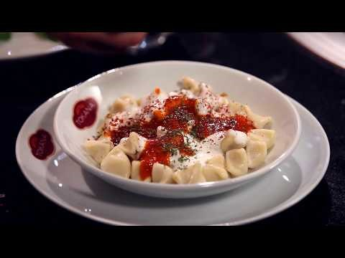

Slide 3
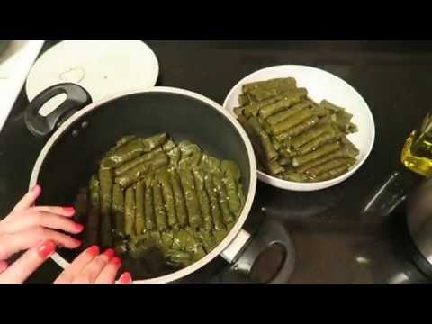

Slide 4
