Slide 1
Erasmus+, KA229, School Partnerships Project
Project meeting, Catania / Italy
30.March – 06.April / 2019
“Turkish Cuisine, Analı Kızlı and Aşure”
By Özel Falez Fen Bilimleri Anadolu Lisesi
Antalya / Turkey

Slide 3
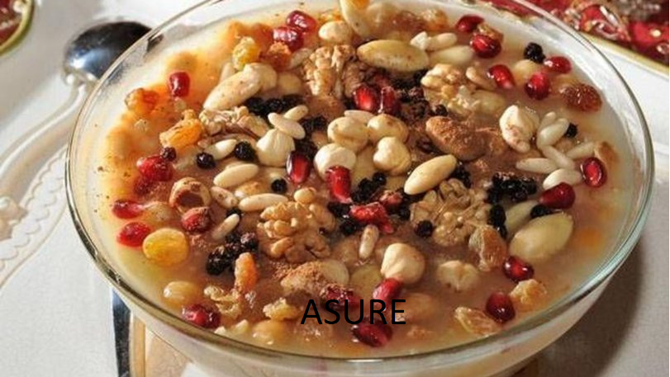

Slide 4
Thank you for watching
Özel Falez Fen Bilimleri Anadolu Lisesi
Antalya / Turkey
2019

