Slide 1
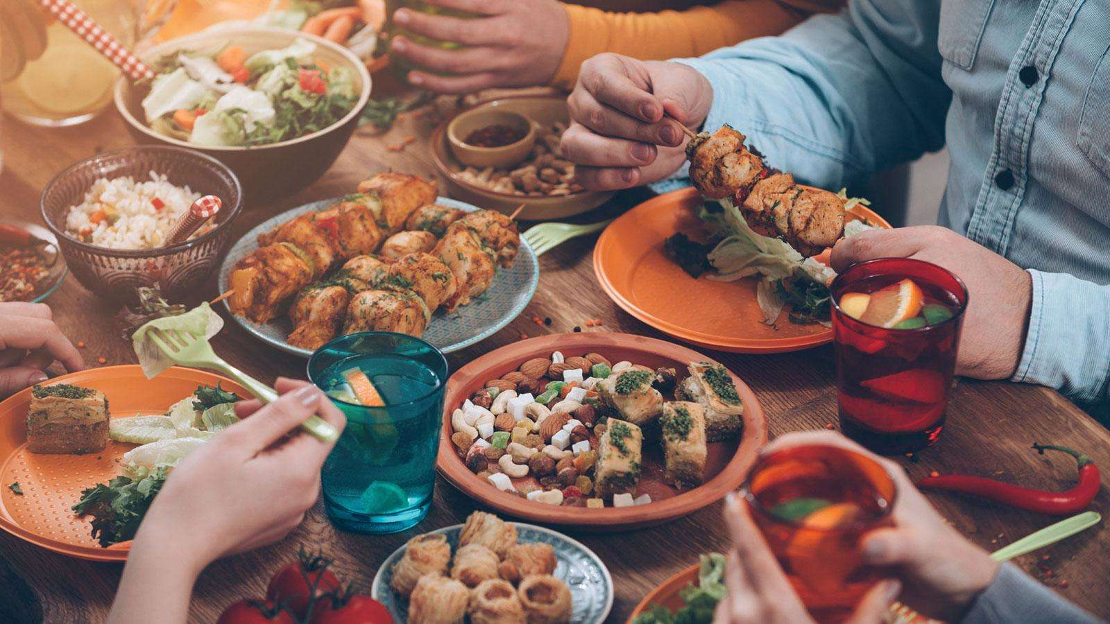
Cyprus Cuisine
Andreas Georgiou
Michallis Iakovides
Georgia Quinton

Slide 2
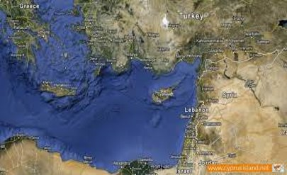
Being so close to the Middle East has definitely had an impact on the island’s cuisine, as many dishes are similar to those in our region. Flavours are also shared between Cyprus and Turkey, but the island’s cuisine is closest to refreshing Greek gastronomy. It has also been influenced by Byzantine, French, Italian, Catalan, Ottoman and other Middle Eastern cuisines.
Here are some unique foods that you have to try.

Slide 3
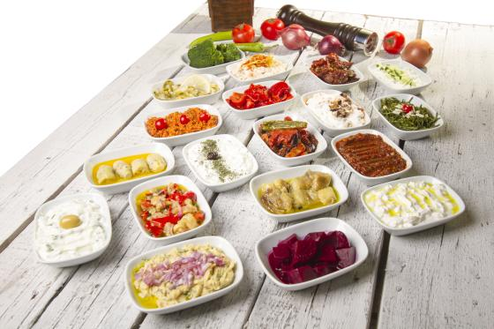
STARTERS OF CYPRIOT CUISINE

Slide 4
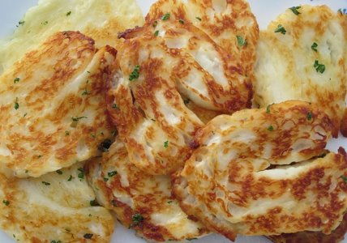
HALLOUMI
Halloumi is probably Cyprus’ most famous product, with its popularity extending to many countries throughout Europe and the Middle East. Distinguishable by its mild salty flavour and rubbery texture, the delicacy has become a favourite for chefs across the globe, appearing in dishes as diverse as lamb roast and halloumi fries.
The cheese is produced by combining a mixture of goat’s and sheep milk, before being set with rennet. This is an unusual practice due to the absence of acid-producing bacteria in any part of the process, a standard for most dairy products. Halloumi’s high melting point means it can be easily fried or grilled, or served cold alongside freshly sliced watermelon; the perfect summer dinner.

Slide 5
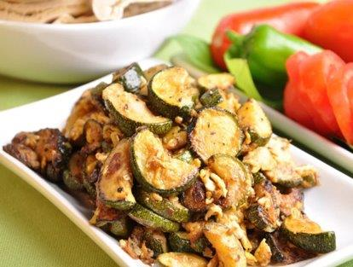
KOLOKOUTHKIA WITH EGGS
This dish often comes along with a dozen other mezze dishes, and consists of fried courgettes with scrambled eggs, sprinkled with salt.

Slide 6
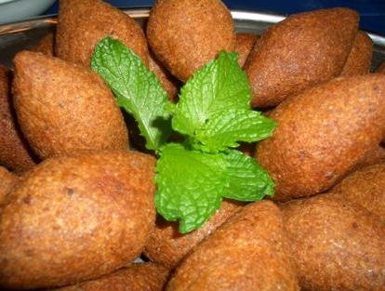
KOUBES
Koubes originate from the Levant region, and are basically a torpedo-shaped croquette. The outer shell is made of bulgur and encases a filling of minced meat infused with middle-eastern spices. These tasty bites are served with lemon wedges, with the zingy zest of the fruit really bringing out the filling flavour.

Slide 7
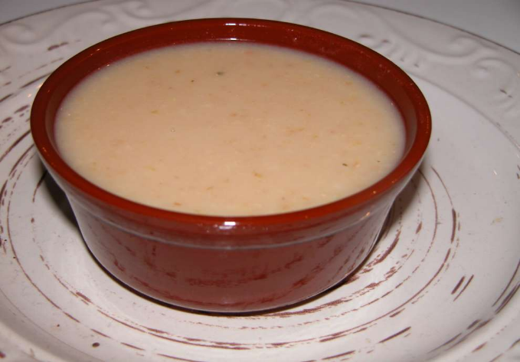
TRACHANAS
This thick soup is another dish that vegetarians can enjoy among the island’s traditionally meat-heavy cuisine. It’s made with dried cracked wheat and soured goat’s milk, and it is the perfect winter meal. It’s common to add pieces of halloumi to the soup once it’s cooked, which softens the cheese and makes it even more chewy.

Slide 8
TAHINI
Tahini condiment is made from toasted sesame seeds and is widely used by Cypriots as a dip sauce, a base for hummus, and, when mixed with water, as a dressing for salads and meals. This is also of Lebanese origin.

Slide 9
TZATZIKI(TALATTOURI)
Tzatziki is one of the most famous Greek dips. It is made from yogurt cheese (a strained yogurt), fresh cucumbers, garlic and pepper mint. Tzatziki is usually served with some bread or vegetables for dipping or as a sauce for meat or garnishing. You can also use it as a topping instead of sour cream.

Slide 10
MELITZANOSALATA
Melitzanosalata is a Greek salad made from baked eggplants. It can be served as a side dish or as a dip.

Slide 11
HUMMUS
The hummus is a dip salad, used in the Middle East as an accompaniment of bread or Arab pie in role appetizer. Traditionally it is made from sesame paste and chickpeas, lemon and olive oil with the addition of various spices and served in a deep dish with olive oil.

Slide 12
TARAMOSALATA
Taramosalata is a dip made of fish eggs, with creamy texture. In Cyprus taramosalata is usually consumed during fasting, because it does not contain dairy products, eggs (poultry).

Slide 13
GREEK SALAD
Greek salad is a salad made of tomato , cucumber , feta cheese , olives , onion, oil , oregano and salt. Sometimes added capers , vinegar and for decorating parsley and green pepper .In restaurants it is simply called "village salad".

Slide 14
YOGHURT
The yoghurt is fed to a creamy state produced from milk that has been fermented . Yoghurt has a soft texture with a slightly acidic aroma due to the lactic acid it contains. It has a high nutritional value and can be produced from cow's and sheep's milk .

Slide 15
TABOULEH
Tabouleh is a famous Arabic salad based on groats , parsley and tomato . Typically, it is served with the addition of other materials. It is a nice accompaniment to grilling. It is mainly consumed in the summer months of the year.

Slide 16
MAIN DISHES

Slide 17
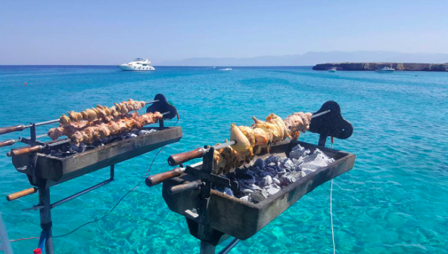
Souvla
Souvla is similar in look to souvlaki but different in taste. It is comprising large chunks of meat slow-cooked on a large skewer over a charcoal barbeque, called foukou in Greek. The meat is either pork, lamb, or chicken. This food is known as the king of meat dishes in Cypriot cuisine. It’s very common that a group of friends gather to cook souvla, while drinking beer, snacking and chatting as it takes a good hour or two. It’s a popular meal eaten on Easter Sunday to celebrate the end of fasting, on namedays and also at birthday parties and can be accompanied with a range of other dishes, usually potatoes and salads.

Slide 19
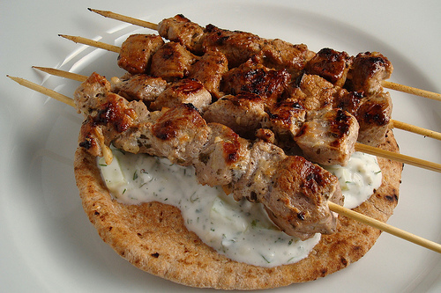
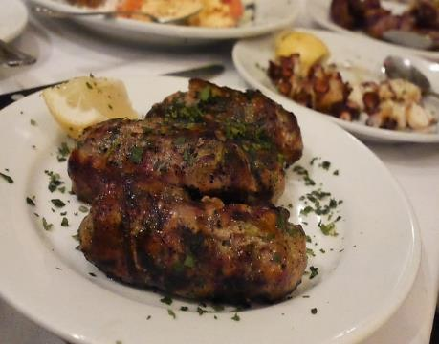
Souvlakia sheftalia
As I said previously souvlaki looks like souvla, but cut in smaller pieces. Souvlaki is also as famous as souvla. It is from pork or chicken and is served with a large amount of fresh salad and sheftalia inside the pitta. Sheftalia is like sausage from pork or lamb meat parcels with herbs wrapped in a caul fat.
Alternatively, if you are vegetarian we have options for you too. You can have pitta with mushrooms and halloumi.

Slide 20
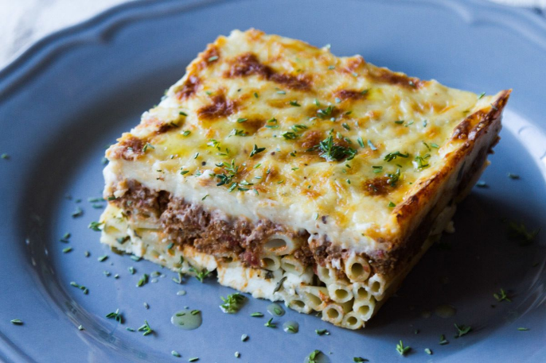
Makaronia tou fournou
Popularly known in Greece as pastitsio, the Cypriot version differs for its use of cheese, which is no other than halloumi, sprinkled with dry mint. Large pasta tubes, béchamel sauce and a tomato minced pork are the main ingredients used. Thin curls of cheese are often sprinkled on the top to give it a crispy crunch. The dish is usually prepared in a large oven pan. When served as a main dish, this Cypriot delicacy usually comes with a side salad.

Slide 21
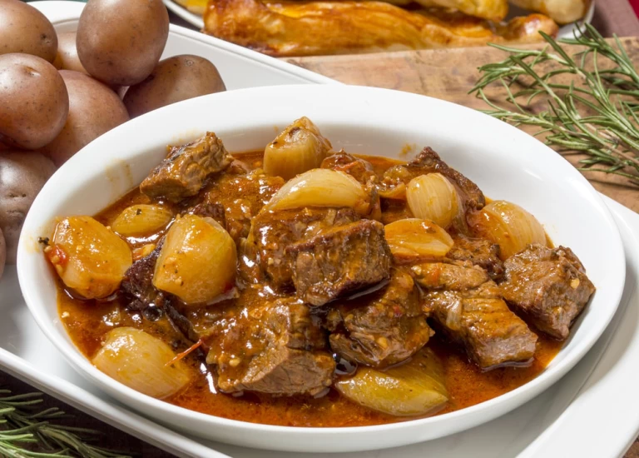
Stifado
Another hearty meat dish that’s a favourite in Cyprus is the moist stifado, prepared with onions and drenched in red wine. Beef is usually cooked alongside cinnamon sticks and cloves that give it a sweet kick. It is believed that the Venetians brought the recipe over and Cypriots added tomatoes in the 16th century when the fruit reached Europe. Stifado is cooked for several hours and is served with rice or bulgur.

Slide 22
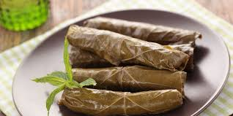
Koupepia (stuffed vine leaves)
Koupepia are made using vine leaves, a mixture of pork and beef minced meat, onion, tomatoes ,rice, olive oil, black pepper ,salt and little lemon juice. They filling the vine leaves with the meat along with the other ingredients and they rolling them up into a small log shape. The koupepia are placed in a saucepan and are pressed down with a small plate in order to stop the vine leaves from opening up. They are cooked on slow fire for about half an hour.

Slide 23
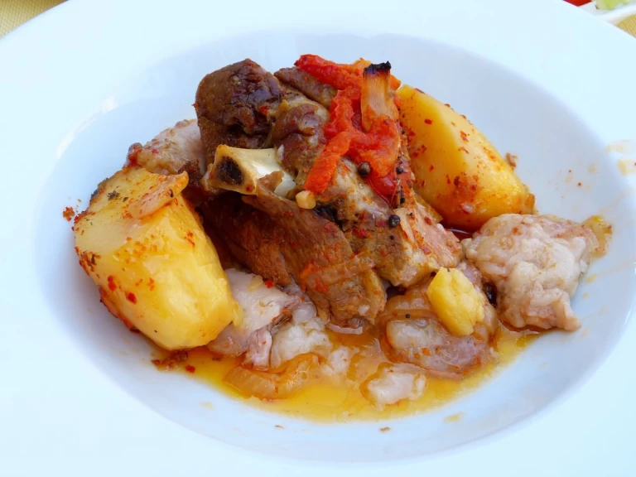
Kleftiko
This dish comes with a fascinating back story. Kleftiko gets its name from the word “stolen”, as historically people used to steal meat and bury it to be slow-cooked in covered holes in the ground, so that no smoke would give away the location of the thieves. Today, it’s cooked in traditional round, white ovens for many hours, flavored with bay leaves, oregano and red wine. The dish is accompanied by soft oven potatoes or bulgar wheat cooked with onions and tomato sauce. Enjoy it with a yoghurt to refresh each bite.

Slide 24
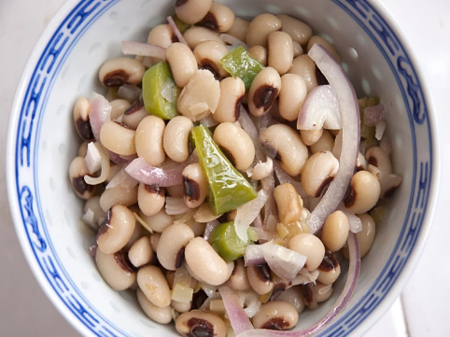
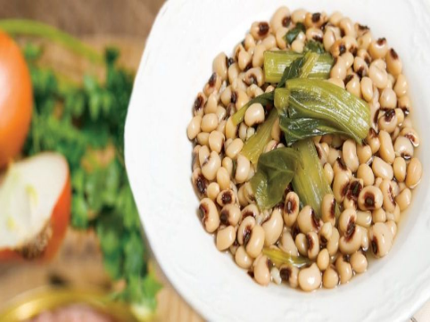
Louvi
A staple in every Cypriot kitchen, this simple and healthy dish mainly consists of black eyed beans, and is served with boiled courgettes or Swiss chard, oil, salt and lemon. The beans are low in fat while being high in carbohydrates and protein. When growing they are extremely drought tolerant, meaning they can survive even in the extreme heat of the scorching Cyprus summers, Tuna, cucumber and tomato are often served as fresh and flavorful side plates with louvi. Many households have beans on Mondays and Tuesdays, a cultural and religious trait passed down through generations.

Slide 26
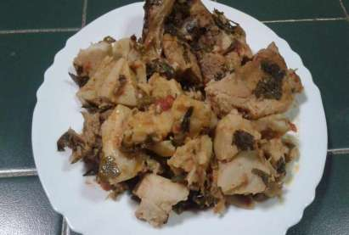
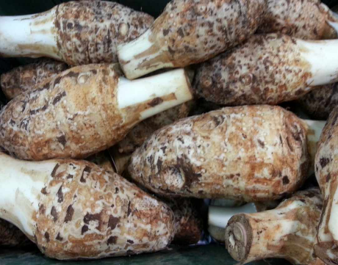
Kolokassi
Kolokassi or taro is a root tuber from Colocasia family, that Cypriots have been boiling and eating for centuries. It tastes like potatoes. The most popular way of preparing taro is baking it with vegetables, meat and some red wine.In Cyprus, taro has been in use since the time of the Roman Empire. Today it is known as "kolokassi" which is similar to the name the Romans used: colocasia.

Slide 27
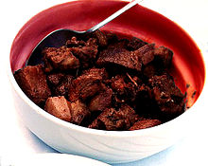
Afelia
Afelia is a traditional Cypriot pork dish. It is pork marinated and cooked in red wine with coarsely crushed coriander seed. In order to prepare the dish, ingredients like salt, pepper, oil etc. are included. During the British period the use of butter was replaced with oil. Afelia is usually served with potatoes, bulgur and yogurt.

Slide 28
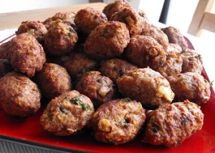
Kieftedes(meatballs)
Meatballs are a worldwide popular dish. A meatball is always ground or minced meat rolled into small balls, sometimes along with other ingredients, such as breadcrumbs, minced onion, eggs, butter and seasonings. Meatballs are cooked by frying, baking, steaming, or braising in sauce.
Cypriot meatballs are always made with ground pork or beef and grated raw potatoes mixed with mint or cinnamon or a mixture of them.

Slide 29
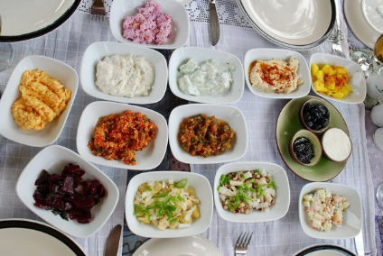
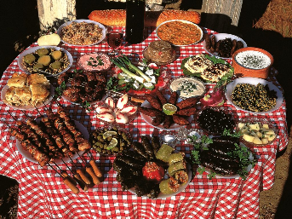
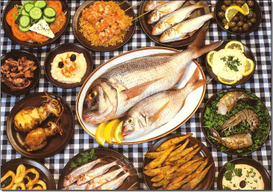
Another eating habit on our night out is either fish or meat meze. Meze ” literally means “small dishes” served and it is a style of eating that involves many courses, each of which contains smaller amounts of different dishes, just enough for everyone to have a taste. The Cypriot Meze starts out with a range of dips, salads and grilled vegetables and usually finishes with a main fish or meat dish respectively . There are lots of delicious dishes in between. Each dish has its very own unique flavour and preparation method, with restaurants often also putting their own spin on these traditional dishes.

Slide 30
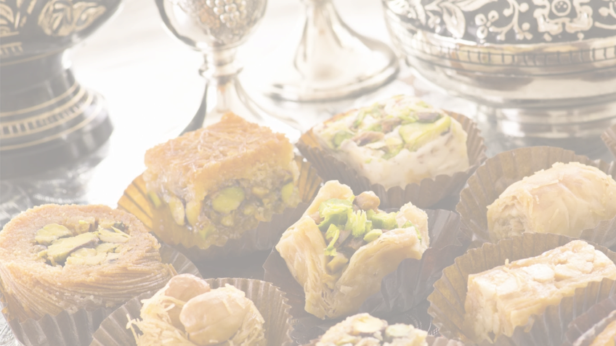
Deserts

Slide 31
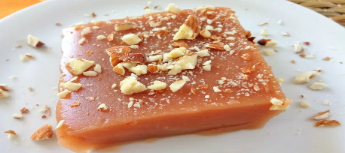
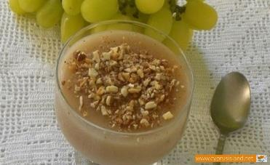
Palouze
The grape jelly of Palouze is a wonderfully traditional Cypriot dessert that takes advantage of the glut of grapes grown in the winemaking villages of the island.
The dessert is made by collecting the grape juice (must) during the grape harvest and boiling it in a large cauldron (‘kazani’), with a small amount of white soil called ‘aspri’, which brings any impurities to the surface for removal.

Slide 32
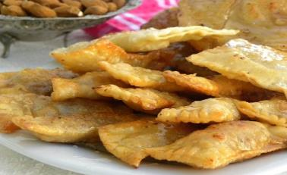
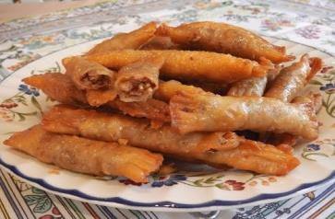
Daktyla
Daktyla, also called daktyla kyrion (meaning ladies fingers) is the most popular Cypriot dessert made with phyllo which is very crispy and very juicy, filled with almonds, cinnamon and sugar. They are fried and then drenched in syrup, scented with rose water, which make them irresistible.
ladies’ fingers, is a very old recipe with a few ingredients but so delicious. As most of the Cypriot traditional recipes, these were made with simple everyday ingredients which people usually had at home.

Slide 33
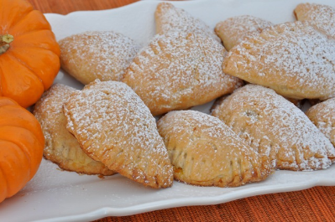
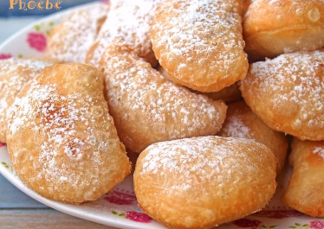
Bourekia
Bourekia are a type of pastry, made with a very thin layer of puff pastry, and are then filled with a variety of ingredients. Sweet bourekia are filled with anari, a soft white cheese and cinnamon. They are then sprinkled with icing sugar on top.
Traditionally the dough is cut with a glass but you can also cut it with a knife and pressing down the edges with a fork
Bourekia are fried in plenty of oil until both sides are golden. Then they are placed in paper towels to soak the oil and lastly they are sprinkled with icing sugar.

Slide 34
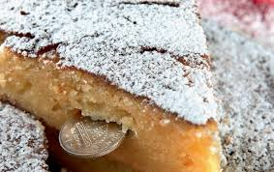
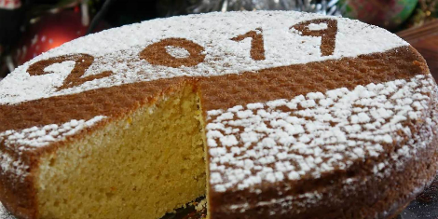
VASILOPITA
Growing up, I can’t remember a New Year’s day that didn’t involve Vasilopita. This Greek New Year’s Bread is sweet and moist, baked with eggs and milk, scented with orange zest, and topped with toasty sesame seeds.
Vasilopita is a traditional New Years cake with one gold coin in it. The person that gets the slice with the coin is said to have good luck all year long.

Slide 35
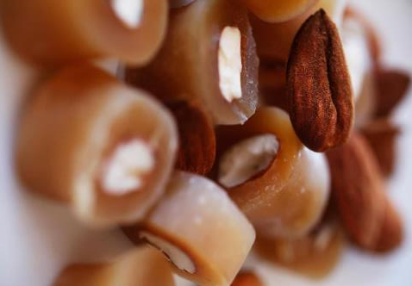
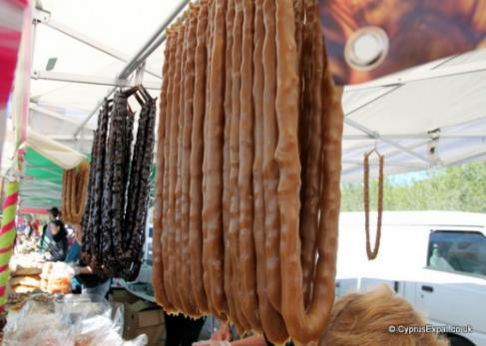
Soutzoukos
Soutzoukos is a traditional, chewy sweet made from grape juice that has a unique appearance (it looks similar to a candle!), and is popular at traditional festivals.
The sweet is made using the surplus of grapes after the grape harvest, which is why it is commonly made in the wine producing villages of Cyprus.

Slide 36
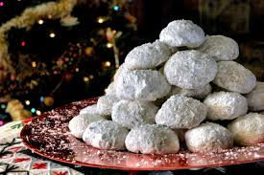
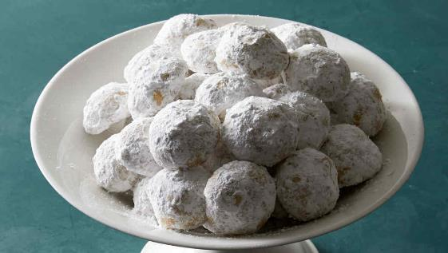
Kourabiedes (sugar buns)
The Greek word kourabiedes comes from the Turkish word kurabiye, derived from the Arabic word for cookie
In Cyprus, Kourabiedes are commonly consumed during the Christmas season, as well as around Easter, and other holidays and special events. They are served traditionally at Greek weddings, as well as birthday parties and special occasions. They are also a popular treat for New Year’s festivities.

Slide 38
THANK YOU FOR YOUR ATTENTION <3

