Slide 1
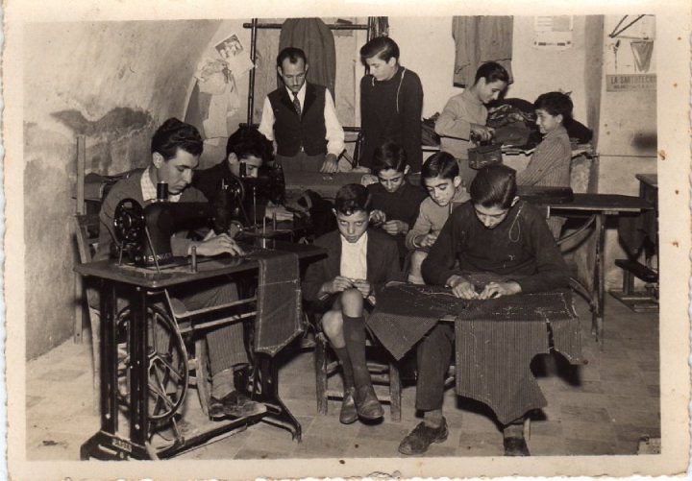
Jobs and Crafts

Slide 2
Until relatively recent times, craft techniques and designs were passed down within one family for many generations or were transmitted by the apprentice system wherein a boy learning the craft served for as long as seven years under a master craftsman. Only fairly recently has the older traditional system of transmitting the skills and knowledge of a craft been partially supplanted by formalized training in schools and books.

Slide 3
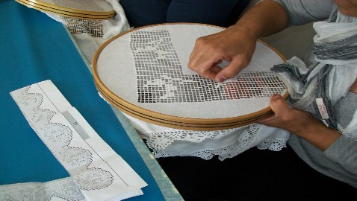

Slide 4
In an earlier era, practically all textiles used in the home were produced in the home and it was a rare occasion when a piece of cloth was purchased. A certain number of texile crafts were practised largely for decorative purposes. These include embroidery, crewel work, needle-point and crocheting. Girls also made samplers that involved intricate decorative needlework. While it is true that these decorative techniques were frequently used by the young ladies of well to-do families and were taught in schools, they were also traditional ad practised in leisure hours by most women.

Slide 5
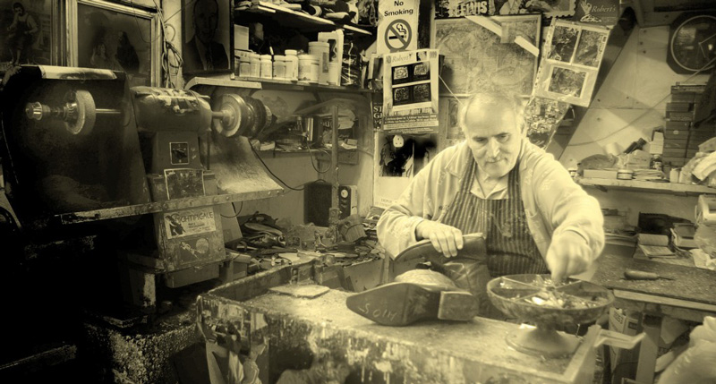

Slide 6
Some craftmen still flaurish in aereas where they repair factory-made items, although not all crafts survive in this way. The shoemaker, for example, has an important role in the community. He was capable not only of repairing shoes , but sometimes also of producing them from individual compoents , adapting, modifying and make them last for a long time.

Slide 7
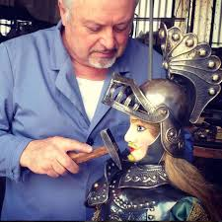

Slide 8
The puppeteers give life to the chivalravs histories taken out from the Renaissance italian poems. The Syracuse’s puppeteers carry this tradition on since 1923 and their experience in the only one in Syracuse. With this knowledge, passed down from father to son, they gave life to unique pieces of art for theater, entertainment and interior design.

