Slide 1
Kourion - petra toy romiou – paphos 25/1/2019

Slide 2
Kourion amphitheater
The archaeological remains of Kourion - which was one of the island’s most important city-kingdoms in antiquity - are of the most impressive on the island, and excavations have unearthed many significant finds, which can be viewed at the site.
The city-kingdom was built on the hills of the area, and overlooked and controlled the fertile valley of the river Kouris. According to archaeological finds, evidence suggests that Kourion was associated with the Greek legend of Argos of Peloponnese, and that its inhabitants believed they were descendents of Argean immigrants. The once-flourishing kingdom was eventually destroyed in a severe earthquake in 365 AD.
The magnificent Greco-Roman theatre - the site’s centerpiece - was built in the 2nd century BC and extended in the 2nd century AD. The theatre has been restored, and is now used for open-air musical and theatrical performances - mainly during the summer months - making it one of the most popular settings for high-calibre cultural events.
East of the theatre are the remains of a prominent building, the ‘House of Eustolios’, which was originally a private villa that was turned into a public recreation centre during the Early Christian period.

Slide 3
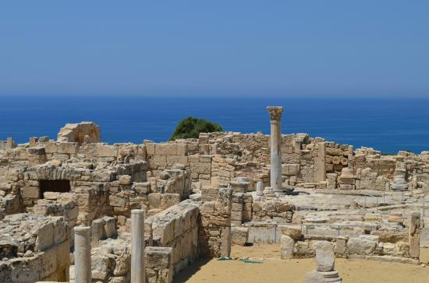
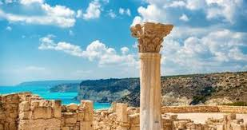

Slide 4
PETRA TOY ROMIOU

Slide 5
According to one legend, this rock is the site of the birth of the goddess Aphrodite, perhaps owing to the foaming waters around the rock fragments, and for this reason it is known as Aphrodite's Rock. Gaia (Mother Earth) asked one of her sons, Cronus, to mutilate his father, Uranus (Sky). Cronus cut off Uranus' testicles and threw them into the sea. Cronus ambushed his father and cut him below the waist with a scythe. Uranus, as he tried to escape flying, lost parts of his truncated body and testicles into the sea. A white foam appeared from which a maiden arose, the waves first taking her to Kythera and then bringing her to Cyprus. The maiden, named Aphrodite, went to the assembly of gods from Cyprus. The Romans widely referred to her as Venus

Slide 6
Another legend SAYS THAT The present name Petra tou Romiou ("Rock of the Roman") associates the place with the exploits of the hero Basil as told in the DigenEs Akritas. Basil was half-Byzantine (East Roman or Romios) and half-Arabic, hence the name Digenes (two-blood). Legend tells that the Christian Basil hurled a huge rock from the Troodos Mountains to keep off the invading Saracens.
A nearby rock is similarly known as the Saracen Rock.

Slide 7
The CASTLE PAPHOS
was originally built as a Byzantine fort to protect the harbor. It was then rebuilt by the Lusignans in the thirteenth century after being destroyed in the earthquake of 1222. In 1570 it was dismantled by the Venetians. After capturing the island, the Ottomans restored and strengthened it. Throughout the ages it has seen many uses. It has served as a fortress, a prison and even a warehouse for salt during the British occupation of the island. More recently the castle serves as a backdrop to the annual open air Paphos cultural festival which takes place in September.

Slide 8
mosaics
Paphos Archaeological Park contains the major part of the important ancient Greek and Roman City and is located in Paphos, southwest Cyprus. The park, still under excavation, is within the Nea Pafos ("New Paphos") section of the coastal city.
Its sites and monuments date from prehistoric times through the Middle Ages. Among the most significant remains so far discovered are four large and elaborate Roman villas: the House of Dionysos, the House of Aion, the House of Theseus and the House of Orpheus, all with superb preserved mosaic floors, especially an Orpheus mosaic. In addition, excavations have uncovered an Agora, Asklipieion, Basilica, Odeion, Hellenistic-Roman Theatre, and a necropolis known as the "Tombs of the Kings".[

Slide 9
KALIDONIA NATURALTRAIL AND OMODOS VILLAGE
26/1/2019

Slide 10
KALIDONIA NATURAL TRAIL
Trail distance: 3 Km
Elevation min: 1225 Meters max: 1756 Meters
Height uphill: 12 Meters downhill: 546 Meters
Difficulty level: Moderate
Ends at start point (loop): No
Activity: Walk

Slide 11
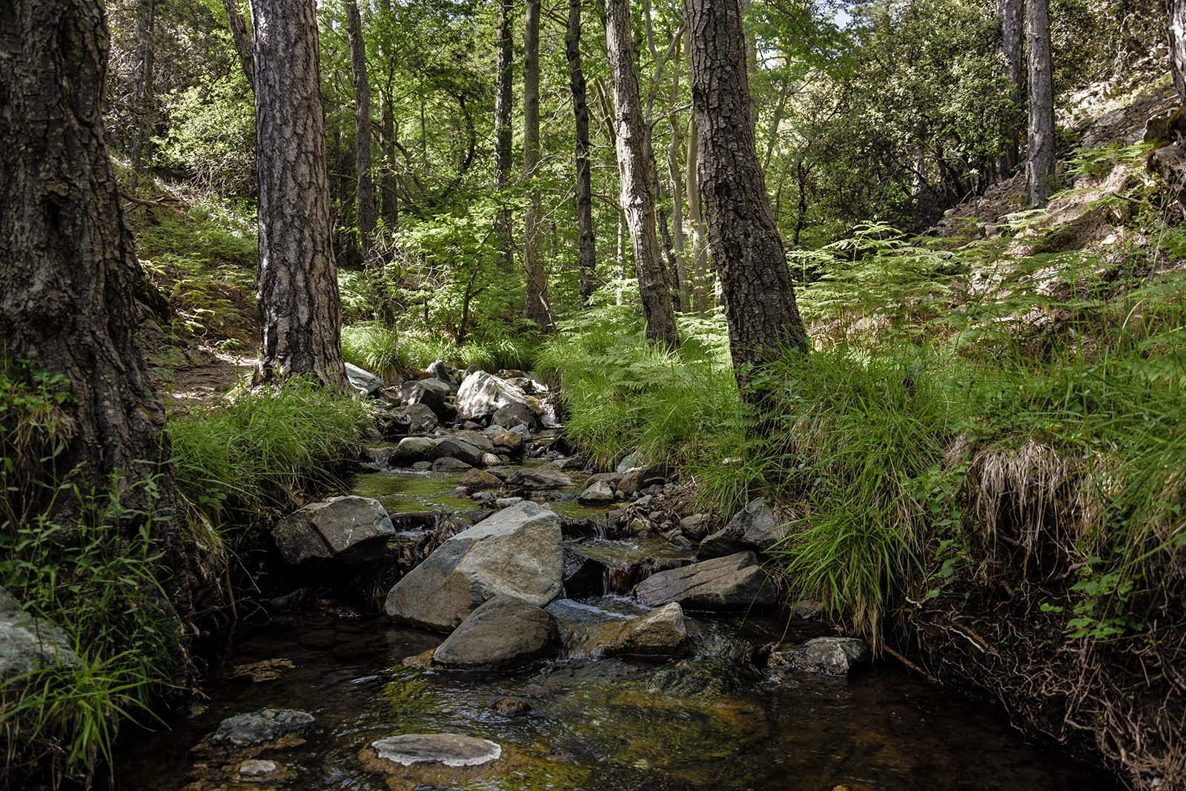

Slide 12
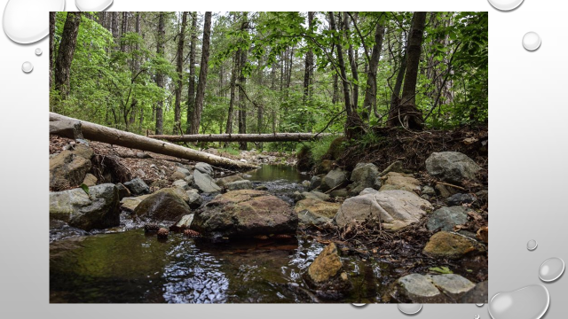
Caledonia trail has a length of just three kilometers and it is quite steep. It crosses a stream at points. Visitors are likely to hear many songbirds -especially towards summer- though it is rather difficult to spot them. About midway we will come to Caledonia Waterfall, a major natural attraction in the area. The water quantity is not significant, but the setting is nevertheless idyllic. The trail finishes in Platres village.

Slide 13
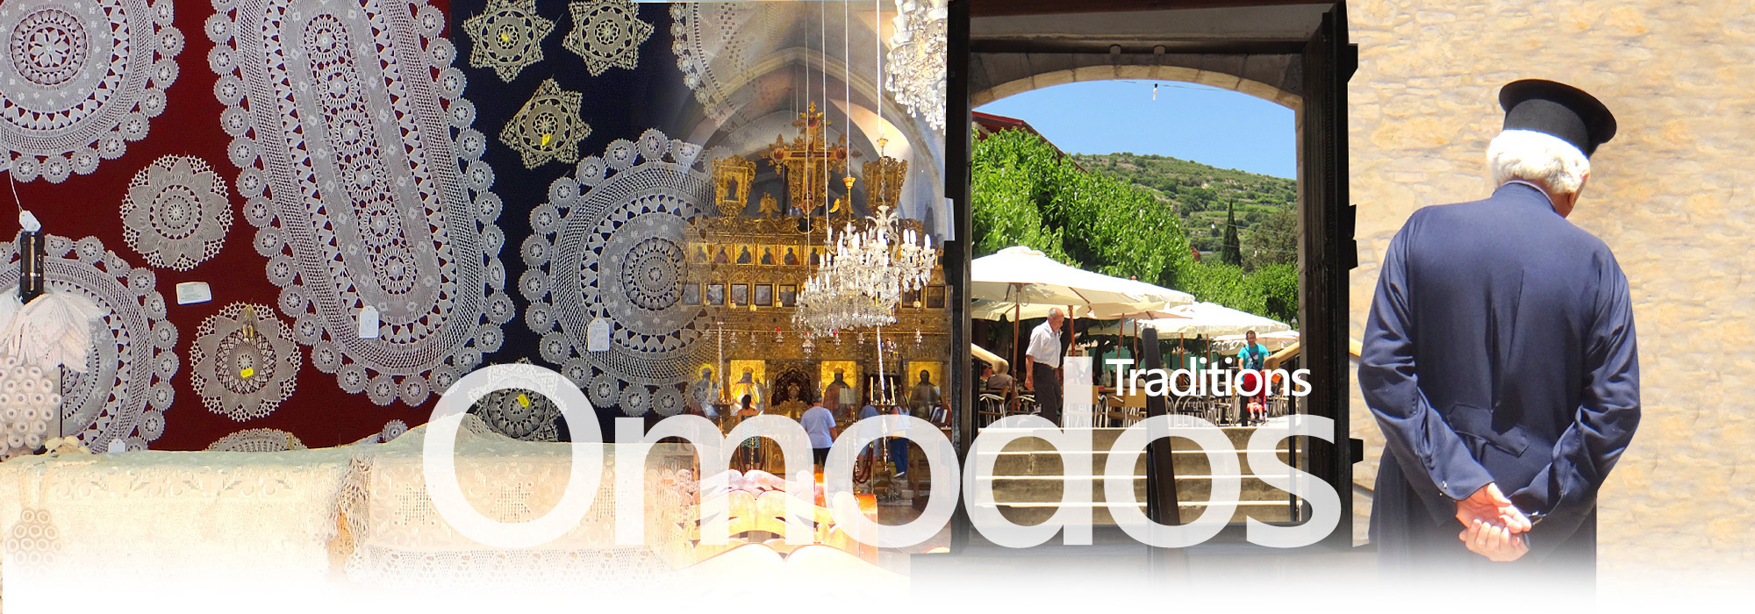
Omodos village
Omodos is located about 42 kilometres north-west of the city of Limassol, in the geographical region of the wine-making villages. It is built near the west bank of the Cha-potami river at an average altitude of 810 meters. The village is surrounded by tall mountaintops, the tallest of which are "Afames" (1153 m.) and "Kremmos of Laona" (Laona's Cliff, 1092 m.).The village produces wine and holds a wine festival every August. You can visit a 17th Century stone built monastery You will also find a good mix of restaurants including traditional taverns and a few modern bars housed in traditional buildings. Home handicraft flourishes in Omodos such as handmade embroideries, making wonderful brocades, tablecloths, threaded quilts, and narrow-knit and Chantilly laces.

