Slide 1
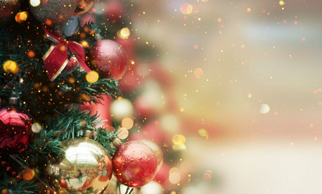
Finnish Christmas traditions

Slide 2
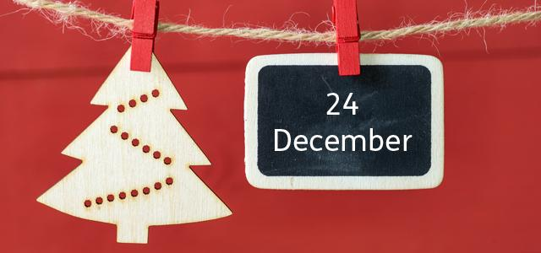
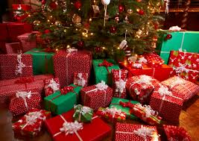
Basic facts
In Finland we celebrate Christmas on Christmas Eve, December 24.
In the evening, Santa will visit the homes and give gifts.
In particular, the Christmas Eve has become the most important celebration of Christmas time, and nowadays it is a paid day off in most workplaces.
By contrast to other public holidays, public
transport is quiet in Finland in the afternoon on Christmas Eve.
The Christmas period ends in Epiphany( january 6).

Slide 3
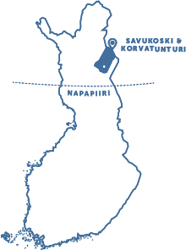
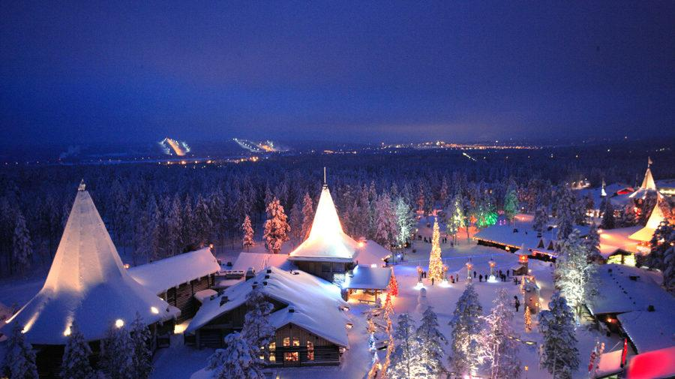
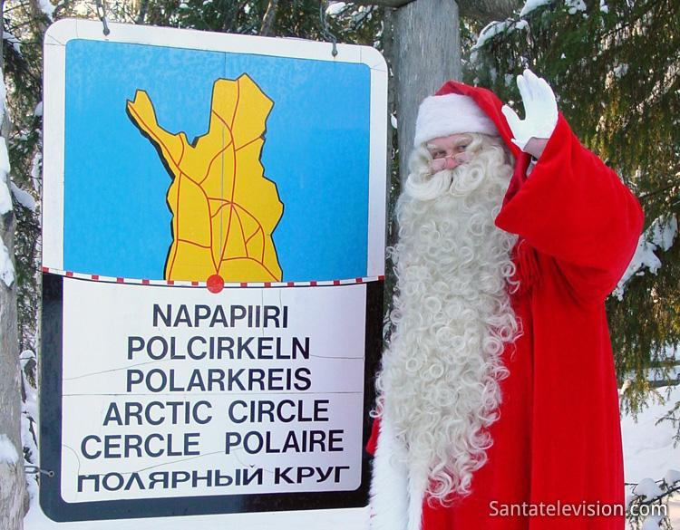
Basic facts
Finnish people believe that Santa Claus or Father Christmas lives in the north part of Finland called Korvatunturi (or Lapland), north of the Arctic Circle. People from all over the world send letters to Santa Claus in Finland.
There is also a big tourist theme park called 'Christmas Land' in the north of Finland, near to where they say that Father Christmas lives.

Slide 4
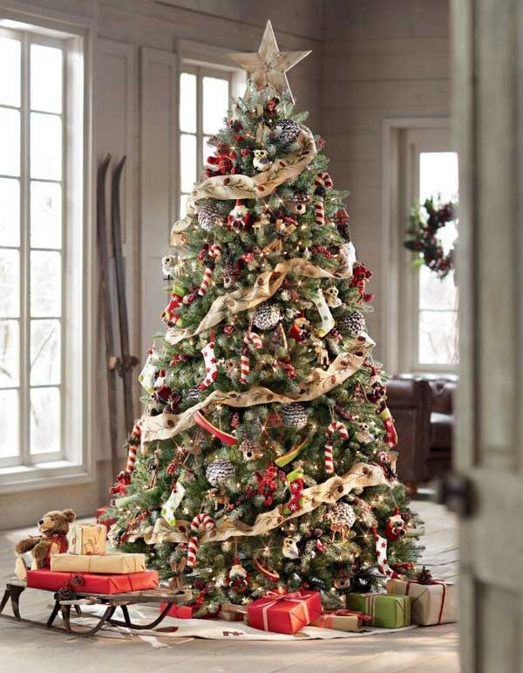
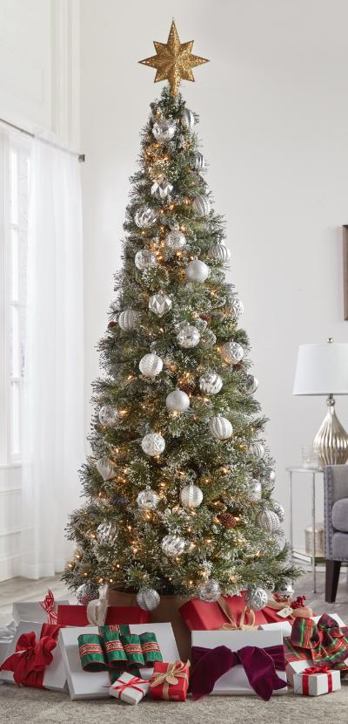
Christmas tree
In christmas we do have christmas trees in homes and we decorate those.
we put our gifts under the tree.
Can be real trees or plastic ones.

Slide 5
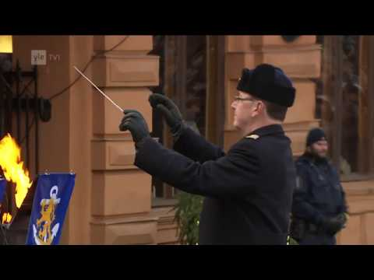
Listen Christmas piece
The tradition of proclaiming Christmas piece continues in Finland, above all in Turku, where the proclamation is read in the Old Great Hall from the balcony of the Brinkkalan House at 12 noon.

Slide 6
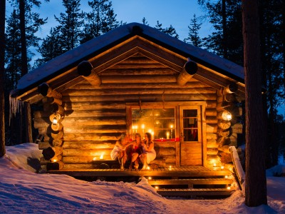
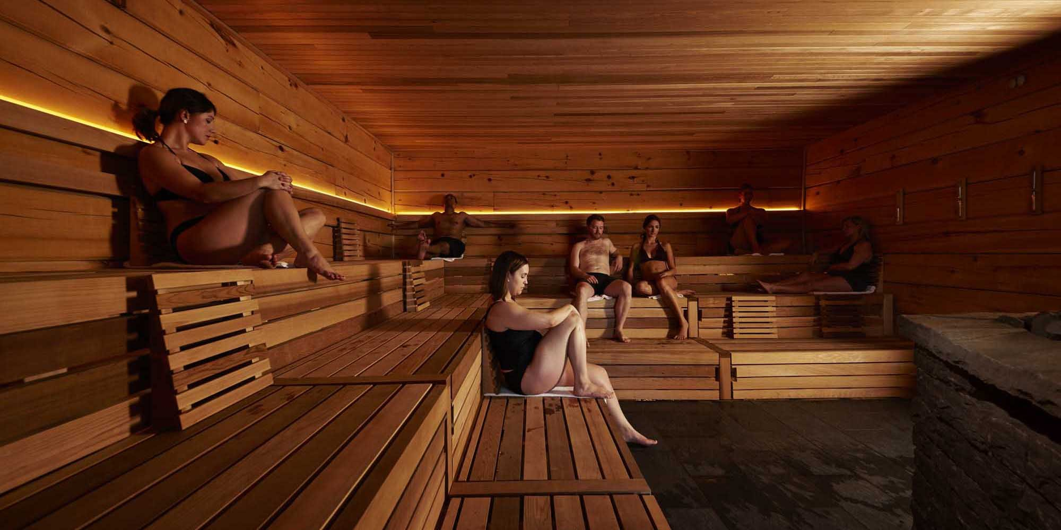
Christmas sauna
The Christmas sauna is a Finnish Christmas tradition. It was the most important event for the old Finns in Christmas, which was prepared with devotion and care. The Christmas sauna has been part of the Finnish peasant's celebration through time. After sauna if its snow in ground people go often cool down and roll over in snow.

Slide 7
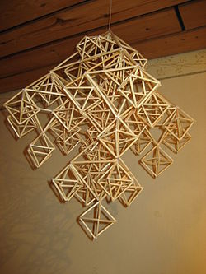
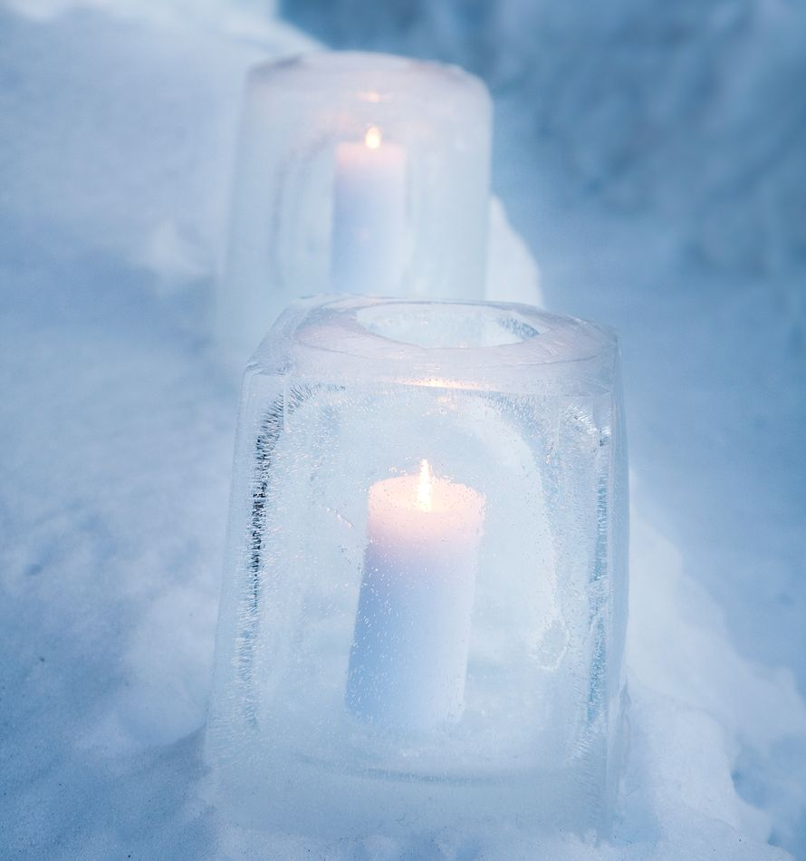
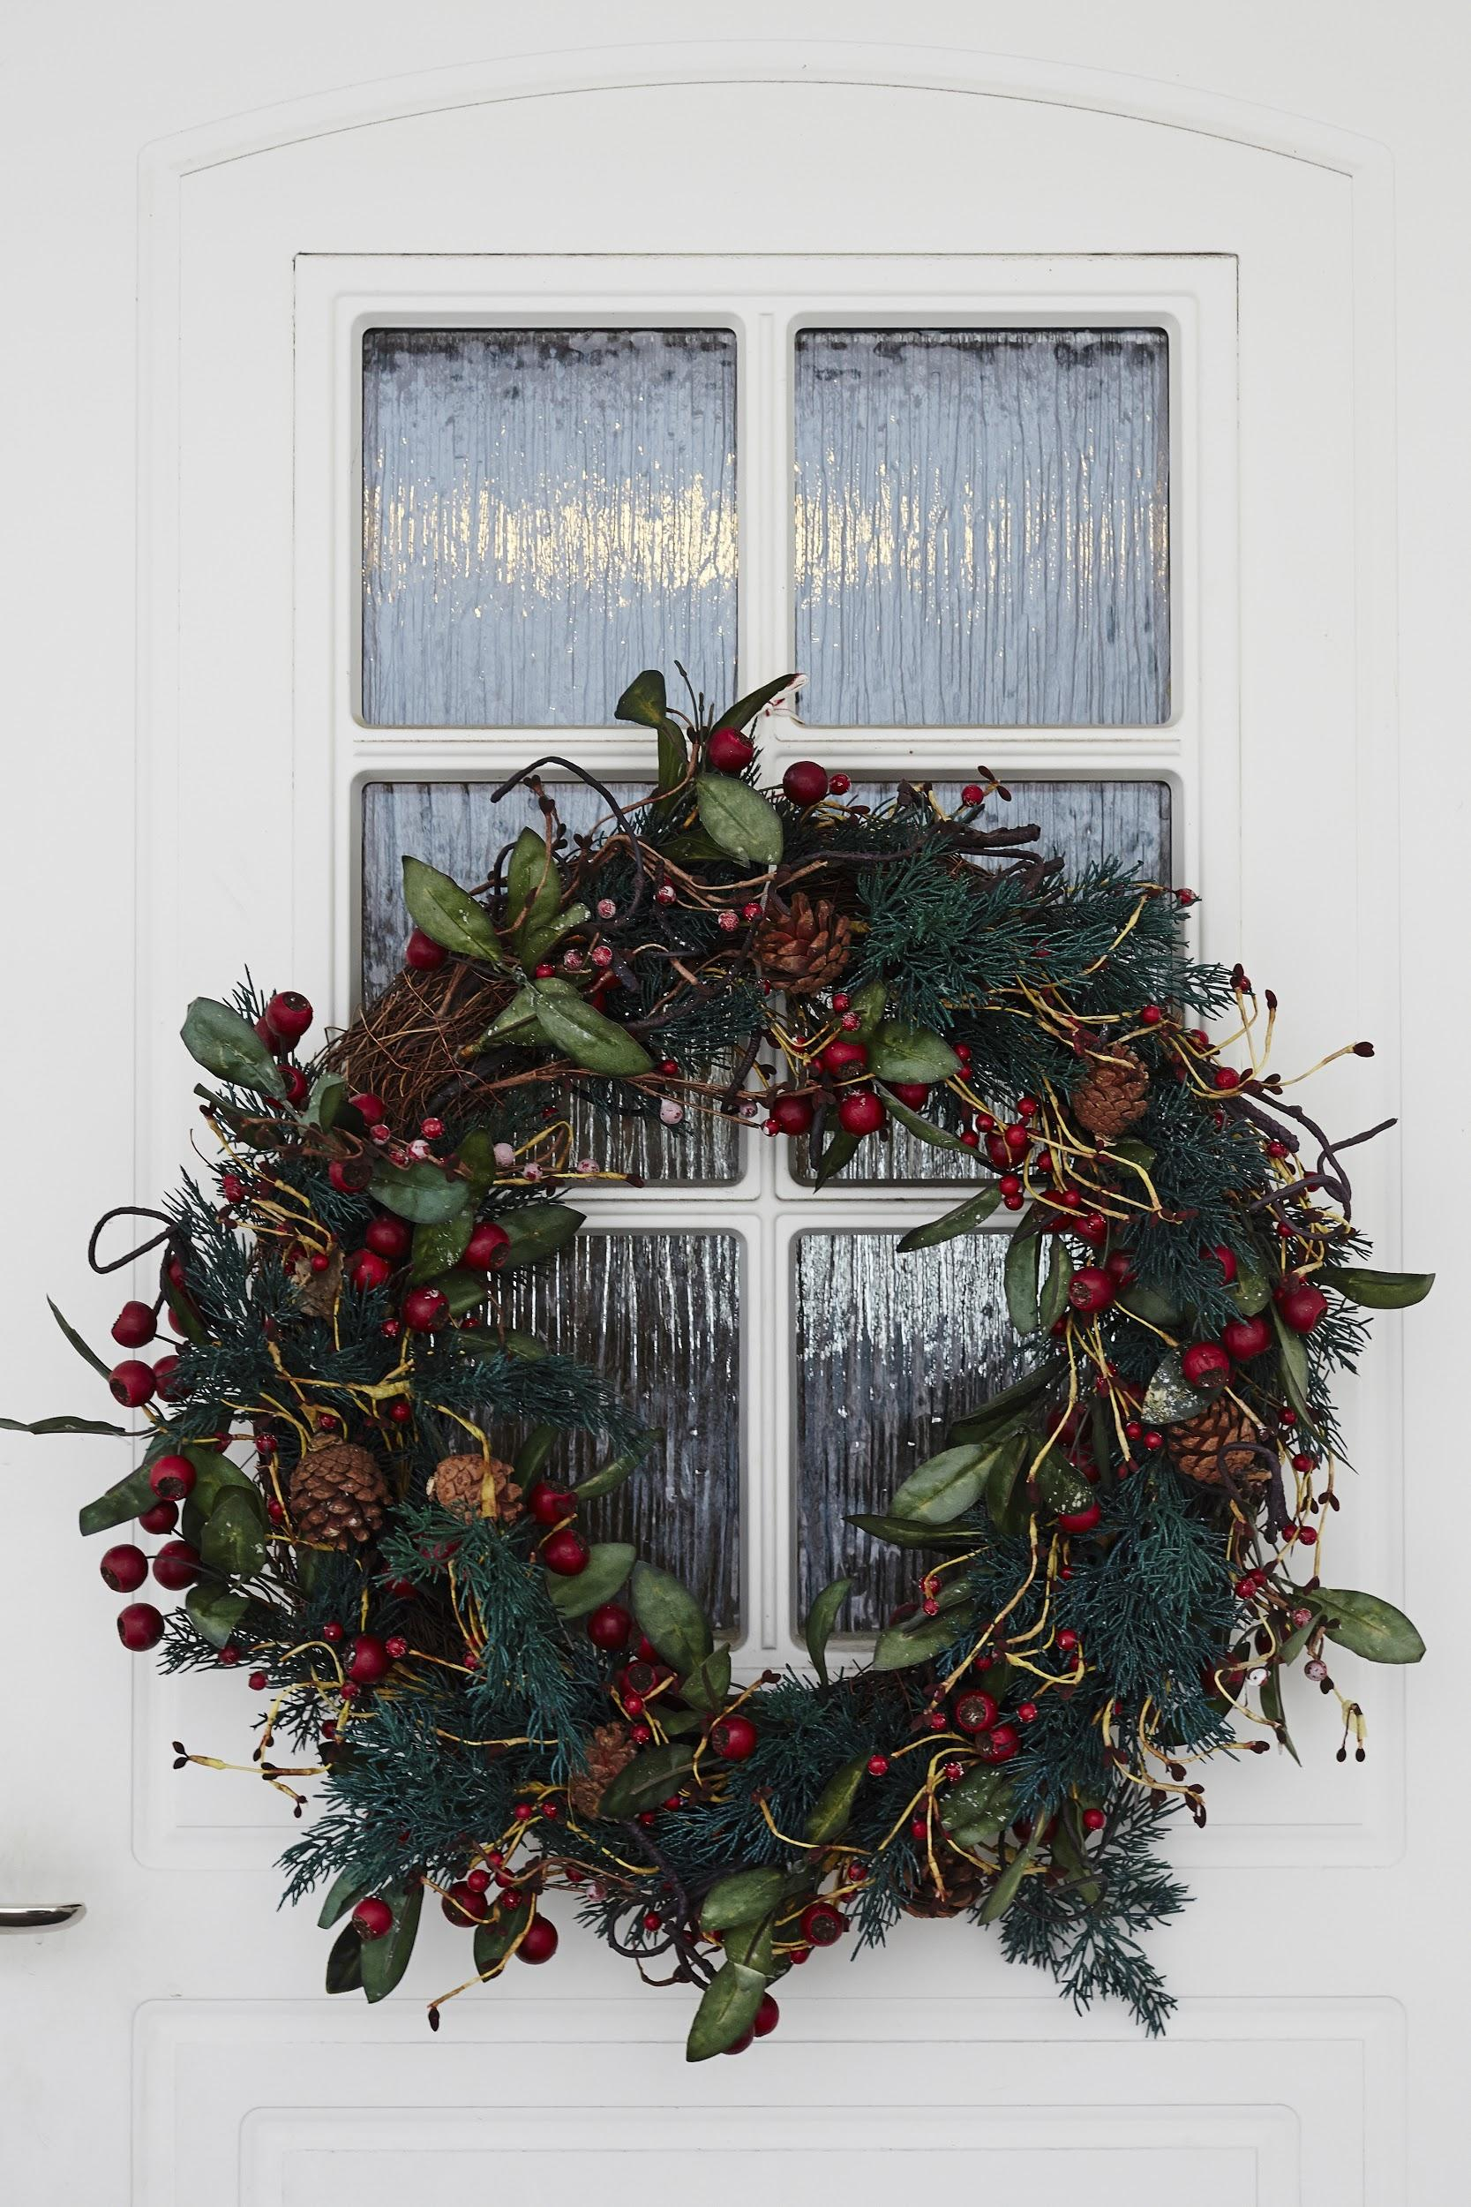
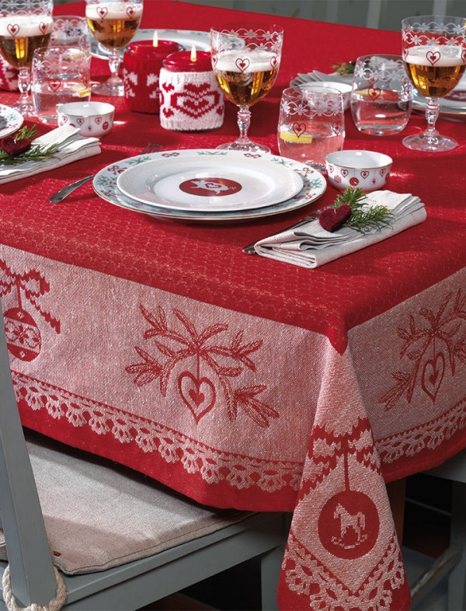
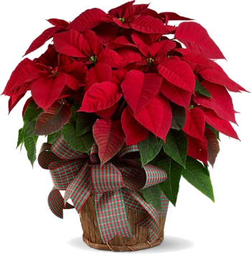
Christmas Decorations
Common Christmas decorations include spruce, christmas tree, Christmas wreaths, shoulder straps, himmels, apples, candles, Christmas tablecloths, Christmas flowers, outdoor entrances,ice lanterns and sheaves.

Slide 8
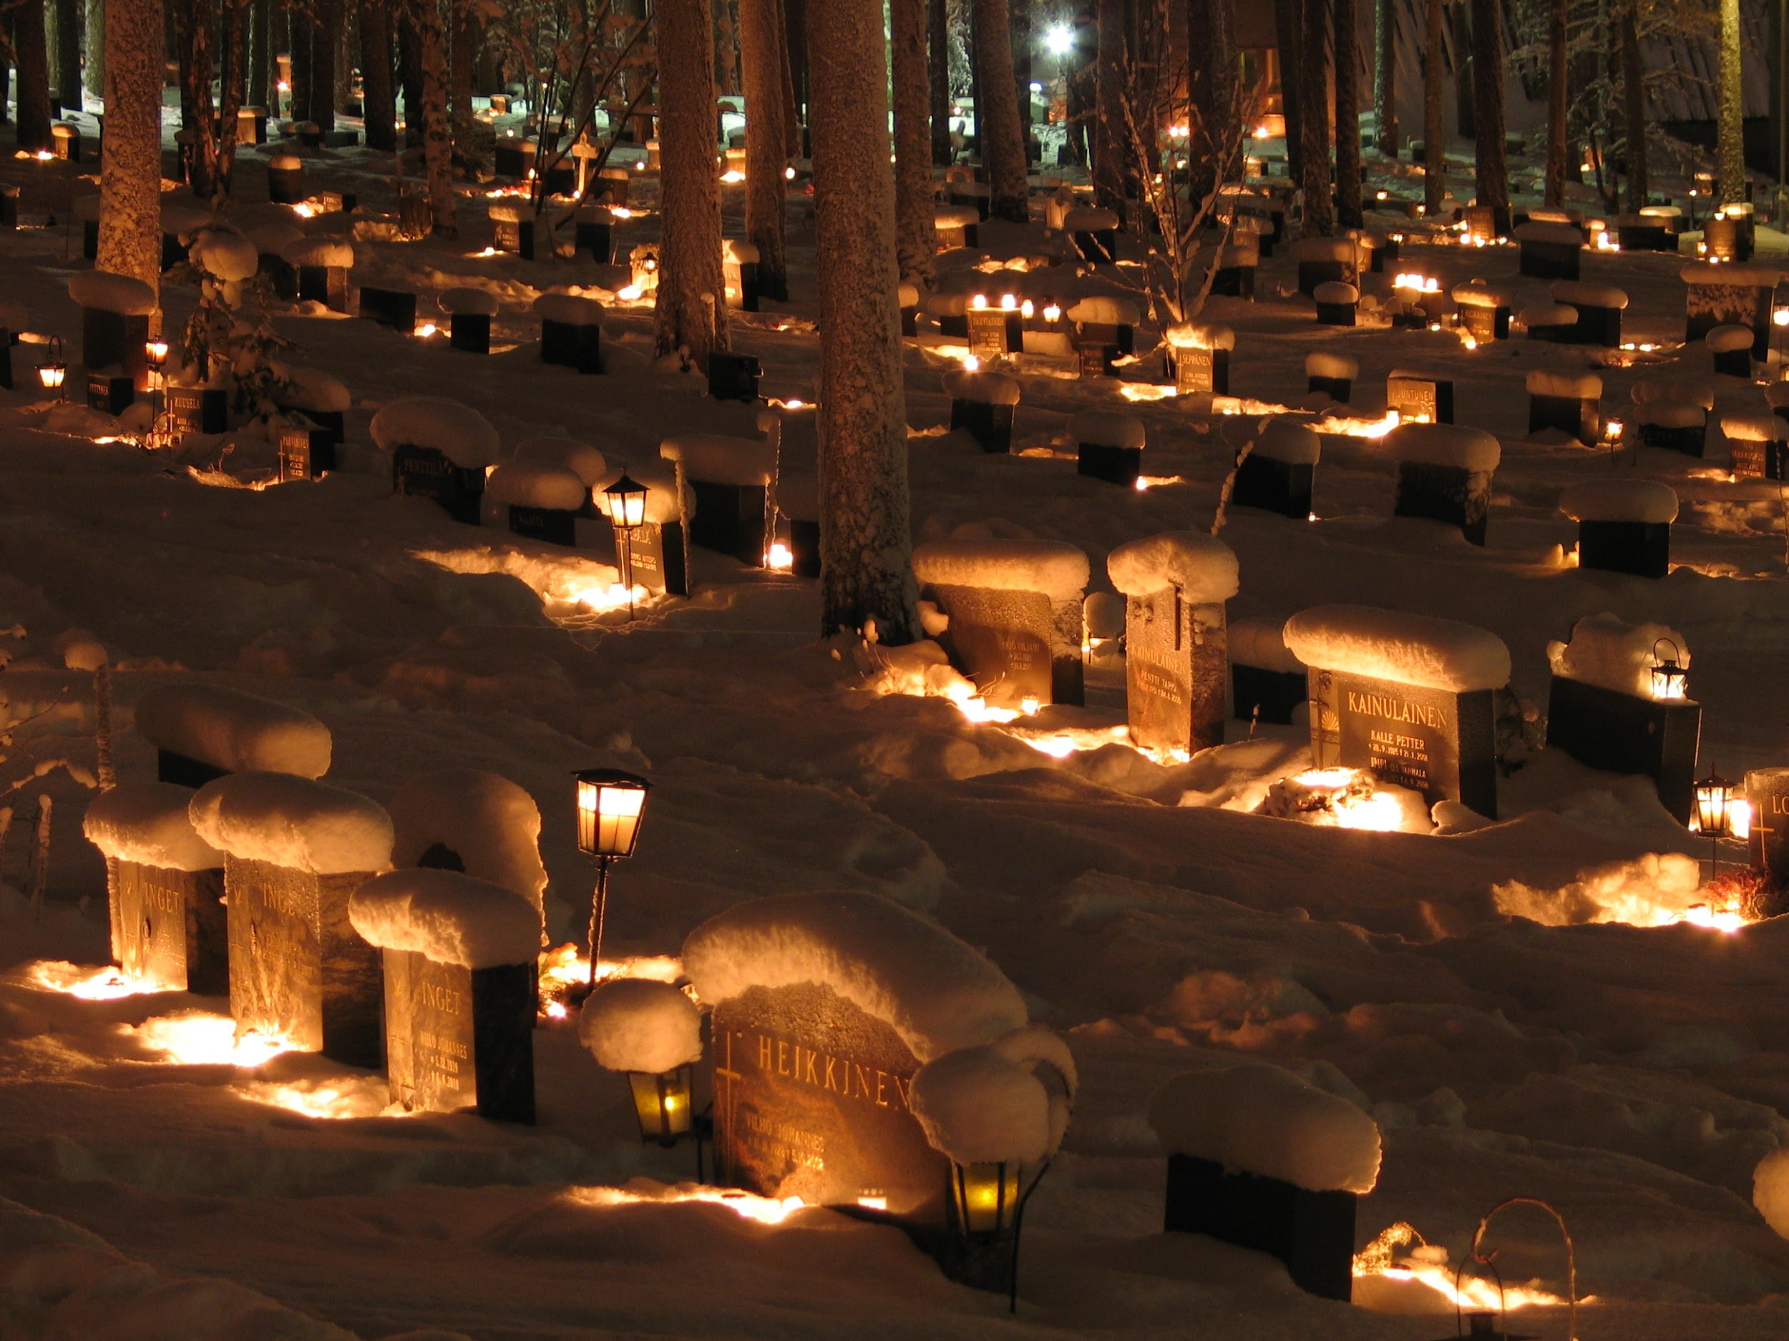
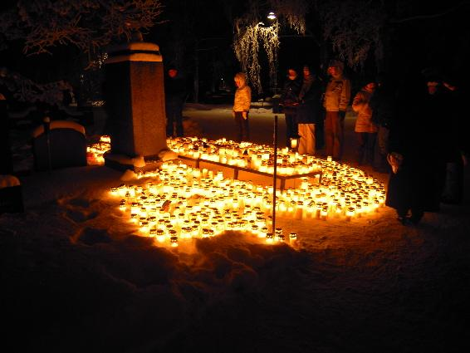
The way to go to the cemetery to light candles to the family farms began in the 20th century and became commonplace after the Winter War with heroic beasts and others.

Slide 9
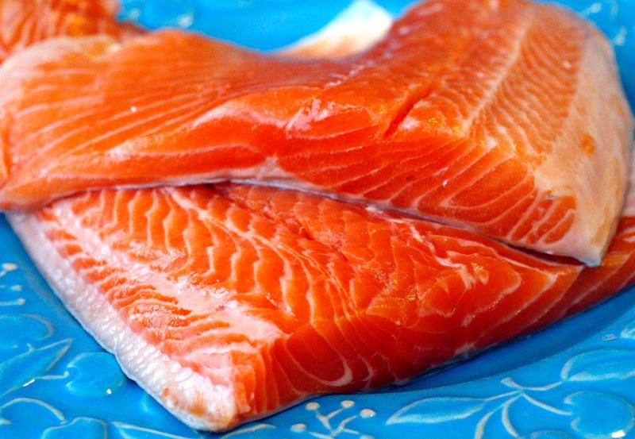
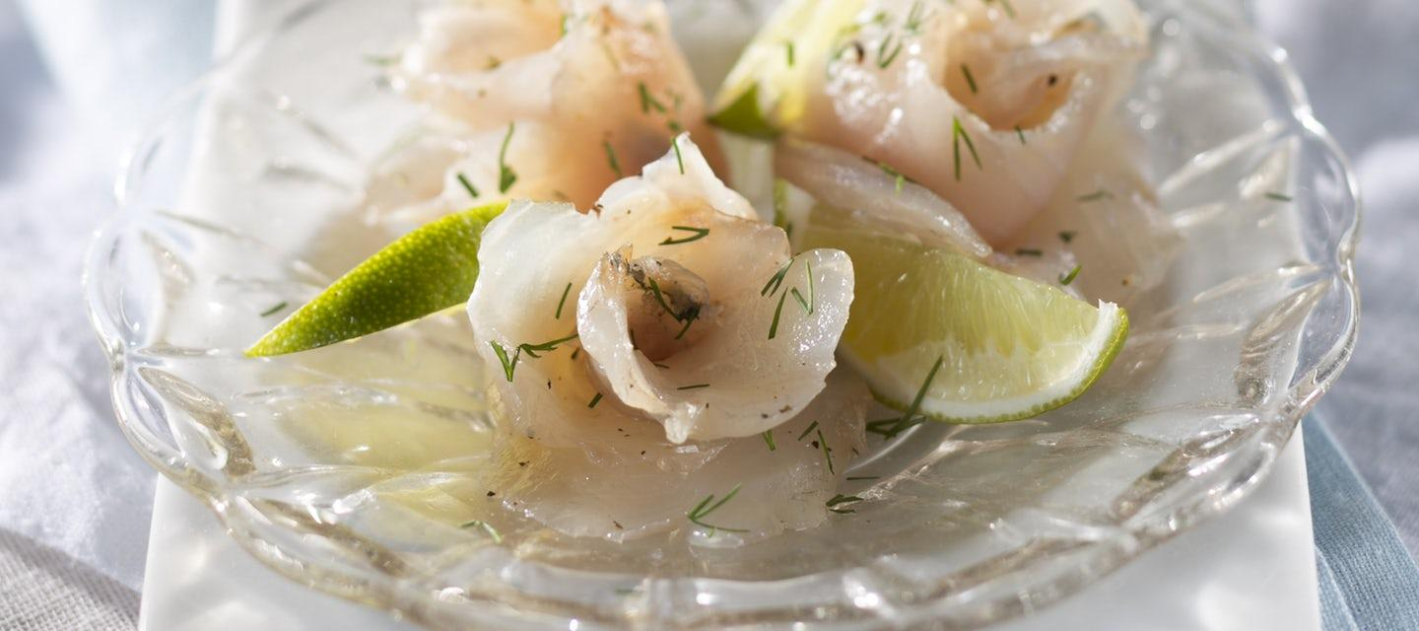
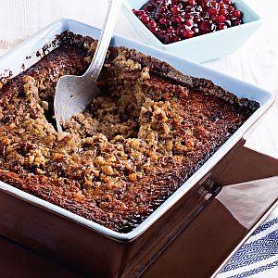
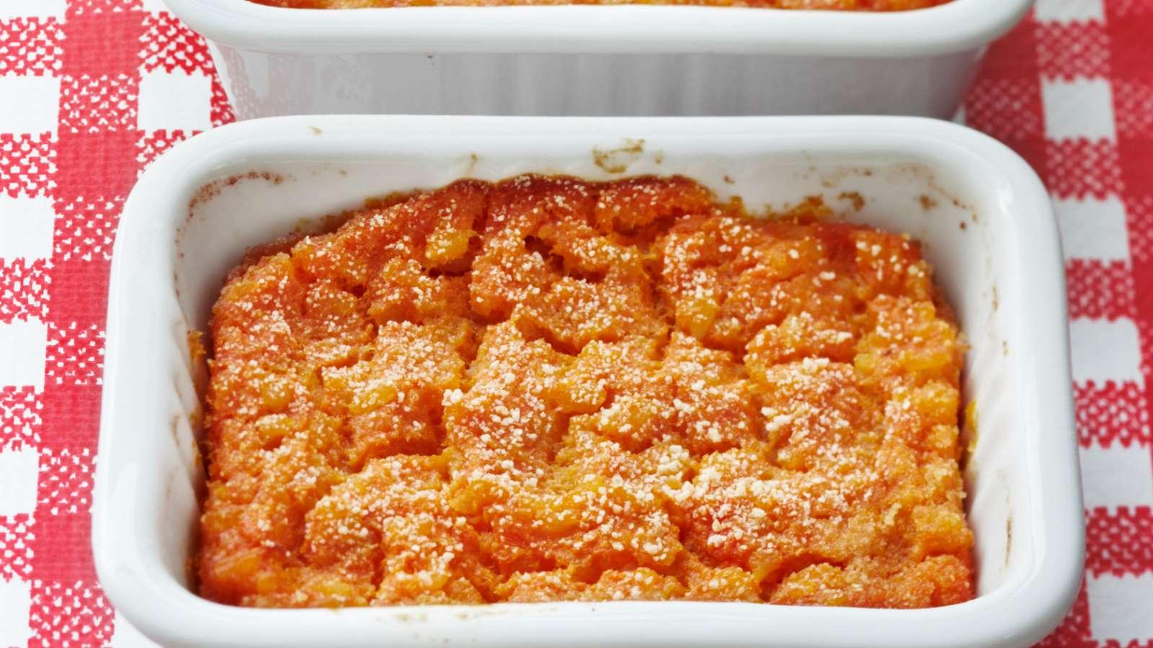
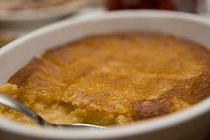
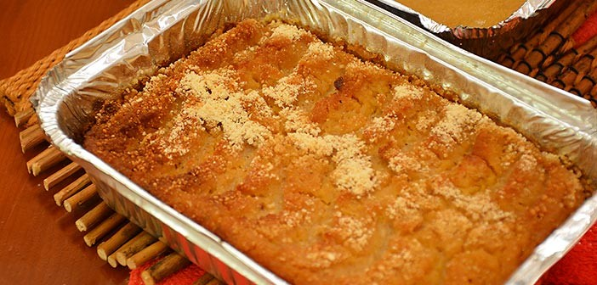
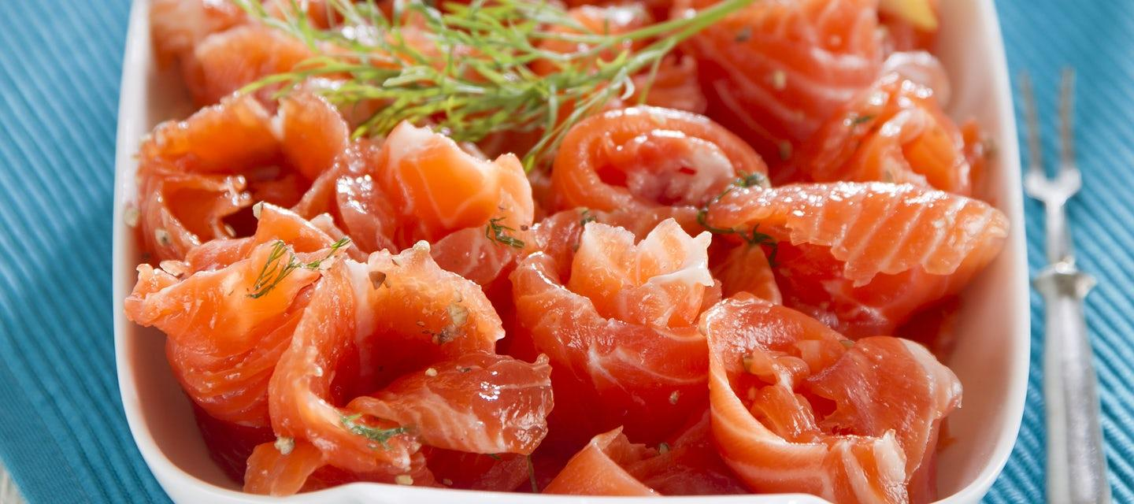
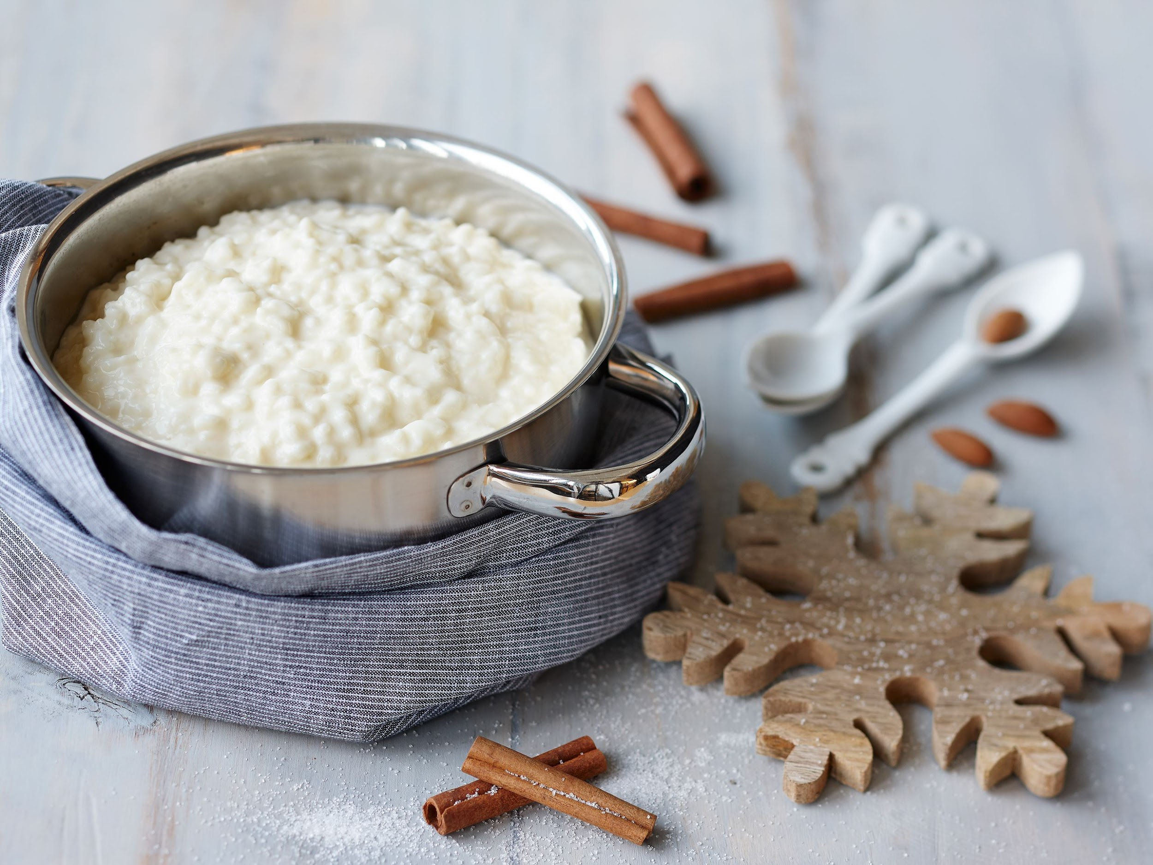
Traditional Christmas food
Typical dishes for Finnish Christmas food include various boxes, usually carrots, Swede and potato boxes, and various fish dishes such as cold-smoked salmon, graavisalmon and graavis. On Christmas Eve morning, we eat rice porridge!

