Slide 1
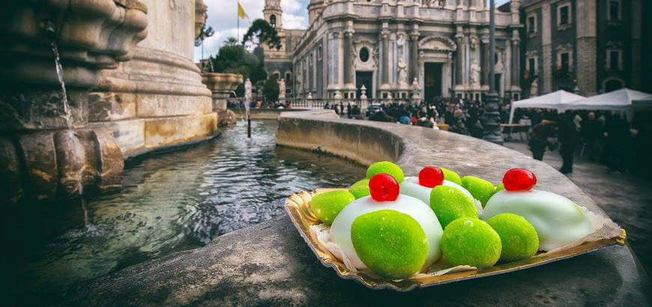
What to eat in Sant'Agata?

Slide 2
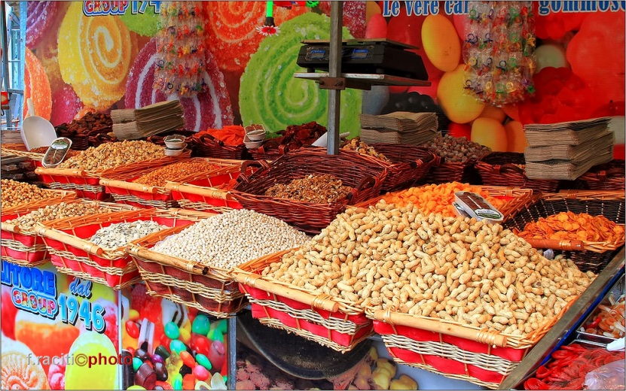
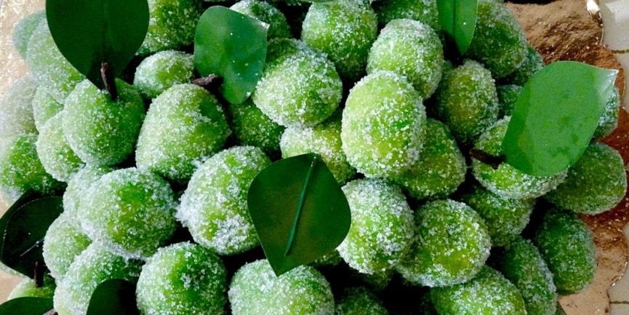
Sant’Agata is a religious celebration that involves all the people of Catania and not, a great show that involves every spiritual, social and cultural aspect of the city.
A lot of street food, many sweets offered by stalls and pastry shops, to be consumed on the street or to take with you, to preserve a memory of one of the most beautiful celebration in the world.
OLIVETTE
They are a true must of the celebration.
The olivette recall the moment when Agata, pursued by Quinziano near the Praetorian Palace, stopped to put on a shoe and, nearby, an olive tree appeared where she could find refreshment.

Slide 3
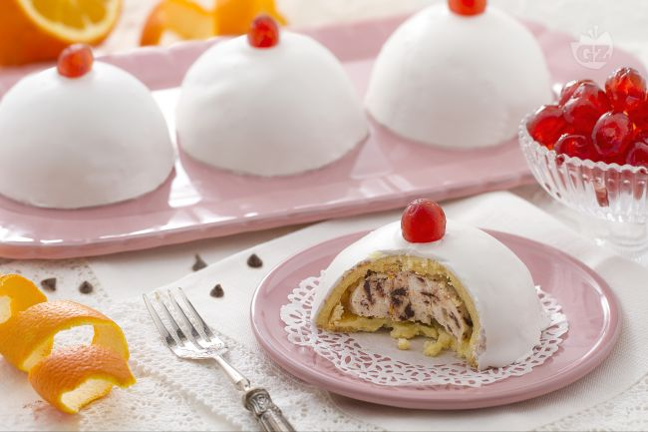
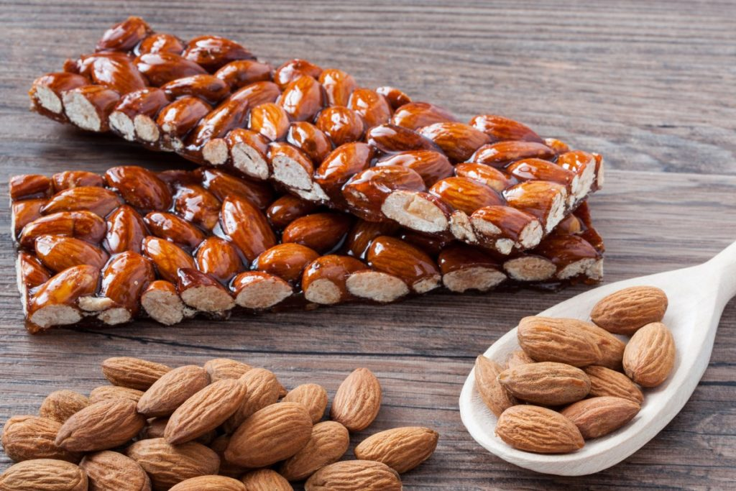
CASSATELLE OR MINNUZZE DI SANT’AITA.
The minnuzze represent of the most typical elements of Sicily: the white snow-capped Etna, the lava in the center represented by a small candied cherry. But more than anything, as legend tells, it seems to represent the breasts that, amputated, miraculously receive the Santa.
TORRONE WITH ALMONDS AND CARAMELED ALMONDS.
The most classic of nougat is an explosion of taste: the almonds, whole, are perfectly combined with caramelized sugar.

