Slide 1




Erasmus+, KA229, School Partnerships Project
5th Project meeting
Karvina, Czech Republic
28. Febr. – 04. March, 2020
“CHILDREN’S FESTIVALS IN TURKEY"
by
Özel Falez Fen Bilimleri Anadolu Lisesi
Antalya / Turkey

Slide 2


Slide 3
Every year, April 23 National Sovereignty and Children’s Day, which Atatürk made a present to all the world’s children, is celebrated with the same enthusiasm.
So, lets see what is the story of this date, which is a national holiday.

Slide 4
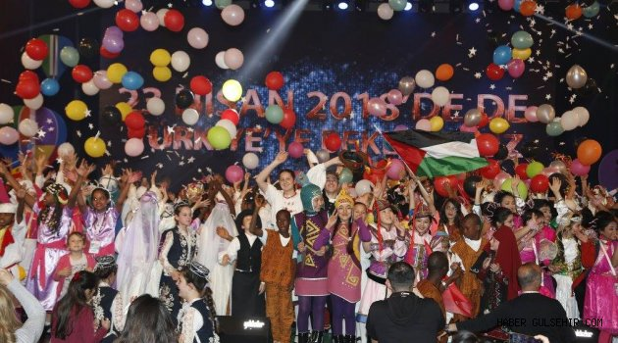
April 23, National Sovereignty and Children’s
Day is a national holiday in Turkey.
April 23, Children’s Day is related to the opening of the Turkish National Assembly.

Slide 5
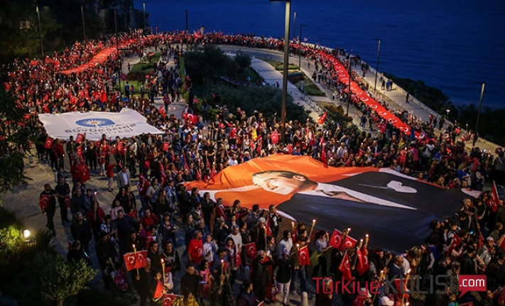

Slide 6
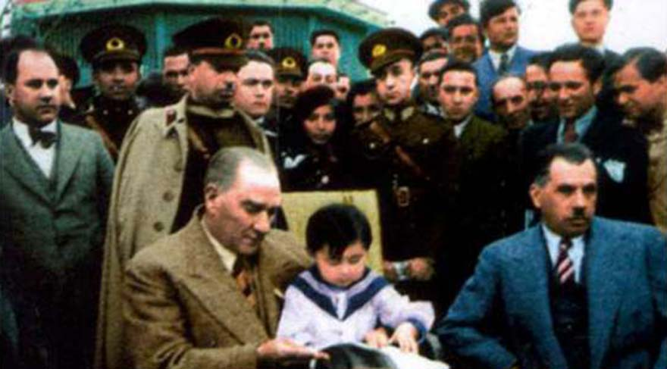
The aim of the National Sovereignty Holiday ”, which is celebrated on 23rd of April every year, is to celebrate the abolition of the sultanate and foundation of the Grand National Assembly of Turkey in 1920 by Atatürk.

Slide 7
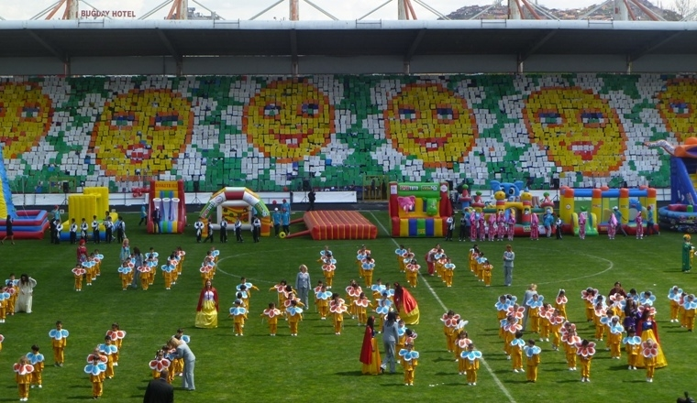
And the purpose of the “Children Day” was to gladden impoverished children left as orphans during the Turkish War of Independence in 1919-22.

Slide 8
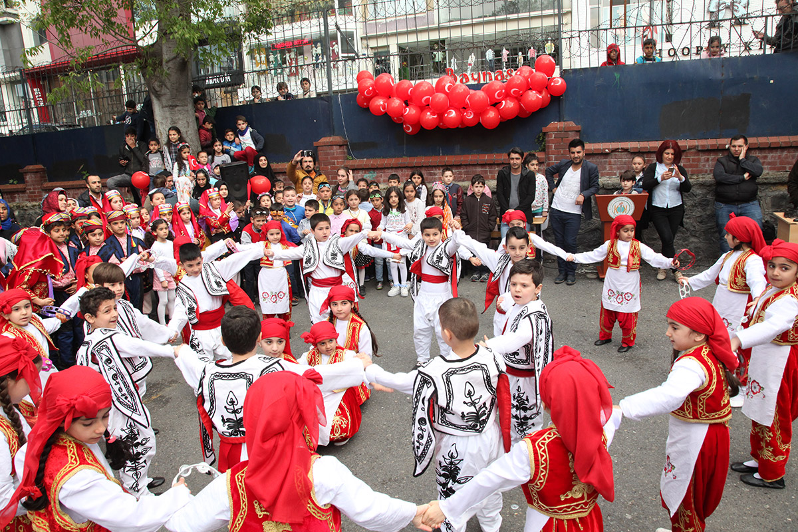
This festival, April 23, is celebrated as a special public holiday in Turkey and it is an international festival.
Thousands of children from at least 50 countries come to Turkey to perform their traditional folk dances, music, theatre and enjoy the friendship in different cities of Turkey for a week.

Slide 9
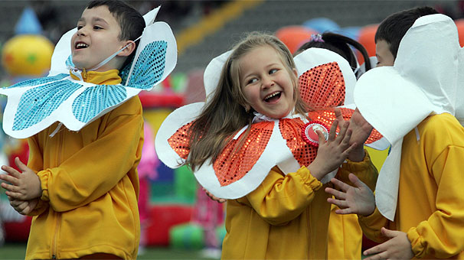
* This is known as the history of the April 23 National
Sovereignty and Children’s Day.
* Atatürk dedicated this day to all children of the world
and pioneered to celebrate this day every year by
children with the same joy and cheer in Turkey.

Slide 10
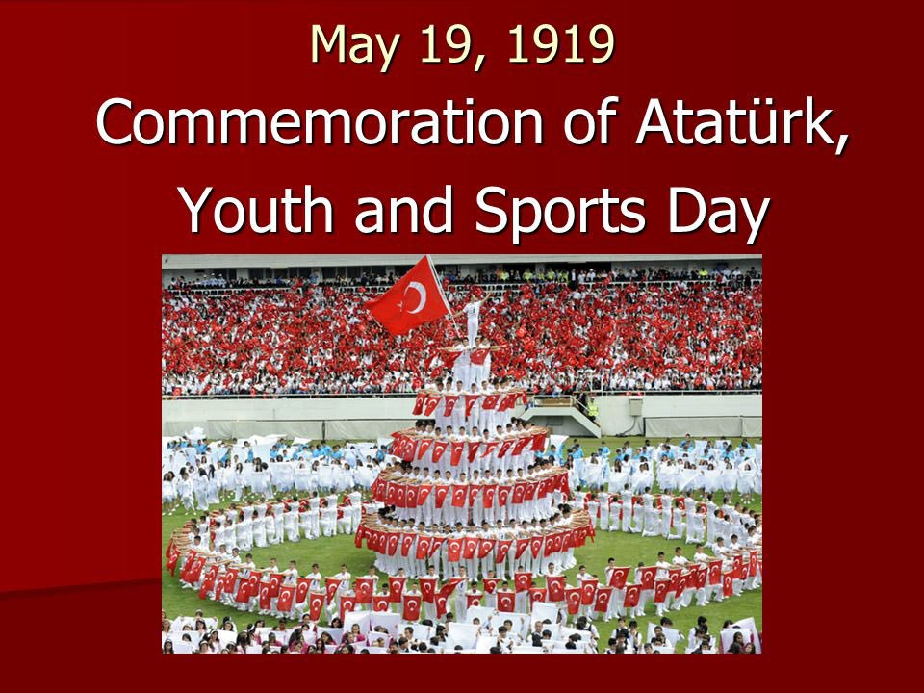


Slide 11
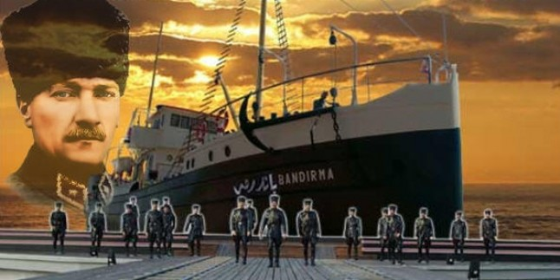
What is Youth and Sports Day?
Also known as Commemoration of Atatürk, Youth and Sports Day is a national holiday in Turkey and celebrated on 19 May every year.
The holiday commemorates Mustafa Kemal Atatürk's landing at Samsun port on 19 May 1919, which is regarded as the beginning of the Turkish War of Independence.

Slide 12
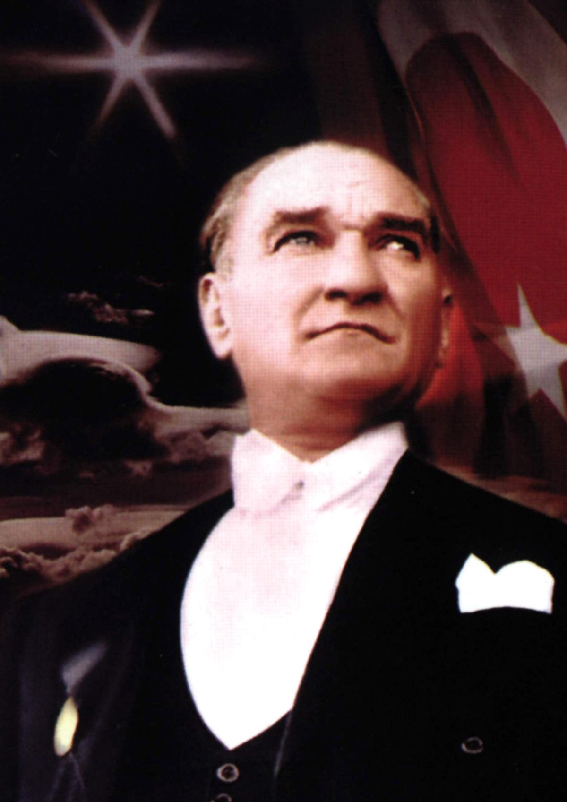
Following the war of independence, 19 May wasn't celebrated as an event until 1936. Later, Atatürk suggested that 19 May should be remembered with a holiday focusing on the youth. Therefore, it became a holiday in 1938 when the 'Festival of Youth and Sports' was passed into law.
In 1981, to mark the centenary of Ataturk's birth, the holiday was renamed as 'Commemoration of Atatürk, Youth and Sports Day'.

Slide 13
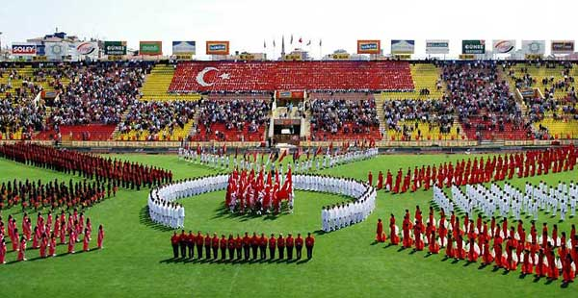
How is Youth and Sports Day celebrated
To mark the day, children play sports, march in parades, sing and dance.
In Samsun, a Turkish flag is brought ashore to remember the days of War of Independence and a wreath is laid at the Mausoleum of Atatürk.

Slide 14
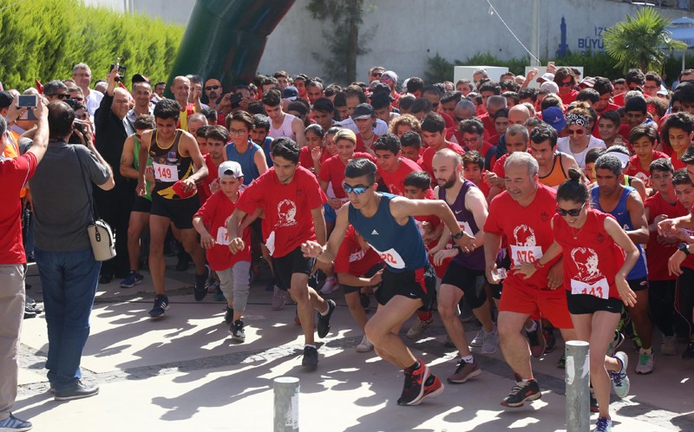
One of the main events of this day is young Turkish athletes run with the Turkish flag from the Black Sea Port in Samsun where Atatürk began the War of Independence and over 10 days the flag is carried across the country to Turkey’s Capital Ankara finishing with the flag being handed to Turkey’s current President who accepts the flag during a ceremony on the 19th of May.

Slide 15
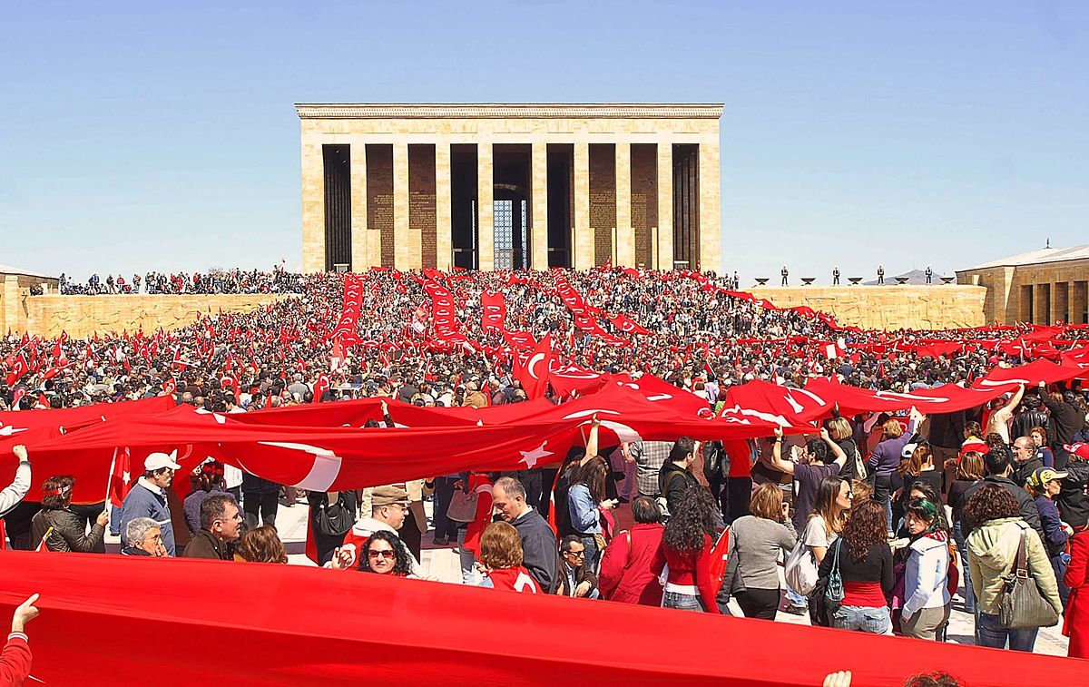
A Minute-silence is also observed in the memory of Atatürk, wreaths and flowers are laid at monuments of Atatürk throughout country including at the mausoleum of Mustafa Kemal Atatürk, Anıtkabir.

Slide 16
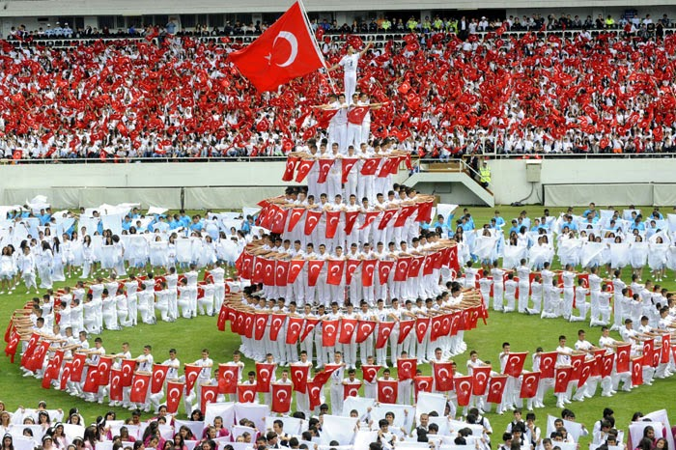
Various sports events take place during the day which are watched by many at the local stadiums and there are also many parades and ceremonies throughout the day. It is also a national holiday.

Slide 17


THANK YOU FOR YOUR ATTENTION!!!
Özel Falez Fen Bilimleri Anadolu Lisesi
Antalya/Turkey

