Slide 1
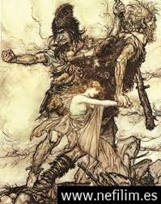
Legends of Cyprus

Slide 2
Not only is Cyprus full of spectacular beaches, culture and great tourist attractions, but also Cyprus is well known for many of its exciting myths and legends.
A legend is a very old and popular story or set of stories from ancient times that may be true or not.

Slide 3
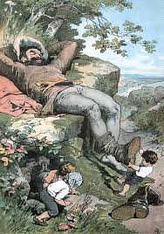
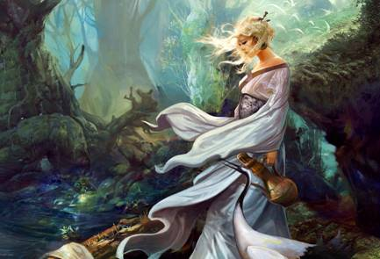
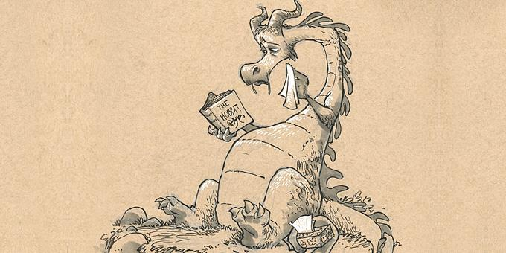
It has the elements of the magic romance, supernatural and improbability. It is not connected in a specific way with place and time. It is refered indefinitely in the remote past. Protagonists are supernatural beings such as dragons, giants, mermaids, fairies, talking animals or heroes/heroines with magic powers for superhuman achievements ,hidden treasures and more.

Slide 4
Legends are also explored as fragmentary sources of oral historical narration and as indications of social values that shape the social map of a group of people. Moreover, it has the elements of magic romance.

Slide 6
Τhe characteristics of the Cypriot legends are many but the most important ones are:
They are written in the Cypriot dialect. The local idiomatic language gives the narrative a sense of functionality so that there may be communication and mutual perception between the legend and the audience.
Τhe world of legend is imaginative and in difficult moments, a miracle is made with the mediation of a supernatural assistant or with the use of a magic medium such as a shawl, an animal ,a ring….

Slide 7
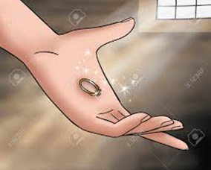
Legends are not refered to specific people or to a specific place and time whereas the heroes have symbolic names depending on their properties or their dressing preferences or their daily routines .”Stachtou”, “The three-eyes man” “ The dragon and the svelte”, The Good-fate woman are some of the favourite legends in our country.

Slide 8
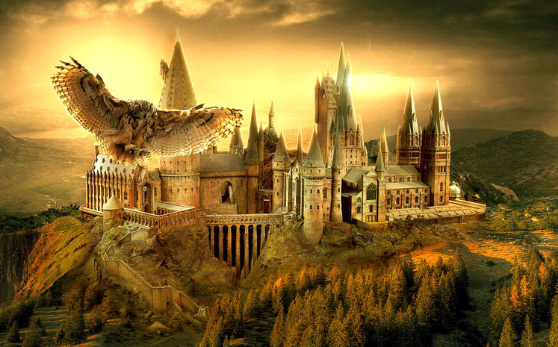
Cyprus’ legends, in their many years of oral tradition and in their relatively recent recording, are monuments of this peculiar, pure Greek speech. Legends were created and spread through hundreds of years by word of mouth. There is always a pleasant end, the good's pay and the punishment of evil.

Slide 10
The adult is entertained, recalls his childhood, escapes from the problems of everyday life and the fatigue of work.
The contact with folk tradition such as customs, beliefs and memories cultivate the national consciousness, as well as the universal consciousness through the common motifs with other peoples. The greatest truths, the truths of the local people ,which have stood during the time ,are hidden in the fairy tales.

Slide 11
Local version of Greek legends
There are common characteristics with the Greek legends due to the Greek origin of the people in Cyprus.
The legends are affected from the Eastern and Western culture.

Slide 12
The most legends are related to existing buildings and existing locations. Such as:
“The digest with the penth and the stone of rome”
“The aphrodite with the stone of rome and with the bath of the aphrodite”
“The rigina with the castle of the ilarion”and much more.

Slide 13
Spanos and 40 dragons
One of the most well-known Cypriot legend is ‘the Spanos and 40 dragons’. It is a traditional Cypriot legend imprinted with engraving. When the Forty Dragons stop the flow of water in the village, Spanos decides to exterminate them and claim the water back. This is how a wrestling fighter and courage against power and size begins. Spanos manages to enter the castle of the Dragon, to convince them of his strength and survive through the various pitfalls that set him up.

Slide 15
ΒΙΝΤΕΟ
ΜΕΤΑΔΙΔΟΝΤΑΝ ΑΠΌ ΣΤΟΜΑ ΣΕ ΣΤΟΜΑ

Slide 16
Dighenis Akritas
A person well known in the legends of Cyprus is Dighenis Akritas .According to the legend, he was one of the Akrites, the guards of the Byzantine border and acquired the nickname Dighenis. His mother Irene was the daughter of a Byzantine general and his father, named Mussur , was an Arab Emir from Syria. Many stories were written about him such as : “Pentadactylos(Five-finger)” and “Stone of Rom”.

Slide 17
Dighenis

Slide 18
Dighenis and Stone of Rom
Moreover, the giant rocks, in the area of the Stone of Rom, are also associated with another more recent legend, according to which the Byzantine hero Dighenis Akritas threw the rocks there to keep the Saracens Arabs (7th-10th centuries) away. The name Stone of Rom comes from this hero.
Another popular legend says that if one swims three times around the rock of Rom, he will have blessing, including eternal youth and beauty, good luck, fertility and true love.

Slide 19
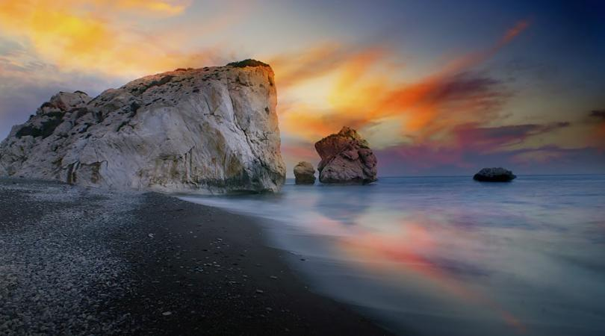
Stone of Rom

Slide 20
Five Finger Mountain and Dighenis
Pentadaktylos is a limestone mountain range stretching north of Cyprus. It has its name of the homonymous top, which is palm-shaped with five fingers.The Five Finger Mountain,the top of Pentadactylos , is one of the most beautiful and popular tourist attractions within Cyprus.Below is just one of the many stories about how the Five Finger Mountain was formed.
According to the tradition ,the legend dates back to Byzantine time.The legend suggests a young hero named Digenis Akritas who saved the people of Cyprus from Saracen Invaders who had come from Asia Minor.While defending Cyprus and the people, he left a hand print in the soft soil, which can be seen today as the jagged edges of the Five Finger Mountain.

Slide 21
Pentadactylos mountain

Slide 22
Many legends related to goddess, Aphrodite
Aphrodite in ancient Greek mythology and religion is the goddess of love, beauty, sexuality, pleasure and childhood. The corresponding goddess of the Ancient Romans was Venus (Latin: Venus), and has many common elements with the Egyptian goddess Athor.

Slide 23
It is said that Afrodite Goddess was born in Cyprus
According to the myth she was born at the stone of Rome

Slide 24
Aphrodite and Stone of Rom
The mythical birthplace of Aphrodite, known as "Stone of Rom", is an interesting formation of huge rocks along one of the most beautiful coasts of the island, on the southwest coast of Paphos. According to legend, the ancient Greek goddess of love and beauty, Aphrodite, was born from the sea foam at this point. The legend says the stone emerged from the waves and a shell was accompanying it to the particular beach.According to the Homeric myth, she was born in Petra of Rom, a coast of Paphos in Cyprus.According to Hesiod, in his Theogony, Aphrodite was born of the foam of the sea when Saturn cut the genitals of Uranus (his father) and threw them into the sea. Pushed by Zephyros to the sea, Aphrodite came naked from the sea to the shores of Paphos and then she was embellished by the therapists, the Hours, and moved to Mount Olympus, where she was presented to Jupiter and the rest of the gods..

Slide 25
THE BATHS OF APHRODITE
The legend says that Afrodite had a bath every day in this spot.
The cave is shaded by an old fig tree and is surrounded by a lush landscape. According to the legend, the ancient Greek goddess Aphrodite had her bath in the waters of the cave. Also, according to Greek mythology, Aphrodite met Adonis ,her lover, in this area when he stopped to drink water while hunting. Adonis fell in love with her as soon as he drank the water from the cave.

Slide 26
BATHS OF APHRODITE

Slide 27
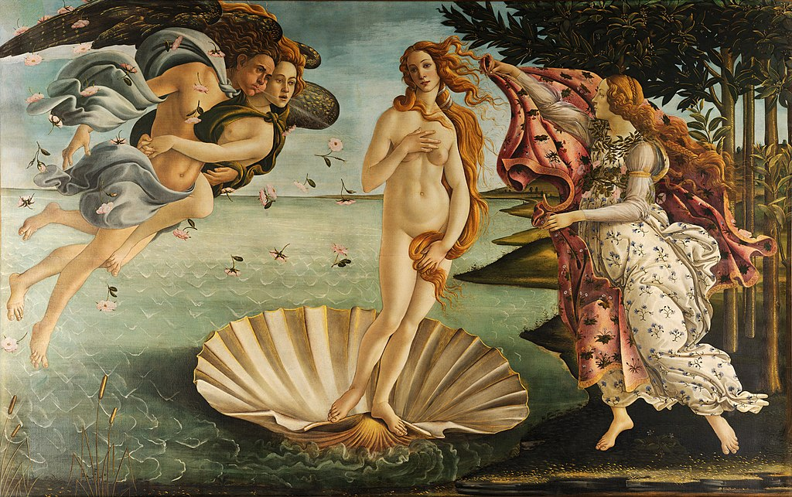
THE BIRTH OF THE APHRODITE

Slide 28
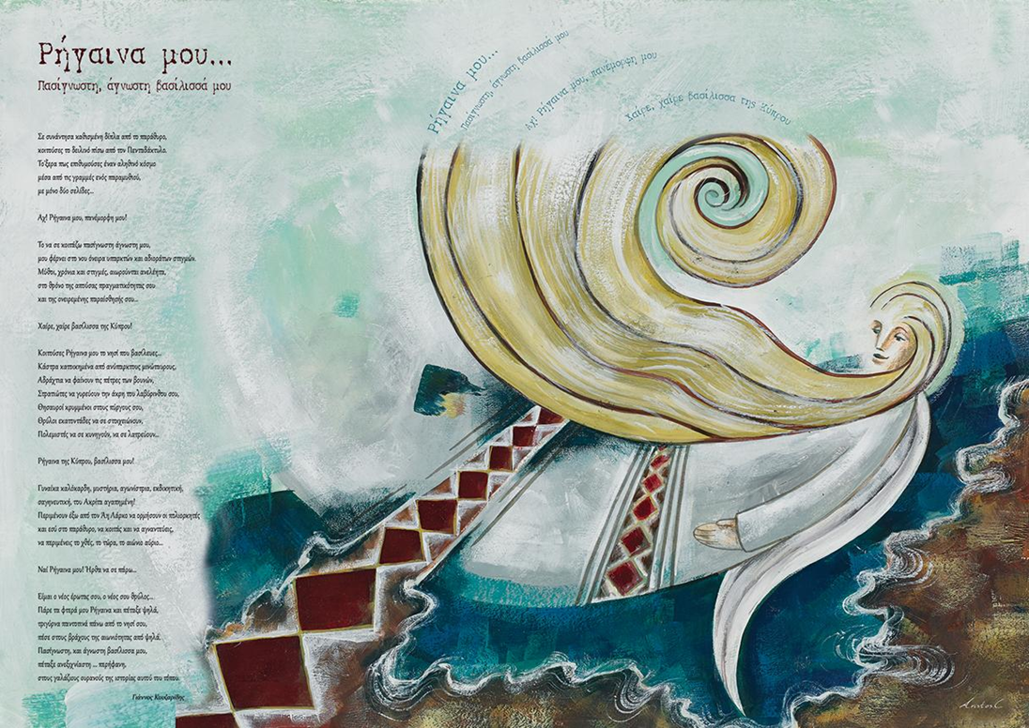
Rigena is the most famous woman but also the most mysterious face of the legends and traditions of Cyprus. She is known everywhere, in every part of the island. She is related to ancient and medieval buildings, beautiful sites, caves and ruins, springs and rivers, churches and chapels, mountains and plains, hidden mythical treasures. In the old stories, she is associated with kings, with warriors, with Digenis Akrita himself sometime, and with other mysterious people.

Slide 29
GREEK MYTHOLOGY
Greek mythology is one of the most widespread in the world and consists of a rich collection of narratives that refer to the life and adventures of a wide variety of gods, heroes and other mythological creatures. These stories were originally formed through the oral and poetic tradition before they were written in the works of Greek literature. The oldest known literary sources are the two epics, the Iliad and the Odyssey of Homer (8th century BC), dedicated to the events of the Trojan War and to the Ulysses adventures that followed.

Slide 30
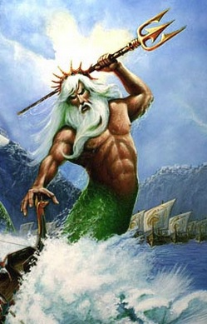
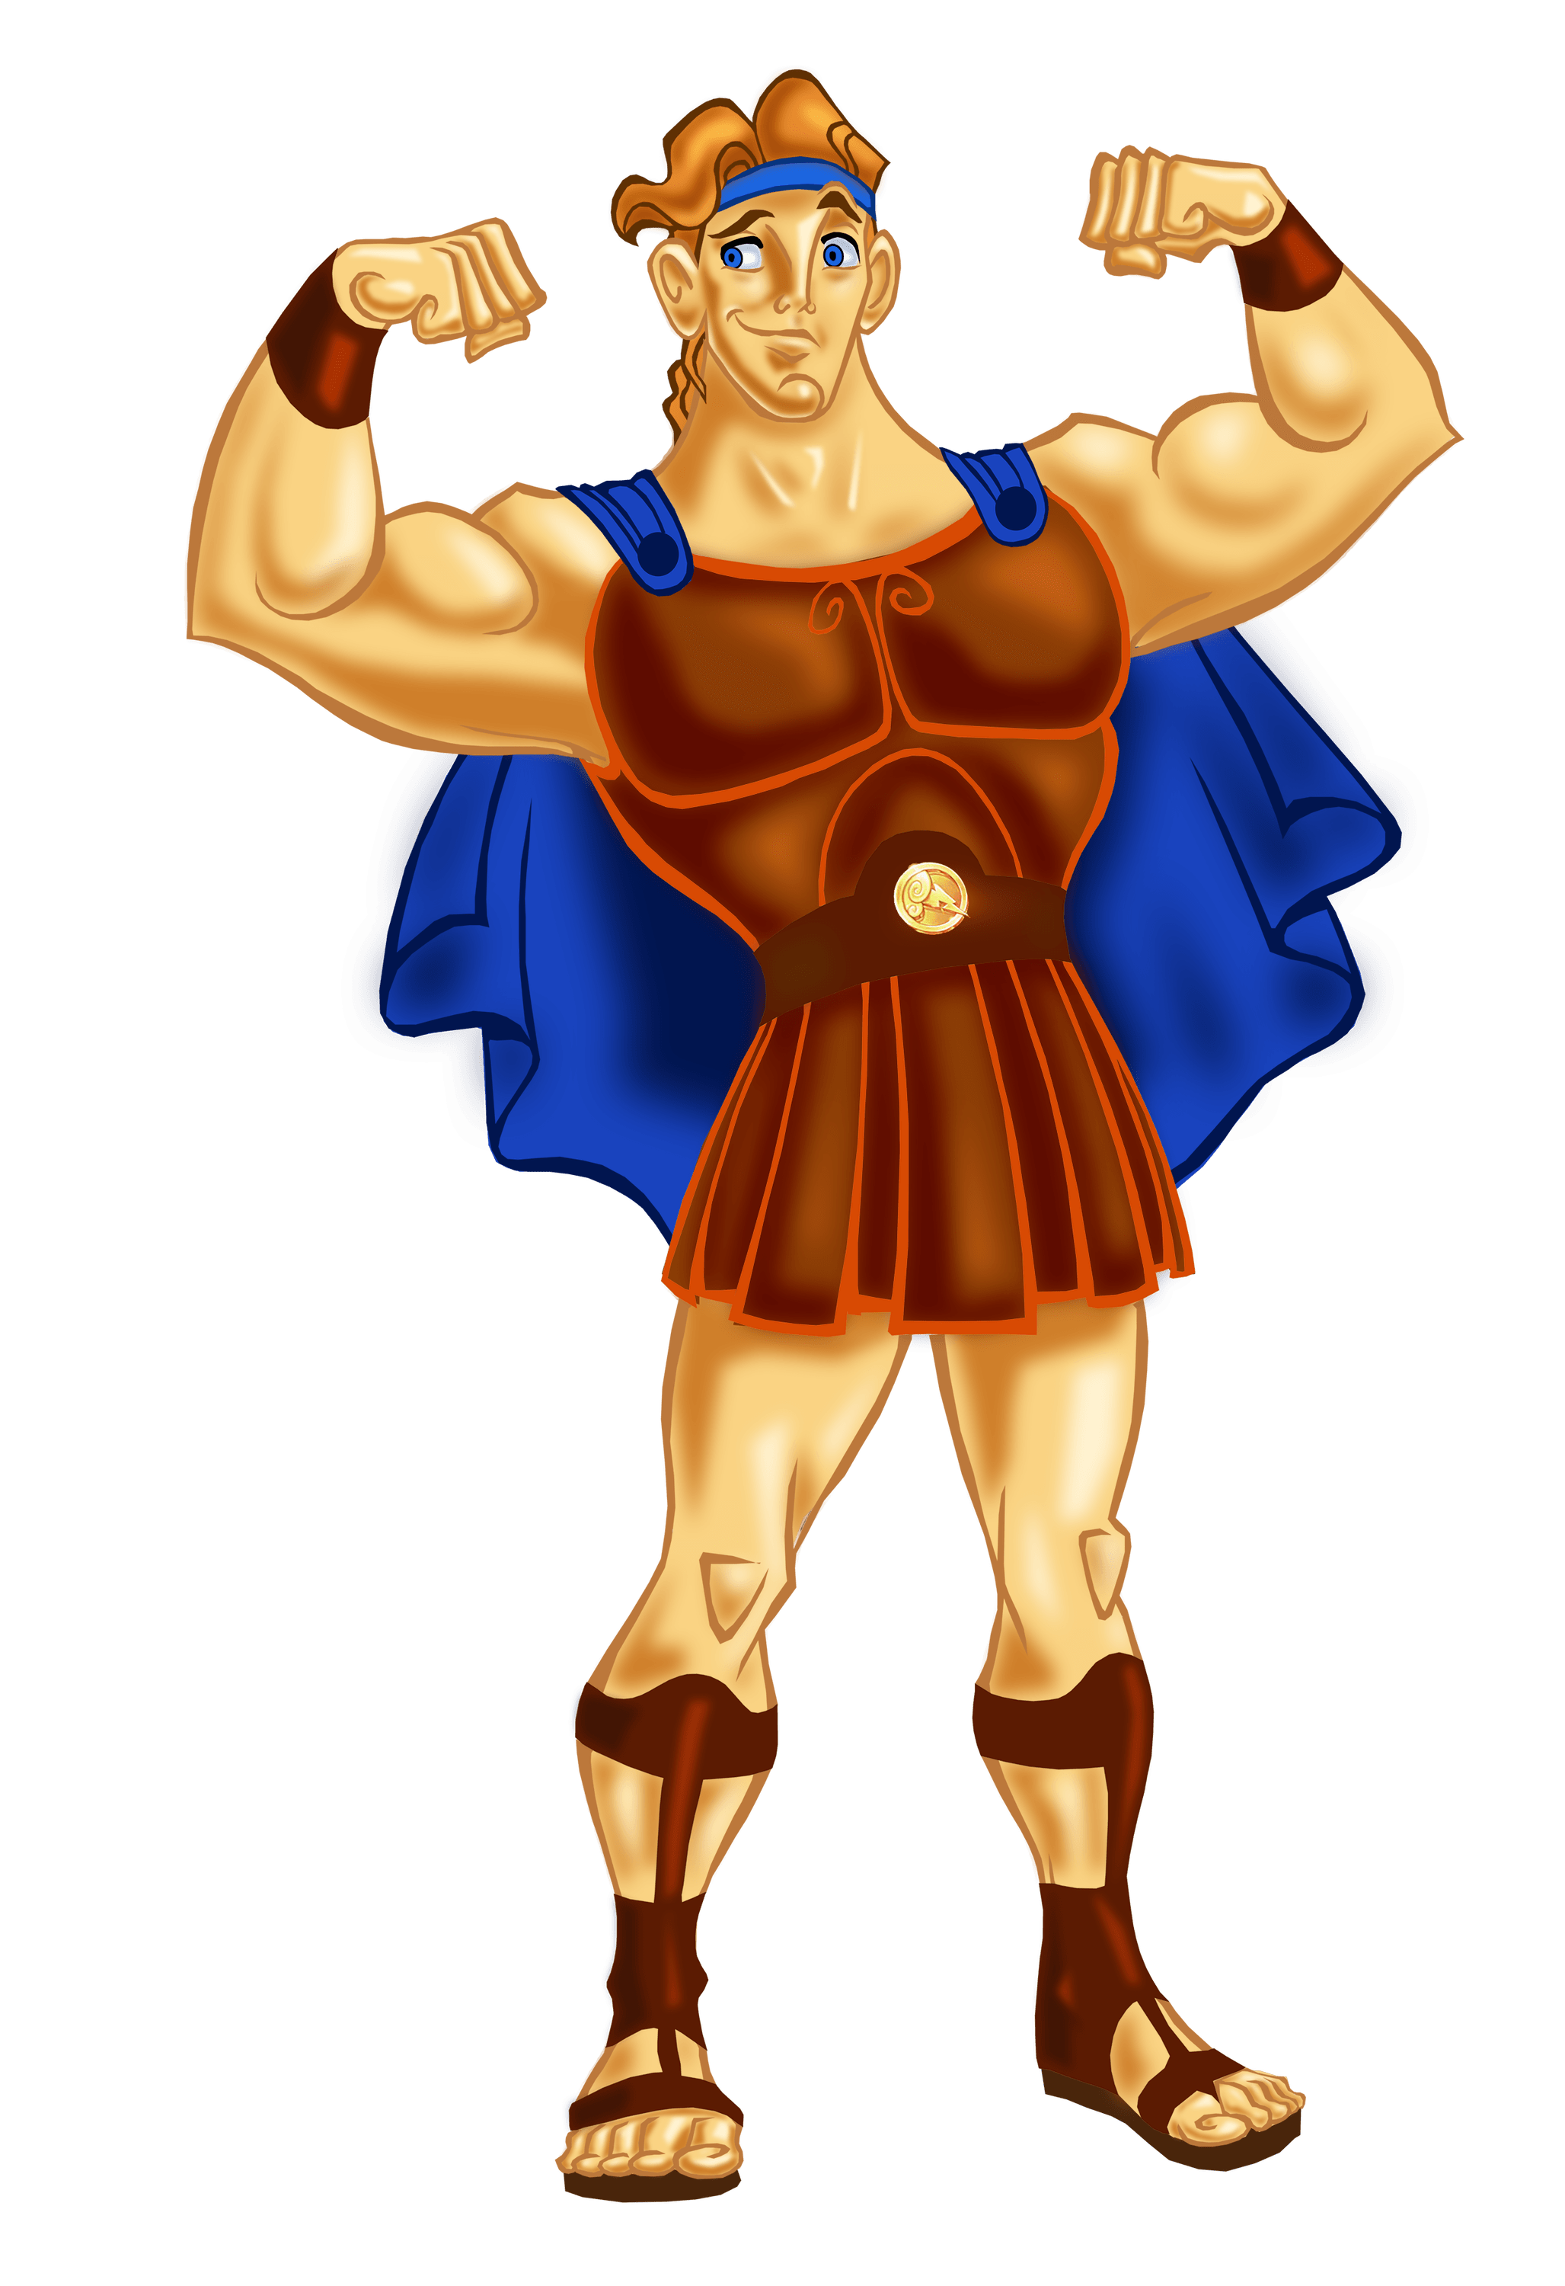
Poseidon
Hercules

Slide 31
Τheir purpose are...
They are mainly intended to entertain and secondly to teach or advise giving a moral connotation
There are cultural elements of Cyprus: morals, customs, eating habits, reference to agricultural work and people are everyday, ordinary Cypriots

Slide 32
THE VALUE OF THE LEGENDS
Cultivate the imagination of both children and adults.
They cause pleasure, mental and emotional satisfaction with the prevailing of a good, happy ending.
Through the promotion of positive standards (kindness, honesty, hard work) the child shapes character and learns to behave.

Slide 33
THANK YOU FOR YOUR ATTENTION

