Slide 1
Traditional Cypriot music, musical instruments and dances

Slide 2
Music
Music has always been an integral part of the cultural identity of the people around the world. For Cyprus in particular, music had and continues to have a special place in its culture.
Greek musical elements are the hallmark of the Cypriot songs. At the same time, the influence of European conquests coming from the West and East is also remarkable. They all conveyed a rich musical folk tradition with unique characteristics that shaped the ultimate character of the music of the place.
Despite the many conquerors Cypriots managed to keep their civilization unaffected, as well as their music. Their music presents, as it is expected, similarities with the music of the other Greek regions, such as Crete, the Dodecanese and Asia Minor.
First recording on its music tradition exists in the Homeric epics where we have a reference to the venereal, devotional celebrations in honor of the goddess Aphrodite, which includes contests of songs.

Slide 3
Types of traditional music
The voices type: it is the most typical of the Cyprus music tradition. The voices are characteristic and unique traditional melodies. The singer is called “kalophonaris”. It means that he has the ideal voice type, a lound tenor.
The tsiatista: they are one of the most vivid pieces of Cypriot folk poetry. These are impromptu poetic creations of instant inspiration, but mostly of a competitive nature. They are erotic, social, bucolic or of political contect. They are sometimes accompanied with music. They are recognized as a courtyard cultural heritage by UNESCO

Slide 4
c. For children: like «ALA ILI» and «PIRI-PIRI TO PAPIRI» are songs to quiet children or help them sleep.
d. Lullabies: like « AYIA MARINA TZAI TZIRA POU POTZIMIZEIS TA MORA…»
e. Festive: these songs are heard at festive events and parties such as Halloween, Easter and Carnival.
f. Satirika: they satirize various character and events
g. Weddings songs: wedding songs are referred to all the customs and customs that precede the wedding, what can be done during the ceremony and what follows after the wedding
h. Fatalities: they are sad songs in which people mourn the death of loved ones such as their son, brother, sister or other close relatives.
i. Historical songs: they come from historical facts and bring history to life.

Slide 5
Themes
In the Mediterranean island of Cyprus, using the idiom of their language, the theme of its songs went from narrating historical heroes to sadness, to the pain of slavery, hostility and poverty.
Cypriot music tradition is influenced mostly by the traditions of Greece. It was conquest by Persians, Phoenicians, Romans, Franks, Venetians and Turks. However, Cypriots managed and maintained through the centuries its own musical tradition.

Slide 6
In Cyprus, musicians are distinguished in three categories:
The musicians who tried to learn an instrument for earning reasons
The main purpose of the musician’s self-promotion
The gifted Music lovers
The last musicians are the ones who respected and kept the musical tradition of Cyprus, improving the melody and the orchestra, always preserving the pattern of the additional music.
Their music was also influenced by Byzantine music after the fall of the city, Due to its geographical location, a crossroad between East and West, music accepted various influences.

Slide 7
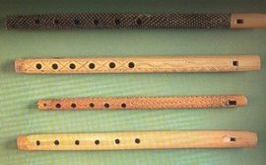
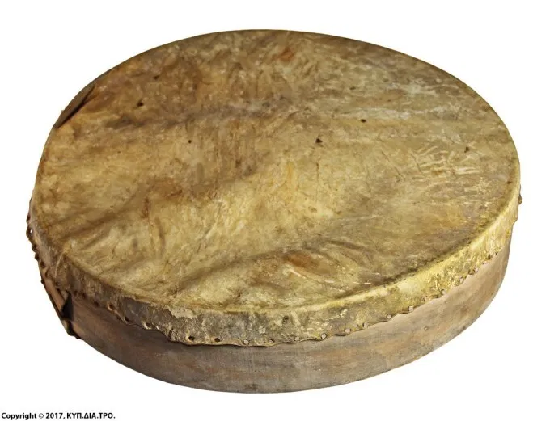
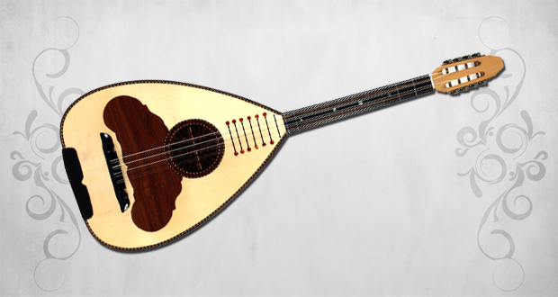
Musical Instruments:
The musical instruments used in the tradition of Cyprus are Pithkiavlin and Tamboutsia. Pithkiavlin is a flute and was mainly a shepherd’s wood instrument. Tabboutsia is like a sieve but with skin without holes. It was a household utensil used as a percussion instrument which was played with the palm and fingers or with two small sticks.
The soloist violin and lute were added later. The lute is a four- string folk musical instrument which mainly provides rhythmic and harmonious accompaniment.

Slide 8
When there was no lute or other musical instrument, the table was used as a percussion instrument to keep the rhythm of the dance. Moreover, the competent performers of the pitkiavlin could perform the repertoire of Cypriot dances and accompany the dance in moments of joy and revelry that were born spontaneously so that people could withstand the endless hours of hard work in the fields, in grazing,etc.

Slide 9
Traditional Dances

Slide 10
The Cypriot traditional dances have also lots in common with the Greek island dances of Aegean and Ionion sea. The repertoire of Cypriot dances has also adopted, adapted and incorporated dance and musical elements from other musical traditions not only from the wider Hellenism, but also from the regions of Asia Minor and Cappadocia.
A key feature of Cypriot traditional dances is the element of improvisation. Maintaining the main elements of the dance tradition (movements, figures, ‘taps’), each dancer tried to showcase his/her own musical and dance sensibility and ability. This resulted in a dialectic relationship between musicians, dancers and spectators.
Folk music and songs create a complex phenomenon which may be interpreted as a creative force of a culture and an image of its psyche and cultural level as well as of its cultural and historical facts. Altogether, they form a strong and cohesive bond of the culture with its roots and create a point of reference and symbol of the primordial cultural and traditional identity.

Slide 11
In the context of the traditional society of Cyprus, as it operated until the 1970s, the anti-criss-to dances were danced exclusively by two people (only men or only women). The characteristic of the traditional Cypriot dances, was the fact that men danced separated from women because of the strict morals of the time. For the same reason women danced more comely and timid, with smaller movements, almost on the spot sometimes, with or without a handkerchief, and movements of their hand movement indicating embroidery or sewing. The women’s dance didn’t included jumps, sits, hitting their foot on the floor, shake of the body or crushing their fingers.
Unlike, the men’s dances were more vivid, intensive, hitting their foot on the floor, going up and down crushing their fingers. Until the 1970s, especially in the agricultural communities, men used to dance at weddings, festivals, celebrations, in the threshing floor or everywhere else men used to gather. On the other hand, women, because of the social circumstances of the time, danced only in weddings which lasted from 3 to 5 days in the most of villages.
During the second half of the 20th century, in Cyprus there were some big changes concerning the maintenance and transmit traditions because of the social, economic, political, technological changes and evolution.

Slide 12
The Cypriot traditional dances, in the form they are kept up today, continue to be a medium of artistic expression and Cypriot externalization of their identity and feelings. The repertoire includes men’s individual male virtuosity in dances which are accompanied by an object or a tool e.g. scythe or knife, comic venues etc.
The dances in Cyprus are usually danced face to face by couples. The most known traditional is the Anti-criss-to from Ancient Greek « vis-a-vis» , face to face- or later known as «kar-silamas»- from the Turkish word Karsi-which was exclusively danced in couples too.

Slide 13
Tatsia or tacha: the dancer puts on the bottom of a sieve with several holes – tool where flour was sifted - one or many glasses of wine while he dances to the rhythm.
Glasses: a glass or many more are put on his head while dancing
Syrtos: a folk dance with its origins in Ancient Greece
Zeibekiko: it was danced only by men
Sousta, karotseris, vraka, kalamatianos are some other kinds of traditional dances.

Slide 14
