Slide 1
BASQUE GASTRONOMY

Slide 2
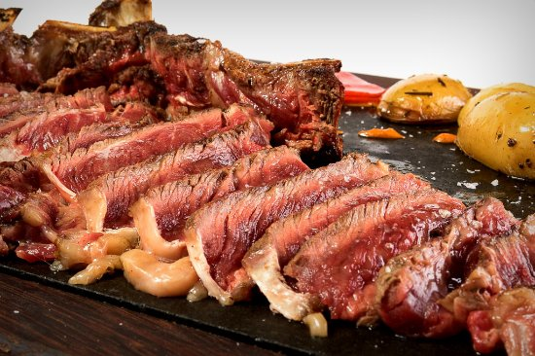
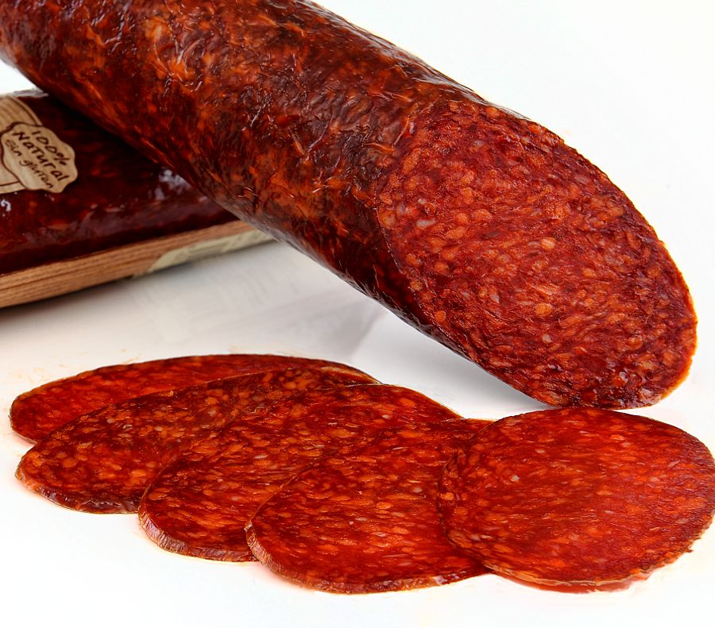
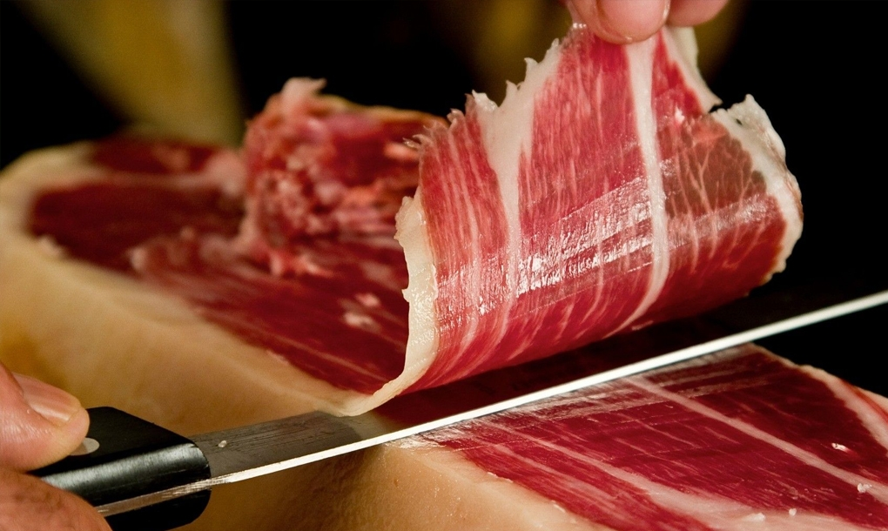
MEAT
Txuleton: a magnificent beef chop grilled.
Txistorra: Familiar with chorizo, generally use for pintxos
Txorizo Pamplonica: Is a great spicy Spanish sausage
The ham is so typical

Slide 3
TXULETON
TXISTORRA
TXORIZO PAMPLONICA
HAM

Slide 4
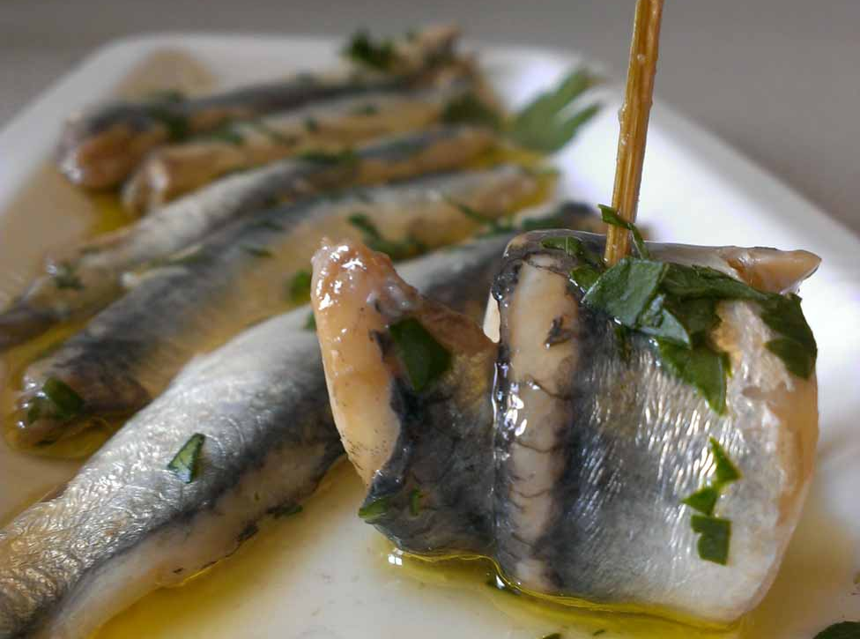
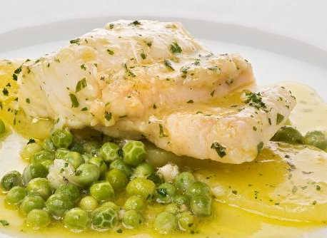
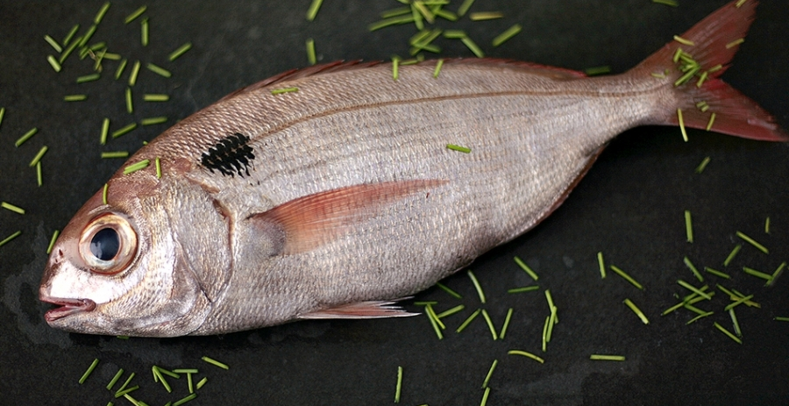
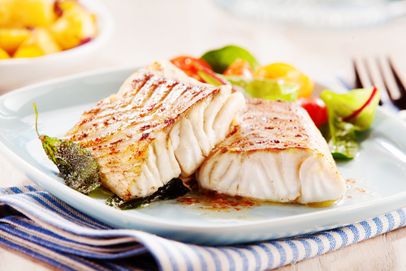
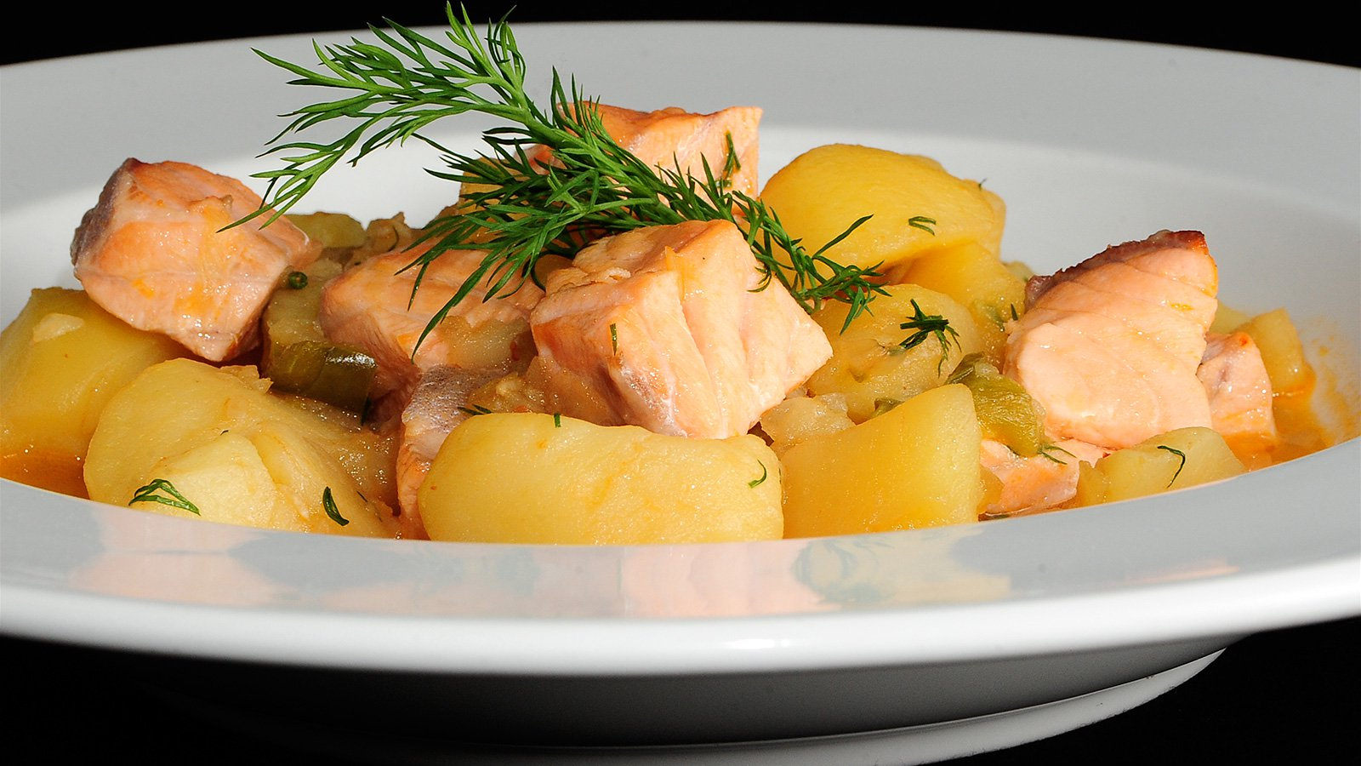
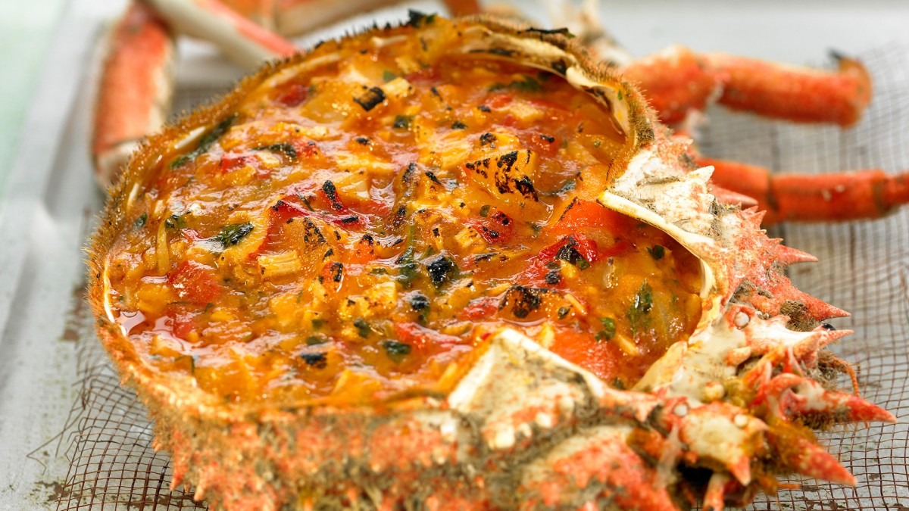
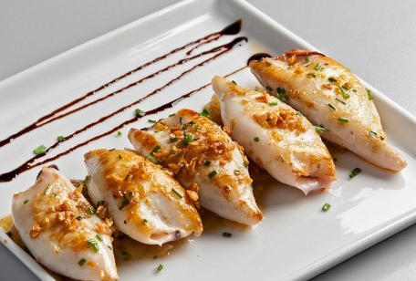
FISH
Antxoak (Anchovy)
Bakallaoa (salt cod)
Bixubua (sea bream)
Legatza (hake)
Marmitakoa
Txipiroiak
Txangurroa (spider-crab)
Notes:
Anchovy: Getaria, Gipuzkoa is a major center of anchovy.
Bacalao (salt cod): It is usually eat with tomato.
Besugo (sea bream): Most often offered bake.
Merluza:
Marmitako: A tradicional recipe delivers this rich tuna and potatoes.
Txipirones: Usually served “en su tinta”.
Txangurro (spider-crab): Most often use in pintxos.

Slide 5
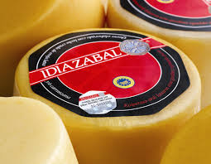
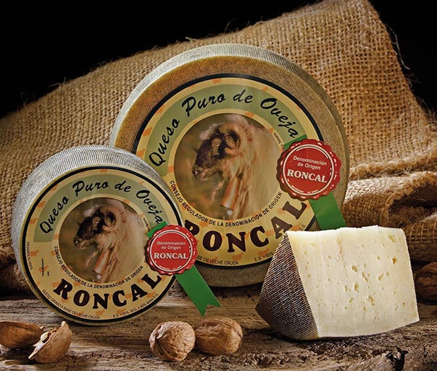
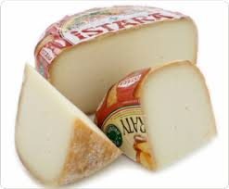
CHEESE
Idiazabal: Is made in Navarre northern province. Often, served with membrillo, a quince jely.
- Roncal: From the northeast Navarrese valley of Roncal, Roncal cheese received its official denomination in 1981.
- Ossau-iraty: North of the Pyrenees.

Slide 6
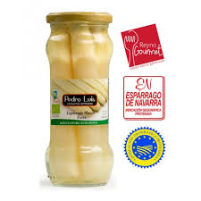
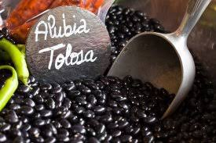
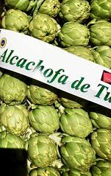
VEGETABLES AND LEGUMES
Asparagus: Are typical from Navarre.
Tolosa beans: Are black/purple.
Artichokes: Are from the south of Navarre (Tudela)

Slide 7
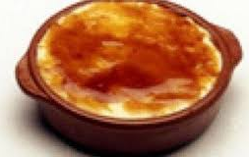
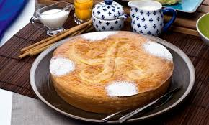
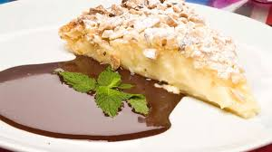
DESSERT
GOXUA
Goxua is a Basque cuisine made with cream covered with cake, pastry cream and caramelised sugar.
BASQUE CAKE
It’s made with broken pasta and filled with fine pastry cream.
PANTXINETA
It is made in the oven with puff pastry stuffed with custard and sprinkled with almonds.

Slide 8
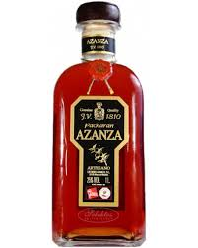
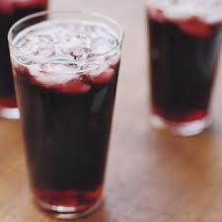
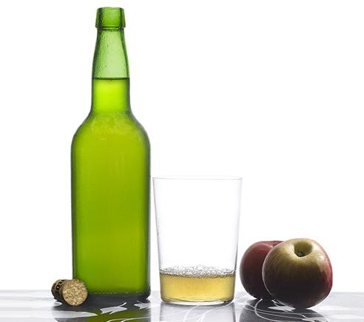
ALCOHOLIC DRINKS
Pacharan: Is made with sloe and sweet anise.
Kalimotxo: This drink is a mixture of Coca-cola and wine.
Cider: Cider is made with apples

Slide 9
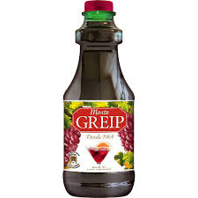
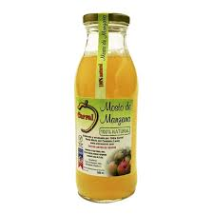
DRINKS WITHOUT ALCOHOL
Grape juice: Is a juice made with grapes.
Apple juice: Is a juice made with apple.

Slide 10
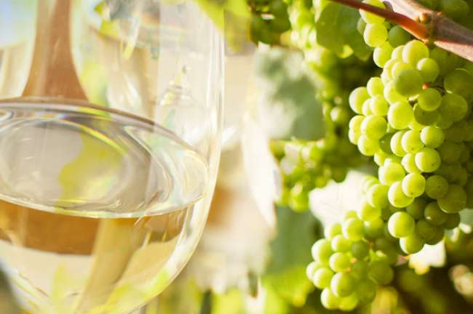
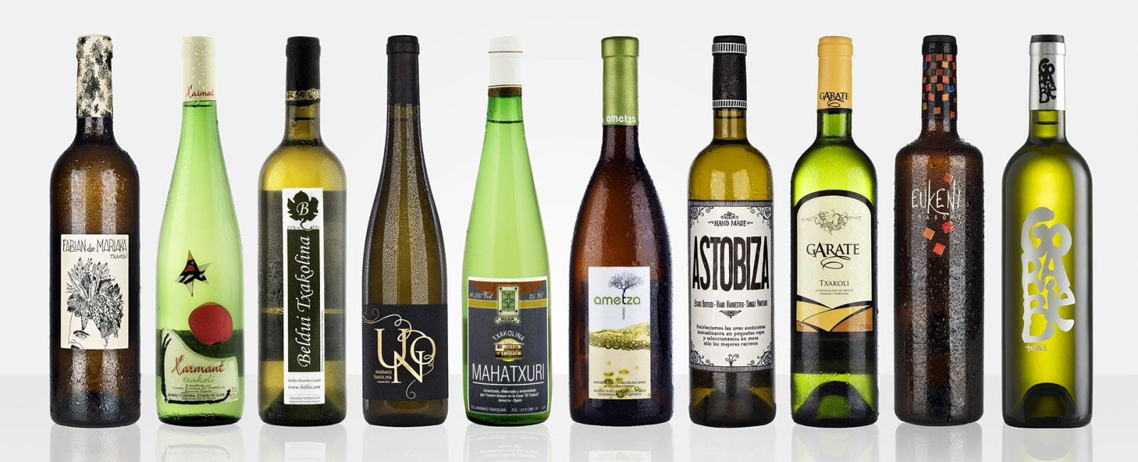
TXAKOLI

Slide 11
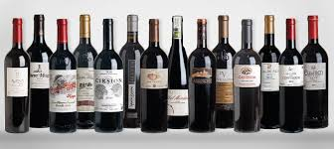
WINE IN THE BASQUE COUNTRY AND NAVARRE
LA RIOJA: There are lot of wine cellars.

Slide 12
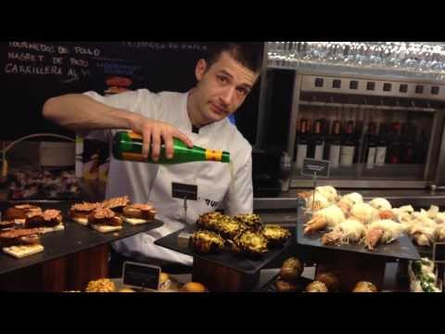
PINTXOS
Pintxos are small salty pieces of food (usually on a piece of bread) and you can eat them anywhere and anytime.

