Slide 1
SEARCHING OUR PAST

Slide 2
WHO DID WE INTERVIEW?
grandmothers, grandparents, mothers and fathers.

Slide 3
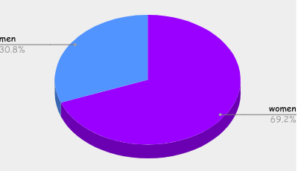
HOW MANY PEOPLE DID WE INTERVIEW? WOMEN / MEN?
13 people in total
9 women and
4men.

Slide 4
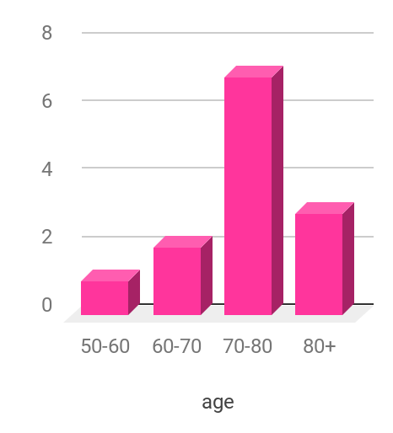
AGE OF THE PEOPLE WE HAVE INTERVIEWED
between 60-80 year old.
The oldest 90 years and the youngest 66.

Slide 5
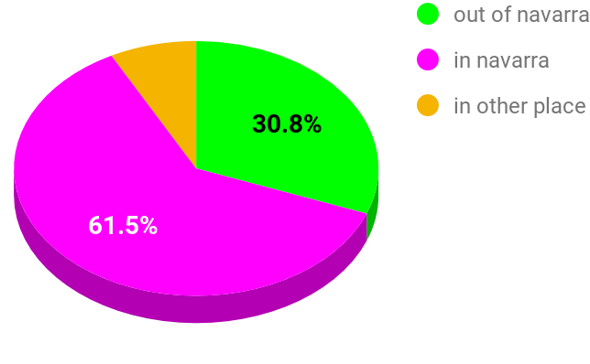
WHERE DO THEY LIVE?
- The 30,8% of the people live out of Navarre.
- The 61,5% of the people live in Navarre.
- The rest 8% live in other places, out of the Basque Country.

Slide 6
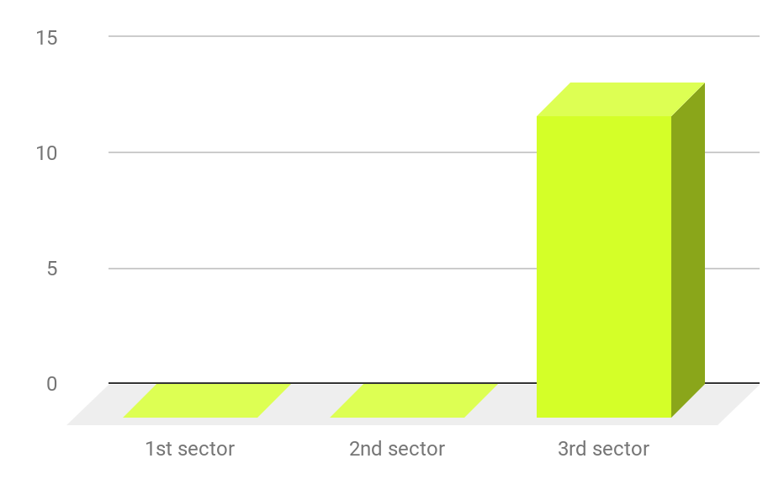
IN WITCH SECTOR THEY WORKED?
All of the interviewed people worked in the 3rd sector

Slide 7
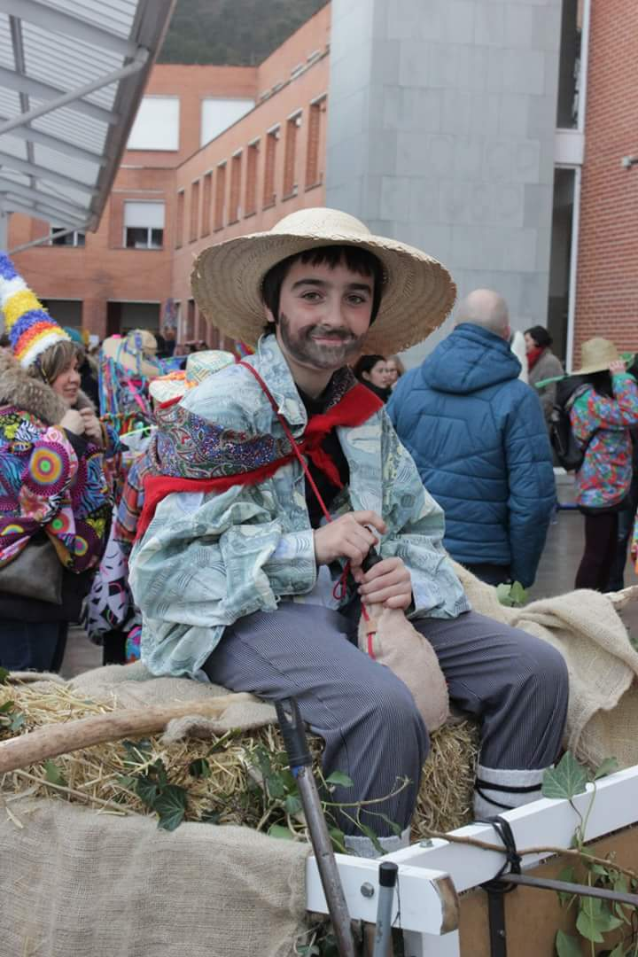
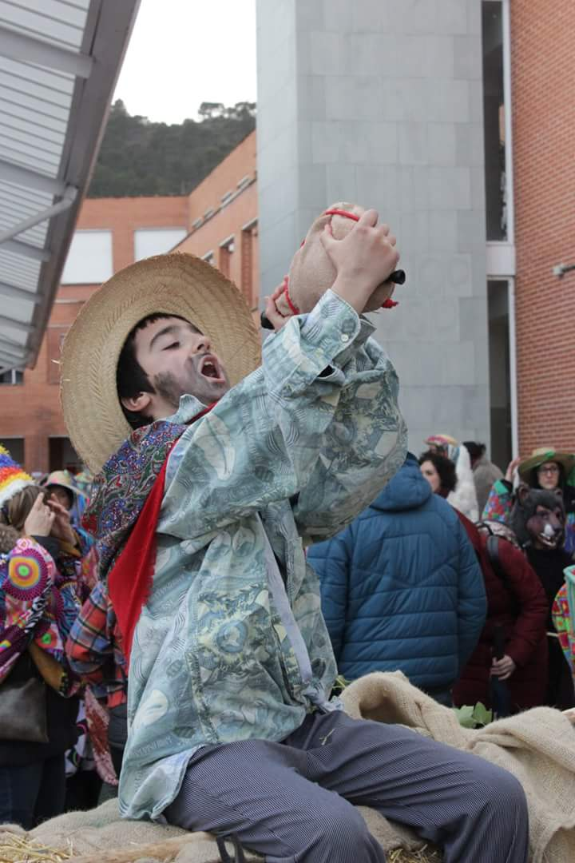
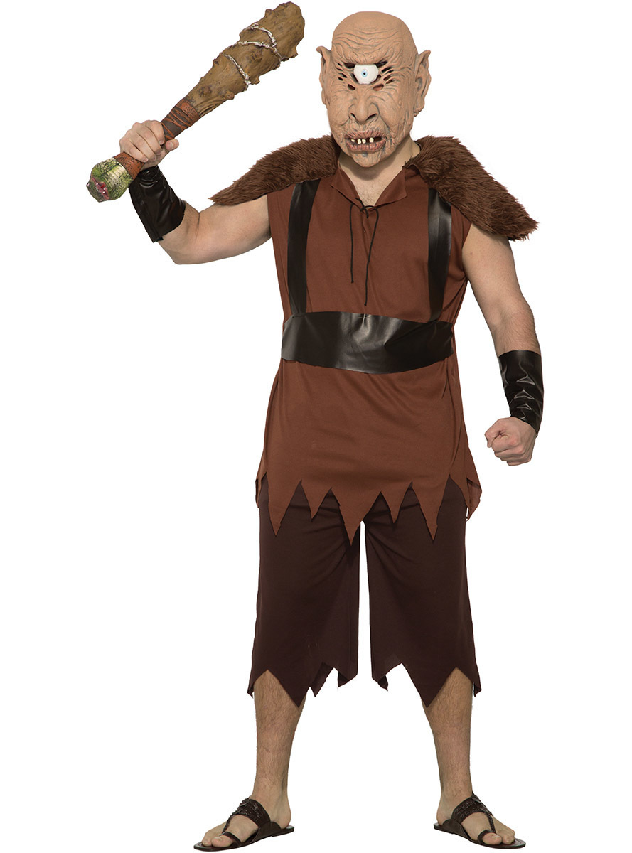
THINGS THAT THE TALES HAVE IN COMMON
The tales that they told us only have one thing in common: they are very old
-ALDABIKA:
- TARTTALO

Slide 8
HOW MANY TALES DO THEY KNOW?
In total the people that we have interviewed knew 13 tales.

Slide 9
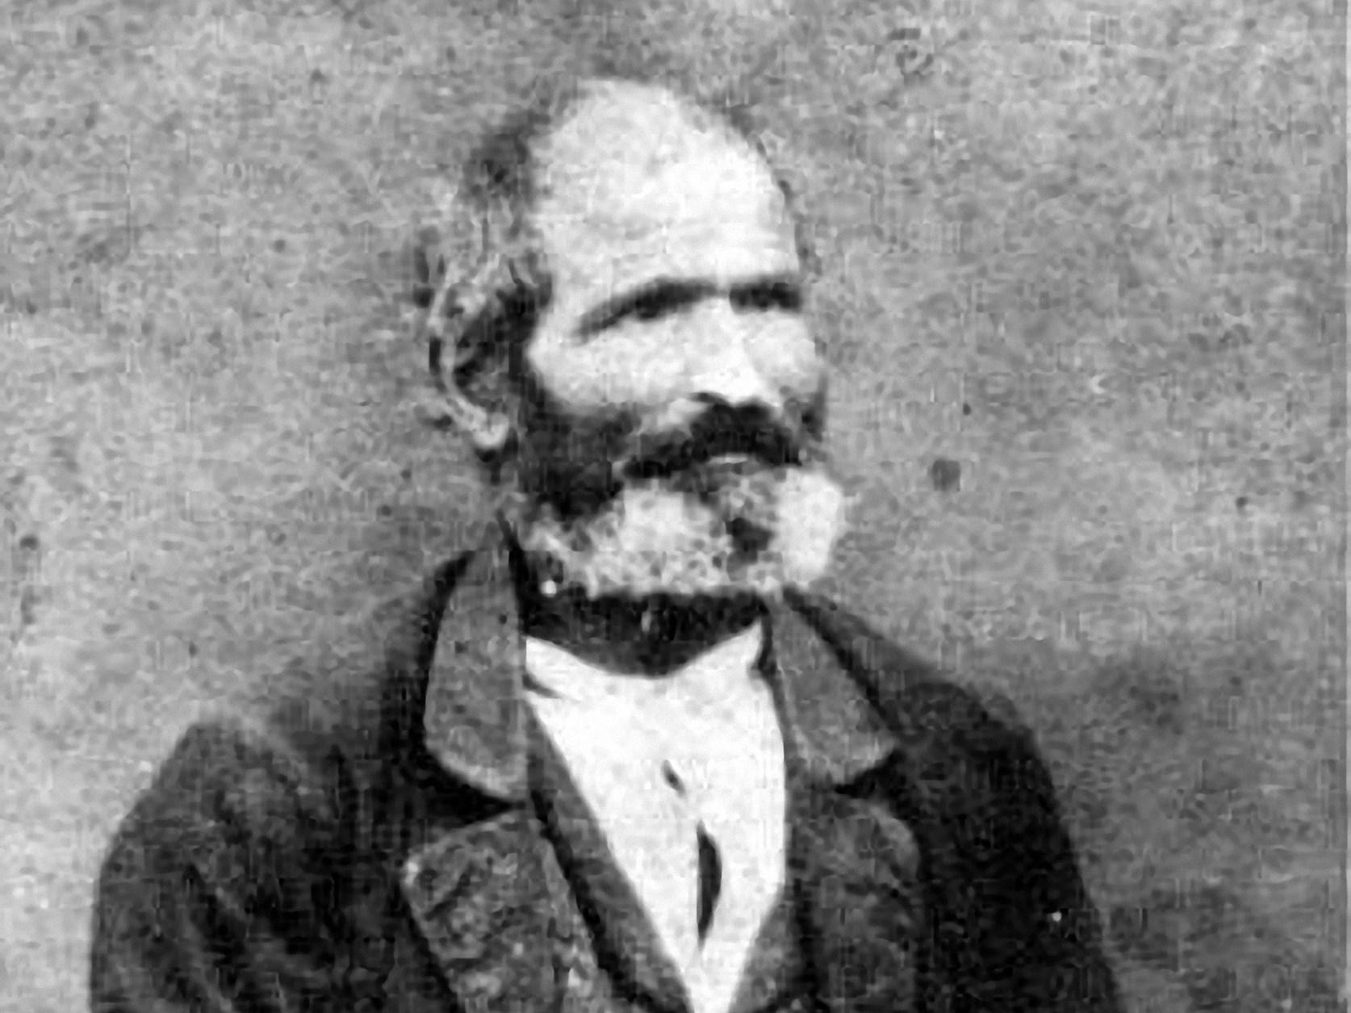
STORIES THAT CAUGHT OUR ATTENTION (1):
Sacamantecas:
Sacamantecas is a history made for children and its objective is to afraid them if they misbehave.
This history is basically to scare children while they are out in the street.
SACAMANTECAS

Slide 10
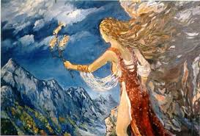
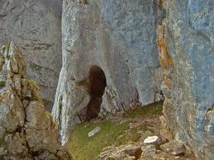
STORIES THAT CAUGHT OUR ATTENTION (2):
Anbotoko Mari:
- Powerful girl, Lady of the Earth and the Meteors.
- She had the dominion of the forces of the climate and the interior of the earth
- “Mari, Anbotoko Mari”.
- Lived in a cave in “Anboto”
- Witch.

Slide 11
ALDABIKA:
our most famous story.

Slide 12
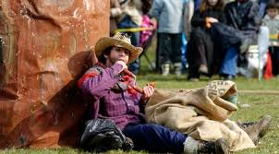
WHO WAS ALDABIKA?
A thief from Lizarra.
Condemned to death because of all his robberies.
After one robbery he fled to the mountains and hid inside of a tree
The guards put traps in all over the zone to caught him.

Slide 13
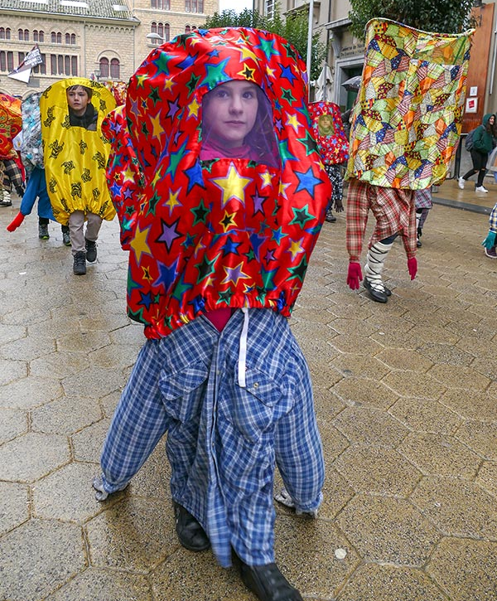
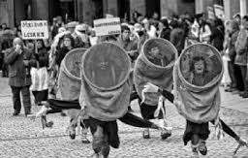
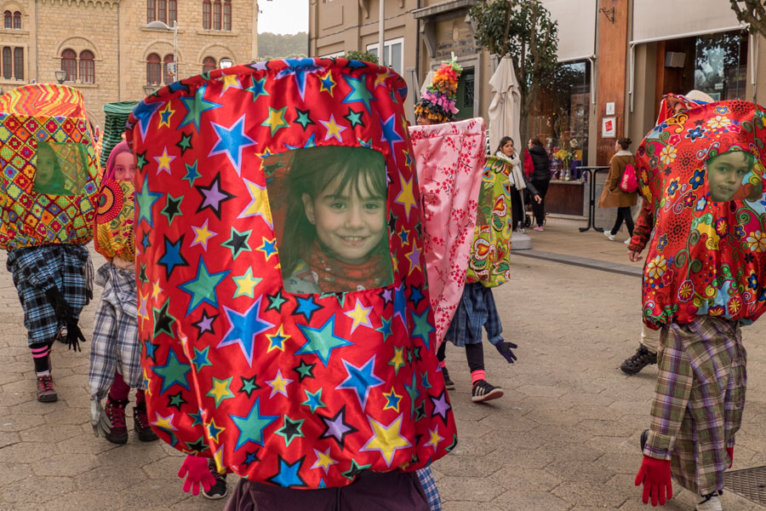
AND WHAT HAPPENED AFTER THAT?
- When Aldabika went to Lizarra, he got caught in a trap.
- The guards took him to the town.
- Then are many versions. Some of them say that Aldabika was burned with people dancing around dressed with palokis

Slide 14
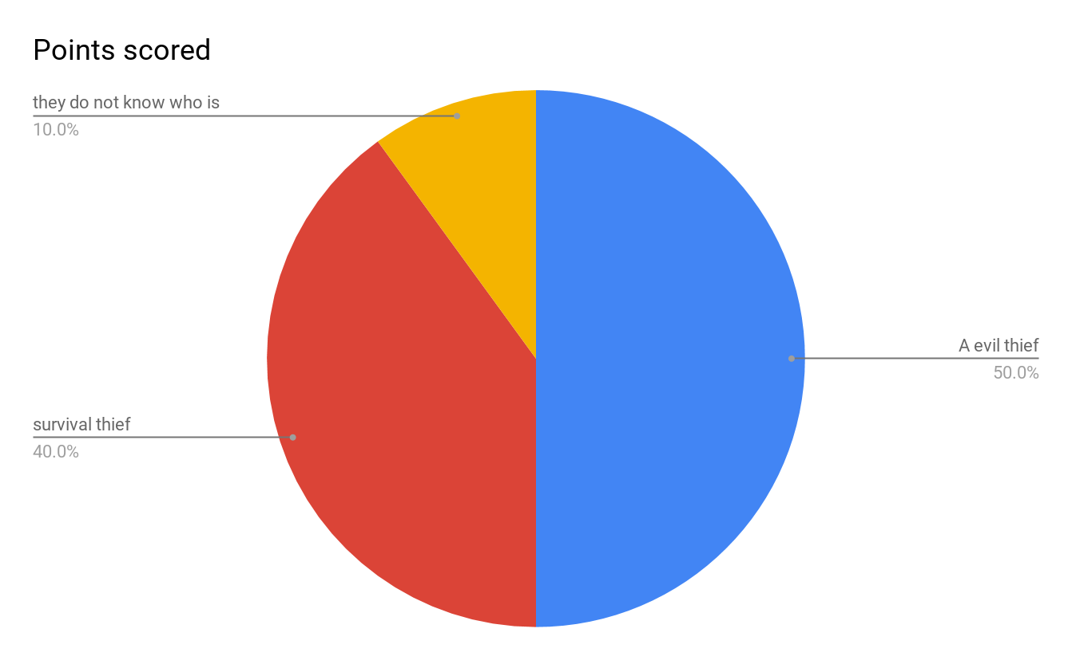
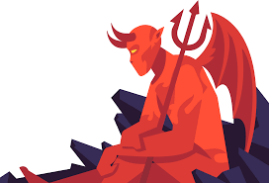
Evil or survivor?
Was Aldabika a thief or just a poor person who only wanted to survive?

Slide 15
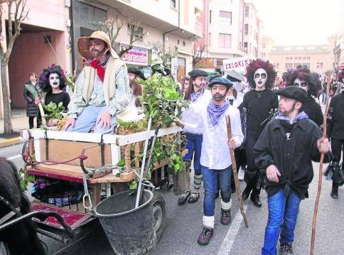
OUR PERFORMANCE ABOUT ALDABIKA
Every year our school performs a theatre about Aldabika where he is shown as a thief for survival: he robbed because he didn’t have other option. The students play different roles of the characters of the history of Aldabika.

Slide 16
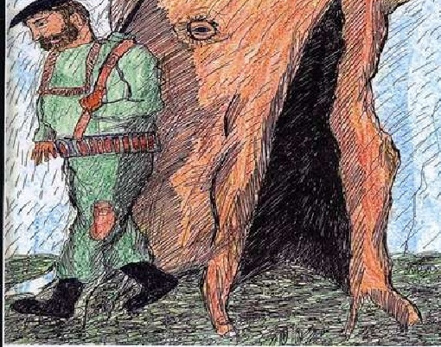
OUR VERSION?
Aldabika was stealing around Lizarra to survive. After a long time hiding in the trunk of a tree, one day he was caught with stocks and he was burned in the town square.

Slide 17
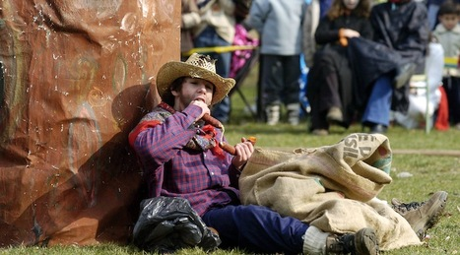
ANOTHER VERSION
Most opinions say Aldabika was an evil thief; there are also people who think the opposite, that he was a good thief.
Some people say that he stole because he didn't have another option and that he was a really good person.

Slide 18
WHAT DO YOU THINK, WAS HE A GOOD OR A BAD GUY?

