Slide 1
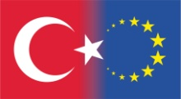
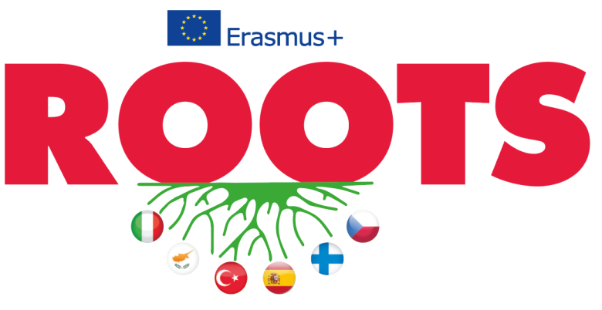
Erasmus+, KA229, School Partnerships Project
5th Project meeting
Karvina, Czech Republic
28. Febr. – 04. March, 2020
“Music and Dance"
by
Özel Falez Fen Bilimleri Anadolu Lisesi
Antalya / Turkey

Slide 2
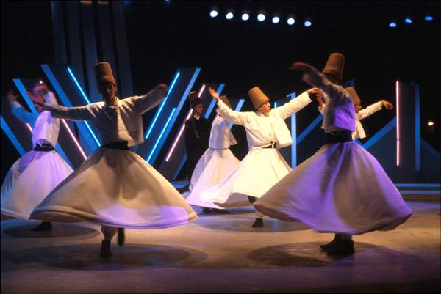
The annual ceremonies on the anniversary of Mevlana's death, who was an Islamic scholar who addressed humanity with his unique philosophy of love are organized in December every year and host thousands of pilgrims in the central Anatolian city of Konya.
According to Mevlana's teachings, human beings are born twice, once of their mothers and the second time of their own bodies. The real birth is the second, spiritual birth.
Mevlevi dervishes are expected to live according to the principles of his teaching.
A long period of spiritual progress is necessary before they can participate in the whirling dance, for which they wear a tall cap symbolizing the tomb of carnality, and a white robe which is its shroud.
Whirling Dervishes, Şeb-i Arus

Slide 3
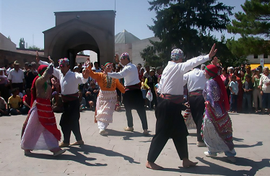
SEMAH
The semah is a means of reaching God through mystical movements in harmony with the rhythm of music and song accompanied by a saz (Turkish stringed instrument)
This is a muslim belief in the Alevi communities that practice and preserve their traditions.
They dance the semah in a circle without touching each other but standing across from one another. The palm of one hand faces the sky while the palm of the other hand looks at the ground shows that, “You are God. I am human. I came from you and bear your essence. I am not separate from you.”
During the semah both men and women dance without discrimination and regardless of religion, language or race.

Slide 4
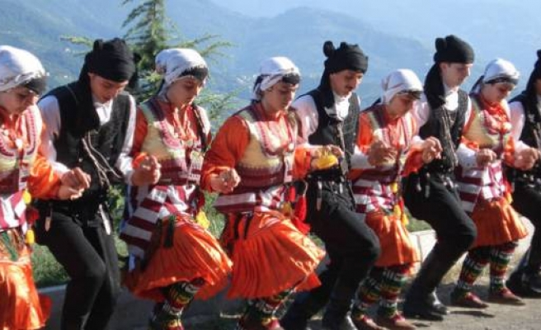
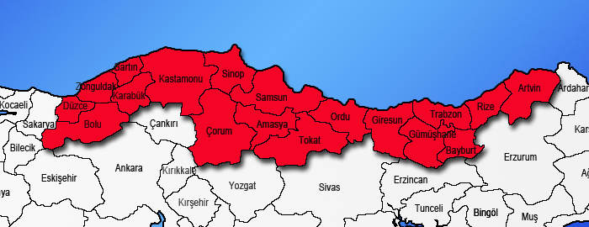
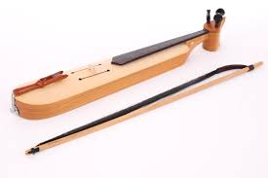
HORON
Horon appears very different from the folk dances in other parts of Turkey with its formation of tempo, rhythm and measure. This typical Black Sea region dance is performed, in general, by groups and their characteristic measure is 7/16, dressed in black with silver trimmings. The dancers link arms and quiver to the vibrations of the kemence, a primitive type of violin.

Slide 5
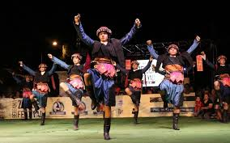
ZEYBEK
In this Aegean dance, colorfully dressed male dancers, called Efe, symbolize courage and heroism.
Zeybek dance is formed, in general, of 9/8 measures and has a variety of tempos such as very slow, slow, fast and very fast. It is rendered by one person or two or by
a group of people.

Slide 6
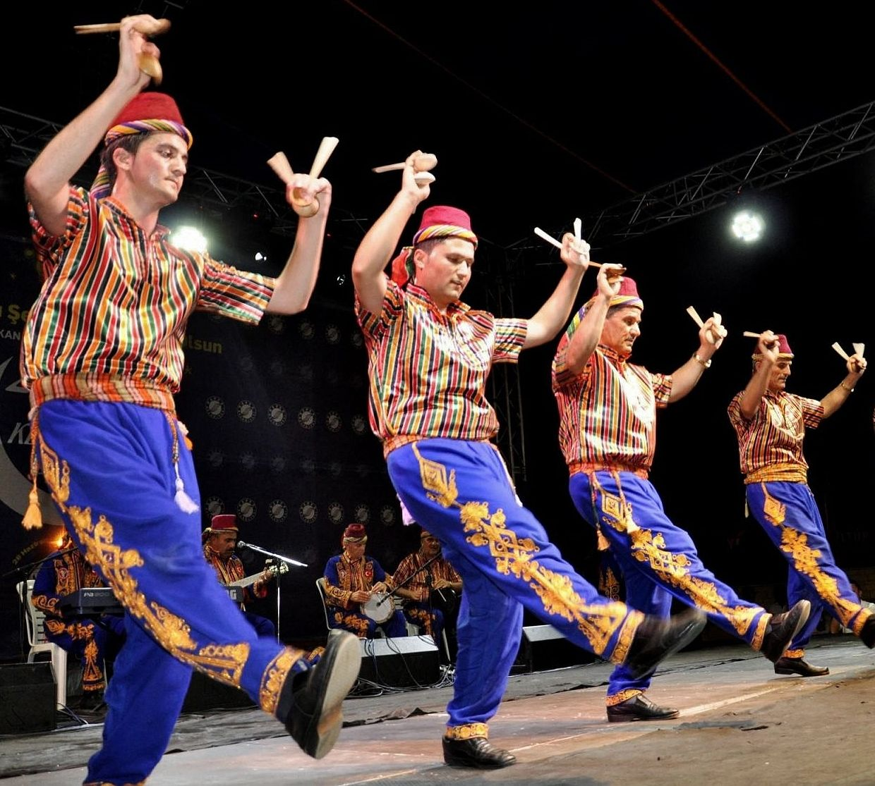
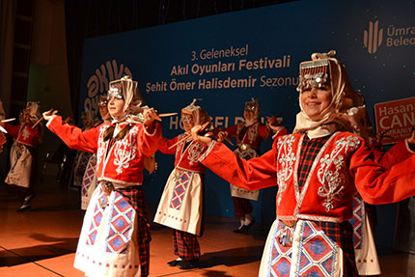
KASIK OYUNU (SPOON DANCE)
Kasik Oyunu is performed in Mid-South part of Turkey (Konya – Silifke cities) and consists of gaily dressed male and female dancers clicking out the dance rhythm with a pair of wooden spoons in each hand.

Slide 7
CLASSICAL TURKISH MUSIC
Classical Turkish music is monophonic, meaning all instruments essentially play the same tune. With the formation of the Turkish Republic, a form of modern polyphonic Turkish music began to develop and there are now numerous successful classical composers.
TURKISH FOLK MUSIC
Turkish folk music combines the distinct cultural values of all civilisations that have lived in Anatolia since the first settlements and the Ottoman territories.

Slide 8
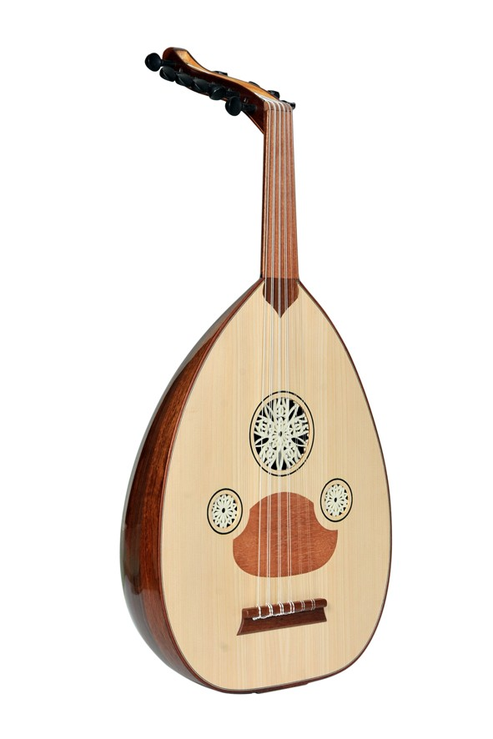
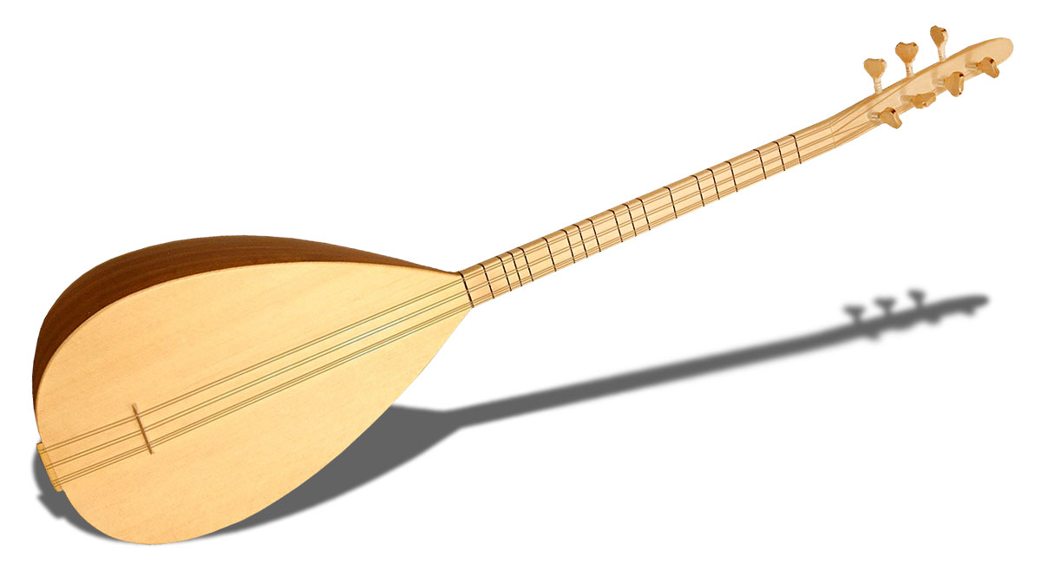
TURKISH MUSICAL INSTRUMENTS
There are a number of musical instruments in Turkey such as;
Stringed Instruments:
Ud
Bağlama

Slide 9
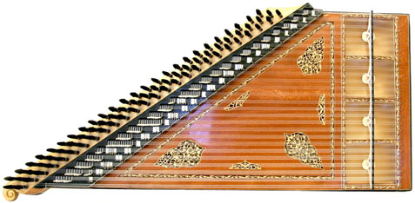
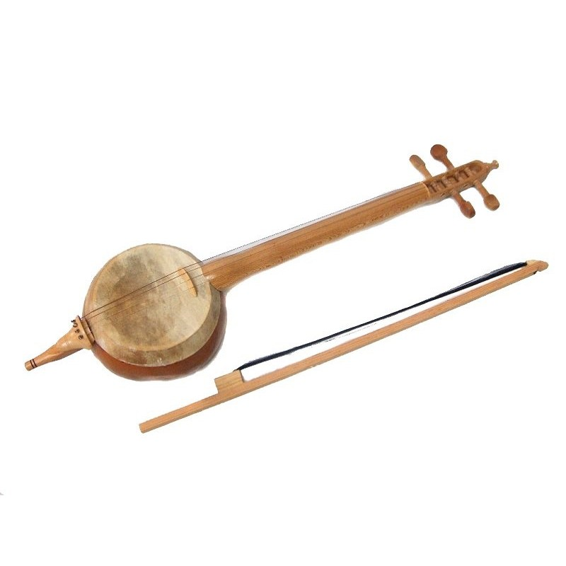
Bow Instruments:
Kemençe
Kanun
Kabak kemane

Slide 10
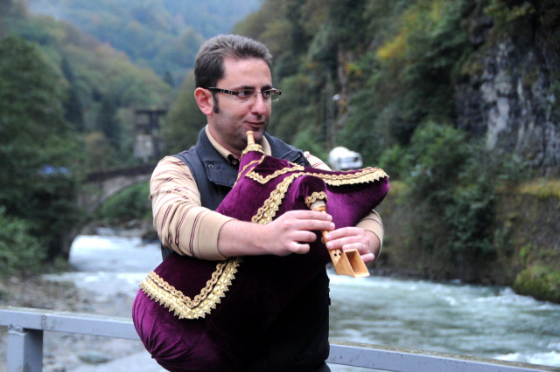
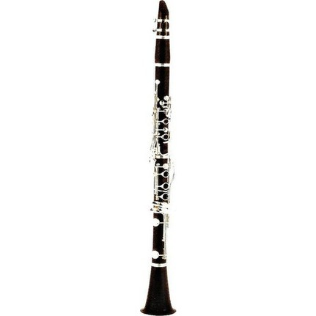
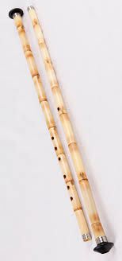
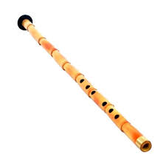
Wind Instruments:
Tulum
Klarnet
Kaval

Slide 11
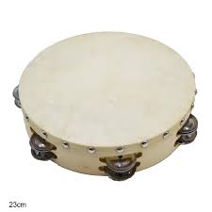
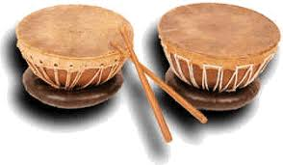
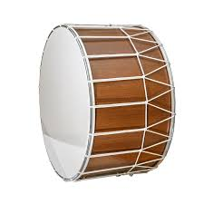
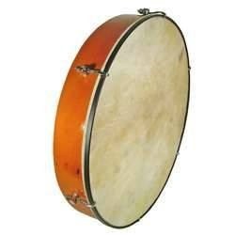
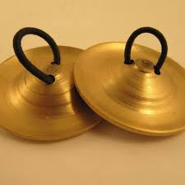
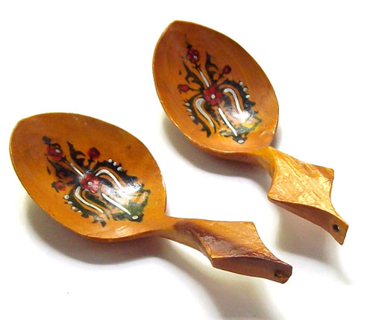
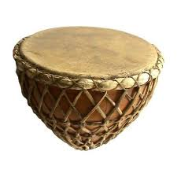
Percussion:

Slide 12
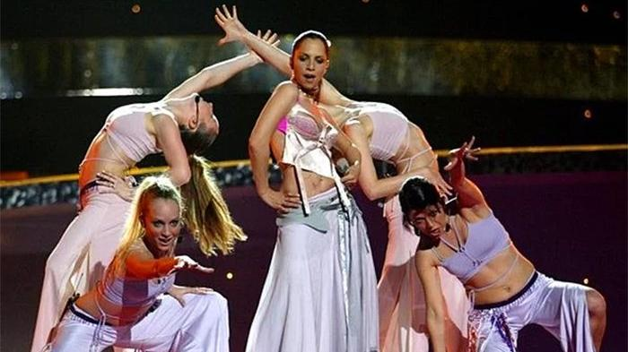
Turkey took part in the Eurovision Song Contest 2003 in Riga, Latvia with the singer, Sertab Erener.
She became the best singer in the contest:
"Everyway That I Can".

Slide 13
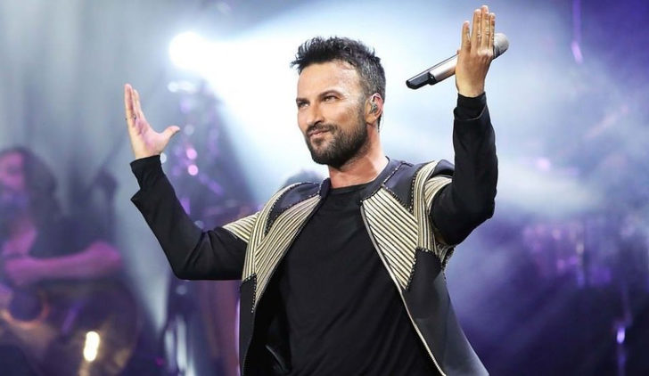
Tarkan, is one of the most well-known Turkish singer and songwriter. Since the early 1990s, Turkish pop music with a continuous list and the sales success, he has been recognized both in Turkey and in Europe.

Slide 14
by
Özel Falez Fen Bilimleri Anadolu Lisesi
Antalya / Turkey

