Slide 1
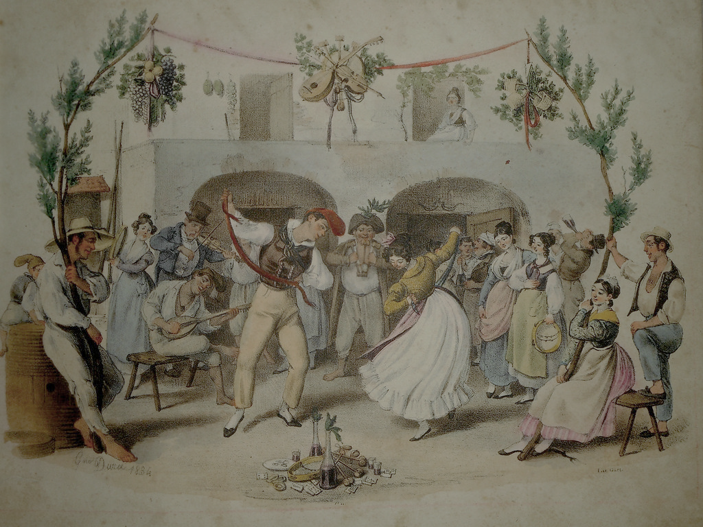

Folk dance
Folk dance in Sicily refer to dances created and performed by the Sicilian population during particular events. The dances were accompagnied by the songs of a folkloric instrument typical of the Sicilian tradition.

Slide 2
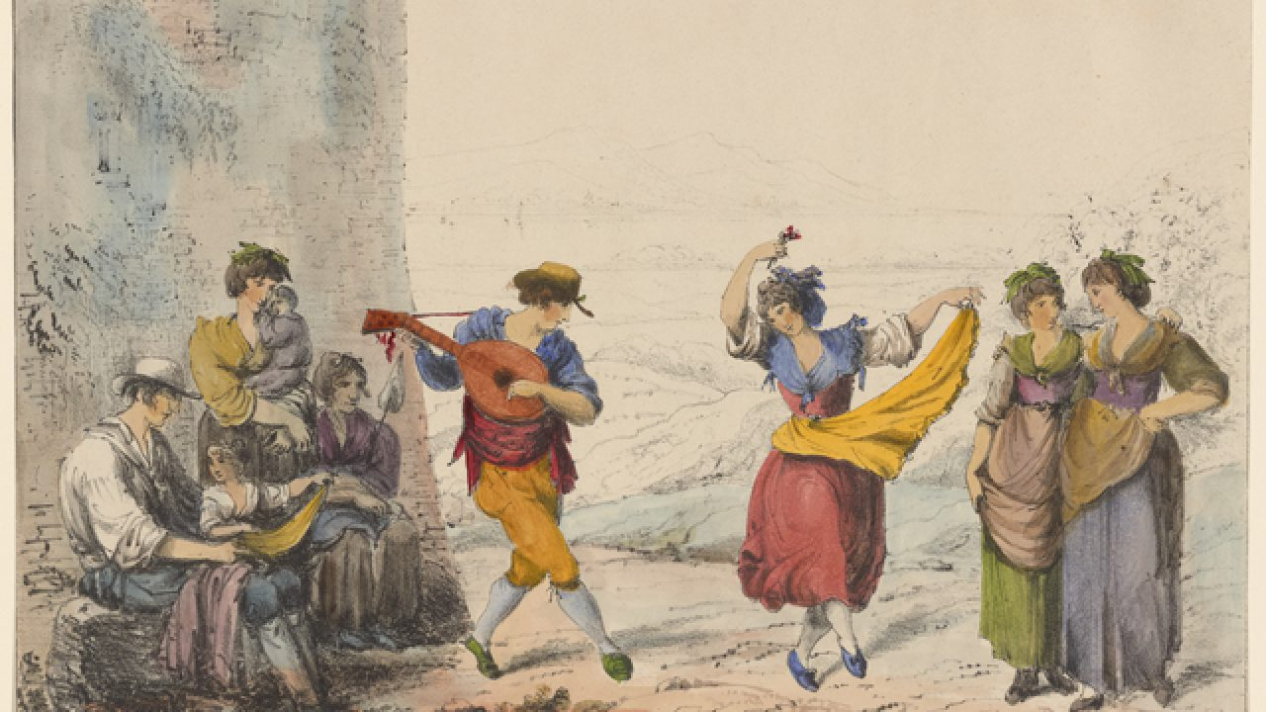
Ballu “a chiovu”
Ballu “a chiovu” represents the typical Sicilian Tarantella performed during harvesting. And at the end of the working day the peasant gathered in the farmyard and dance accompanied by typical instruments. The name derives from steps as the feet tap always on the same area. It is generally dances by a man and a woman.

Slide 3
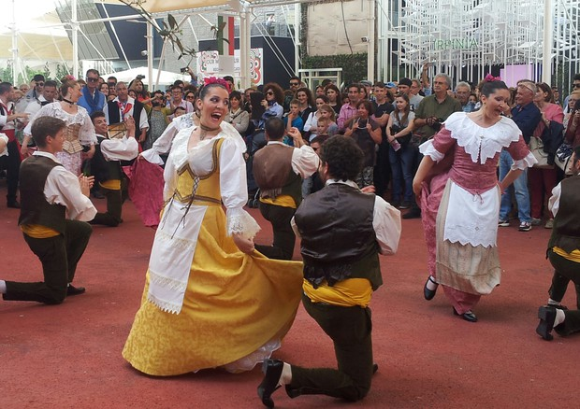
“U nozzu”
The dance called“u nozzu”is a courting dance. Men, to court their women sang a typical song called“u toccu”. The song was performed by a group of men in front of beer mugs or wine glasses; meanwhile, playing cards, they improvised this dance. This dance can be defined as a mixture between the waltz and the Sicilian tarantella.

Slide 4
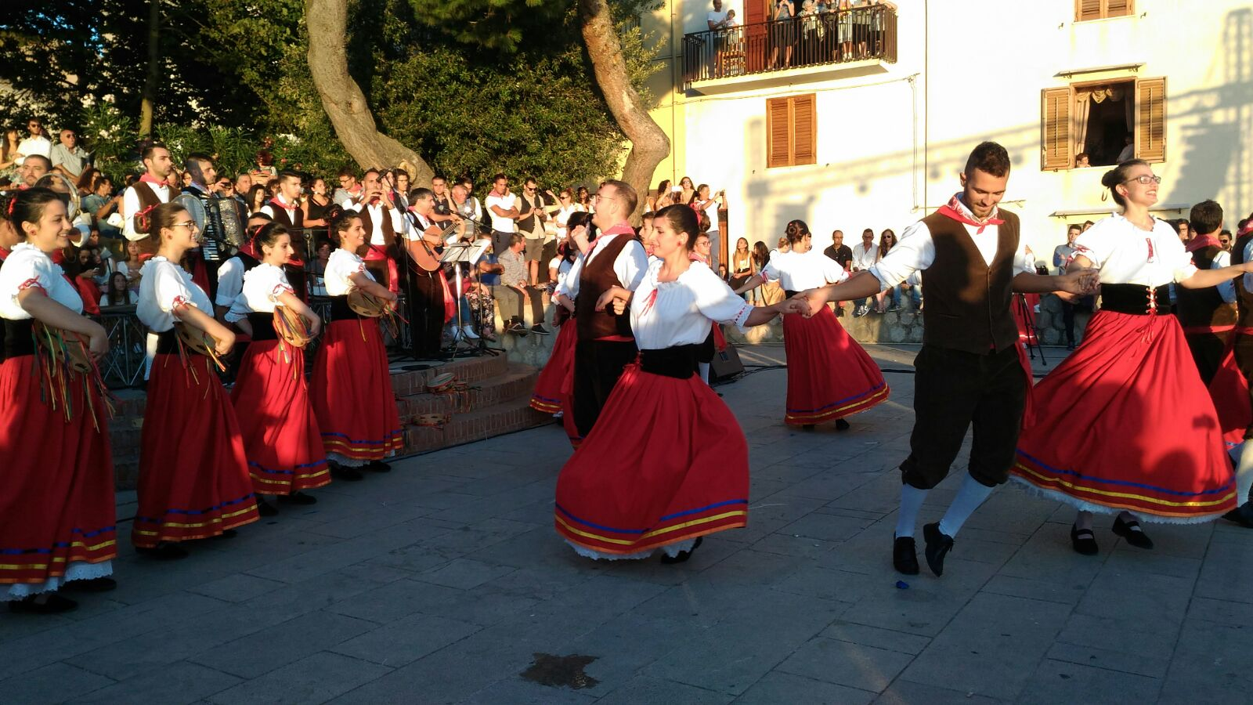
“ Controdanza”
The French invasions in the island spread a particular dance called “Controdanza”.
It’s typical of the carnival time but also of the village festivals and especially of the wedding ones. It can be considered a group dance as the participant follows the orders of the one who commands it.

Slide 5
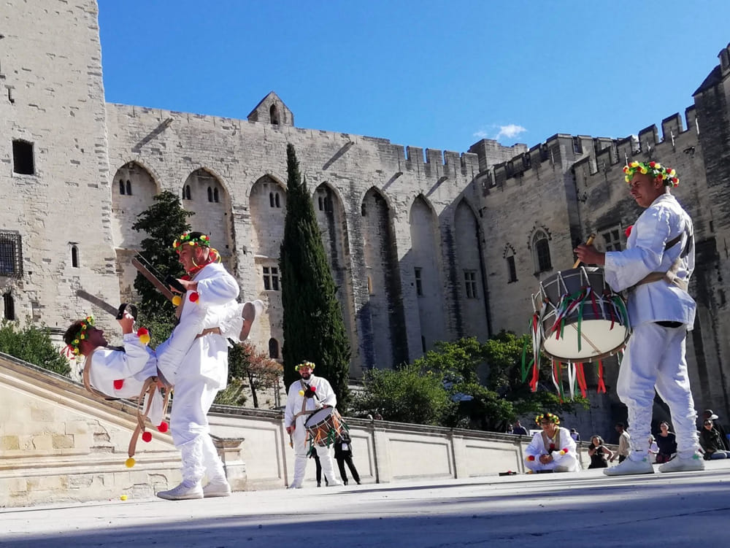
“Tataratà”
Dance still practiced at Casteltermini, whose name refers to the rhythmic sound of the drum.
The Tataratà is represented in May and the dancers wear a crown of flowers on their heads.

Slide 6
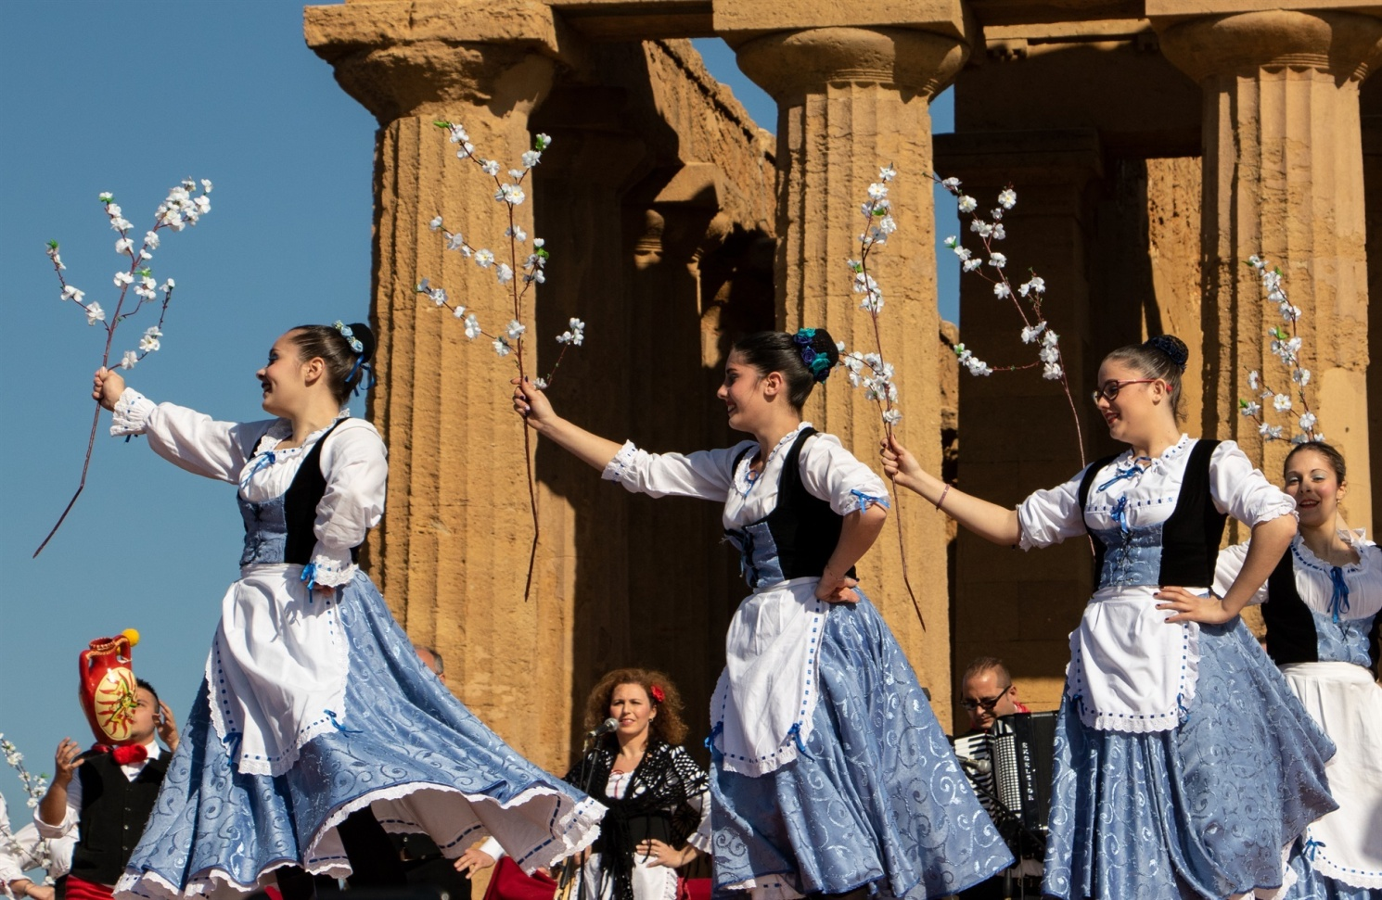
“Siciliana”
It’s an ancient shepherd’s dance and it’s a slow dance that has been inserted into the compositions of some of the greatest musicians in the history of music (Mozart, Haydn, Bach and others).

Slide 7
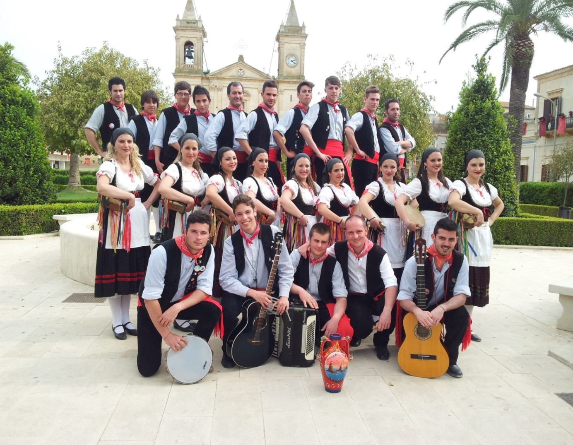
“ Tarantella”
One of the most famous dances and characteristics of all southern Italy is the tarantella. This popular dance, related to Arab culture, according to some takes its name from the city of Taranto; The tarantella can be danced both in pairs and by one person.

