Slide 1

TURKISH CUISINE
Online presentation
6th meeting, Spain
May, 2020
By Özel Falez Fen Bilimleri Anadolu Lisesi
Antalya / Turkey

Slide 2
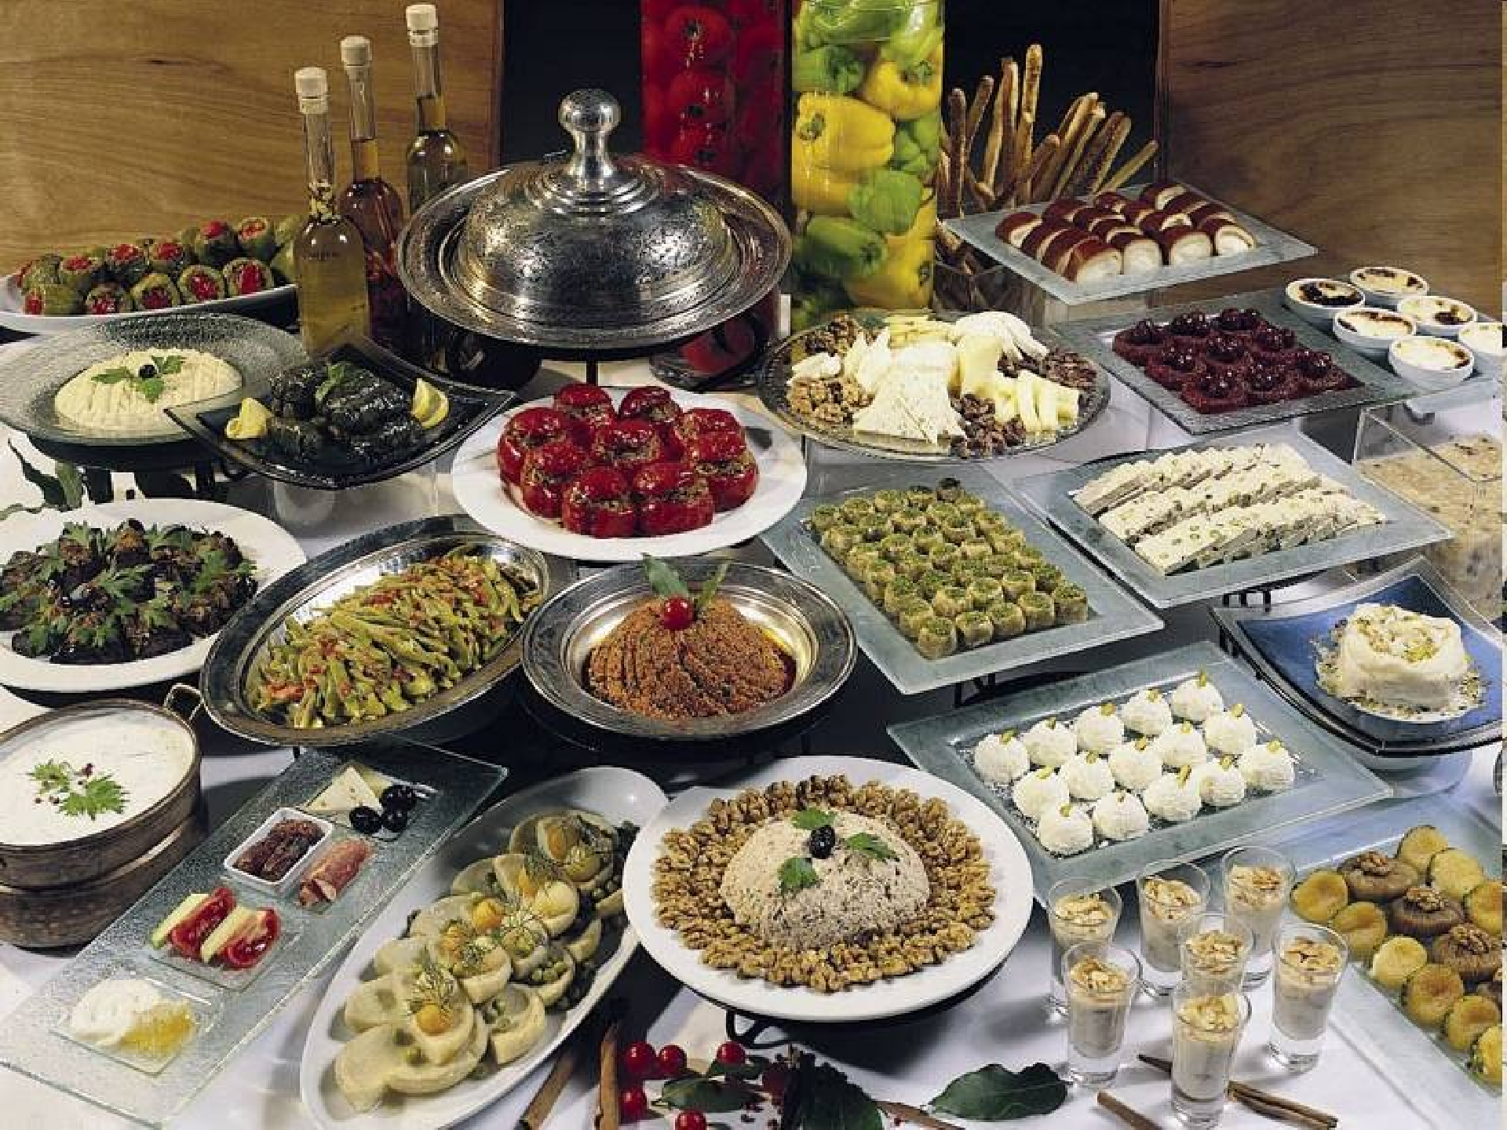



Slide 3
Culinary Culture
Turkish Cuisine is very rich because there are a lot of factors for this:
*Interaction with many different cultures over a long historical process
*The variety of products from Asia and Anatolia
*The Turkish cuisine has both affected and has
been affected by the Balkan and Middle East
cuisines. Therefore, it has a lot of different foods

Slide 4


Dishes made from wild vegetables
Sauced Dishes Prepared by:
-Cereals
-Vegetables
-Meat
Soups
Cold Dishes Cooked With:
-Olive Oil
-Pastry Dishes
Health Food:
-Pekmez
- Yoghurt

Slide 5



Food and Beverages Eaten at Meals
The main meals are;
*breakfast, lunch and dinner.
Cheese
Olives
Bread
Eggs
Jam
Honey
Tomato
Cucumber
Pepper
Tea
Soup
Stews
Salad
Dessert
Soup
Lamb & Beef
Kebab
Meatball
Olive Oil Dish
Pilav
Salad
Dessert

Slide 6
Food and Beverages Peculiar to Special Days
*Some foods and beverages, peculiar to special days and which have a symbolic meaning although they take much more time to prepare, are part of Turkish cuisine.
*Food peculiar to such special days is prepared communally, known as called “imece.”
At engagement, wedding and circumcision ceremonies, at Ramadan with its deep religious meaning and other religious and seasonal festivals, food is prepared with more attention, more special assortments are served, and tables are specially decorated. Birth, death and wedding meals can be cited as examples.

Slide 7
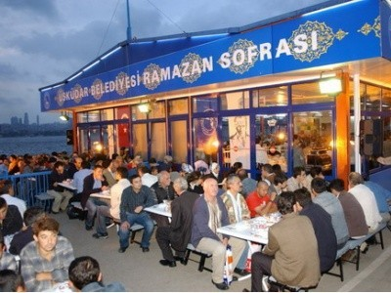

Friends, relatives and neighbours visit women who have given birth, and bring soup, milk, yogurt and eggs. During “loğusa” time (women recovering from childbirth), guests are served loğusa sherbet (a non-alcoholic drink made with spices and fruit juices), biscuits, milk and desserts. It is believed that a woman who has given birth must have milk, onion, sherbet, wheat and lentils and must not eat chickpea or beans nor drink cold water if she wants to have sufficient milk to feed her child.
Ramadan
Loğusa Time

Slide 8
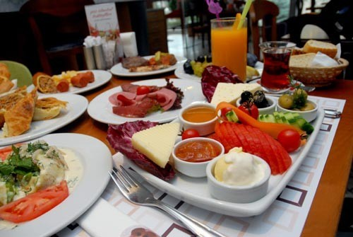
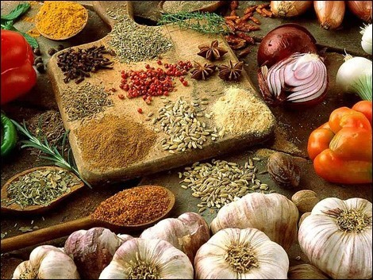
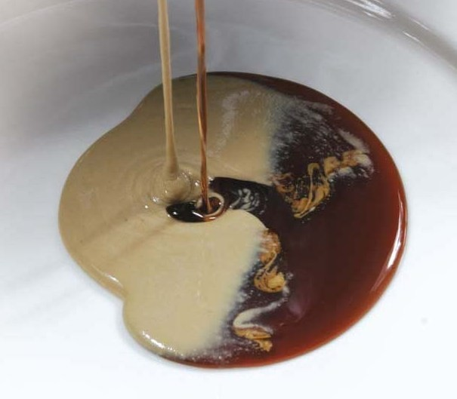
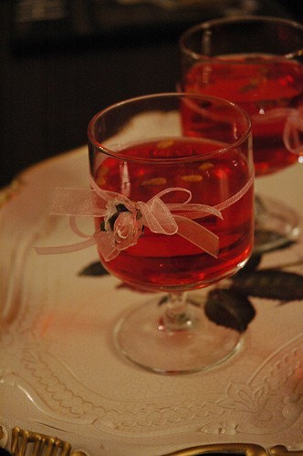
Breakfast
Spices
Pekmez
Loğusa Syrup

Slide 9
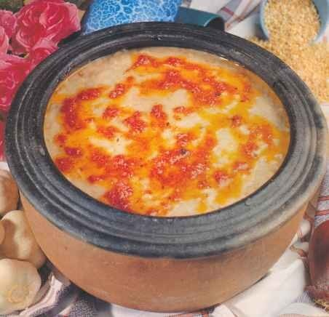
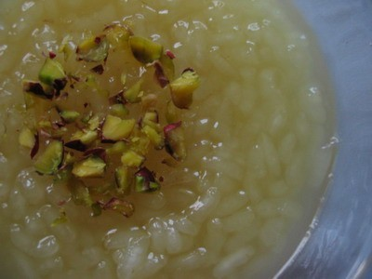
At weddings; rice, vegetables, beans or chickpea and fruit juices are served with a main course of meat. In nearly every region, vermicelli and yogurt soups, keskek (pounded wheat with meat), rice and meat are served at wedding meals. Desserts are usually helva, zerde (a gelatinous dessert colored with saffron), rice pudding and baklava.
Keşkek
Zerde

Slide 10
In addition to these, some other foods are served in funerals. In a funeral house, food is not cooked for 3-7 days (depending on the region), and neighbours bring food instead.
When the body of dead person is taken from the house, then the tradition of cooking flour helva starts and food is served on the 3rd, 7th, 40th and 52nd days after death

Slide 11
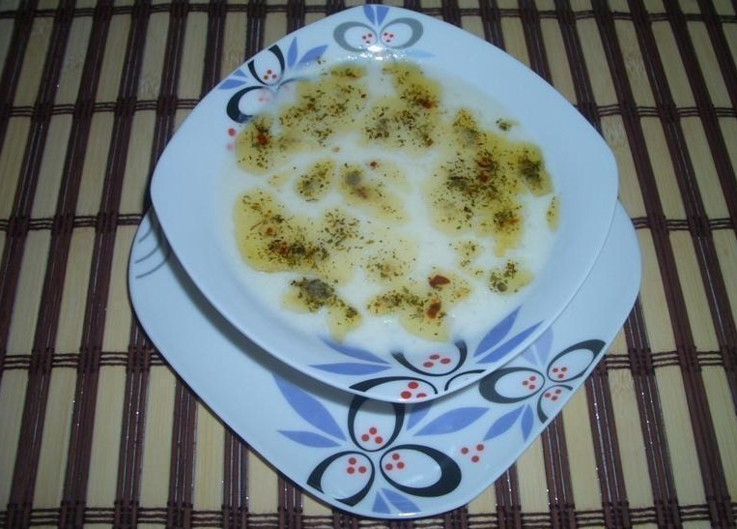
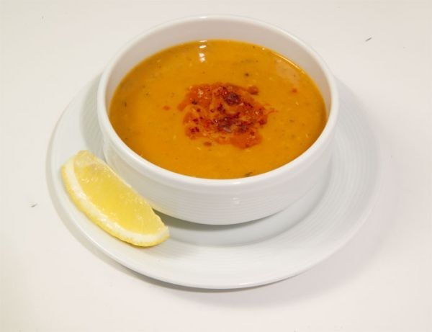
Soups (Çorbalar)
A Turkish meal usually starts with a thin soup. Soups are usually named after their main ingredient, the most common types being lentil, yoghurt, or wheat (often mashed) called and tarhana soup.

Slide 12
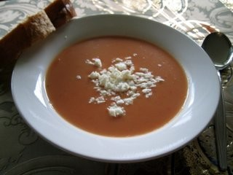
Tarhana Soup (Tarhana Çorbası)
It is a famous Turkish soup. You can have it at every meal, including breakfast. It is made of yoghurt, mint, flour, red pepper, green pepper, tomatoes. If you want, you can put onion on it.

Slide 13
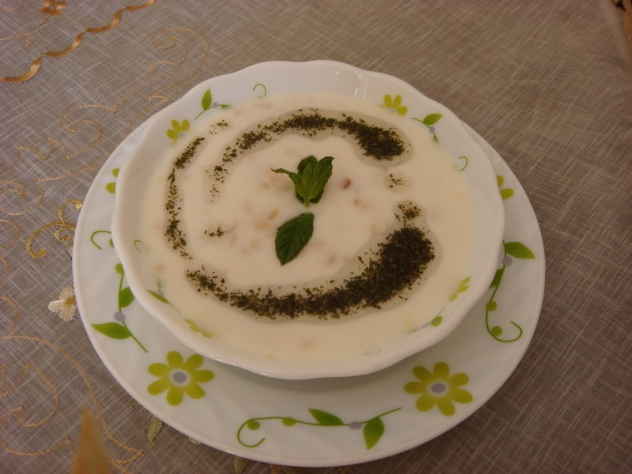
Yoghurt Soup (Yoğurt Çorbası)
It is a kind of Turkish soup. You can find, a lot of different kinds of yoghurt soup.
It is made of rice, yoghurt, chickpea, parsley, and mint. It tastes delicious.

Slide 14
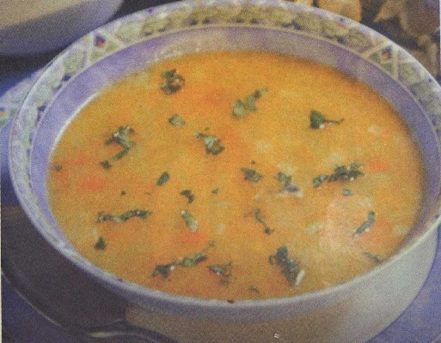
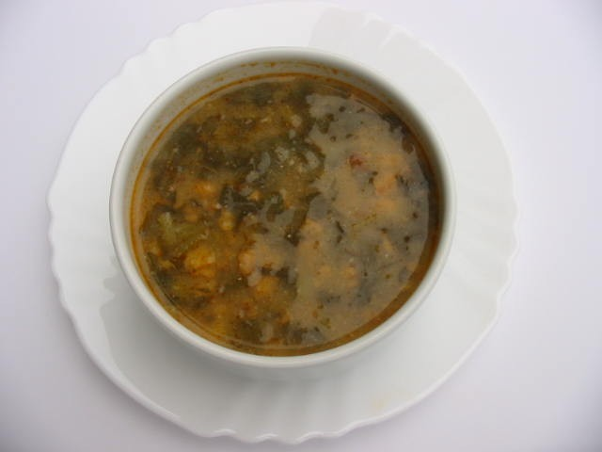
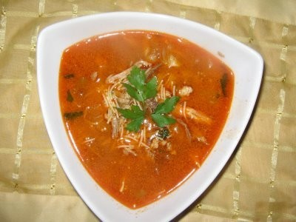
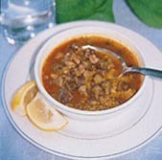
Black Cabbage Soup
Anchovy Soup
Chicken Soup with Vermicelli
Okra Soup

Slide 15

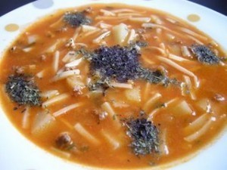
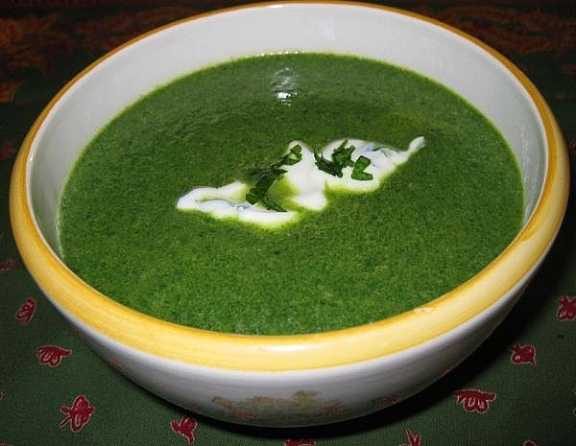
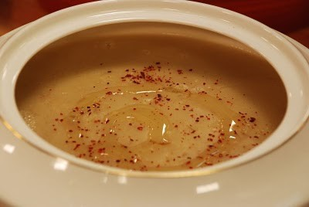
Soup With Home-Made Noodles
Red Lentil Soup
Spinach Soup
Tandir Soup

Slide 16
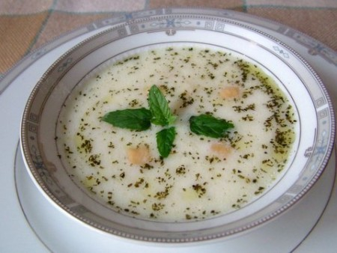
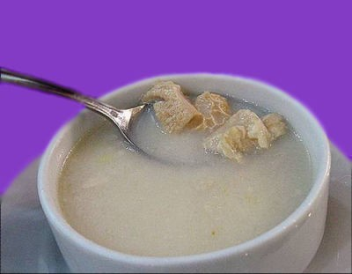
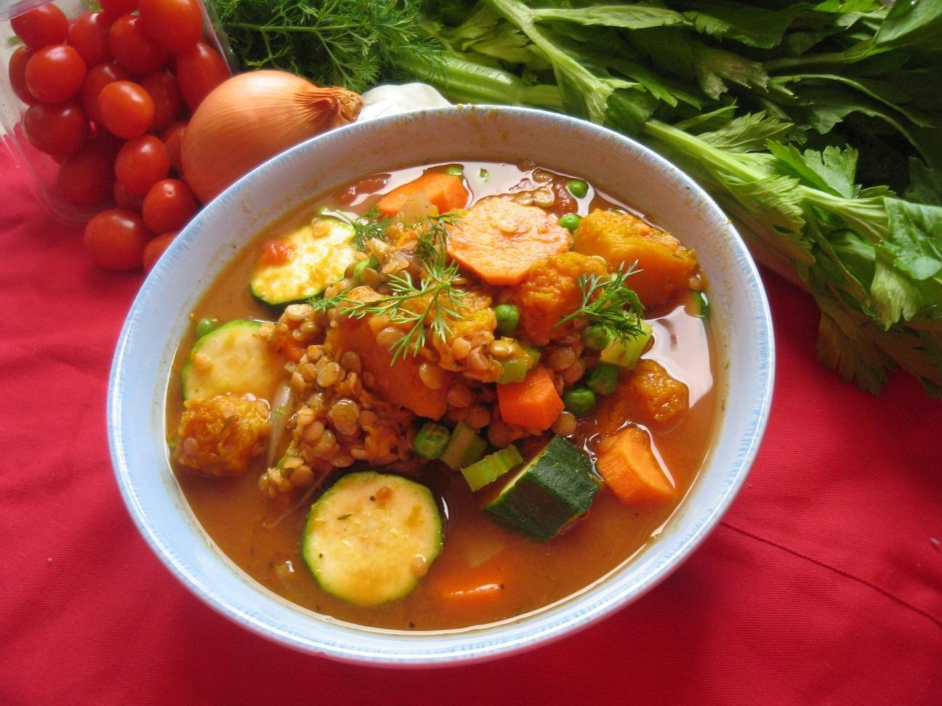
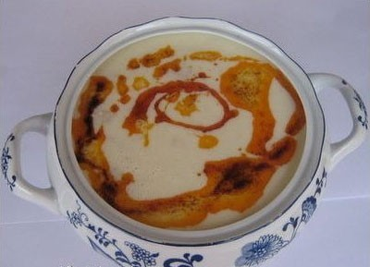
Tripe Soup
Toyga Soup
Vegetable Soup
Wedding Soup

Slide 17
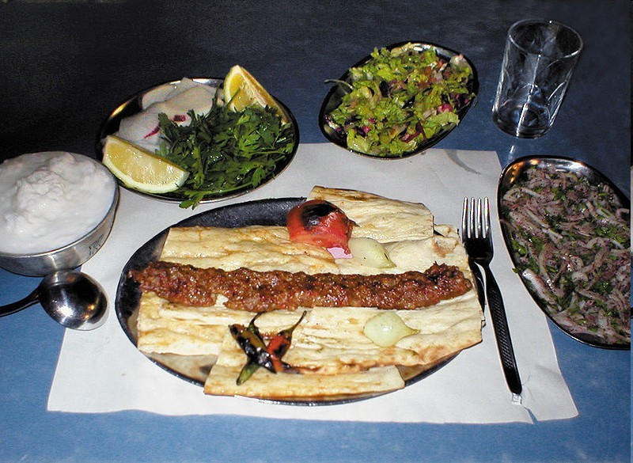
Kebabs & Beefs (Kebap & Etler)
Most of the meat dishes in Turkish cuisine kebabs, meatballs and juicy meat dishes are in the class.

Slide 18
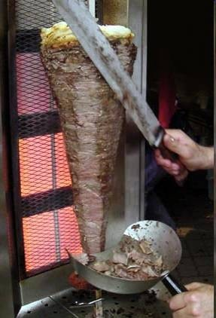
Döner (Döner)
Döner is a kind of Turkish kebab. You can fry it by putting the fat, meat and spices on a stick. Döner meat can be eaten in a sandwich (pita or bread) but also with rice. Döner is an eating out Turkish food. You can have it in fast food restaurants.

Slide 19
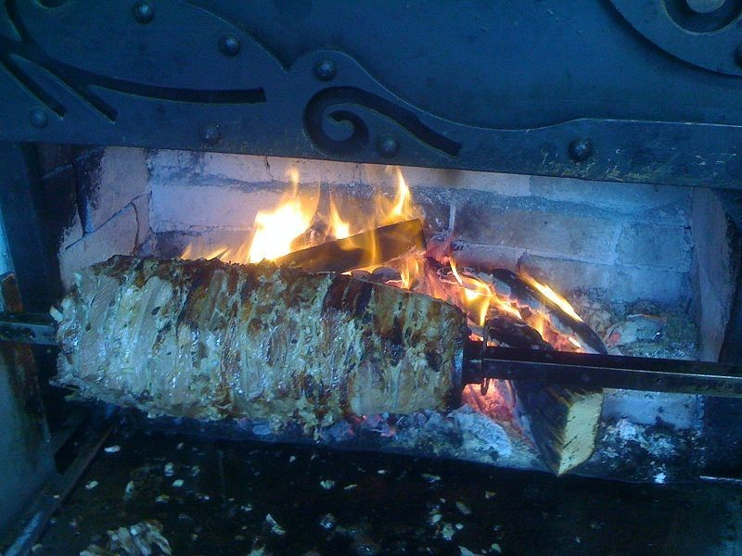
Cağ Kebab (Cağ Kebap)
Cağ kebab, is a rotating kind of kebab,originating in Erzurum, Turkey.
Cağ Kebab is probably by the way is the ancestor of the Döner as we know it.
History:
Ottoman Travel books of the 18th century, cite a kebab cooked on wood fire consisting of horizontal stack of meat, known as "Cağ Kebab”.

Slide 20
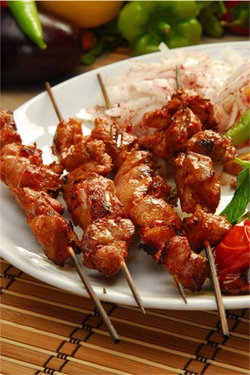
Skewer Kebab (Şiş Kebap)
Şiş Kebap (şiş, pronounced "shish", means "skewer" in English) consists of marinated chicken or lamb meat. Meat on skewers are grilled over an open fire.

Slide 21
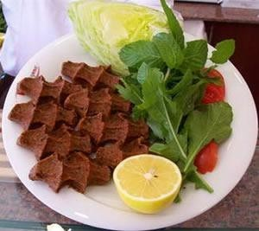
Çiğ Köfte
It is a kind of Turkish kebab which is kneaded and mixed meat, tomatoe paste, parsley and spices.
History:
According to lore, çiğ köfte was invented in Urfa at the time of prophet Abraham. When Nimrod collected all firewood in Urfa in order to build a monumental execution pyre, the wife of a hunter had to prepare venison raw. She mixed the meat with bulgur, herbs and spices and crushed the mixture with stone implements until it was palatable.

Slide 22
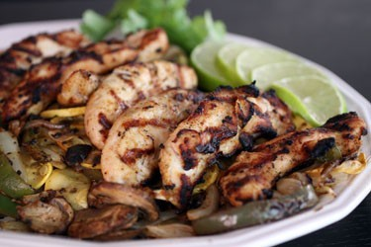
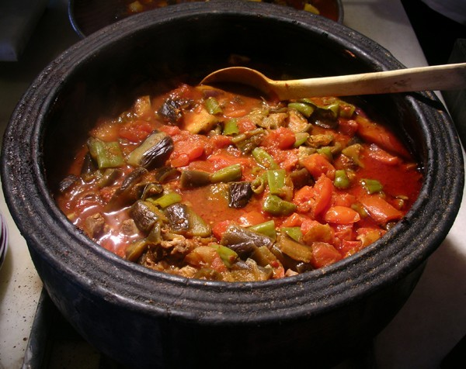
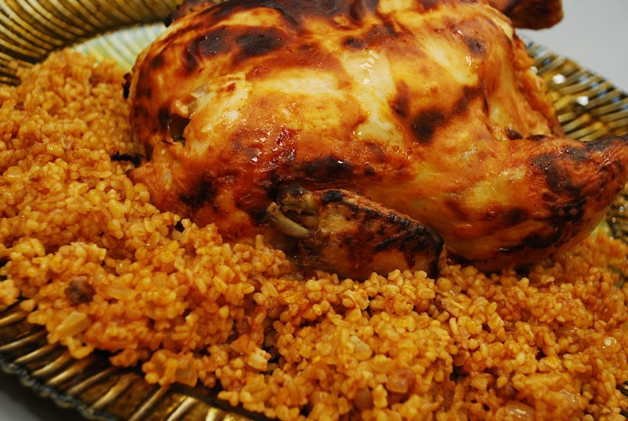
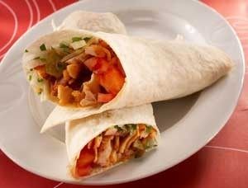
Chicken Stew
Chicken And Mixed Vegetable Casserole
Chicken with Walnut Sauce
Stuffed Chicken-Court Style

Slide 23
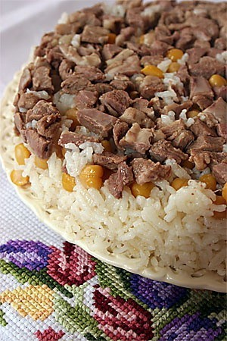
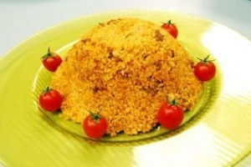
Pilav
Wheat Pilav with Chickpeas
Pilav With Lamb Meat

Slide 24
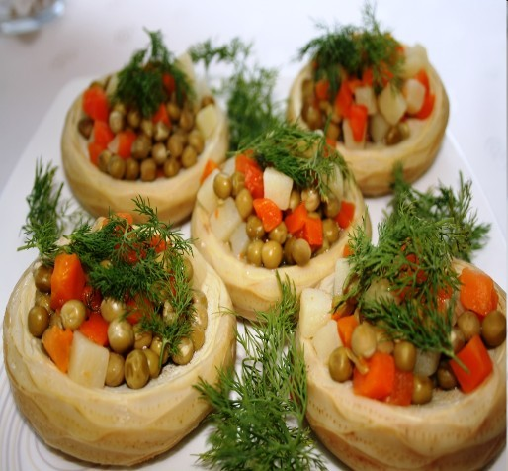
Vegetable Dishes (Sebze Yemekleri)
Turkish cuisine in a great variety of vegetable dishes is a kitchen with dolma and sarma, meat and vegetable dishes, fried vegetables and countless varieties of olive oil are available.

Slide 25
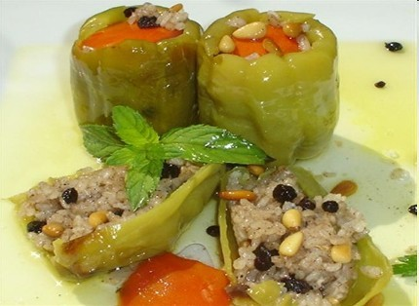
Stuffed Food (Dolma)
Dolma has a special place in Turkish cuisine. It can be eaten either as a meze or a main dish. It can be cooked either as a vegetable dish or meat dish. If a meat mixture is put in, it is usually served hot with yoghurt and spices such as oregano and red pepper powder with oil.

Slide 26
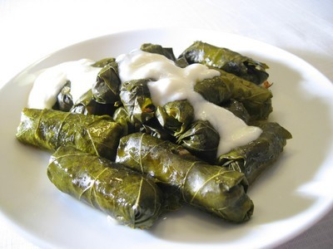
Grape Leaf Rolls with Olive Oil (Zeytinyağlı Yaprak Dolması)
Zeytinyağlı dolma
(dolma with olive oil) is the dolma made with vine leaves cooked with
olive oil and stuffed
with a rice-spice mixture. Such a
type does not
contain meat, is served cold and also referred to as
sarma, which means
“wrapping” in Turkish.

Slide 27
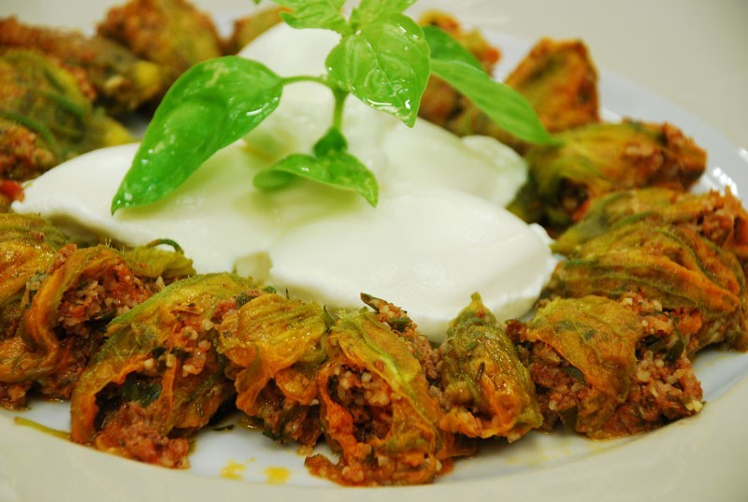
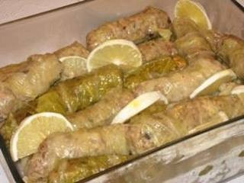
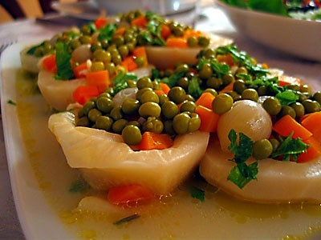
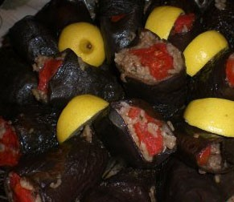
Stuffed Cabbage
Squash Blossoms
Stuffed Celery Roots
Stuffed Eggplant

Slide 28
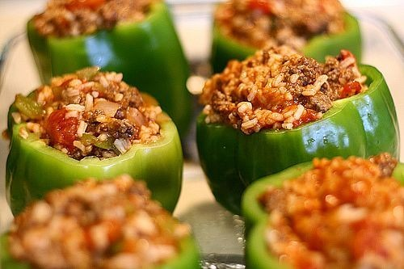
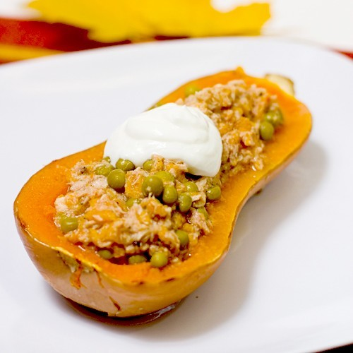
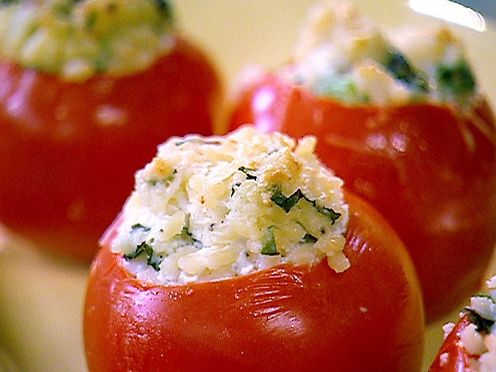
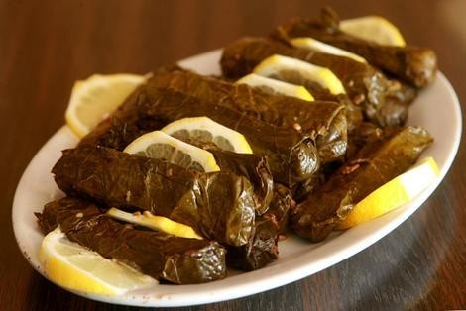
Stuffed Squash
Stuffed Green Peppers
Stuffed Tomatoes
Wrapped Vine Leaves

Slide 29
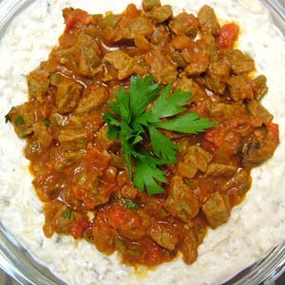
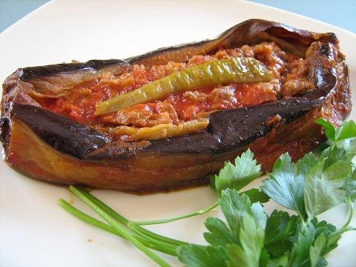
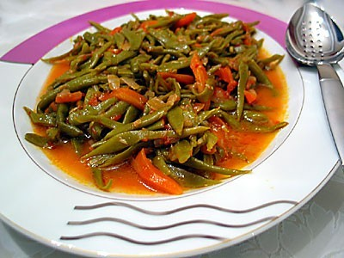
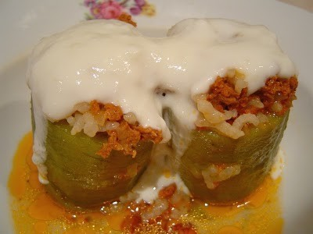
Karnıyarık - Eggplants
Alinazik
Fresh Beans with Olive oil
Stuffed Squash With Olive Oil

Slide 30
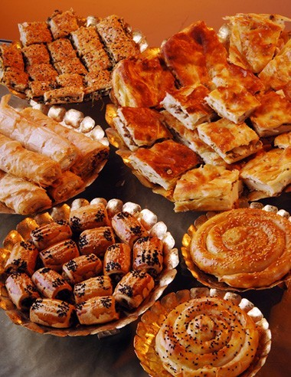
Pastries (Hamur İşleri)
Lahmacun, Su Böreği, Mantı and pies are among the most popular of Turkish cuisine.

Slide 31

Lahmacun
It is a famous Turkish food too. It is made by putting meat, pepper, parsley and spices on a circle dough.

Slide 32

Su Böreği
It is also a very famous Turkish food. It is made of dough, which is put in boiled water for a few seconds, egg, cheese or meat.
Old women usually do it excellently.

Slide 33

Mantı
Mantı is a kind of Turkish meal
which is boiled in
water. You can put small pieces of
meat in dough.
You can serve it
by putting
(dropping) yoghurt, tomato
paste, and butter.
Mantı tastes delicious.

Slide 34


Mezes & Salads (Mezeler & Salatalar)
Meze is a selection of food served as the appetizer course with or without drinks.
Some of them can be served as a main course as well.

Slide 35

Shepherd's Salad (Çoban Salatası)
It is one of the most popular salads in Turkey.
It is considered by many as light, refreshing and easy to make and is especially popular during summer.
It is a combination of finely chopped tomatoes, cucumbers, onions, green peppers and flat-leaf parsley. The dressing consists of a simple mix of lemon juice, extra virgin olive oil and salt.

Slide 36

Piyaz (Piyaz)
Piyaz is a kind of Turkish salad or meze that is made from any kind of dry beans with hard- boiled egg and vegetables.
Common additional ingredients include onion, parsley and sumac. In Antalya province of Turkey it is prepared differently from other regions with other ingredients like sesame oil. During the Ottoman period, piyaz was also made from artichoke, pea, chickpea, broad bean and potato, which was introduced to Turkey in the last quarter of the 19th century.

Slide 37

Cacık (Cacık)
Cacık is a Turkish dish of seasoned, diluted yoghurt, eaten throughout the former Ottoman world. Cacık is made of yogurt, salt, olive oil, crushed garlic, chopped cucumber, dill, mint, and lime juice, diluted with water to a low consistency, and garnished with sumac. Among these ingredients, olive oil, lime juice, and sumac are optional. Dill and mint (fresh or dried) may be used alternately. Cacık, when consumed as a meze, is prepared without water but follows the same recipe.

Slide 38




Cabbage-Carrot Salad
Bulgur Salad (Kısır)
Eggplant Salad
Green Lentil Salad

Slide 39




Purslane Salad
Potato Salad
Tomato Salad
Wheat Salad with Walnuts

Slide 40


Drinks (İçecekler)
At breakfast and all day long Turkish people drink black tea. Tea is made with two teapots in Turkey.
Turkish coffee, Turkish tea and Ayran are the most popular drinks in Turkey.

Slide 41

Turkish Coffee (Türk Kahvesi)
Turkish coffee is a world-known coffee which can be served sweet or bitter.
Turkish coffee, it is different in aroma and taste from the classical Turkish coffee. It is the first ( only ) coffee which is served with coffee ground.

Slide 42

Turkish Tea (Türk Çayı)
Turkish tea is a type of tea that is popular mainly in the Turkish- speaking countries. In Turkey, Turkish tea tends to be more popular than Turkish coffee among the younger generation.

Slide 43

Ayran (Ayran)
Ayran (salty yoghurt drink) is the most common cold beverage, which may accompany almost all dishes in Turkey. Ayran is a mixture of yoghurt, water, and sometimes salt. It is thought to have originated as a way of preserving yogurt by adding salt.

Slide 44




Rose Syrup
Boza
Salep
Lemonade

Slide 45

Desserts (Tatlılar)
One of the world- renowned desserts of Turkish cuisine is baklava. Turkish cuisine has a range of baklava-like desserts which includes Sütlaç, Turkish Delight.

Slide 46

Turkish Baklava (Baklava)
It is made of walnuts, Antep nuts, almond or hazelnut. It tastes delicious. Baklava is prepared on large trays and cut into a variety of shapes.

Slide 47

Sütlaç
Sütlaç is the most famous milky dessert in Turkish cuisine. It is made of, milk, rice and sugar. You can serve it putting cinnamon on it.

Slide 48

Turkish Delight (Lokum)
Turkish delight is one of the most famous desserts in the world. It is made of water, sugar, starch and salts of lemon.
Turkish people usually serve it to their visitors.

Slide 49




Chicken Breast Pudding
Asure
Gullac
Halva

Slide 50




Pumpkin Dessert
Kemal Pasha Dessert
Semolina Halva
Stuffed Figs

Slide 51
AFİYET OLSUN
ENJOY YOUR MEAL
BON APPETIT
GUTEN APPETIT
DOBROU CHUŤ
NAUTI ATERIASTASI
ΚΑΛΗ ΟΡΕΞΗ
DISFRUTE DE SU COMIDA
BUON APPETITO
ПРИЯТНОГО АППЕТИТА
SKANAUS
どうぞお召し上がりください
Nyd dit måltid

Slide 52
Thank you for watching
Healthy days
Özel Falez Fen Bilimleri Anadolu Lisesi
Antalya / Turkey
May, 2020

